Slide 1
Don’t Overfit
By Samuel Uong, Richard Ching and Luca Scalerandi

Slide 2
Outline
Classification
Algorithm selection – Performance Cross-Validation
Parameter tuning
Ranking and overall results

Slide 3
Classification Models
As we all know we want to predict if a single sample is part of the 0 or 1 class.
This results in needing to use some sort of classification algorithm.
What common classification algorithms did we find: (of course there are a lot more, but we wanted to focus on the more commonly used ones.)

Slide 4

Algorithm selection
Classification Tree
Deep Learning
Support Vector Machines
Naive Bayes
Logistic Regression (Our choice)

Slide 5

Classification Tree
Advantages regarding our problem:
allow non-linear decision boundaries¹
Weaknesses regarding our Problem:
Prone to Overfitting¹
Our best result (training data):
Decision Tree Classifier: 0.7066

Slide 6
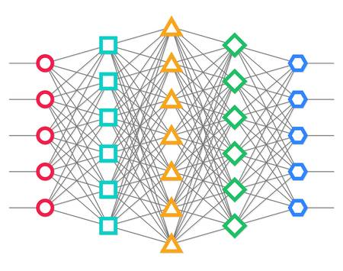
Deep Learning
Advantages regarding our problem:
Good performance on classifying problems
Weaknesses regarding our Problem:
Lots of training data needed
Our best result (training data):
Neural Network MLP Classification: 0.64

Slide 7
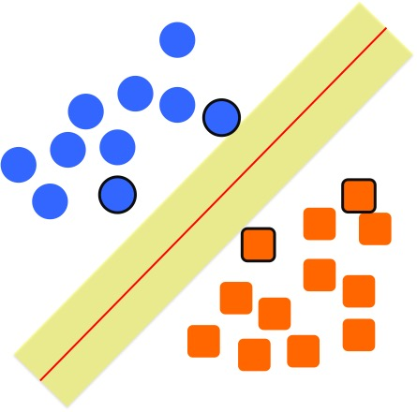
Support Vector Machines
Advantages regarding our problem:
allow non-linear decision boundaries¹
Robust regarding overfitting
Weaknesses regarding our Problem:
Can have big performance loss if #parameters > #samples
Our best result (training data):
Regression: 0.68
Classification: .68

Slide 8
Naive Bayes
Advantages regarding our problem:
Usually provides good performance, especially regarding the complexity
Weaknesses regarding our Problem:
The simplicity makes it less competitive compared to other Models
Our best result (training data):
Naïve Bayes GaussianNB: 0.64

Slide 9
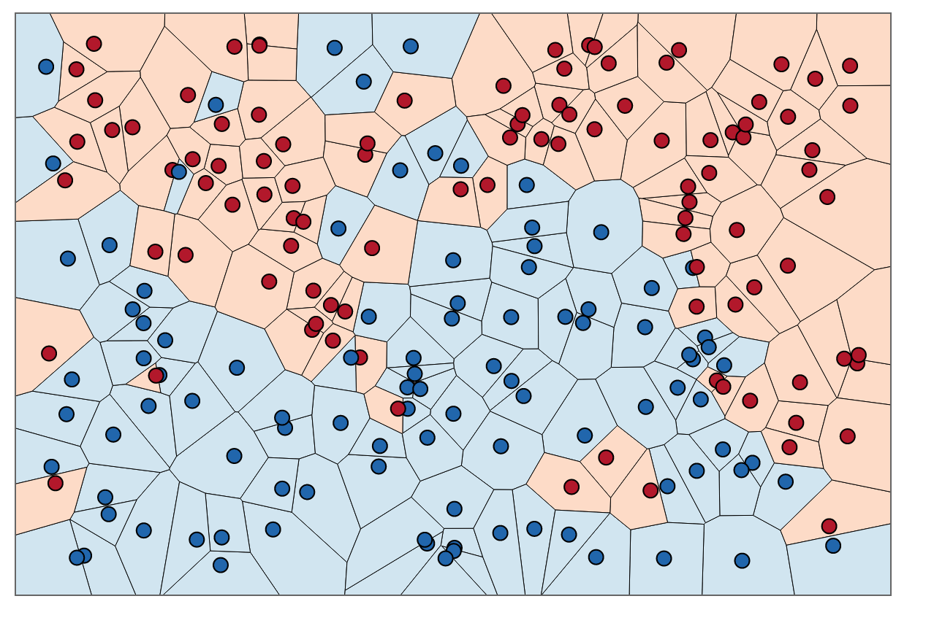
K-Nearest Neighbors
Advantages regarding our problem:
Usually provides good performance, especially regarding the complexity
Weaknesses regarding our Problem:
Curse of Dimensionality: Poor results if too many variables/features
Our best result (training data):
K-Nearest Neighbors: .6933

Slide 10
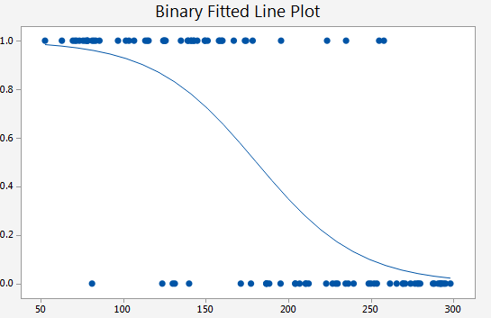
Logistic Regression
Advantages regarding our problem:
- Can be regularized to avoid overfitting!
Weaknesses regarding our Problem:
- Weak on multiple non-linear boundaries
Our best result (training data):
Logistic Regression: 0.8
Test Data:
Best result: .774

Slide 11
Parameter Tuning
Penalty = “L1”, C =.1
Lower values of C lead to sparser solutions
L1 penalty sparser than L2
Solver = “liblinear”
Uses a Coordinate Descent Algo²
Behaves as a multiclass classifier (separate binary classifiers are trained for all classes) ²
Intercept_scaling = 5

Slide 12
Ranking Result

Slide 13
Ranking Result Explained
Training Data: 175 Rows (70%)
Validation Data: 75 Rows (30%)
Best Performer: Logistic Regression
Validation Accuracy: 77.33%
Testing Accuracy: 73.35%

Slide 14
Sources
¹https://elitedatascience.com/machine-learning-algorithms

Slide 15
Appendix

