Slide 1
Don’t Overfit
By Samuel Uong, Richard Ching and Luca Scalerandi

Slide 2
Outline
Goal/Approach
Algorithm selection – Performance Cross-Validation
Feature Selection
Parameter tuning
Ranking and overall results

Slide 3
Goal/Approach
Goal
To Predict if a single sample is a 0 or 1.
Learn about and utilize Scikit Libraries to predict results
Approach
Initial Run through of various algorithms
Use the most successful algorithm
Further tune for better results

Slide 4

Algorithm selection
Support Vector Machines
Naive Bayes
K Nearest Neighbors
Multi Layer Perceptron Classifier
Lasso Regression
Logistic Regression

Slide 5
Ranking Result (Test Data)

Slide 6

What we didn’t use
Support Vector Machine
Naïve Bayes
The simplicity makes it less competitive compared to other Models
K Nearest Neighbors
Curse of Dimensionality: Poor results if too many variables/features
Can have big performance loss if #parameters > #samples

Slide 7

What we used
Multi Layer Perceptron
Logistic Regression
Can be regularized to avoid overfitting
Lasso Regression
Automatically performs feature selection
Good for classifying problems

Slide 8
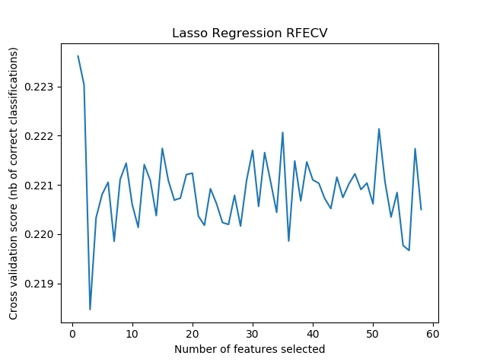
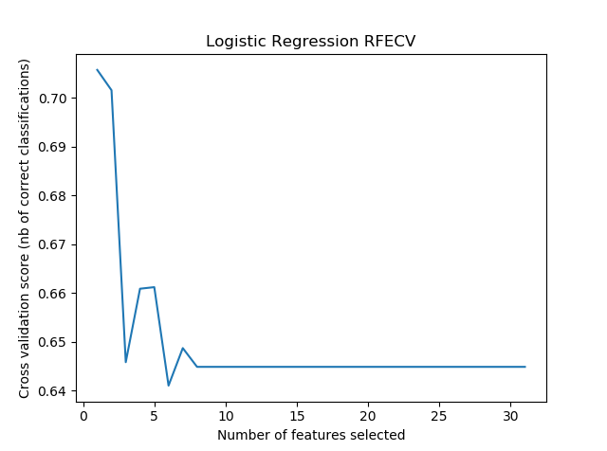
Feature Selection (Lasso Model)
Recursive Feature Elimination and Cross Validation Selection (RFECV)
Used the Lasso Algorithm as model
Used StratisfiedKFold of 20 to split up the data for RFECV
16 Parameters chosen w/ step of 5

Slide 9
Parameter Tuning Log Regression
Alpha = 0.031
Constant that multiplies the L1 term
Tol = 0.01
Sets the tolerance for the optimization
Random State = 4
Sets seed of random number generator
Selection = “random”
Updates a random coefficient every iteration
Selects a random feature to update
Notes:
https://scikit-learn.org/stable/modules/generated/sklearn.linear_model.Lasso.html

Slide 10
Prediction Model (Logistic Regression)
Able to return probabilities of classifications
Scoring using AUC (Area Under the Curve)
probabilities minimize penalty for wrong prediction
Lasso Regression is unable to return probabilities
Tied with MLP Classifier
Logistic Regression is simpler and less resource intensive
Less likely to overfit data

Slide 11
Parameter Tuning Log Regression
Penalty = “L1”, C =.2
Lower values of C lead to sparser solutions
L1 penalty sparser than L2
Solver = “liblinear”
Behaves as a multiclass classifier (separate binary classifiers are trained for all classes) ²
Class Weight = “Balanced”
automatically adjust weights inversely proportional to class frequencies in the input data
Fit Intercept = False
Intercept is not added into decision function
Notes:
https://scikit-learn.org/stable/modules/generated/sklearn.linear_model.LogisticRegression.html
https://scikit-learn.org/stable/modules/generated/sklearn.linear_model.LogisticRegression.html
https://scikit-learn.org/stable/auto_examples/linear_model/plot_logistic_l1_l2_sparsity.html#sphx-glr-auto-examples-linear-model-plot-logistic-l1-l2-sparsity-py

Slide 12
Submission Results
High Score: .842
Submission Scores:
Logarithmic: .842
Lasso: .847
MLP: .842
Without feature selection:
.733 (Lasso, Logarithmic, MLP)
Notes:
https://scikit-learn.org/stable/modules/generated/sklearn.linear_model.LogisticRegression.html
https://scikit-learn.org/stable/modules/generated/sklearn.linear_model.LogisticRegression.html
https://scikit-learn.org/stable/auto_examples/linear_model/plot_logistic_l1_l2_sparsity.html#sphx-glr-auto-examples-linear-model-plot-logistic-l1-l2-sparsity-py

Slide 13
Sources
¹https://elitedatascience.com/machine-learning-algorithms
²https://scikit-learn.org

Slide 14
Appendix

