Slide 1
Don’t Overfit
By Samuel Uong, Richard Ching and Luca Scalerandi

Slide 2
Outline
Goal/Approach
Algorithm selection – Performance Cross-Validation
Feature Selection
Parameter tuning
Ranking and overall results

Slide 3
Goal/Approach
Goal
To Predict if a single sample is a 0 or 1.
Learn about and utilize Scikit Libraries to predict results
Approach
Initial Run through of various algorithms
Use the most successful algorithm
Further tune for better results

Slide 4

Algorithm selection
Support Vector Machines
Naive Bayes
K Nearest Neighbors
Multi Layer Perceptron Classifier
Lasso Regression
Logistic Regression

Slide 5
Ranking Result (Test Data)

Slide 6

What we initially tried
Support Vector Machine
Naïve Bayes
The simplicity makes it less competitive compared to other Models
K Nearest Neighbors
Curse of Dimensionality: Poor results if too many variables/features
Can have big performance loss if #parameters > #samples

Slide 7

What we tuned
Multi Layer Perceptron
Logistic Regression
Can be regularized to avoid overfitting
Lasso Regression
Automatically performs feature selection
Good for classifying problems

Slide 8
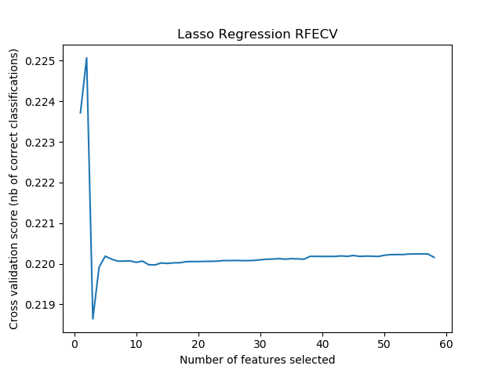
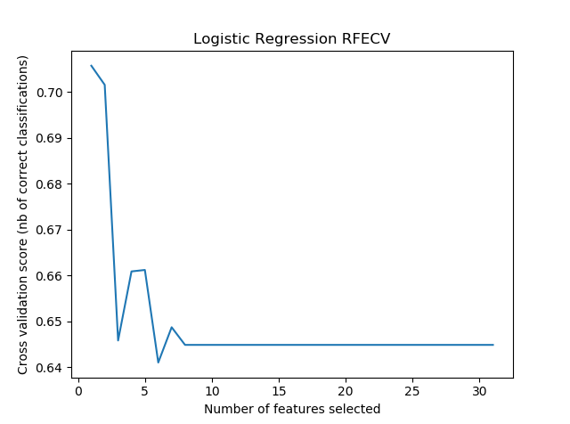
Feature Selection (Lasso/Logistic Model)
Recursive Feature Elimination and Cross Validation Selection (RFECV)
Used the Lasso Algorithm as model
Used StratisfiedKFold of 20 to split up the data for RFECV
16 Parameters chosen w/ step of 5

Slide 9
Parameter Tuning Lasso Regression
Alpha = 0.03
Constant that multiplies the L1 term
Tol = 0.01
Stopping point for optimization
Notes:
https://scikit-learn.org/stable/modules/generated/sklearn.linear_model.Lasso.html

Slide 10
Prediction Model (Lasso Regression)
Feature Selection/Regularization
Lasso Regression takes advantage of feature selection
Key Advantages
Reduces overfitting by eliminating irrelevant variables
Good for large features/small # of data
Logarithmic and MLP do not innately have feature selection
Not Resource intensive
Notes:
https://beta.vu.nl/nl/Images/werkstuk-fonti_tcm235-836234.pdf

Slide 11
Submission Results (Decimal)
High Score: .847
Submission Scores:
Logistic: .842
MLP: .805
Combined Models:
.838 (Lasso, Logarithmic, MLP)
Lasso: .847
Notes:
https://scikit-learn.org/stable/modules/generated/sklearn.linear_model.LogisticRegression.html
https://scikit-learn.org/stable/modules/generated/sklearn.linear_model.LogisticRegression.html
https://scikit-learn.org/stable/auto_examples/linear_model/plot_logistic_l1_l2_sparsity.html#sphx-glr-auto-examples-linear-model-plot-logistic-l1-l2-sparsity-py

Slide 12
Submission Results Graph

Slide 13
Submission Results (Classified 0,1)
High Score: . 763
Submission Scores:
Logistic: .763
MLP: .727
Lasso: .706
Notes:
https://scikit-learn.org/stable/modules/generated/sklearn.linear_model.LogisticRegression.html
https://scikit-learn.org/stable/modules/generated/sklearn.linear_model.LogisticRegression.html
https://scikit-learn.org/stable/auto_examples/linear_model/plot_logistic_l1_l2_sparsity.html#sphx-glr-auto-examples-linear-model-plot-logistic-l1-l2-sparsity-py

Slide 14
Submission Results Graph

Slide 15
How AUC (Area Under the Curve) Scores
- AUC takes the total sum of 0 and 1 differences.
- Predicting with Regression/Probabilities boosts score
- Predicting with only 0 and 1’s creates larger differences (detrimental to score)

Slide 16
Thanks
Questions

Slide 17
Sources
¹https://elitedatascience.com/machine-learning-algorithms
²https://scikit-learn.org

Slide 18
Appendix

