Slide 1
Don’t Overfit
By Samuel Uong, Richard Ching and Luca Scalerandi

Slide 2
Outline
Goal/Approach
Algorithm selection – Performance Cross-Validation
Feature Selection
Parameter tuning
Ranking and overall results

Slide 3
Goal/Approach
Goal
To Predict if a single sample is a 0 or 1.
Learn about and utilize Scikit Libraries to predict results
Approach
Initial Run through of various algorithms
Use the most successful algorithm
Further tune for better results

Slide 4

Algorithm selection
Support Vector Machines
Naive Bayes
K Nearest Neighbors
Multi Layer Perceptron Classifier
Lasso Regression
Logistic Regression

Slide 5
Ranking Result (Test Data)

Slide 6

What we initially tried
Support Vector Machine
Naïve Bayes
The simplicity makes it less competitive compared to other Models
K Nearest Neighbors
Curse of Dimensionality: Poor results if too many variables/features
Can have big performance loss if #parameters > #samples

Slide 7

What we tuned
Multi Layer Perceptron
Logistic Regression
Can be regularized to avoid overfitting
Lasso Regression
Automatically performs feature selection
Good for classifying problems

Slide 8
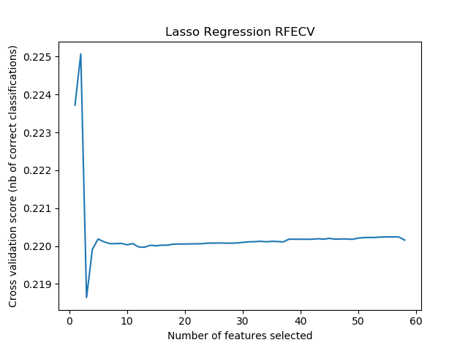
Feature Selection (Lasso)
Recursive Feature Elimination and Cross Validation Selection (RFECV)
Used the Lasso Algorithm as model
Used StratisfiedKFold of 20 to split up the data for RFECV
16 Parameters chosen w/ step of 5

Slide 9
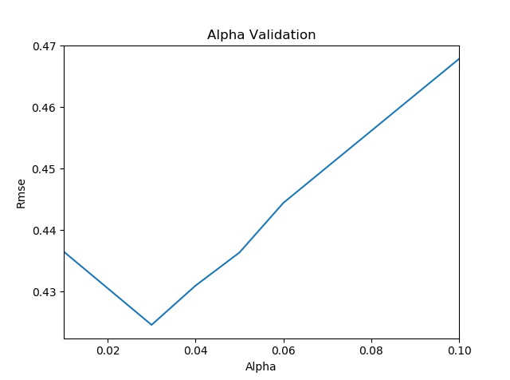
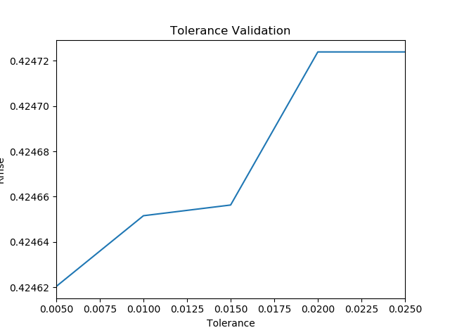
Parameter Tuning Lasso Regression
Alpha = 0.03
Constant that multiplies the L1 term
Tol = 0.01
Stopping point for optimization
Modifies the number of parameters that are selected
When specified number is reached, regression is stopped
Notes:
https://scikit-learn.org/stable/modules/generated/sklearn.linear_model.Lasso.html

Slide 10
Prediction Model (Lasso Regression)
Feature Selection/Regularization
Lasso Regression takes advantage of feature selection
Key Advantages
Reduces overfitting by eliminating irrelevant variables
Good for large features/small # of data
Logarithmic and MLP do not innately have feature selection
Not Resource intensive
Notes:
https://beta.vu.nl/nl/Images/werkstuk-fonti_tcm235-836234.pdf

Slide 11
Submission Results (Decimal)
High Score: .847
Submission Scores:
Logistic: .842
MLP: .805
Combined Models:
.838 (Lasso, Logarithmic, MLP)
Lasso: .847
Notes:
https://scikit-learn.org/stable/modules/generated/sklearn.linear_model.LogisticRegression.html
https://scikit-learn.org/stable/modules/generated/sklearn.linear_model.LogisticRegression.html
https://scikit-learn.org/stable/auto_examples/linear_model/plot_logistic_l1_l2_sparsity.html#sphx-glr-auto-examples-linear-model-plot-logistic-l1-l2-sparsity-py

Slide 12
Submission Results Graph

Slide 13
Submission Results (Classified 0,1)
High Score: . 763
Submission Scores:
Logistic: .763
MLP: .727
Lasso: .706
Notes:
https://scikit-learn.org/stable/modules/generated/sklearn.linear_model.LogisticRegression.html
https://scikit-learn.org/stable/modules/generated/sklearn.linear_model.LogisticRegression.html
https://scikit-learn.org/stable/auto_examples/linear_model/plot_logistic_l1_l2_sparsity.html#sphx-glr-auto-examples-linear-model-plot-logistic-l1-l2-sparsity-py

Slide 14
Submission Results Graph

Slide 15
How AUC (Area Under the Curve) Scores
- AUC takes the total sum of 0 and 1 differences.
- Predicting with Regression/Probabilities boosts score
- Predicting with only 0 and 1’s creates larger differences (detrimental to score)

Slide 16
Thank You
Questions?

Slide 17
Sources
¹https://elitedatascience.com/machine-learning-algorithms
²https://scikit-learn.org

Slide 18
Appendix

