Slide 1

G2M Case Study
Virtual Internship
17 May 2024

Slide 2
Background –G2M(cab industry) case study
XYZ is a private equity firm in US. Due to remarkable growth in the Cab Industry in last few years and multiple key players in the market, it is planning for an investment in Cab industry.
Objective : Provide actionable insights to help XYZ firm in identifying the right company for making investment.
The analysis has been divided into four parts:
Data Understanding
Forecasting profit and number of rides for each cab type
Finding the most profitable Cab company
Recommendations for investment

Slide 3
Data Exploration
21 Features (17 + 4 derived features)
Derived features:
Profit
Revenue
Retention Rate
Market Penetration
Timeframe of the data: 31/01/2016 to 31/12/2018.
Total data points: 808,682
Assumptions:
Profit of rides are calculated keeping other factors constant and only
Price_Charged and Cost_of_Trip features used to calculate profit.
Users feature of city dataset is treated as number of cab users in the city.
we have assumed that this can be other cab users as well.
Cab_Data.csv
Customer_ID.csv
Transaction_ID.csv
City.csv
Final cab data

Slide 4
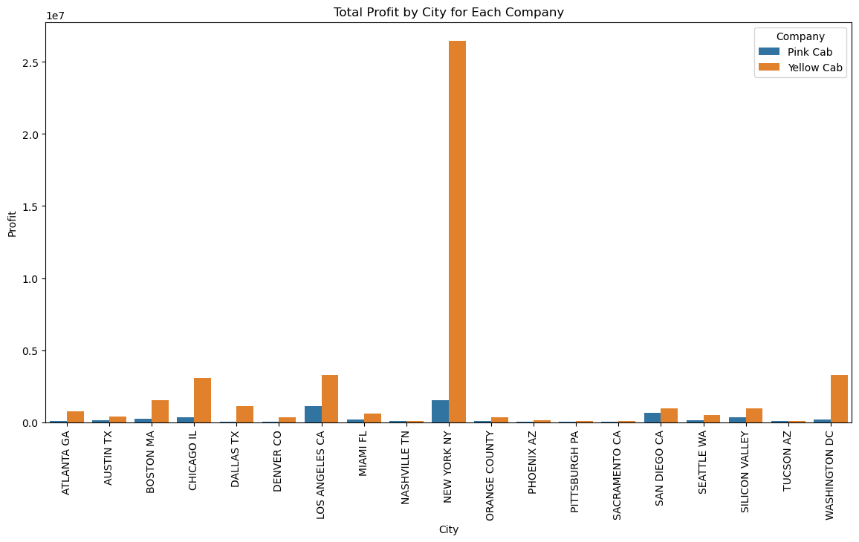
Profit Analysis
Profit-by-city Analysis
Yellow Cab company is more profitable in most cities.
The difference is significant for large cities like New York or Washington DC.

Slide 5
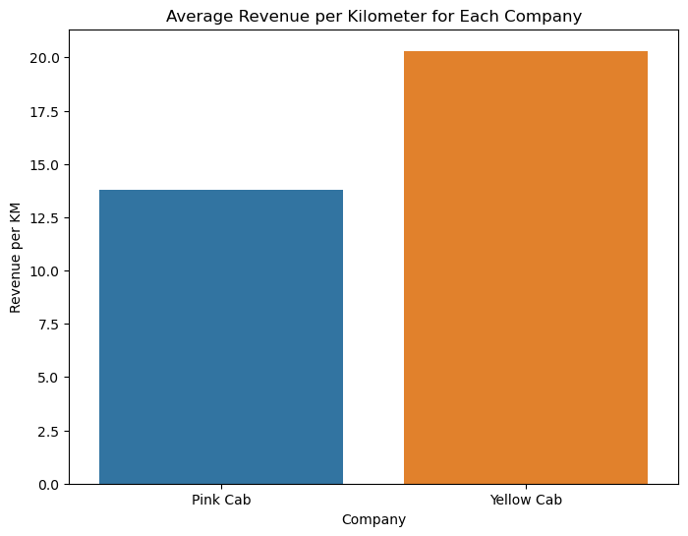
Average revenue per km
Yellow Cab company has 60% higher revenue per km.

Slide 6
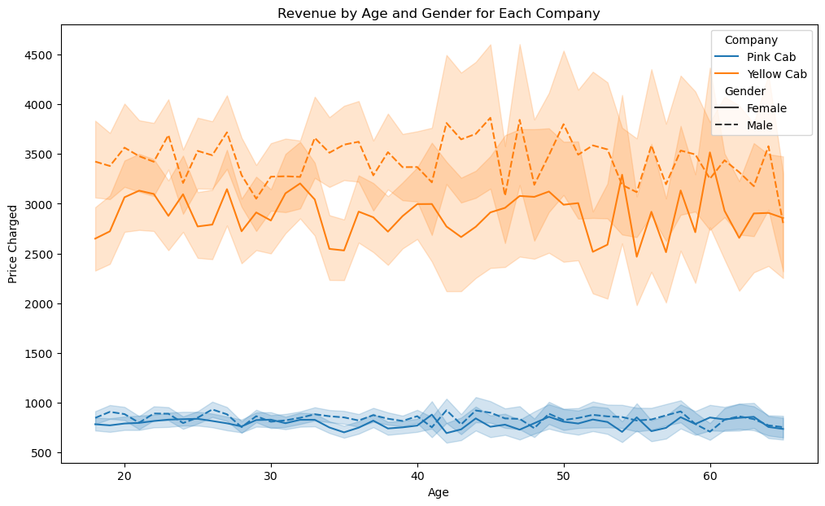
Customer Demographics Impact on Revenue
Both Yellow Cab Company and Pink Cab company sees no impacts age of customers on price charged.
Yellow Cab company sees more spending from male customers, whilst Pink Cab sees no significant difference.

Slide 7
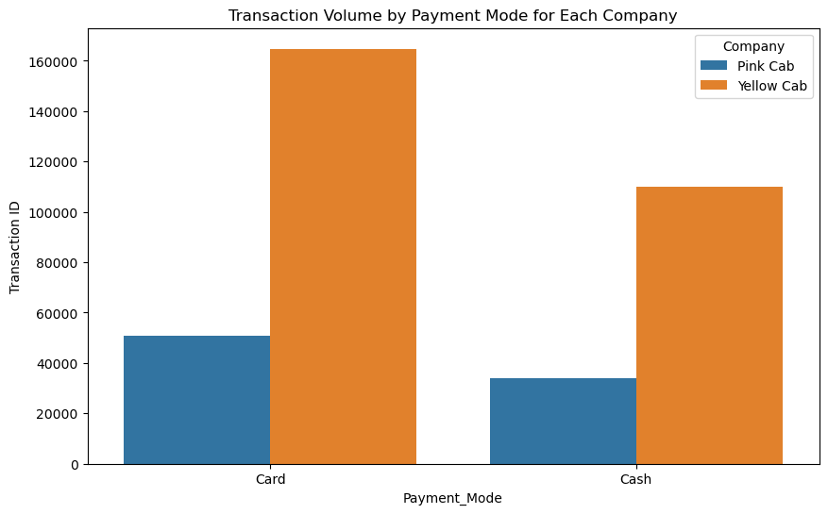
Impact of Payment Mode on Transaction Volume
Both companies see more transactions by card.
However, Yellow Cab company sees significantly higher Card:Cash ratio (~1.6 compared to ~1.2).

Slide 8
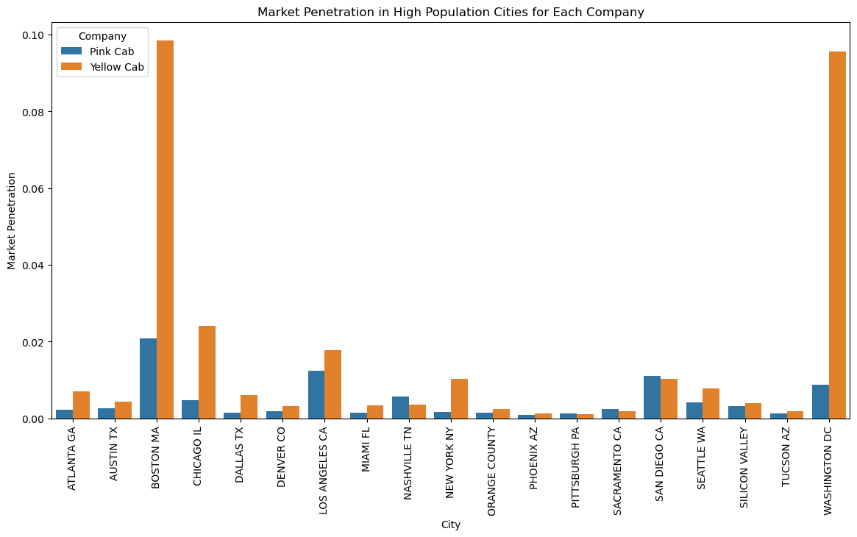
Market Penetration in High Population Cities
Yellow Cab Company sees higher penetration in almost all large cities. The company is particularly dominating in Boston and Washington DC.
Yellow Cab company sees more spending from male customers, whilst Pink Cab sees no significant difference.

Slide 9
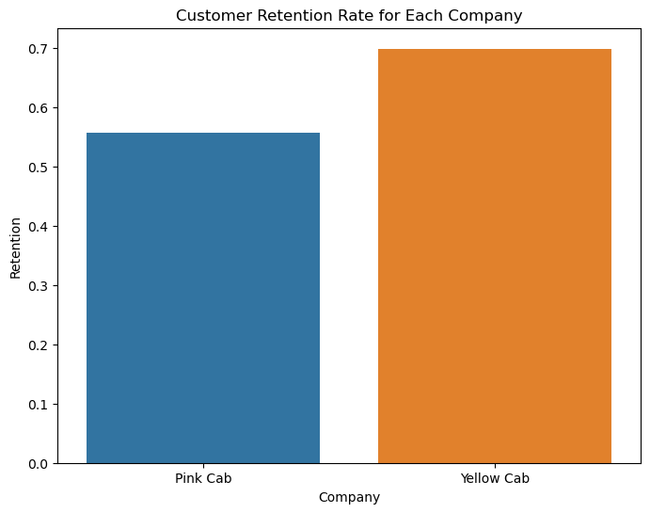
Customer Retention Rate
Yellow Cab Company sees 30% higher customer retention rate compared to Pink Cab company.

Slide 10
Recommendations
We have evaluated both the cab companies on following points and found Yellow cab better than Pink cab:
Profitability: Yellow cab is similar or significantly higher profitable, especially for large cities.
Revenue : Yellow Cab Company has 60% higher revenue per km.
Customer Retention: Yellow cab company has 30% higher retention rate.
Customer demographic: Yellow Cab Company sees more revenue from male customers. Revenue is almost independent of age for both companies.
Payment method: Yellow Cab company sees 33% higher Card:Cash transaction ratio.
Market penetration: Yellow Cab company sees similar or higher penetration in almost all cities, especially for large cities like Boston and Washington DC.
On the basis of above point, we will recommend Yellow cab for investment.

Slide 11
Thank You

