Slide 1
Pulling everything together
Mike Jackson, ARCHER CSE Team
michaelj@epcc.ed.ac.uk

Slide 2

Reusing this material
This work is licensed under a Creative Commons Attribution-NonCommercial-ShareAlike 4.0 International License.
http://creativecommons.org/licenses/by-nc-sa/4.0/deed.en_US
This means you are free to copy and redistribute the material and adapt and build on the material under the following terms: You must give appropriate credit, provide a link to the license and indicate if changes were made. If you adapt or build on the material you must distribute your work under the same license as the original.
Note that this presentation contains images owned by others. Please seek their permission before reusing these images.

Slide 3





http://www.archer.ac.uk
support@archer.ac.uk

Slide 4
Best practices for scientific computing
Wilson G, Aruliah DA, Brown CT, Chue Hong NP, Davis M, et al. (2014) Best Practices for Scientific Computing. PLoS Biol 12(1): e1001745. doi:10.1371/journal.pbio.1001745. http://dx.doi.org/10.1371/journal.pbio.1001745.
Write programs for people, not computers
A program should not require its readers to hold more than a handful of facts in memory at once
Make names consistent, distinctive, and meaningful
Make code style and formatting consistent
Let the computer do the work
Make the computer repeat tasks
Save recent commands in a ﬁle for re-use
Use a build tool to automate workﬂows
Notes:
“Scientists spend an increasing amount of time building and using software. However, most scientists are never taught how to do this efficiently. As a result, many are unaware of tools and practices that would allow them to write more reliable and maintainable code with less effort. We describe a set of best practices for scientific software development that have solid foundations in research and experience, and that improve scientists' productivity and the reliability of their software.”

Slide 5
Best practices for scientific computing
Make incremental changes
Work in small steps with frequent feedback and course correction
Use a version control system
Put everything that has been created manually in version control
Don’t repeat yourself (or others)
Every piece of data must have a single authoritative representation in the system
Modularize code rather than copying and pasting
Re-use code instead of rewriting it

Slide 6
Best practices for scientific computing
Plan for mistakes
Add assertions to programs to check their operation
Use an off-the-shelf unit testing library
Turn bugs into test cases
Use a symbolic debugger
Optimize software only after it works correctly
Use a proﬁler to identify bottlenecks
Write code in the highest-level language possible

Slide 7
Best practices for scientific computing
Document design and purpose, not mechanics
Document interfaces and reasons, not implementations
Refactor code in preference to explaining how it works
Embed the documentation for a piece of software in that software
Collaborate
Use pre-merge code reviews
Use pair programming when bringing someone new up to speed and when tackling particularly tricky problems
Use an issue tracking tool

Slide 8
Ten simple rules for reproducible computational research
For every result, keep track of how it was produced
Avoid manual data manipulation steps
Archive the exact versions of all external programs used
Version control all custom scripts
Record all intermediate results, when possible in standardized formats
For analyses that include randomness, note underlying random seeds
Always store raw data behind plots
Generate hierarchical analysis output, allowing layers of increasing detail to be inspected
Connect textual statements to underlying results
Provide public access to scripts, runs, and results
Sandve GK, Nekrutenko A, Taylor J, Hovig E (2013) Ten Simple Rules for Reproducible Computational Research. PLoS Comput Biol 9(10): e1003285. doi:10.1371/journal.pcbi.1003285. http://dx.doi.org/10.1371/journal.pcbi.1003285.
Notes:
Track how results were produced. This includes: data files, parameters, command-line parameters, configuration files, URLs of online data sources, software versions etc.
Automate manual data manipulation steps – shell scripts, Python scripts, pipelines e.g. e.g. sed, awk, grep, head, tail, sort,
If a file format supports meta-data then use it to record – who, when, what version of software produced it etc.
If you are defining your own file format, then add this meta-data.

Slide 9
Iterative development
What did you think of this workshop?
http://www.archer.ac.uk/training/feedback/
Sticky Notes:
One good point on green - learned, enjoyed
One bad point on red - confused, bothered
Optional post-course questionnaire:
http://tinyurl.com/2014-12-03-edinburgh-post

Slide 10
Getting access to ARCHER
Standard research grant
Request Technical Assessment using form on ARCHER website
Submit completed TA with notional cost in Je-S
Apply for time for maximum of 2 years
ARCHER Resource Allocation Panel (RAP)
Request Technical Assessment using form on ARCHER website
Submit completed TA with RAP form
Every 4 months
Application for computer time only
Instant Access – Pump-Priming Time
Request Technical Assessment using form on ARCHER website
Submit completed TA with 2 page description of work

Slide 11
Support and Documentation
Helpdesk
Email support@archer.ac.uk
via ARCHER SAFE http://www.archer.ac.uk/safe
phone: +44 (0)131 650 5000
By post, to: Liz Sim EPCC, University of Edinburgh JCMB, The King's Buildings Mayfield Road, EDINBURGH, EH9 3JZ
http://www.archer.ac.uk/community/techforum/
http://www.archer.ac.uk/documentation/

Slide 12
Training opportunities
ARCHER Training (free to academics)
http://www.archer.ac.uk/training/
Online sessions (using Blackboard Collaborate)
Technical Forum meetings (normally 15:00 last Wednesday of month)
technical presentations of interest to ARCHER users
http://www.archer.ac.uk/community/techforum/
Virtual tutorials (normally 15:00 second Wednesday of month)
opportunity for discussion with ARCHER staff on any topic
usually starts with a presentation of general interest
http://www.archer.ac.uk/training/virtual/
EPCC MSc in HPC (scholarships available)
http://www.epcc.ed.ac.uk/msc/

Slide 13
Funding calls
Embedded CSE support
Through a series of regular calls, Embedded CSE (eCSE) support provides funding to the ARCHER user community to develop software in a sustainable manner for running on ARCHER. Funding will enable the employment of a researcher or code developer to work specifically on the relevant software to enable new features or improve the performance of the code
Apply for funding for development effort
Planned every 4 months
4th call closes at 4pm on Tuesday 13th January 2015
See http://www.archer.ac.uk/community/eCSE/ for details

Slide 14
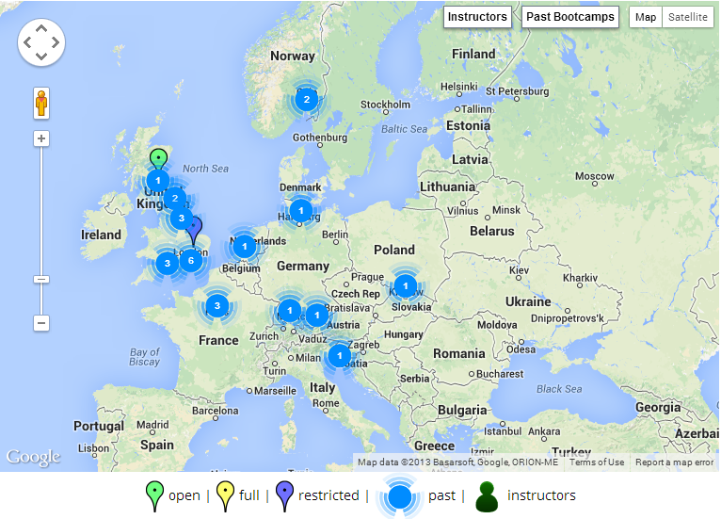



Getting involved in Software Carpentry
admin-uk@software-carpentry.org
http://software-carpentry.org/workshops
http://software-carpentry.org/lessons.html

Slide 15

Software Sustainability Institute
We want the research community to
Recognise software as a fundamental research output
Recognise the value of research software engineers
Receive better software training
Recognise the role of software in reproducibility
Not broken software broken science but…
What we do
Fellowship: we find and nurture researchers with combined talents in research and software
Software Carpentry: teaching basic software skills to researchers from all disciplines
Consultancy: providing software expertise to advance research software
Campaigning: raising the profile of software in research and highlighting the issues it faces
We are supported by EPSRC under grant EP/H043160/1

Slide 16
Thank you!

