Slide 1
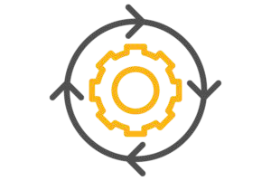
Continuous Delivery
Changing the way we deliver our software

Slide 2


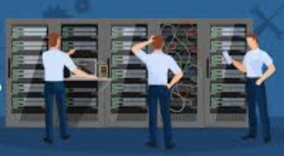
How we used to deploy?
Delays in getting new features into production
Manual infrastructure creation and checkup
Provisioning too many resources
2
Lost opportunities and revenue
Burn money on infrastructure which is not used
Slow deployments and human errors

Slide 3
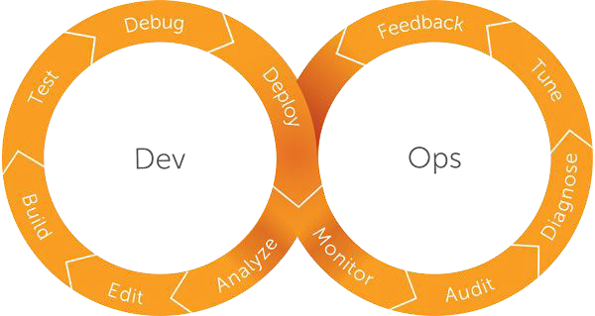
CI/CD comes in ...
3

Slide 4
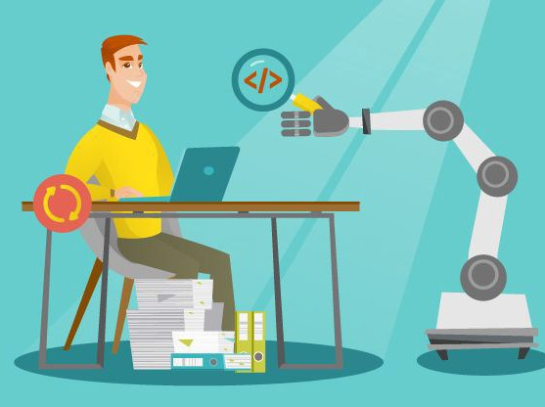
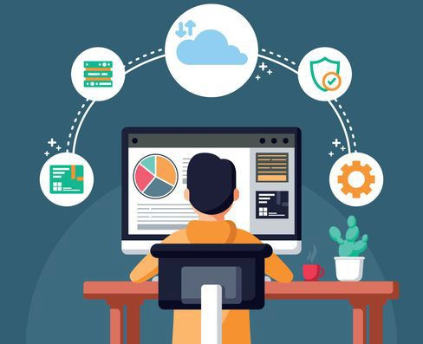
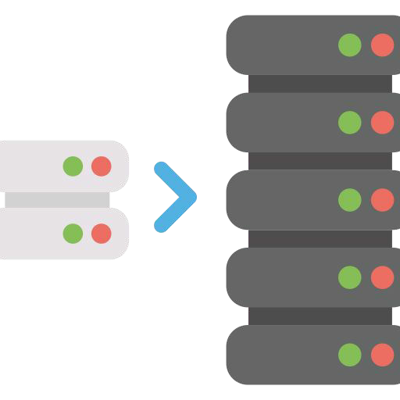
What can we do now?
Catch compile and unit test failures after merge
Automate infrastructure creation and monitoring
Scale servers to our needs
Avoid extra costs on infrastructure
4
Less bugs in production, more time for developing new features
Less human error and faster deployments

Slide 5
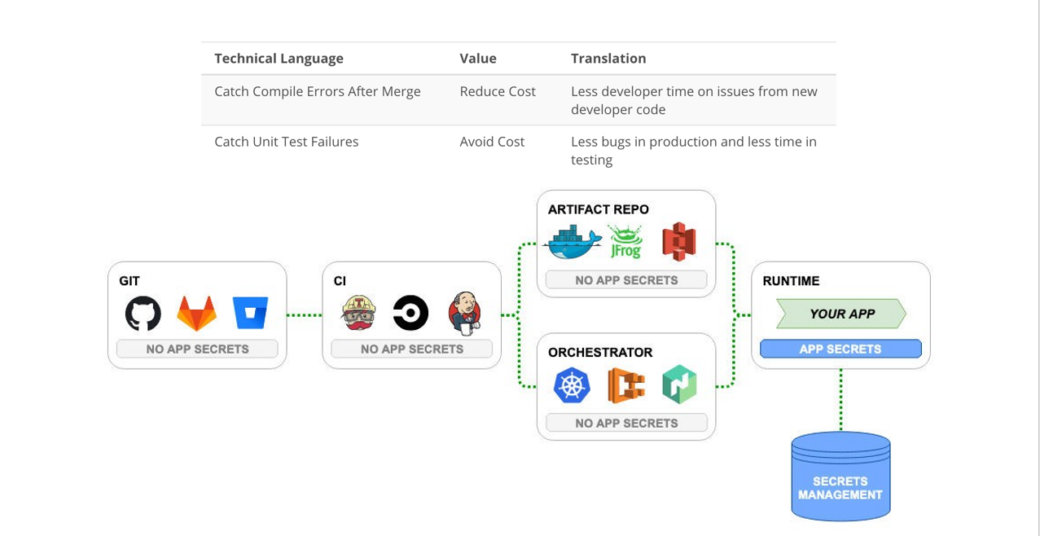

Slide 6

thanks!
Any questions, I’m always here to help you

