Slide 1
Visualizing Objects in Multidimensional Space
Project Problem
2014 Math Contest
University of Houston

Slide 2
Directions
Your work should be bound in a 3 tab folder or 3 ring binder. The first page should be a title page containing the school name and the names of the project team members. The second page (and third or more if needed) should contain the table of contents for the project write-up. The subsequent pages should contain well written solutions to exercises 1-9 (stated on the last few pages of this document). The final portion of your write-up should contain a description and URL for the YouTube video requested in exercise 10. Exercise 10 is worth 25% of the total grade on the project. Exercises 1-9 are equally weighted.
Note: Some of the problems will require the use of a computer, and possibly some programming.
All work will be evaluated based upon quality, clarity, precision and presentation.
Project solutions can be submitted in either of the following ways:
  On the day of the contest between 8 and 9 am.
  Via email to jmorgan@math.uh.edu by 8am on the day of the contest. In this case, the document should be attached as a pdf.
Email questions and comments, and check the contest homepage for updates.

Slide 3
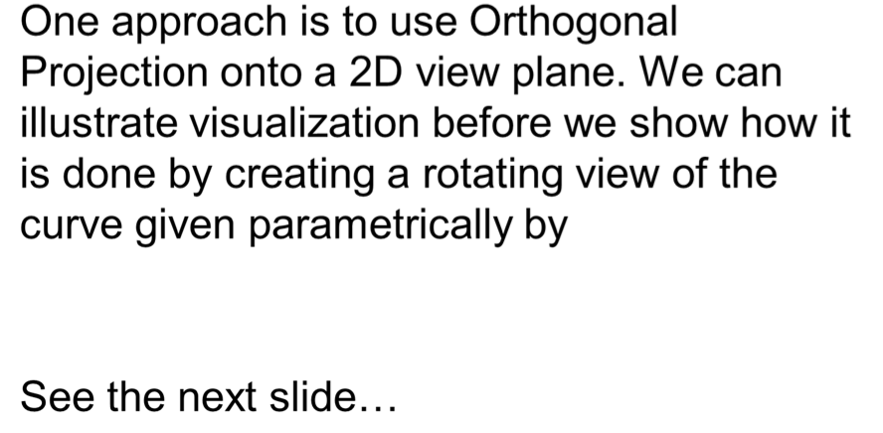
How Do We Plot Objects in
3 Dimensional Space?

Slide 4
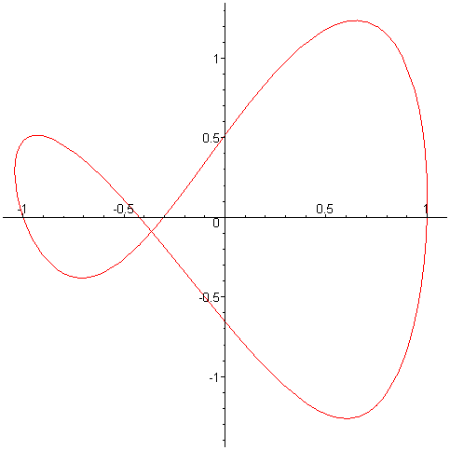
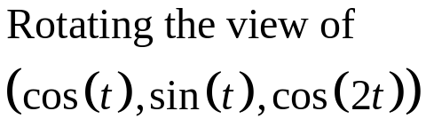
In this case, the View-Plane is Rotating
The axes show are axes for the view plane (to be discussed shortly).
You will have to play the slide show in Power Point to see the rotation.

Slide 5
Orthogonal Projection - Concepts
Direction to the “eye” (only valid in 3 space)
Orthogonal coordinate system on a view plane.
Orthogonal projection onto the view plane.

Slide 6
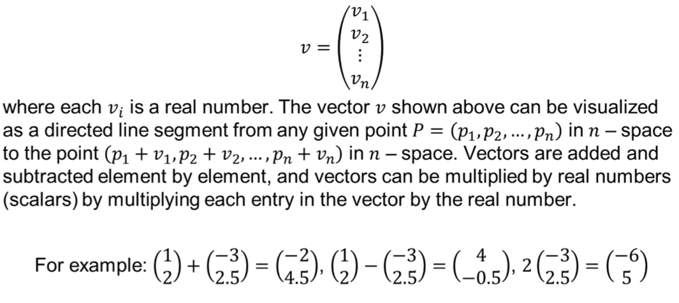
Fundamental Concepts I

Slide 7
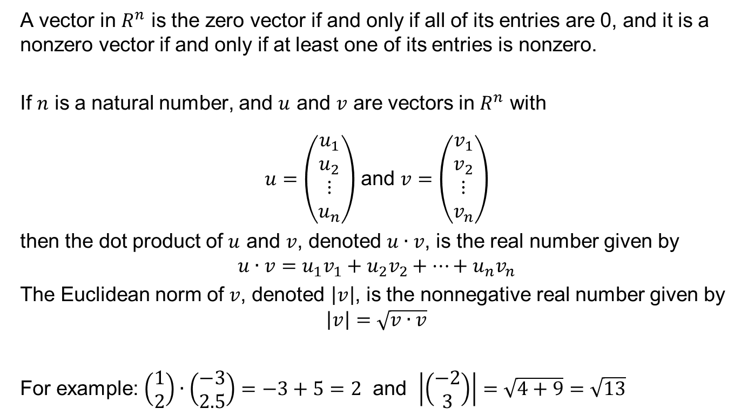
Fundamental Concepts II

Slide 8
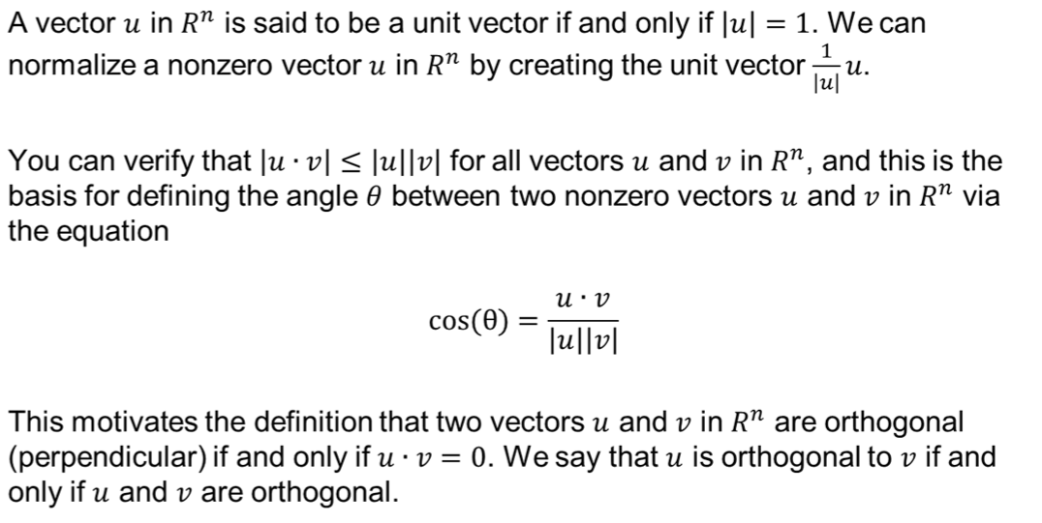
Fundamental Concepts III

Slide 9
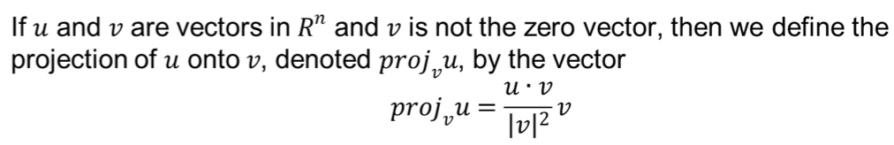
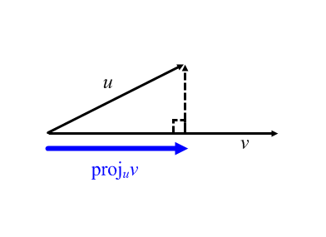
Fundamental Concepts IV

Slide 10
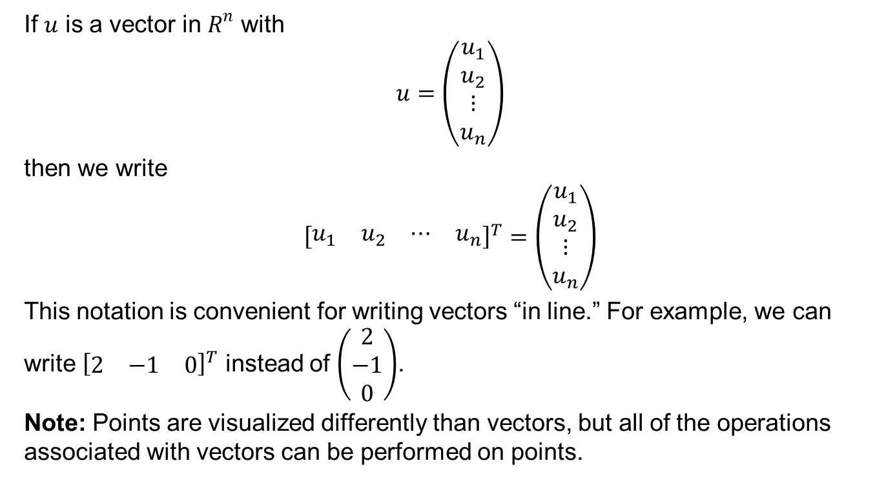
Fundamental Concepts V

Slide 11
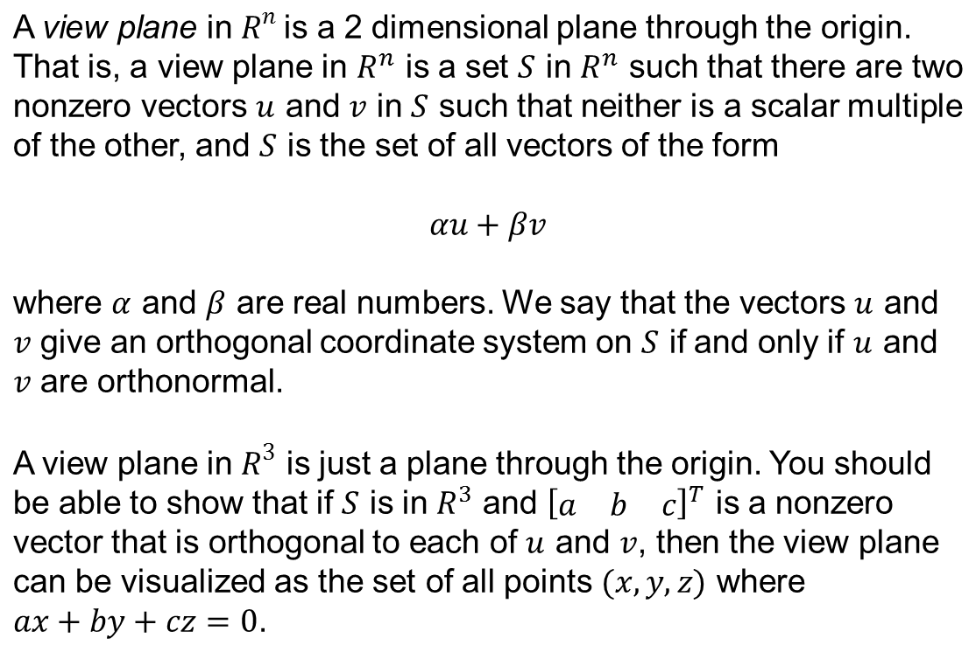


View Plane With Orthogonal Coordinate System

Slide 12
Orthogonal Projection
(3 Space Version)
z
View Plane
ax + by + cz = 0
Assume a and b are not both zero.
eye = [a b c]^{T}
(orthogonal to the view plane)
y
x

Slide 13
Orthogonal Projection
(3 Space Version)
z
View Plane
ax + by + cz = 0
eye = [a b c]^{T}
(orthogonal to the view plane)
y
coordinate axes in the view plane.
x

Slide 14
Orthogonal Projection
(3 Space Version)
z
View Plane
ax + by + cz = 0
eye = [a b c]^{T}
(orthogonal to the view plane)
up
right
y
coordinate axes in the view plane.
x

Slide 15
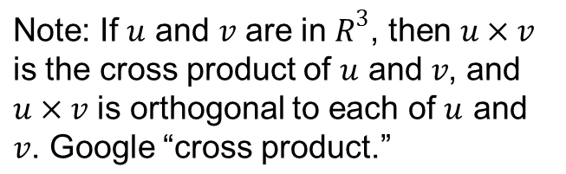
Orthogonal Projection
(3 Space Version)
z
View Plane
ax + by + cz = 0
eye = [a b c]^{T}
(orthogonal to the view plane)
up
right
y
coordinate axes in the view plane.
up = projection of [0 0 1]^{T} onto the view plane
= [0 0 1]^{T} − proj_{eye} [0 0 1]^{T}
right = up x eye
x

Slide 16
Orthogonal Projection
(3 Space Version)
z
View Plane
ax + by + cz = 0
P = (x₀,y₀,z₀) is a point.
eye = [a b c]^{T}
(orthogonal to the view plane)
up
right
y
coordinate axes in the view plane.
up = projection of [0 0 1]^{T} onto the view plane
= [0 0 1]^{T} − proj_{eye} [0 0 1]^{T}
right = up x eye
Then normalize these two vectors.
x

Slide 17
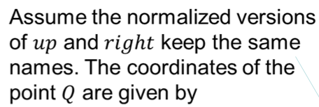

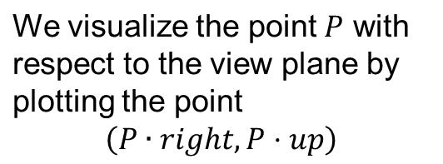
Orthogonal Projection
(3 Space Version)
Q = The projection of P onto the view plane.
z
P = (x₀,y₀,z₀) is a point.
eye = [a b c]^{T}
(orthogonal to the view plane)
up
right
y
coordinate axes in the view plane.
up = projection of [0 0 1]^{T} onto the view plane
= [0 0 1]^{T} − proj_{eye} [0 0 1]^{T}
right = up x eye
Then normalize these to unit vectors.
x

Slide 18
Warning: Orthogonal projection can create illusions because there is no perspective.

Slide 19
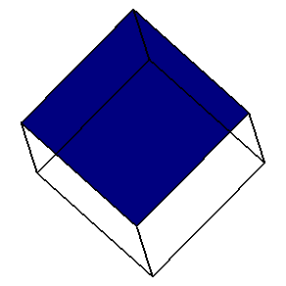
Can you see the illusion in this rotating view?
You will have to play the slide show in Power Point to see the rotation.

Slide 20
Matlab Code
(.m file to create a rotated view w/o face shading)
hold off x=[0 0 0 0 0 NaN 1 0 NaN 1 0 NaN 1 0 NaN 1 0 NaN 1 1 1 1 1]; y=[0 0 1 1 0 NaN 0 0 NaN 1 1 NaN 1 1 NaN 0 0 NaN 0 0 1 1 0]; z=[0 1 1 0 0 NaN 0 0 NaN 0 0 NaN 1 1 NaN 1 1 NaN 0 1 1 0 0]; P=[x;y;z]; P=P-1/2; plot([NaN],[NaN]); axis([-2 2 -2 2]); axis manual axis off ginput(1); hold on | for i=0:2000 theta=pi/4+i*pi/200; eye=[cos(theta) sin(theta) 1]; up=[0 0 1]; pup=up-dot(up,eye)/dot(eye,eye)*eye; right=cross(pup,eye); u=right/norm(right); v=pup/norm(pup); xp=u*P; yp=v*P; plot(xp,yp,'b'); axis([-2 2 -2 2]); axis off drawnow hold off end
Note: If you do not have Matlab, then you can use this as pseudo code to see how the rotation can be created. You do not need Matlab to complete this project.

Slide 21

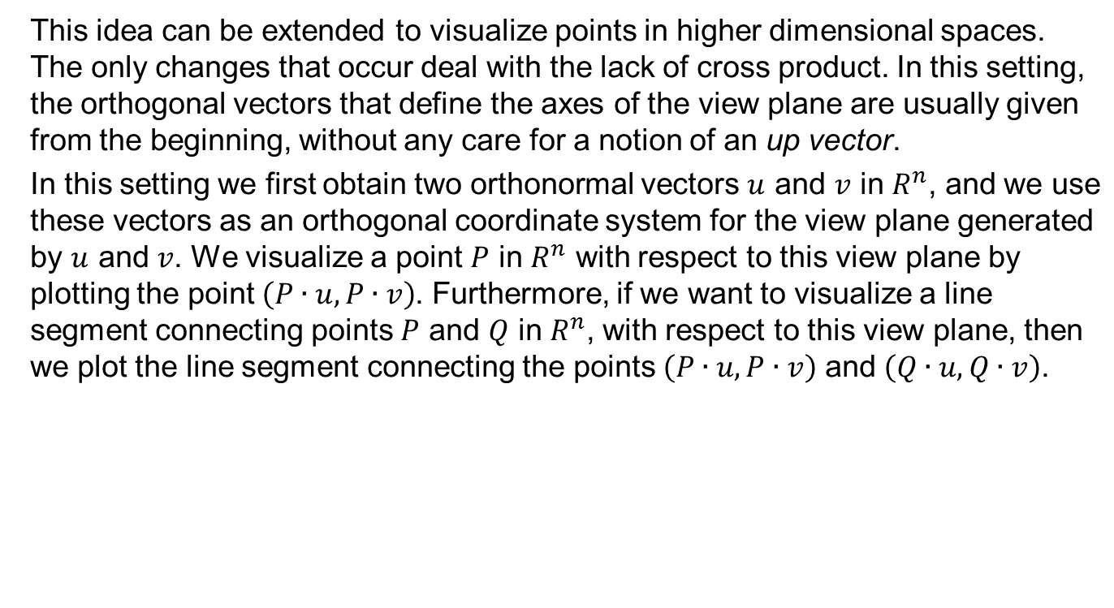

Slide 22
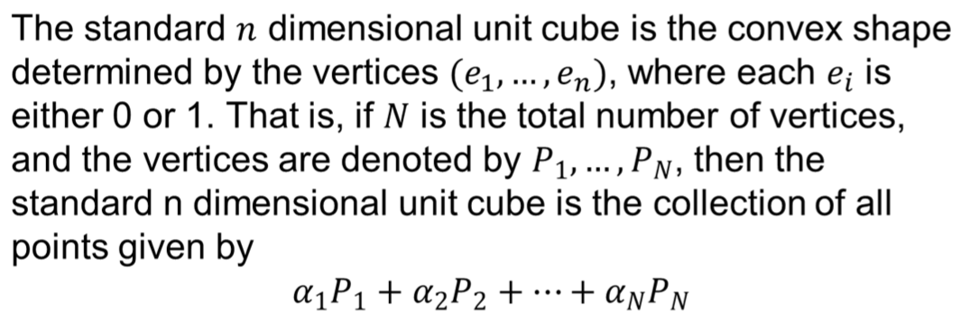
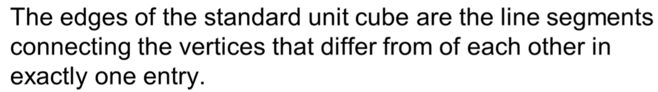
The Standard n Dimensional Unit Cube

Slide 23
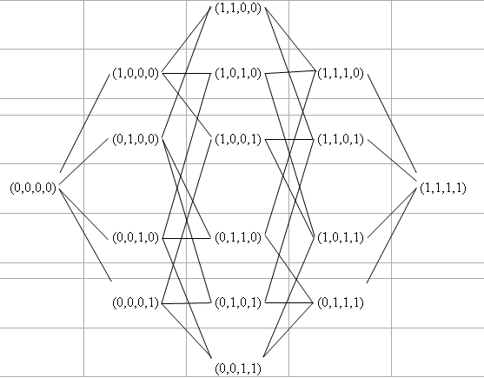
Standard 4 Dimensional Unit Cube
Vertices and Edges

Slide 24

Standard 5 Dimensional Unit Cube
Vertices and Edges
)

Slide 25
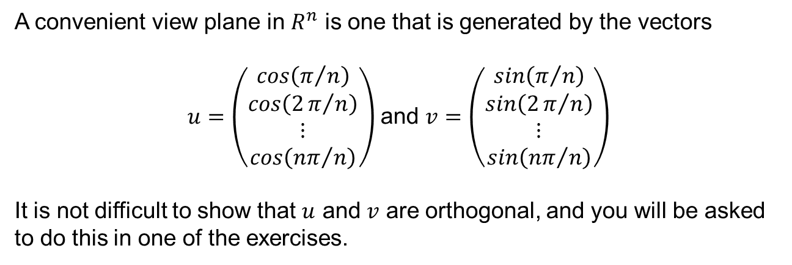
A Convenient View Plane

Slide 26
Strategy for Visualizing the Standard n Dimensional Unit Cube
Create orthonormal vectors that generate the view plane.
Create the vertices for the cube.
Create the coordinates for the projected vertices (in the view plane).
Determine the connections to create edges.
Sketch the edges by connecting the appropriate projected vertices in the view plane.
Note: The sketch created through this process only represents the edges of the cube, but it is enough to visualize the cube.

Slide 27
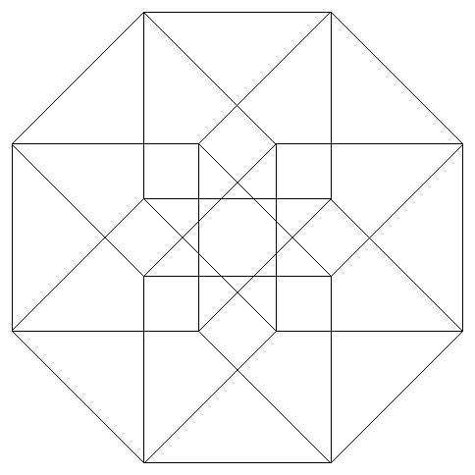
4 Dimensional Unit Cube wrt the Convenient View Plane

Slide 28
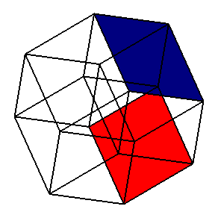
4 Dimensional Unit Cube with Rotation
(actually, the view plane is rotating to create the effect)
I have colored 2 of the 2 dimensional faces in the cube so that you can see how they move with the rotation.
You will have to play the slide show in Power Point to see the rotation.

Slide 29
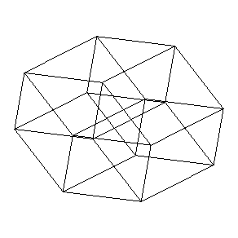
Another View of the Rotating
4 Dimensional Unit Cube
This one better illustrates changes in plots depending upon different view planes.
You will have to play the slide show in Power Point to see the rotation.

Slide 30
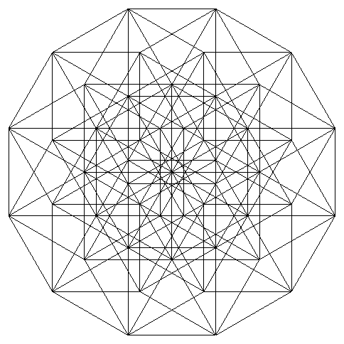
6 Dimensional Unit Cube wrt the Convenient View Plane

Slide 31
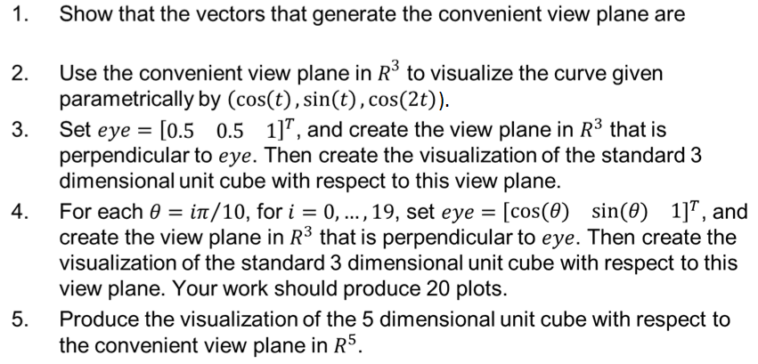
Exercises
If you write a computer program to create the visualizations, then include your code.

Slide 32
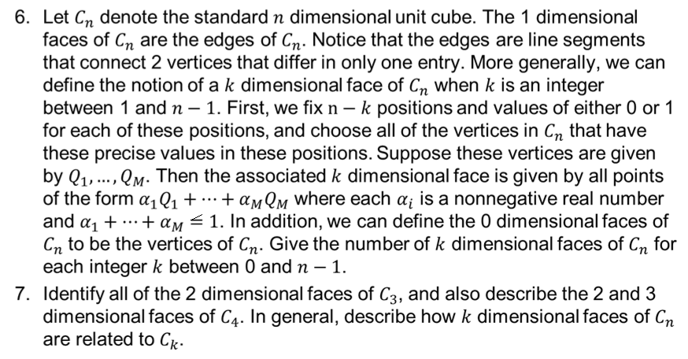
Exercises Continued
Note: In problem 6, “between” includes the possibility of the first value and the last value.

Slide 33
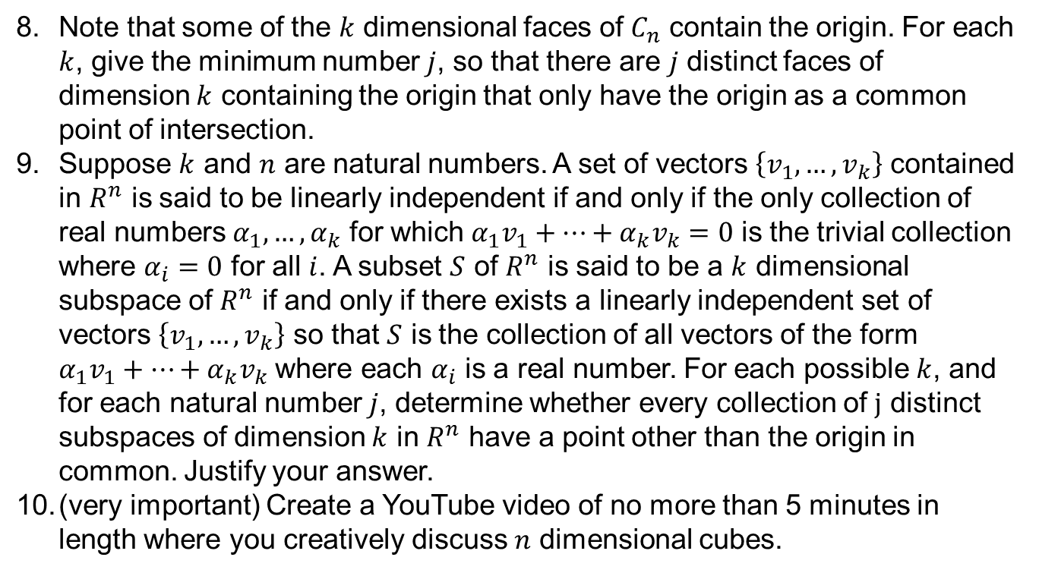
Exercises Continued

