Slide 1


Cross-Lingual Transfer Learning for POS Tagging without Cross-Lingual Resources
Joo-Kyung Kim, Young-Bum Kim, Ruhi Sarikaya, Eric Fosler-Lussier
Notes:
Thanks for the introduction. My name is Joo-Kyung Kim. This work is collaborated with Young-Bum Kim and Ruhi Sarikaya at Amazon Alexa and Eric Fosler-Lussier at the Ohio State University.

Slide 2
POS Tagging with limited labeled datasets
POS tagging is a relatively easy sequence tagging task given sufficient training examples
Still difficult for low-resource languages
Cross-lingual transfer learning for POS tagging
We can use POS datasets from resource-rich languages as the source to improve the POS tagging for the low-resource language
Notes:
Part-of-speech tagging is a relatively easy sequence tagging task given sufficient training examples. However, it would be still difficult for low-resource languages without enough training examples.
One way to deal with such low-resource languages is using cross-lingual transfer learning, which utilizes the datasets from resource-rich languages like English as the source language to help improve the performance for the low-resource target languages.

Slide 3
Cross-lingual Transfer Learning for POS Tagging
Previous work usually requires cross-lingual resources to encourage the input representations to be compatible
Parallel corpora: [Täckström+, TACL13], [Duong+, ACL13],
[Kim+, EMNLP15], [Zhang+, NAACL16]
Dictionaries: [Wisniewski+, EMNLP14], [Fang&Cohn, ACL17]
Morphological analyses: [Hana+, EMNLP04]
Eye movement relatedness: [Barrett+, COLING16]
Character-level cross-lingual transfer learning [Yang+, ICLR17]
Share character embeddings for different languages
”Canada” → “Canadá” in Spanish
“taxi” → “taxa”, “bus” → “bus” in Danish
Doesn’t work for disparate alphabets (e.g., English and Persian)
Our model focuses on transfer learning in the intermediate (BLSTM) layers
Not using any cross-lingual resources about the relations between a source language and a target language
Notes:
To perform cross-lingual transfer learning for POS tagging, previous work usually utilized cross-lingual resources, which are about the relations between different languages. They used parallel corpora, dictionaries, morphological analyses, and eye movement relatedness.
The problem is obtaining the cross-lingual resources can be expensive or limited.
Recently, Yang et al did cross-lingual transfer learning for sequence tagging by just sharing character embeddings for different languages. It has been shown effective since many languages have overlapped alphabets. For example, the spellings of Canada are similar for both English and Spanish. Also, I could see many danish words similar to English words while walking to here from my hotel room. However, this approach doesn’t work always and many languages have disparate alphabets.
All those approaches are focusing on making input spaces of different languages to be compatible.
In our work, we focus on the transfer learning in the intermediate layer instead of the input layer without utilizing any cross-lingual resource about the relations between a source language and a target language.

Slide 4

























Model Architecture
Softmax Output
Loss function inputs from red boxes
Language
Discriminator
$$p_{1}$$
$$p_{2}$$
…
$$p_{N}$$
Gradient
Reversal
Bidirectional Language Model
CNN/MaxPool Encoder
$$w_{2}$$
$$w_{3}$$
$$w_{eos}$$
$$w_{bos}$$
$$w_{1}$$
…
$$w_{N−1}$$
Common BLSTM
Private BLSTM
$$h_{1}^{cb}$$
$$h_{2}^{cb}$$
…
$$h_{N}^{cb}$$
$$h_{1}^{pb}$$
$$h_{2}^{pb}$$
…
$$h_{N}^{pb}$$
$${ h}_{1}^{cf}$$
$${ h}_{2}^{cf}$$
$${ h}_{N}^{cf}$$
$${ h}_{1}^{pf}$$
$${ h}_{2}^{pf}$$
$${ h}_{N}^{pf}$$
$$h_{1}^{p}$$
$$h_{2}^{p}$$
$$h_{N}^{p}$$
$$h_{1}^{p}$$
$$h_{2}^{p}$$
$$h_{N}^{p}$$
Word(private) + Char(common) Embeddings
$$w_{1}$$
$$w_{2}$$
…
$$w_{N}$$
$$c_{1}^{b}$$
$$c_{2}^{b}$$
$$c_{m}^{b}$$
shared for all the languages
$$e_{1}$$
$$e_{2}$$
$$e_{N}$$
…
parameters for each language
$$c_{1}^{f}$$
$$c_{2}^{f}$$
$$c_{m}^{f}$$
Baseline: similar to [Plank+, ACL16]
Notes:
This is the overall architecture of our model. Those green boxes represent the components for the baseline, which has a word+char embedding layer, a single BLSTM, and the softmax output layer. The baseline architecture is similar to Plank et al.’s architecture.
I’ll describe the other components in the following slides.

Slide 5
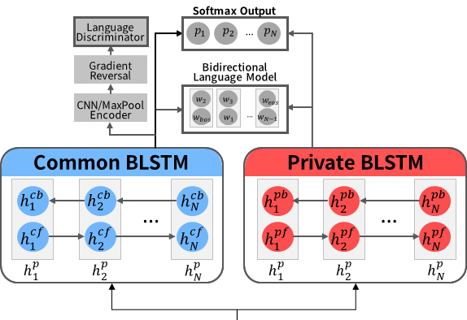
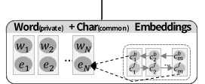
Language-general/Language-specific Representations
Common BLSTM for language-general representations
Shared parameters for all the languages
For knowledge transfer from other languages
Private BLSTMs for language-specific representations
Different parameters for different languages
For representing information necessary for specific languages
Inspired by domain adaptation models for image recognition [Bousmalis+, NIPS16] and slot-tagging [Kim+, COLING16]
Notes:
On top of the embedding outputs, we use two separate bidirectional LSTMs.
The common BLSTM is used for language-general representations. The parameters of the common BLSTM are shared for all the languages so that the knowledge transfer from other languages can be made.
The private BLSTMs are used for language-specific representations. Private BLSTMs have different parameters for different languages so that language-specific information can be represented.
Using two separated layers is inspired by Bousmalis et al.’s domain adaptation for image recognition and Kim et al.’s multitask learning for slot-filling.

Slide 6
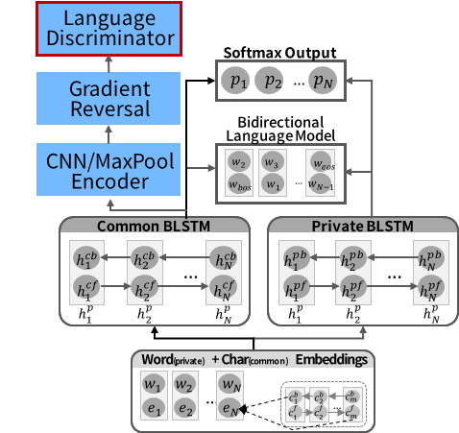
Language-Adversarial Training
Let the common BLSTM outputs to be language indistinguishable so that transfer learning from other languages can be more effective
Inspired by Domain-Adversarial Training for image recognition [Ganin+, JMLR16]
Encourages the representation to be domain indistinguishable
Then, the model performance for the target domain is
improved
Notes:
I just said that the common BLSTM is used for language general representations for all the languages. On top of the common BLSTM outputs, we added language-adversarial training components to encourage the language general representations to be more language-indistinguishable.
This idea is inspired by domain-adversarial training for image recognition by Ganin et al. They showed that encouraging the representation to be domain indistinguishable can improve the model performance for the target domain. Similarly, we tried to make the language general representations to be more language-agnostic so that the knowledge transfer from the source languages to be more effective.

Slide 7
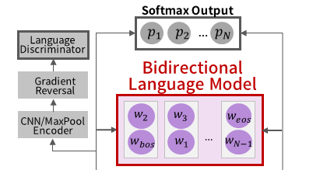
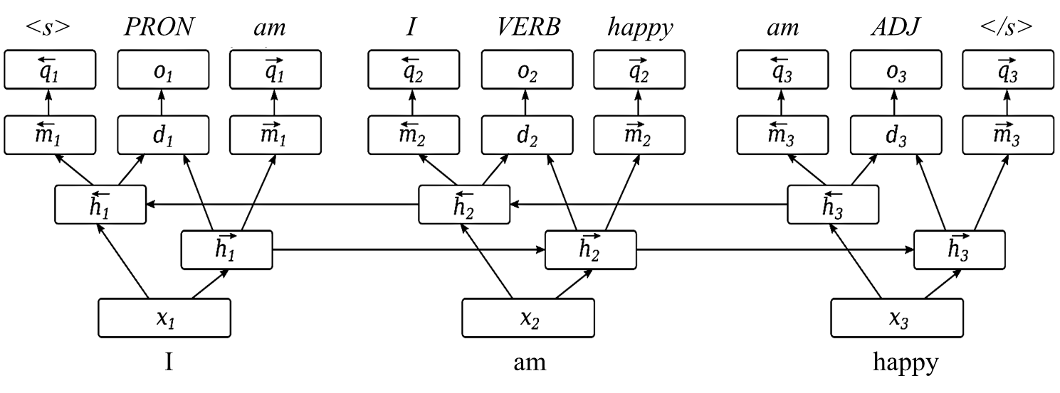
Bidirectional Language Modeling
Adding language modeling objectives encourages learning general-purpose representations, which is also helpful for specific tasks [Rei, ACL17]
Models w/ adversarial training usually try to reduce information loss from the adversarial training by reconstruction
In our experiments, bidirectional language modeling showed better performance than word embedding reconstruction [Yuan+, TACL17] and seq2seq autoencoding [Gui+, EMNLP17]
Courtesy of [Rei, ACL17]
Notes:
Another auxiliary objective is bidirectional language modeling on top of the output combination of the common BLSTM and a private BLSTM.
Marek Rei showed that having forward directional language modeling for forward LSTM and backward directional language modeling for backward LSTM encourages learning general-purpose representations, which is also helpful for specific tagging tasks.
One issue related to adversarial training is, many people use input reconstruction objectives with adversarial training to reduce the information loss from the adversarial training. For example, Yuan et al. used word embedding reconstruction and Gui et al. used seq2seq autoencoding. Although we didn’t report the numbers, in our experiments, using bidirectional language modeling showed better performance than those other reconstruction approaches. That may be because predicting the neighbors might be better than reconstructing itself.

Slide 8
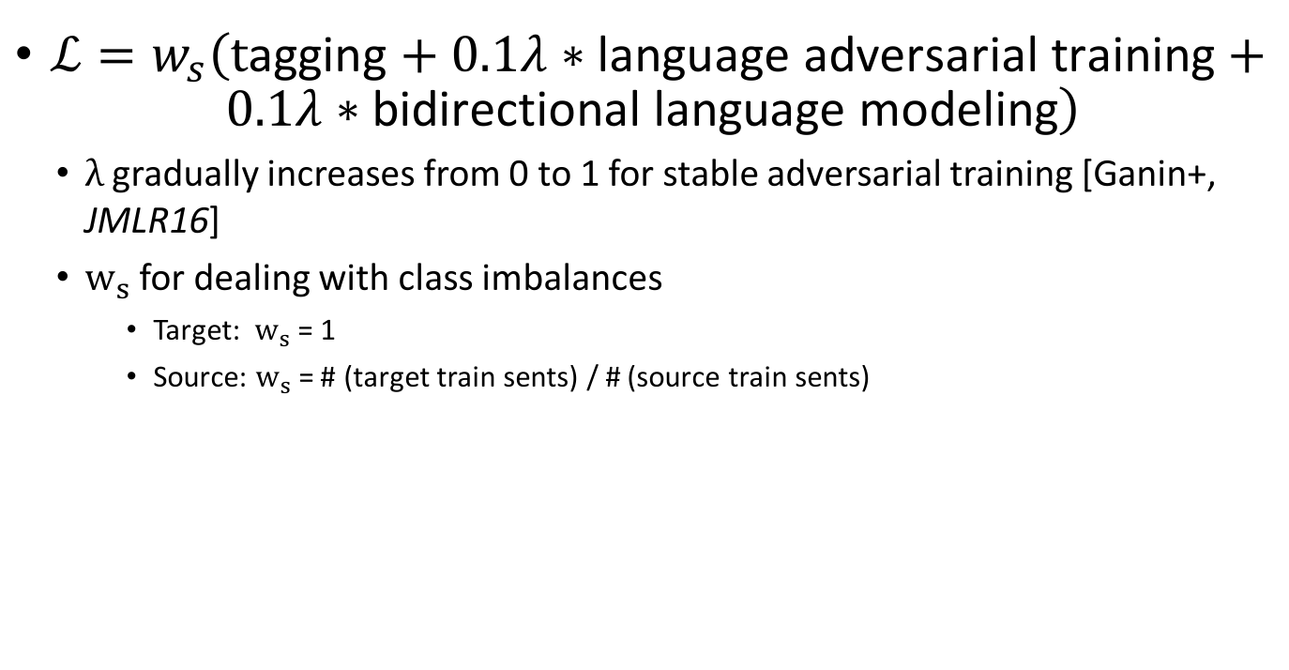
The Loss Function
$ℒ=w_{s}\left(\text{t}\text{agging}+0.1λ∗\text{language} \text{adversarial} \text{training}+ 0.1λ∗\text{bidirectional} \text{language} \text{modeling}\right)$
$λ$ gradually increases from 0 to 1 for stable adversarial training [Ganin+, JMLR16]
$w_{s}$ for dealing with class imbalances
Target: $w_{s}$ = 1
Source: $w_{s}$ = # (target train sents) / # (source train sents)
Notes:
So, we have three objectives, tagging, language-adversarial training, and bidirectional language modeling. We combined them in this way to get a single loss function. To deal with the class imbalances, we used gradient weighting instead of oversampling or downsampling.

Slide 9
Evaluation Datasets
1 source + 14 target POS tagged datasets from Universal dependencies corpus v 1.4 [Nivre+, LREC16]
For training, used all the train sentences for the Adversarial training and LM but only 1,280 or fewer sentences for tagging (to simulate low-resource settings)
Language Family | Language | # POS tags | # train sents | # dev sents | # test sents
Germanic | English | 17 | 12,543 | 2,002 | 2,077
 | Swedish | 16 | 4,303 | 504 | 1,219
 | Danish | 17 | 4,868 | 322 | 322
 | Dutch | 16 | 13,000 | 349 | 386
 | German | 16 | 14,118 | 799 | 977
Slavic | Slovenian | 16 | 6,471 | 735 | 790
 | Polish | 15 | 6,800 | 700 | 727
 | Slovak | 15 | 8,483 | 1,060 | 1,061
 | Bulgarian | 16 | 8,907 | 1,115 | 1,116
Romance | Romanian | 17 | 7,141 | 1,191 | 1,191
 | Portuguese | 18 | 8,800 | 271 | 288
 | Italian | 18 | 12,837 | 489 | 489
 | Spanish | 17 | 14,187 | 1,552 | 274
Indo-Iranian | Persian | 16 | 4,798 | 599 | 600
Uralic | Hungarian | 16 | 1,433 | 179 | 188
Notes:
So, we evaluated our model with English as the source language and 14 target languages.
Since different languages have different trainset sizes, for the fair evaluation, we just used 1280 training sentences with tag labels for each language.
However, we used all the training sentences for Adv and LM since they can be trained without tag labels. So, the evaluation setting can be seen as a semi-supervised learning.

Slide 10
Results (for 1,280 tag-labeled train sentences)
Overall Pr, Co, Adv, LM is the best
 |  | Target Only |  | Source (English) → Target
Language Family | Language | Pr | Pr, LM | Pr, LM | Co, LM | Pr, Co, LM | Co, Adv, LM | Pr, Co, Adv, LM
Germanic | Swedish | 93.26 | 94.31 | 94.36 | 94.39 | 94.51 | 94.38 | 94.63
 | Danish | 92.13 | 93.41 | 93.34 | 93.76 | 94.05 | 93.74 | 94.26
 | Dutch | 83.24 | 84.73 | 85.20 | 84.92 | 84.85 | 84.99 | 85.83
 | German | 89.27 | 90.69 | 90.06 | 90.40 | 90.01 | 90.14 | 90.71
 | Avg | 89.47 | 90.78 | 90.74 | 90.87 | 90.86 | 90.82 | 91.36
Slavic | Slovenian | 93.06 | 93.79 | 93.83 | 94.06 | 94.20 | 93.93 | 94.06
 | Polish | 91.30 | 91.30 | 91.69 | 92.11 | 91.86 | 91.77 | 92.11
 | Slovak | 86.53 | 89.56 | 90.11 | 89.88 | 89.98 | 90.40 | 90.01
 | Bulgarian | 93.45 | 95.27 | 95.33 | 95.50 | 95.52 | 95.25 | 95.65
 | Avg | 91.09 | 92.48 | 92.74 | 92.89 | 92.89 | 92.84 | 92.95
Romance | Romanian | 93.20 | 94.09 | 94.22 | 94.17 | 94.05 | 93.91 | 94.20
 | Portuguese | 94.23 | 95.18 | 95.42 | 95.15 | 95.55 | 95.36 | 95.51
 | Italian | 93.80 | 95.95 | 95.79 | 95.61 | 95.84 | 95.70 | 95.92
 | Spanish | 91.94 | 93.34 | 93.34 | 93.31 | 93.29 | 92.94 | 93.44
 | Avg | 93.29 | 94.64 | 94.69 | 94.56 | 94.68 | 94.48 | 94.77
Indo-Iranian | Persian | 93.91 | 94.63 | 94.68 | 94.79 | 94.78 | 94.49 | 94.83
Uralic | Hungarian | 93.20 | 93.27 | 94.40 | 94.66 | 94.69 | 94.29 | 94.45
 | Total Avg | 91.61 | 92.82 | 92.98 | 93.05 | 93.08 | 92.95 | 93.26
Notes:
So, this table shows the POS tagging results for 14 different target languages.
The 3rd column shows the accuracy of the baseline, which just uses a private BLSTM, and the 4th column shows the cases with the bidirectional language modeling. Since adding bidirectional language modeling showed consistently better performance, we used it for all the other experiments. The 5th to the last columns show the transfer learning results. We tried different combinations of the components, and we could see that using all the components including the private BLSTM, the common BLSTM, language-adversarial training, and bidirectional language modeling showed the best performance on average. Interestingly, our approach was shown to be effective even when the source language and the target language are quite different.
We also tried using smaller numbers of tag-labeled training sentences, and our approach was still shown effective in many cases, but not always. One issue is that we didn’t tie the output spaces of different languages. So, without certain minimal numbers of tag-labels, our approach might not be very effective. This is one of the major future work directions we need to study.

Slide 11
Work after the submission: Multi-source cross-lingual transfer learning
Tried multi-task learning of 4 languages for each language family (Germanic, Slavic, Romance)
1,280 tag-labeled training sentences for each language (1,280*4 = 5,320 train sents)
Significantly better performance than using only English (12,543 train sents) as the single source language
Notes:
After the submission, we also tried to use multiple languages as the source languages. So, we did multi-task learning of 4 languages for each language family we evaluated.

Slide 12
Multi-source results (for 1,280 tag-labeled train sentences)
Significant improvement compared to the single-source (En) case
Details in the 1st author’s dissertation: https://supakjk.github.io/dissertation.pdf
 |  | Target Only |  | Source (English) → Target
Language Family | Language | Pr | Pr, LM | Pr, LM | Co, LM | Pr, Co, LM | Co, WAdv, LM | Pr, Co, WAdv, LM
Germanic | Swedish | 93.26 | 94.31 | 94.57 | 94.96 | 94.72 | 94.62 | 94.73
 | Danish | 92.13 | 93.41 | 93.95 | 93.98 | 94.19 | 93.73 | 93.97
 | Dutch | 83.24 | 84.73 | 86.22 | 85.76 | 85.35 | 84.97 | 86.14
 | German | 89.27 | 90.69 | 90.48 | 89.94 | 90.48 | 90.23 | 90.45
 | Avg | 89.47 | 90.78 | 91.30 | 91.16 | 91.18 | 90.89 | 91.32
Slavic | Slovenian | 93.06 | 93.79 | 94.65 | 94.28 | 94.44 | 94.41 | 94.57
 | Polish | 91.30 | 91.30 | 92.73 | 92.96 | 93.21 | 92.86 | 92.89
 | Slovak | 86.53 | 89.57 | 91.11 | 91.17 | 91.59 | 91.50 | 91.94
 | Bulgarian | 93.45 | 95.27 | 95.72 | 95.02 | 95.70 | 95.37 | 95.72
 | Avg | 91.09 | 92.48 | 93.56 | 93.36 | 93.74 | 93.53 | 93.78
Romance | Romanian | 93.20 | 94.09 | 94.72 | 94.51 | 94.65 | 94.44 | 94.82
 | Portuguese | 94.23 | 95.18 | 95.79 | 95.61 | 95.91 | 95.89 | 95.79
 | Italian | 93.80 | 95.95 | 96.31 | 96.13 | 96.41 | 96.05 | 96.30
 | Spanish | 91.94 | 93.34 | 93.28 | 93.13 | 93.06 | 93.37 | 93.22
 | Avg | 93.29 | 94.64 | 95.02 | 94.84 | 95.01 | 94.94 | 95.03
 | Total Avg | 91.29 | 92.64 | 93.29 | 93.12 | 93.31 | 93.12 | 93.38
Notes:
This is the result table. Using multiple source languages showed significantly better performance even with smaller number of total tag-labeled training sentences.
The details of the multi-source approach is described in my dissertation.

Slide 13
Conclusion
Improved POS tagging performance with cross-lingual transfer learning without cross-lingual knowledge or resources
Language general / Language specific representations
Language adversarial training
Bidirectional Language Modeling
Future directions
Effectively tying output spaces
Trying allegedly better adversarial training algorithms
e.g., adversarial training from WGAN-GP
Different weighting of the common BLSTM and the private BLSTMs for different languages
Learning to select the source languages

Slide 14
Thank you!
PyTorch code is available at https://github.com/OSU-slatelab/seq_tagger
Acknowledgement: All the experiments in this work were conducted with machines at Ohio Supercomputer Center
Notes:
Ok. That’s it. The code is already on github. And all the experiments in this work were conducted with machines at Ohio Supercomputer Center.
Thank you!

Slide 15
Results (for 320 tag-labeled train sentences)
 |  | Target Only |  | Source (English) → Target
Language Family | Language | Pr | Pr, LM | Pr, LM | Co, LM | Pr, Co, LM | Co, Adv, LM | Pr, Co, Adv, LM
Germanic | Swedish | 87.43 | 90.49 | 91.02 | 90.45 | 90.48 | 90.72 | 90.70
 | Danish | 86.42 | 90.00 | 90.74 | 90.69 | 90.02 | 90.16 | 90.79
 | Dutch | 76.76 | 82.24 | 82.61 | 82.46 | 82.10 | 82.58 | 82.15
 | German | 86.25 | 88.95 | 89.10 | 88.69 | 88.93 | 88.08 | 89.68
 | Avg | 84.22 | 87.92 | 88.37 | 88.07 | 87.88 | 87.88 | 88.33
Slavic | Slovenian | 87.02 | 89.97 | 90.29 | 90.00 | 90.32 | 89.58 | 90.59
 | Polish | 82.10 | 84.13 | 85.21 | 85.41 | 85.30 | 85.46 | 85.50
 | Slovak | 76.22 | 81.03 | 82.95 | 83.40 | 82.68 | 82.70 | 83.17
 | Bulgarian | 87.32 | 92.81 | 92.68 | 92.07 | 92.30 | 92.20 | 92.39
 | Avg | 83.16 | 86.98 | 87.78 | 87.72 | 87.65 | 87.48 | 87.91
Romance | Romanian | 88.67 | 91.44 | 91.44 | 90.87 | 91.22 | 90.85 | 91.37
 | Portuguese | 90.66 | 93.73 | 93.55 | 93.90 | 93.81 | 93.58 | 94.20
 | Italian | 89.78 | 93.99 | 83.82 | 93.27 | 93.46 | 93.51 | 94.00
 | Spanish | 85.91 | 91.07 | 90.59 | 90.59 | 91.07 | 90.17 | 90.88
 | Avg | 88.76 | 92.56 | 92.35 | 92.16 | 92.39 | 92.03 | 92.61
Indo-Iranian | Persian | 90.64 | 92.40 | 91.98 | 91.97 | 92.12 | 92.18 | 91.83
Uralic | Hungarian | 89.14 | 90.65 | 91.45 | 91.48 | 90.91 | 91.52 | 90.72
 | Total Avg | 86.02 | 89.49 | 89.82 | 89.66 | 89.62 | 89.52 | 89.86

Slide 16
Results (for 32 tag-labeled train sentences)
 |  | Target Only |  | Source (English) → Target
Language Family | Language | Pr | Pr, LM | Pr, LM | Co, LM | Pr, Co, LM | Co, Adv, LM | Pr, Co, Adv, LM
Germanic | Swedish | 60.85 | 81.08 | 83.85 | 82.19 | 82.43 | 83.00 | 82.52
 | Danish | 56.42 | 83.67 | 84.59 | 84.60 | 84.11 | 83.51 | 84.72
 | Dutch | 59.59 | 75.85 | 77.34 | 77.20 | 76.42 | 76.35 | 76.18
 | German | 61.58 | 81.88 | 82.09 | 80.92 | 82.59 | 82.34 | 81.79
 | Avg | 59.61 | 80.62 | 81.97 | 81.23 | 81.39 | 81.30 | 81.30
Slavic | Slovenian | 58.15 | 80.90 | 80.91 | 81.97 | 80.82 | 80.51 | 80.80
 | Polish | 55.95 | 72.69 | 74.84 | 76.78 | 73.51 | 75.11 | 73.54
 | Slovak | 51.69 | 68.80 | 71.14 | 75.15 | 72.79 | 74.12 | 72.14
 | Bulgarian | 62.58 | 84.50 | 84.58 | 84.49 | 83.37 | 85.21 | 83.94
 | Avg | 57.09 | 76.72 | 77.87 | 79.60 | 77.62 | 78.74 | 77.60
Romance | Romanian | 61.44 | 83.79 | 84.10 | 83.87 | 82.58 | 83.32 | 83.79
 | Portuguese | 66.81 | 88.74 | 89.20 | 88.61 | 89.40 | 88.94 | 89.19
 | Italian | 69.79 | 87.60 | 87.57 | 86.55 | 87.92 | 86.61 | 87.21
 | Spanish | 57.74 | 82.50 | 82.92 | 81.99 | 82.19 | 81.71 | 83.33
 | Avg | 63.94 | 85.66 | 85.95 | 85.26 | 85.52 | 85.14 | 85.88
Indo-Iranian | Persian | 72.11 | 85.76 | 85.49 | 84.53 | 85.11 | 84.05 | 84.41
Uralic | Hungarian | 60.50 | 78.42 | 80.31 | 78.18 | 79.67 | 79.48 | 79.93
 | Total Avg | 61.09 | 81.16 | 82.07 | 81.93 | 81.64 | 81.73 | 81.68

Slide 17
Multi-source results (for 320 tag-labeled train sentences)
 |  | Target Only |  | Source (English) → Target
Language Family | Language | Pr | Pr, LM | Pr, LM | Co, LM | Pr, Co, LM | Co,WAdv, LM | Pr, Co, WAdv, LM
Germanic | Swedish | 87.43 | 90.49 | 91.67 | 91.51 | 91.71 | 91.70 | 91.69
 | Danish | 86.42 | 90.01 | 91.20 | 91.20 | 91.43 | 90.86 | 91.30
 | Dutch | 76.76 | 82.24 | 82.68 | 81.47 | 82.37 | 81.91 | 81.96
 | German | 86.25 | 88.95 | 89.05 | 88.50 | 89.48 | 87.98 | 89.35
 | Avg | 84.22 | 87.92 | 88.65 | 88.17 | 88.75 | 88.13 | 88.57
Slavic | Slovenian | 87.02 | 89.97 | 90.77 | 90.81 | 91.24 | 91.13 | 91.06
 | Polish | 82.10 | 84.13 | 87.82 | 87.27 | 87.14 | 86.71 | 87.56
 | Slovak | 76.22 | 81.03 | 84.31 | 85.05 | 85.29 | 85.27 | 85.22
 | Bulgarian | 87.32 | 92.81 | 92.91 | 92.16 | 92.88 | 92.28 | 92.85
 | Avg | 83.16 | 86.98 | 88.95 | 88.82 | 89.14 | 88.85 | 89.17
Romance | Romanian | 88.67 | 91.44 | 92.56 | 91.95 | 92.11 | 91.91 | 92.11
 | Portuguese | 90.66 | 93.73 | 94.32 | 94.33 | 94.71 | 94.08 | 94.50
 | Italian | 89.78 | 93.99 | 94.08 | 93.61 | 94.50 | 93.40 | 94.32
 | Spanish | 85.91 | 91.07 | 90.97 | 90.60 | 90.44 | 90.60 | 91.09
 | Avg | 88.76 | 92.56 | 92.98 | 92.62 | 92.94 | 92.50 | 93.00
 | Total Avg | 85.38 | 89.15 | 90.02 | 89.87 | 90.26 | 89.82 | 90.25

Slide 18
Baseline Architecture (Target only)
PROPN
VERB
NOUN
Word Embed+Char Embed → BLSTM → Softmax Out
Similar to [Plank+, ACL16]
Juli
loves
cats
<w>
c
a
t
s
</w>
Courtesy of [Plank+, ACL16]

