Slide 1
EnterpriseChat
"Genie" — Your AI Assistant
genie.haadthip.com · Azure Sandbox POC · RG-ENTCHAT-POC-SAND-SEA
9 July 2026

Slide 2
Agenda
01
What is Genie?
Architecture, key numbers, how it works
02
Getting Started
Login, interface tour, basic chat
03
Knowledge Bases
4 KBs — search corporate docs, SAP, IR, HR
04
Tools & Functions
E-Expense FAQ, web search, custom tools
05
Model Selection & Prompts
Which model when, custom system prompts
06
LiteLLM Dashboard
Token tracking, cost, API keys, audit logs
07
Resources & Community
Pre-built tools, functions, prompts from GitHub
08
Integration & Next Steps
Dev tools, API access, feedback

Slide 3
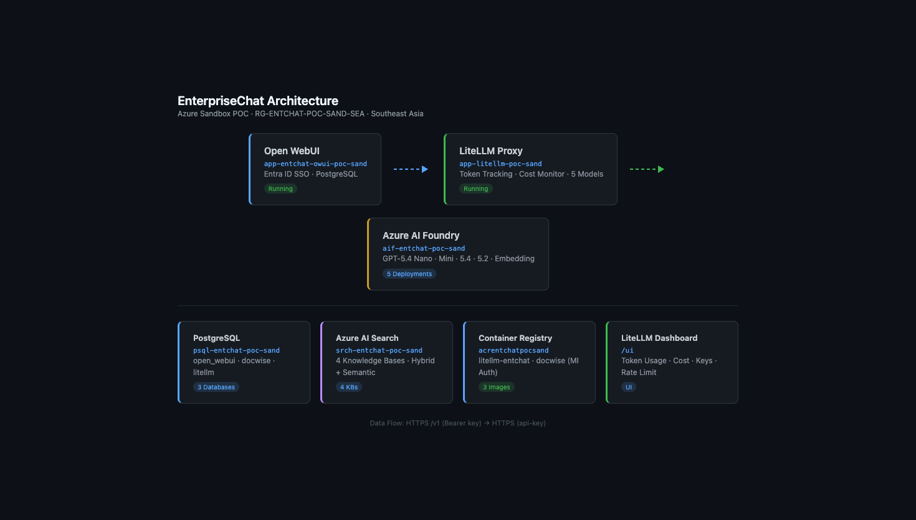
What is Genie?
Enterprise AI Chat — built on Open WebUI + LiteLLM + Azure AI Foundry
genie.haadthip.com → Open WebUI → LiteLLM Proxy → Azure AI Foundry (GPT-5.4)
Entra ID SSO (login with @haadthip.com) · 5 AI Models · 4 Knowledge Bases · Token Tracking

Slide 4
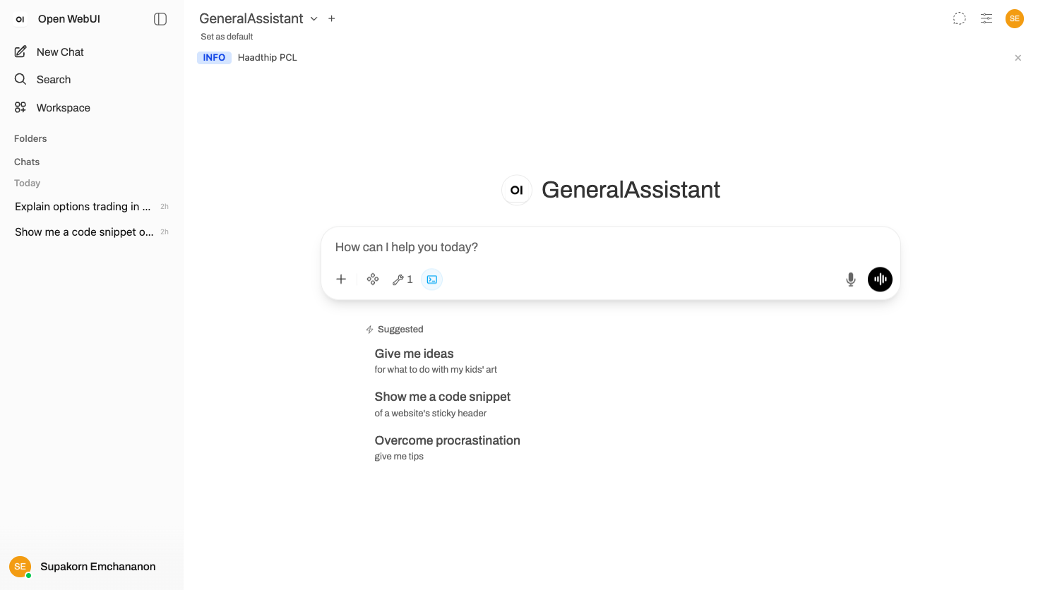
Getting Started
1
Go to genie.haadthip.com
Open any browser
2
Sign in with Microsoft
Use your @haadthip.com account
3
New Chat
Click "New Chat" or just start typing
4
Select Model
Dropdown top-left — pick GPT-5.4 model
5
Ask anything!
English or Thai — chat naturally
genie.haadthip.com

Slide 5
Knowledge Bases
4 Knowledge Bases — search company documents with AI-powered retrieval
Corporate Knowledge
haadthip-ks · 23 docs
MFA · VPN · Email O365 · Meeting Room · IT Policy · DLP
Type / → "Haadthip Knowledge"
SAP HIP Manuals
sap-docs-ks · 32 docs
Tcodes · Procedures · Branch Operations · Accounting
Type / → "SAP Knowledge"
Investor Relations
ir-docs-ks · 31 docs
Annual Report · Form 56-1 · Financial Data · MD&A · AGM
Type / → "IR Knowledge"
HR Knowledge
mihcm-hr-ks · ~20 docs
Leave · Benefits · Compensation · Work Rules · Policies
Type / → "HR Knowledge"
How: Type / in chat box → select Knowledge Base → ask your question in Thai or English

Slide 6
Tools & Functions
Built-in tools — model can choose which to call automatically (Agentic Mode)
🛫 E-Expense FAQ
🔧 How Tools Work
42 FAQ documents — ask about:
1. You ask: "MFA on Android?"
2. GPT decides: "Need to search KB"
3. Calls search tool → gets 3 docs
4. GPT reads docs → answers you
5. You see the answer + sources
• Travel Plans (แผนเดินทาง)
• Cash Advances (เบิกทดรองจ่าย)
• Expense Clearing (เคลียร์ค่าใช้จ่าย)
• Medical Claims (ค่ารักษาพยาบาล)
Just ask naturally: "ขออนุมัติเดินทางต่างประเทศ"
Available Tools
KB Search (4 corpuses) · E-Expense FAQ · Web Search · Code Interpreter · (more coming)
Token Tracking Filter
Every request & response is logged — tracks model, user, token count, and latency

Slide 7
Model Selection & Custom Prompts
Which Model Should I Use?
gpt-5.4-nano
$ Cheapest
Simple queries, KB planning, quick lookups
gpt-5.4-mini
$$ Balanced
General chat, everyday use, tools/agents
gpt-5.4
$$$ Best quality
Complex Thai, Pipe final answers, reasoning
gpt-5.2
$$ Legacy
Fallback compatibility
Custom System Prompts
Control how the AI behaves — tone, expertise, language, format
How to Set:
1. Settings → Models → click the pencil ✏️ next to a model
2. Scroll to "System Prompt" text box
3. Write your custom instructions (Thai or English)
4. Example: "คุณเป็นผู้ช่วยฝ่าย IT ของ Haadthip ตอบเป็นภาษาไทย สุภาพ กระชับ"
5. Save → start a new chat with that model → prompt is applied

Slide 8
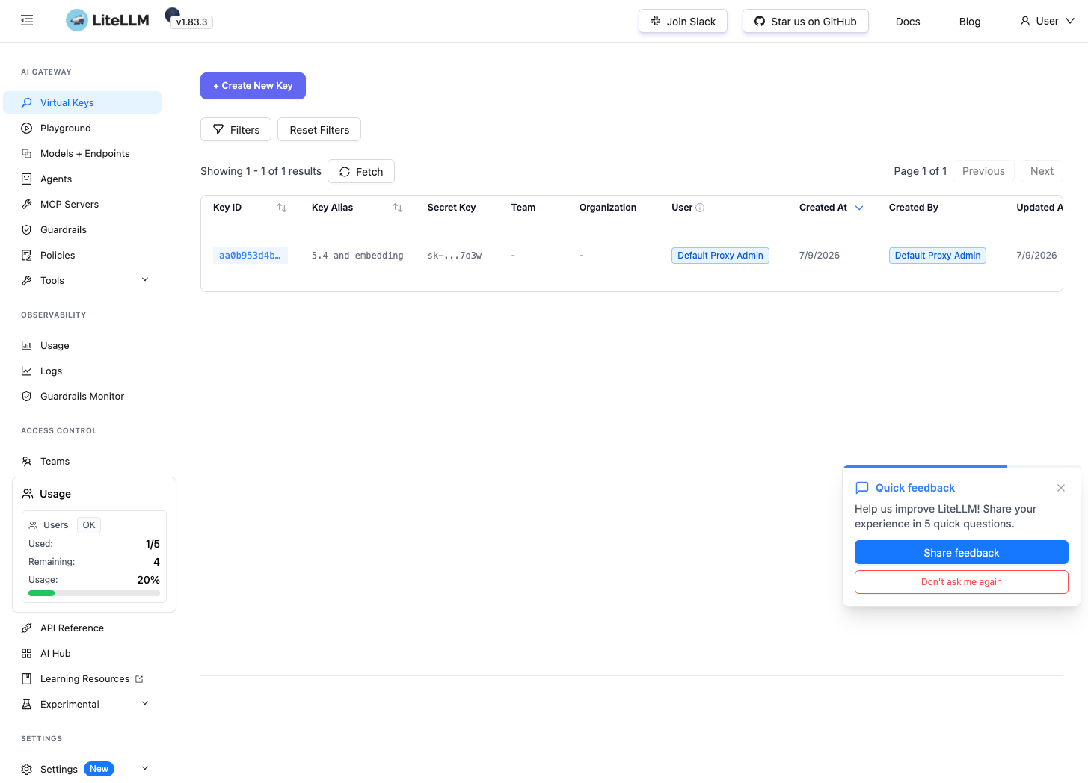
LiteLLM Dashboard
Token Usage
Track per user, model, team — real-time
Cost Monitoring
Budget limits, spend alerts, per-project
API Keys
Generate keys for dev tools & CI/CD
Audit Logs
Every request logged — who, what, when
Rate Limiting
Prevent API abuse, set per-user limits
Model Dashboard
5 models: Nano, Mini, 5.4, 5.2, Embedding
Dashboard: genie.haadthip.com/litellm/ui
Login: admin / Master Key · SSO with Entra ID coming soon

Slide 9
Integration — Connect from Anywhere
🌐 Web Browser (End Users)
genie.haadthip.com → Sign in with Microsoft → Start chatting. No installation. Works on mobile.
Auth: Entra ID SSO (OIDC) — auto signup for all @haadthip.com accounts
💻 Developer Tools & IDE
Continue.dev (VS Code)
OpenAI provider → URL: genie.haadthip.com/litellm/v1
Cursor / Windsurf
OpenAI-compatible endpoint → API key from LiteLLM
Claude Code / Gemini CLI
Set OPENAI_BASE_URL → genie.haadthip.com/litellm/v1
Custom Script / curl
POST /v1/chat/completions → Bearer your-api-key
🔑 How to Get an API Key
LiteLLM Dashboard → Keys → Create Key → Set budget & rate limit → Copy to your tool. Each key can be scoped per user/team with individual limits.
API Endpoint: genie.haadthip.com/litellm/v1

Slide 10
Key Numbers
5
4
3
1
AI Models
Knowledge Bases
Databases
SSO Provider
GPT-5.4 Nano → 5.4
Corporate · SAP · IR · HR
open_webui · docwise · litellm
Microsoft Entra ID
URLs & Access Points
Genie (Chat UI)
genie.haadthip.com
LiteLLM API
genie.haadthip.com/litellm/v1
LiteLLM Dashboard
genie.haadthip.com/litellm/ui

Slide 11
Resources & Community
Explore existing tools, functions, and prompts — install in 1 click or copy-paste
🌟 Official
🛠️ Community Tools
📝 Prompts
Community Hub
Haervwe/tools
Prompt Library
openwebui.com
Modular tools, pipes, filters
danielrosehill/OpenWebUI-Prompt-Library
Browse & 1-click import
Skyzi000/extensions
Sub Agent Tool
Model Index
Functions Repo
danielrosehill/Open-Web-UI-Model-Index
suurt8ll/functions
github.com/open-webui/functions
Gemini, Venice.ai pipes
Core-team curated
owndev/Functions
⚡ Install
Real-world pipelines
Plugin Docs
mplogas/open-webui
1-Click:
docs.openwebui.com/plugin
GitHub reader tools
openwebui.com → Find → Get
How to build your own
Manual:
bgeneto/functions
Copy .py → Workspace → Paste → Save
Community registry
All repos: github.com search "open-webui tools" or "open-webui functions"

Slide 12
Frequently Asked Questions
Q: ข้อมูลปลอดภัยไหม?
Azure Thailand (Southeast Asia), Private Endpoint, ทุกอย่างอยู่ภายใน Azure ของ Haadthip เท่านั้น
Q: AI เอาเอกสารบริษัทไป train ต่อไหม?
ไม่ — Azure OpenAI ไม่ใช้ข้อมูลลูกค้าเทรนโมเดล (Enterprise data protection)
Q: ใช้มือถือได้ไหม?
ได้ — Open WebUI responsive, เปิด browser มือถือเข้า genie.haadthip.com ได้เลย
Q: คนนอกเข้าได้ไหม?
ไม่ได้ — ต้องมี @haadthip.com account ผ่าน Microsoft Entra ID SSO เท่านั้น
Q: ถ้า AI ตอบผิด?
AI อาจ hallucinate — ตรวจสอบข้อมูลสำคัญกับต้นทางเสมอ. ทุกคำตอบระบุแหล่งที่มา
Q: เพิ่มเอกสารใหม่ยังไง?
ทีม IT อัปโหลดผ่าน ingestion pipeline → index ใน AI Search → ใช้ได้ทันที
Q: ดู token usage ได้ที่ไหน?
LiteLLM Dashboard (genie.haadthip.com/litellm/ui) หรือ Admin Panel ใน Open WebUI

Slide 13
Next Steps
→ Add pilot users to Internal User group
Thank You
→ Collect feedback: model quality, KB coverage
→ Setup budget limits per user/team
Questions & Feedback
→ Integrate with Continue.dev for developers
→ Add more Knowledge Bases as needed
→ Prepare production deployment plan
Quick Links
Genie Chat
genie.haadthip.com
LiteLLM Dashboard
genie.haadthip.com/litellm/ui
LiteLLM API
genie.haadthip.com/litellm/v1
Documentation
CONTEXT.md (internal)
EnterpriseChat POC · Haadthip PCL · Confidential

