Slide 1
Deadlock Handling
Lecture 22
Klara Nahrstedt

Slide 2
CS241 Administrative
Read Stallings Chapter 6 about Deadlock Handling
Regular Quiz 7 this week on Queuing and Deadlock Handling
Discussion Sessions this week (on Queuing and File Systems – needed for LMP1)
LMP1 (Long Machine Problem) starts today
    LMP1 is part of three major assignments (LMP1, LMP2, LMP3 which together will build distributed file system services)
    LMP1 will be split into two parts, PART I and overall LMP1 delivery.
    You will need to deliver PART I by Wednesday, March 28 and the final overall LMP1 will be due by April 2. For each delivery you will receive points.
    LMP1 quiz will be on April 2.
    The graders will provide some feedback on the Part I that should assist you in the overall LMP1 delivery.

Slide 3
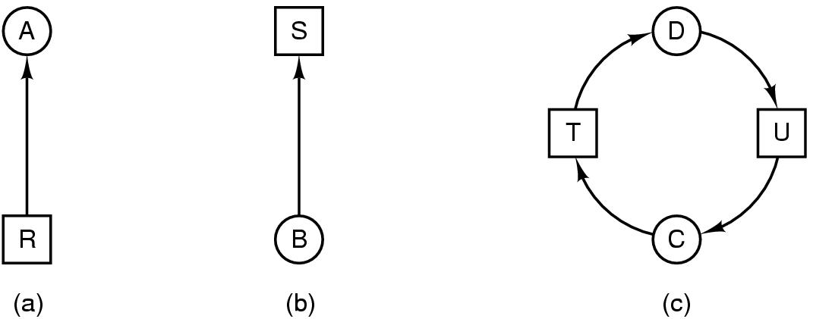
Review: Deadlock Modeling
Modeled with directed graphs
  resource R assigned to process A
  process B is requesting/waiting for resource S
  process C and D are in deadlock over resources T and U
assign
request

Slide 4
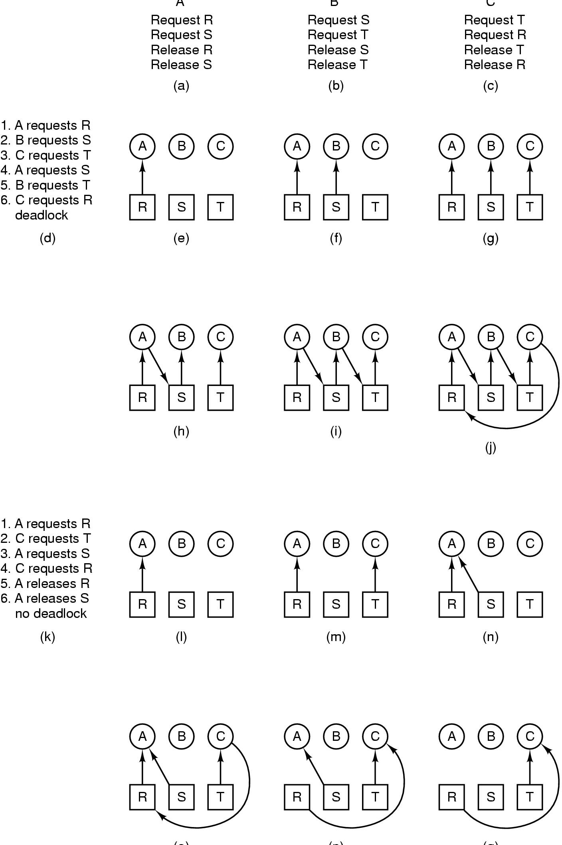
Deadlock Modeling
A B C
How deadlock occurs

Slide 5
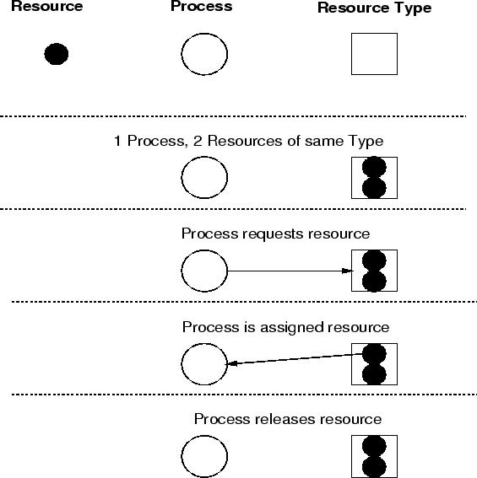
Resource Allocation Graph
(multiple resource types)

Slide 6
Strategies
Strategies for dealing with Deadlocks
  prevention
    negating one of the four necessary conditions
  dynamic avoidance
    careful resource allocation
  detection and recovery

Slide 7
Deadlock Prevention
Prevention: design a system in such a way that deadlocks cannot occur, at least with respect to serially reusable resources
Having rules so that a deadlock can NEVER happen

Slide 8
Deadlock Prevention:
Havender's Algorithms
If any one of the conditions for deadlock (with reusable resources) is denied, deadlock is impossible

Slide 9
Mutual Exclusion
We don't want to deny this; exclusive use of resources is an important feature. However, sometimes its possible---
  Virtual memory
  Virtual network connections
  Virtual disk
  Caches
  CPU preemption

Slide 10
Wait-for Condition
Force each process to request all required resources at once. It cannot proceed until all resources have been acquired

Slide 11
While did not get all resources
{
P(mutex)
Try to pick up all resources
if did not get all resources put resources back
V(mutex)
wait a while and try again
}
Use resources
P(mutex)
Release all resources
V(mutex

Slide 12
No Preemption Condition
If a process holding some reusable resources makes a further request which is denied, and it wishes to wait for the new resources to become available, it must release all resources currently held and, if necessary, request them again along with the new resources. Thus, resources are removed from a process holding them

Slide 13
while need a resource
{
P(mutex)
Test to see if resource is free
if free, grab resource else release all resources
V(mutex)
Wait a while and try again
}

Slide 14
Circular Wait Condition
All resource types are numbered
Processes must request resources in numerical order
if a resource of order N is held, the only resources which can be requested must be of order > N

Slide 15
Process 1
Process 2
Process 3
P(s1)
P(s2)
Work
V(s2)
V(s1)
P(s2)
P(s3)
Work
V(s3)
V(s2)
P(s1)
P(s3)
Work
V(s3)
V(s1)

Slide 16
Deadlock Avoidance
Avoidance: impose less stringent conditions than for prevention, allowing the possibility of deadlock, but sidestepping it as it approaches
Banker algorithm
  Each process provides the maximum number of resources for each type
  For each request, the system checks if granting this request may lead to a deadlock in the worse case
    If yes, not granting the request
    If no, granting the request

Slide 17
Deadlock Avoidance
The system needs to know the resource ahead of time
Banker Algorithm (Dijkstra, 1965)
  Each customer tells banker the maximum number of resources it needs
  Customer borrows resources from banker
  Customer returns resources to banker
  Customer eventually pays back loan
  Banker only lends resources if the system will be in a safe state after the loan
Safe state - there is a lending sequence such that all customers can take out a loan
Unsafe state - there is a possibility of deadlock

Slide 18
Safe State and Unsafe State
Safe State
  there is some scheduling order in which every process can run to completion even if all of them suddenly request their maximum number of resources immediately
  From safe state, the system can guarantee that all processes will finish
Unsafe state: no such guarantee
  Not deadlocked state
  Some process may be able to complete

Slide 19
Example (Safe Sequence)
Res. Alloc Max Need Available (Banker)
Processes | A B | A B | A B | A B
---------------------------------------------------------------------------------------------------------------------
P1 3 0 5 3 2 3 6 5
P2 2 2 6 5 4 3
P3 1 3 9 8 8 5
P4 0 5 8 5 8 0
Sequence:
P1 can go (borrows from Banker A(2) and B(3), since Need.A(2) is less than Available A(6) and Need.B(3) < Available.B(5). After lending, Available will be A(4), B(2)). After P1 finishes it releases Allocated Resources A(3) and B(0) to the banker, and so the banker will have A(8) = A(6) + A(3) and B(5)=B(5)+B(0) available
P2 can go (borrows from Banker A(4) and B(3)). After P2 finishes it releases the allocated resource A(1) and B(3) to the banker and available will be A(11), B(7)
P3 can go (borrows from Banker A(8) and B(5), since Need.A(8) < Available.A(11) and Need.B(5) < Available.B(7)). After P3 finishes, it releases the allocated resources to the banker and Available resources will be A(12) = A(11) + A(1) and B(10)=B(7+B(3)
P4 can go because P4 can borrow from Banker Need.A(8) < Available.A(12) and Need.B(0)<Available.B(10). After P4 finishes, the resources are released, and Banker will have available A(12) and B(15)
Hence, there exists a safe sequence with this snapshot of resources and processes. The safe sequence is P1, P2, P3, P4

Slide 20
Example (Unsafe State) – let’s assume Max/Need changes for the processes
Res. Alloc Max Need Available (Banker)
Processes | A B | A B | A B | A B
-----------------------------------------------------------------------------------------------------
P1 3 0 5 6 2 6 6 5
P2 2 2 9 5 7 3
P3 1 3 9 8 8 5
P4 0 5 8 5 8 0
Sequence:
P1 can’t go because Need.B(6) > Available.B(5)
P2 can’t go because Need.A(7) > Available.A(6)
P3 can’t go because Need.A(8) > Available.A(6)
P4 can’t go because Need.A(8) > Available.A(6)
Hence, there is no safe sequence and this is snapshot is in “unsafe” state

Slide 21
Deadlock Detection
Detection: in a system that allows the possibility of deadlock, determine if deadlock has occurred, and which processes and resources are involved
Check to see if a deadlock has occurred!
Single resource per type
  Can use wait-for graph
  Check for cycles
  O(n²)

Slide 22
Wait for Graphs
Resource Allocation Graph
Corresponding Wait For Graph

Slide 23
Deadlock Recovery
Recovery: after a deadlock has been detected, clear the problem, allowing the deadlocked processes to complete and the resources to be reused
How? (Hint: traffic deadlock)

Slide 24
Recovery From Deadlock
OPTIONS:
  Kill deadlocked processes and release resources
  Kill one deadlocked process at a time and release its resources
  Rollback all or one of the processes to a checkpoint that occurred before they requested any resources
Note: with rollback, difficult to prevent indefinite postponement

Slide 25

The Ostrich Algorithm
Guess: what is implemented in Linux?
Don’t do anything, simply restart the system (stick your head into the sand, pretend there is no problem at all).
Rational:
  make the common path faster and more reliable
  Deadlock prevention, avoidance or detection/recovery algorithms are expensive
  if deadlock occurs only rarely, it is not worth the overhead to implement any of these algorithms.

Slide 26
Summary
Deadlock issues
Deadlock Prevention - Havendar’s Algorithms
Deadlock Avoidance – Banker Algorithm
Deadlock Detection – Wait-For-Graphs
Deadlock Recovery

