Slide 1
Disney+HotStar Data Analysis
Suparna
MB30

Slide 2
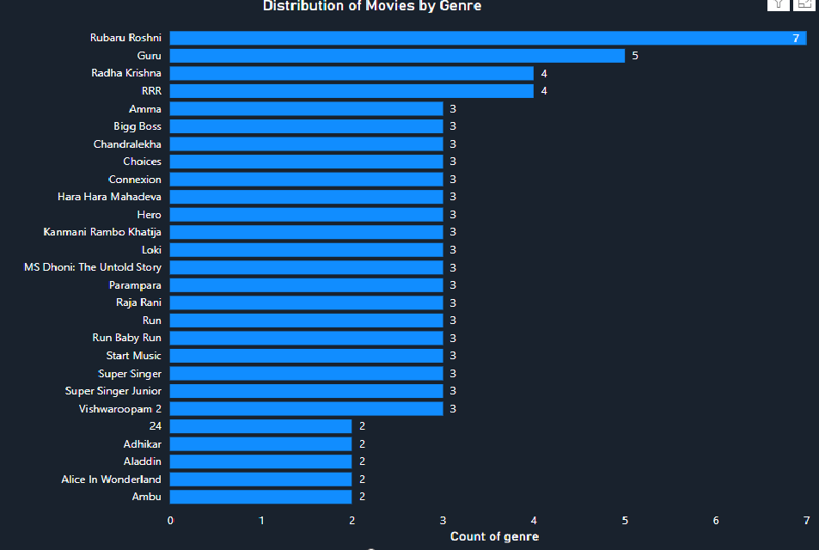
1. Data Visualization and Storytelling
This slide emphasizes the importance of visually representing data in a way that is both engaging and informative. It focuses on how data visualization can transform complex datasets into easy-to-understand visuals, making it easier to derive insights and tell a compelling story.
Purpose:
To highlight the ability to present data in a structured and visually appealing manner to communicate trends, patterns, and insights effectively.
Creating a bar chart showing the distribution of movies by genre to quickly identify popular genres.

Slide 3
2.Data Cleaning and Preprocessing
Prepare data for accurate and reliable analysis.
1
Key Steps:
2
Handle Missing Data:
Fill or remove missing values.
Correct Inconsistencies:
3
Standardize formats (e.g., dates, labels).
Remove Duplicates: Ensure unique and accurate records.
Transform Data: Extract or reorganize data for better usability.
4

Slide 4

3. Exploratory Data Analysis (EDA)
This slide introduces the concept of exploring data to uncover patterns, trends, and relationships before detailed analysis. EDA helps to get a better understanding of the dataset and guides further steps in the project.
To analyze and summarize the dataset's key characteristics using visuals and basic statistics.
Steps:
Understand the Data: Review the dataset's structure and content.
Example: Look at columns like genre, release year, and running time.
Identify Patterns: Spot trends and relationships between variables.
Example: Check if certain genres are more common in specific years.
Detect Outliers: Find unusual values that may affect analysis.
Example: A movie with an abnormally long running time.
Visualize Data: Use charts and graphs to make insights clearer.
Example: Create a bar chart to show the number of movies by genre.
Outcome: EDA provides a solid foundation to build meaningful visualizations and insights.

Slide 5

4. Using Power BI for Visualizations
This slide focuses on the tools used to create impactful and interactive visualizations, making data insights easy to understand.
Use visualization tool Power BI to represent data clearly and interactively.
Features of Tools:
Customizable Charts: Bar charts, line graphs, scatter plots, and more.
Example: Create a bar chart to show movie counts by genre.
Interactive Dashboards: Allow users to filter and explore data easily.
Example: Filter by age rating to see trends for family movies.
Data Linking: Combine multiple datasets for deeper insights.
Example: Link movie genres with viewer ratings to find correlations.
Automation: Automatically update visualizations when data changes.
Tools like Tableau/Power BI make it easier to identify patterns, share insights, and make informed decisions visually.

Slide 6

5.Analytical Thinking and Deriving Insights
This slide highlights how analytical thinking helps interpret data and extract meaningful insights for decision-making.
Purpose of this : Analyze visualized data to uncover trends, relationships, and actionable insights.
Steps:
Ask Questions:
Example: Why are certain genres more popular than others?
Identify Trends:
Example: Notice that action movies are released more often during summer.
Compare Metrics:
Example: Compare average running times for different genres to find patterns.
Make Data-Driven Recommendations:
Example: Suggest creating more family-friendly movies if age rating analysis shows demand.
Analytical thinking bridges the gap between raw data and meaningful strategies, enabling smarter decisions in content planning and marketing.

Slide 7

6. Media and Entertainment Domain
This slide provides context about the media and entertainment industry, highlighting its relevance to the analysis.
Overview :
The media and entertainment industry includes streaming platforms, movies, TV shows, and more.
It’s driven by data to understand audience preferences and deliver engaging content.
Relevance to the Project:
Streaming Platforms:
Platforms like Disney+Hotstar use data to recommend movies and optimize user experience.
Example: Analyzing popular genres helps decide what content to acquire or produce.
Content Trends:
Understanding historical trends aids in forecasting audience demands.
Example: Identifying that family movies see higher views during holidays.
Audience Insights:
Age ratings and preferences help target specific demographics effectively.
Analyzing data in this domain supports better content strategies, audience engagement, and marketing decisions.

Slide 8

7.Dataset Overview
This slide introduces the dataset used in the analysis, providing an understanding of its structure and contents.
The purpose of this Dataset is to explore movie trends, audience preferences, and historical insights
Key Points for Analysis:
Genre: For identifying the most popular genres.(e.g., Action, Drama, Comedy)
Running Time: To understand average and extreme durations.(e.g., Movie durations in minutes)
Release Year: To analyze trends over time.(e.g., Year of the movie release.)
Age Rating: To segment movies by audience suitability.(e.g., Categories like PG, R, etc)
This dataset serves as the foundation for uncovering valuable insights into movie trends and audience preferences.

Slide 9

8.Problem Statement
The project aims to analyze a movie dataset to uncover trends and insights.
Questions:
Which genres are most popular?
What are the average and typical running times?
How has movie production changed over the years?
How do age ratings vary by genre?
Use of Problem Statement:
Help Disney+Hotstar improve content strategy.
Align movie production with audience preferences.

Slide 10

9. Business Use Cases
This slide highlights how the analysis can be applied in real-world scenarios to drive business decisions.
1. Content Strategy:
Identify trending genres to plan new content.
Example: If action movies are popular, prioritize acquiring or producing more action content.
2. Audience Segmentation:
Use age ratings and running times to tailor recommendations.
Example: Recommend family-friendly movies to parents and animated movies to kids.
3. Marketing Campaigns:
Leverage trends in movie releases and popular genres for targeted campaigns.
Example: Promote comedies heavily during festive seasons.
4. Historical Analysis:
Analyze past data to predict future trends and inform production decisions.
Example: If dramas showed consistent popularity over a decade, focus on creating similar content.
These use cases show how data insights can enhance decision-making, improve user experience, and drive engagement on Disney+Hotstar.

Slide 11
10. Approach
This slide outlines the step-by-step methodology used in the project, providing clarity on how the analysis was conducted.
1. Data Loading:
Imported the dataset into Power BI for visualization and analysis.
2. Data Cleaning:
Addressed missing or inconsistent values to ensure accuracy.
Example: Deleting the missing columns like episodes/durations.
3. Data Visualization:
Created charts like bar, line, and scatter plots to analyze trends and patterns.
Example: A bar chart showing the count of movies by genre.
4. Exploratory Data Analysis (EDA):
Explored data relationships, distributions, and trends.
Example: Analyzed how running times vary across genres.
5. Documentation:
Summarized findings and insights in an easy-to-understand format using dashboards and reports.
Purpose:
This structured approach ensures that the analysis is comprehensive, accurate, and actionable for business use.

Slide 12

11. Key Findings
This slide summarizes the most important insights derived from the analysis.
1. Popular Genres:
Identified the genres with the highest number of movies.
Example: Action and drama are the top genres.
2. Running Time Trends:
Analyzed the average running time and its variation by genre.
Example: Documentaries are generally shorter than feature films.
3. Yearly Trends:
Observed the number of movies released each year.
Example: A surge in releases was noted during specific periods.
4. Audience Preferences:
Distribution of movies by age ratings shows preferences among audience segments.
Example: A high number of PG-rated movies indicate family-friendly content is a focus.
The findings provide actionable insights for improving content strategies, tailoring recommendations,
and targeting specific audience groups effectively.

Slide 13
12. Final Results
This slide emphasizes the final outcomes of the project and their significance.
1. Visual Insights:
Created clear, interactive visualizations such as bar charts, line graphs, scatter plots.
Example: A bar chart showing the most popular genres.
2. Data-Driven Understanding:
Provided insights into movie distribution by genre, running time, release year, and age ratings.
Example: Identified the most common running time for movies.
3. Trend Analysis:
Highlighted patterns like the rise of specific genres over time.
Example: Growth in demand for animated movies in recent years.
4. Business Insights:
Delivered actionable insights to aid in content strategy, audience segmentation, and marketing efforts.
Example: Targeting campaigns for family-friendly content based on PG movie trends.
The results showcase how analysis can provide valuable guidance for decision-making and strategy development at Disney+Hotstar.

Slide 14
THANK YOU

