Slide 1
Work & Responsibility

Slide 2
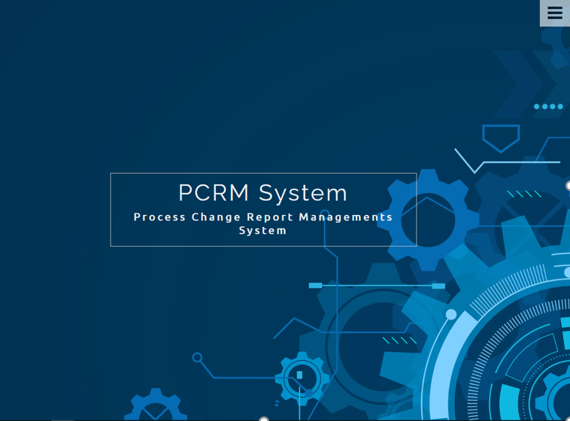
Work & Responsibility(Support)
1
Development Process Change Report System (PCR)
2
Check finger scan (Support)
3
Support MHRD exam (Support)
3

Slide 3

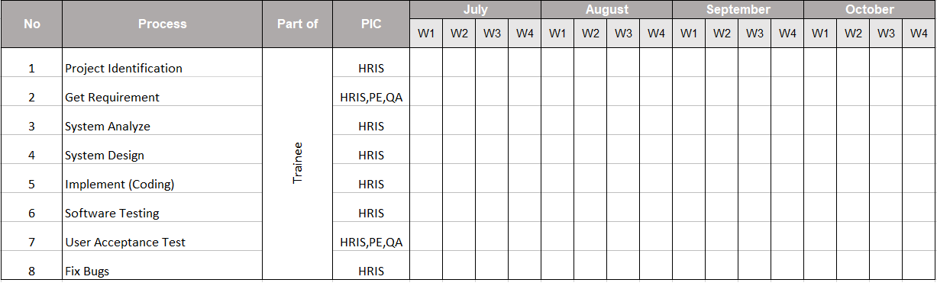
Action Plan
Plan
Process
Analyze System
Design
Get requirements
Analyze requirements
Design mock up of system
Confirm mock up with user
AUG
OCT
JUL
Analyze System
SEP
Implements
Analyze requirements
Design diagram
Confirm requirements
Coding PCR system in phase 1
Test System & Demo System
Presentation PCR System

Slide 4

What is PCR System ?
Process Change Report (PCR) system which records changes.
The work processes of each department within the company and information
management.

Slide 5













What Problems ?
01
ปัญหาเกี่ยวกับกระบวนในการจัดเก็บข้อมูลของเอกสาร PCR
02
ปัญหาเกี่ยวกับการออกเอกสาร PCR ที่ยุ่งยาก และใช้เวลานาน
03
ปัญหาเกี่ยวการใช้ทรัพยากรที่มีจำนวนมาก เช่น กระดาษ เป็นต้น

Slide 6
Work & Responsibility
Analyze PCR System
Storage
Access
Design : PCR System
Storage
Access
Manage role all
Implement : PCR System
Edit PCR form
Approve User Register
Manage role all
Kittiya Yangso

Slide 7
Work & Responsibility
Analyze PCR System
Form
Design : PCR System
PCR ,QAP, BKD Form
Annual Plan Form
Manage role QA
Implement : PCR System
Create PCR form
Manage role QA
Kanyarat Rodtong
- Approve departments
- setting role QA
- PCR List

Slide 8
Work & Responsibility
Analyze PCR System
- Work Flow
Design : PCR System
Work Flow
Cancel PCR form
Implements : PCR System
Cancel PCR form
View PCR form
Manage Annual Plan
Approver Department
Supatchai Kamaporn
Manage Annual Plan
View PCR form

Slide 9
Introduction & Process

Slide 10
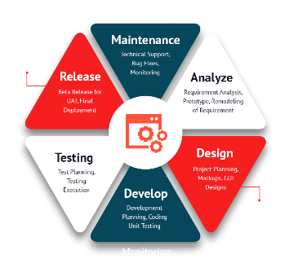








Tool
SDLC is a process followed for a software project, within a software organization.
Software Development
Life Cycle (SDLC)
Notepad ++
Draw.io
Microsoft PowerPoint
Microsoft Word
phpMyAdmin
language

Slide 11
Analyze System
01
02
03
FORM
WORK FLOW
STORAGE & ACCESS

Slide 12
Analyze System
WORKFLOW
Analyze Workflow
Old Work Flow
People involved in the work Flow
01
Old Work Flow
02
People involved in the work Flow
03
Problems Work Flow

Slide 13
Old Work Flow
Plan
Result
Input change point
details and schedule
Input Evaluation result
Check
PE
PE
Check
Approve
Approve
Approve
PD
PD
Approve
No
If rank => C2
Check
Yes
Input Planning review result
QAP
QAC
Approve 1
Input cleanliness check
requirement
BKD
Approve 2
Check
Acknowledge and distribute
Approve 1
QAC
Alert to owner and share
to concern person
Approve 2
Alert to owner + share
to concern person
Process change
request finished

Slide 14









Analyze System
WORK FLOW
จากการวิเคราะห์ Old Work Flow พบปัญหาคือ
ปัญหาในการแจ้งเตือนการอนุมัติซึ่งก็ให้เกิดการล้าช้าในการเปลี่ยนแปลงกระบวนการทำงาน
ปัญหาในการใช้งานที่ยังไม่ครอบคุมต่อการเปลี่ยนแปลงกระบวนการทำงานจากผู้ใช้งานในส่วนอื่นๆ
01
Old Work Flow
Department Other
Department Other
02
People involved in the work Flow
03
Problems Work Flow
PE,QA
PCR

Slide 15
New Work Flow
Plan
Result
Input change point
details and schedule
Input Evaluation result
And selected approver
Creator
Creator
Reject
Reject
Creator Select Checker
Maximum 5 checker
PE
Creator Select Checker
Maximum 5 checker
Check
Approver
Department
PE
Check
Approver
Department
Reject
Approve
Reject
Approve 1
Reject
Acknowledge Approver
Approve
PD
No
PD
Reject
Approve 2
Acknowledge Approver
If rank => C2
โดยทุกๆการอนุมัติจะมีการแจ้งเตือนส่งไปหาคนถัดไปเสมอ
Yes
Input Planning review result
QAP
Reject
QAC
Approve
Input cleanliness check
requirement
BKD
Setting By QA Admin
Reject
Approve
QAC
Setting By QA Admin
Alert to owner and share
to concern person
Alert to owner + share
to concern person
Process change
request finished

Slide 16
New Work Flow
Plan
Result
Input change point
details and schedule
Input Evaluation result
And selected approver
Creator
Creator
Reject
Reject
Check
Check
Approver
Department
Reject
Approver
Department
Approve
Reject
Approve 1
Reject
Approve
No
Reject
Approve 2
Acknowledge Approver
Acknowledge Approver
If rank => C2
Yes
Input Planning review result
QAP
Reject
QAC
Approve
Input cleanliness check
requirement
BKD
Reject
Approve
QAC
Alert to owner and share
to concern person
Alert to owner + share
to concern person
Process change
request finished

Slide 17
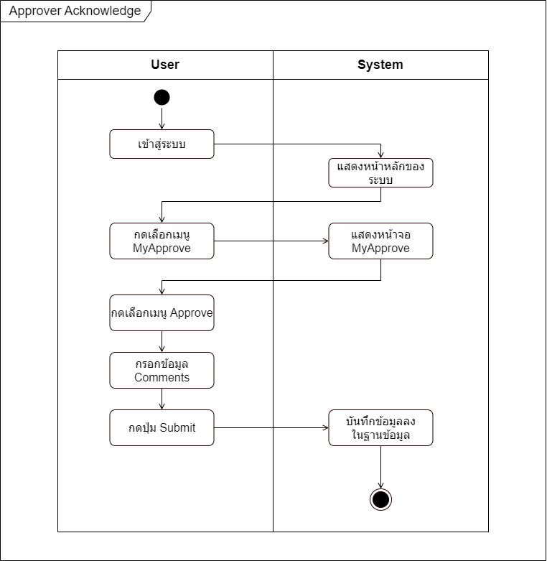
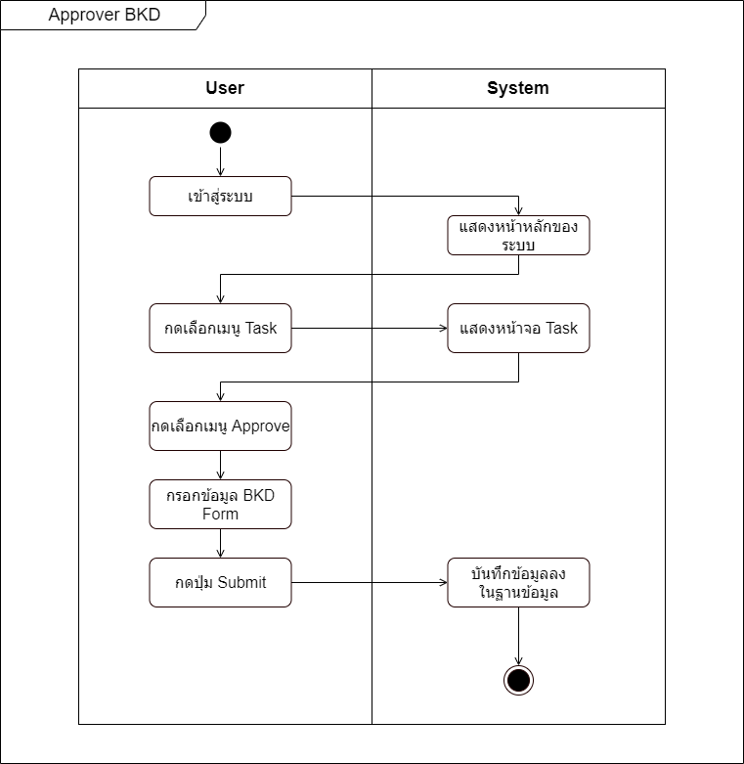

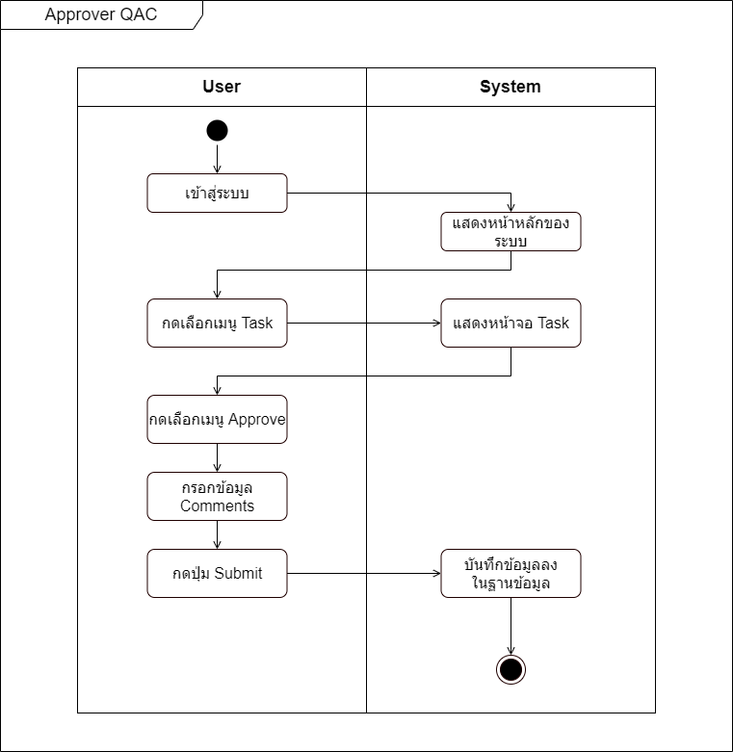

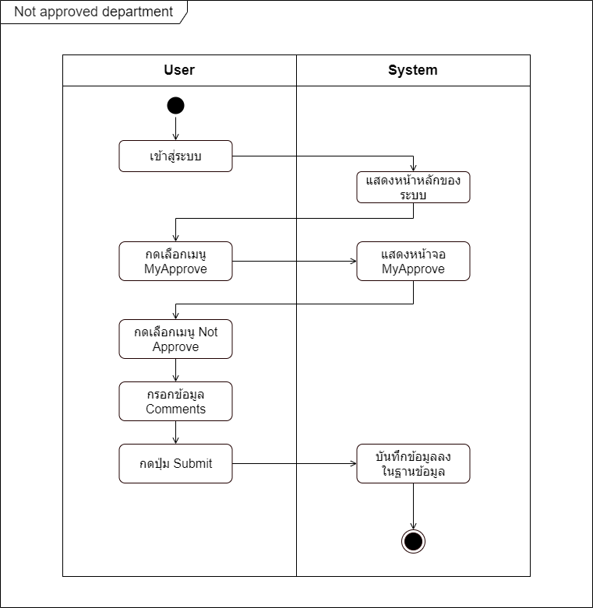


Activity Diagram
WORK FLOW

Slide 18
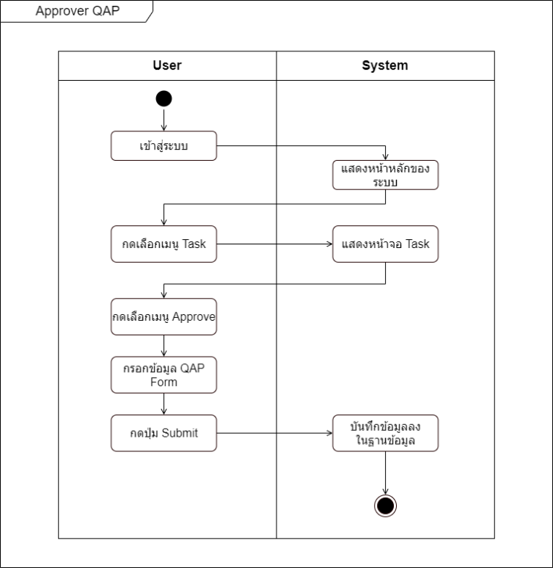
Activity Diagram
WORK FLOW

Slide 19
Activity Diagram
WORK FLOW

Slide 20
Activity Diagram
WORK FLOW

Slide 21
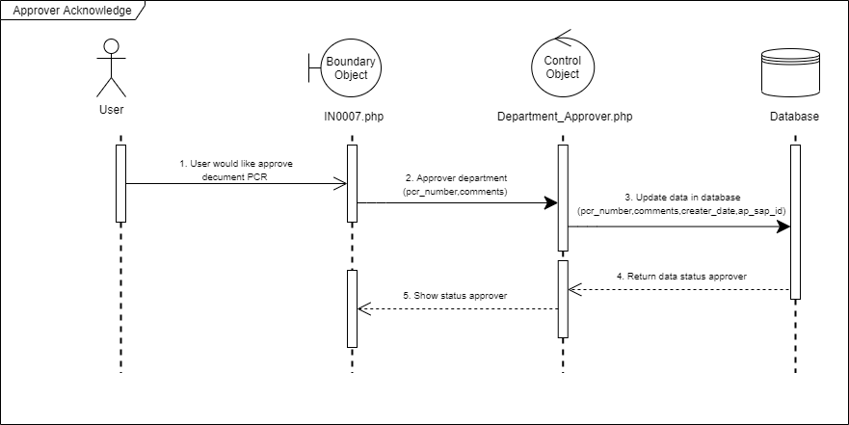
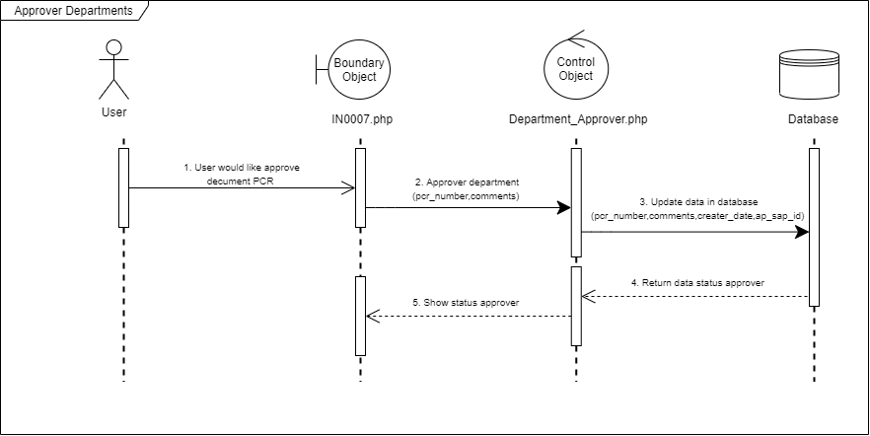
Sequence Diagram
WORK FLOW

