Slide 1

Log In

Slide 2

Log In
Welcome
Log In
ID Employee :
xxxxxxxxx
Password :
xxxxxxxxx
Remember me
Forgot Password / ID Employee ?
Submit

Slide 3

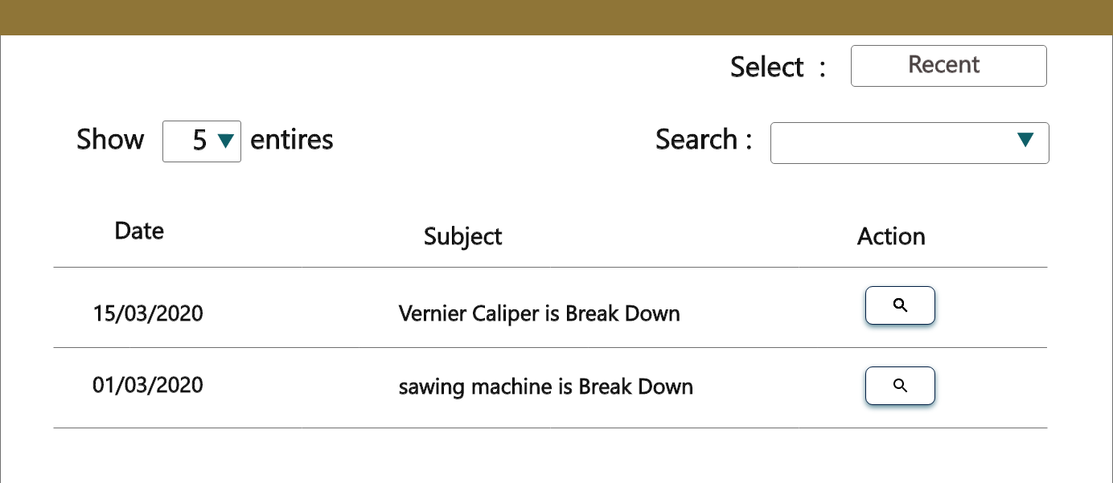
Process Change Report System
Change Process
Approval
Report
Change Process
Change Process

Slide 4

Process Change Report System
Change Process
Approval
Report
Status = User
Change Process
Name : Supatchai kamaporn
Change Process
Position : Trainee
Division : PE
Log out

Slide 5
Process Change Report System
Change Process
Approval
Report
Change Process
Change Process

Slide 6
Process Change Report System
Change Process
Approval
Report
Change Process
Change Process

Slide 7
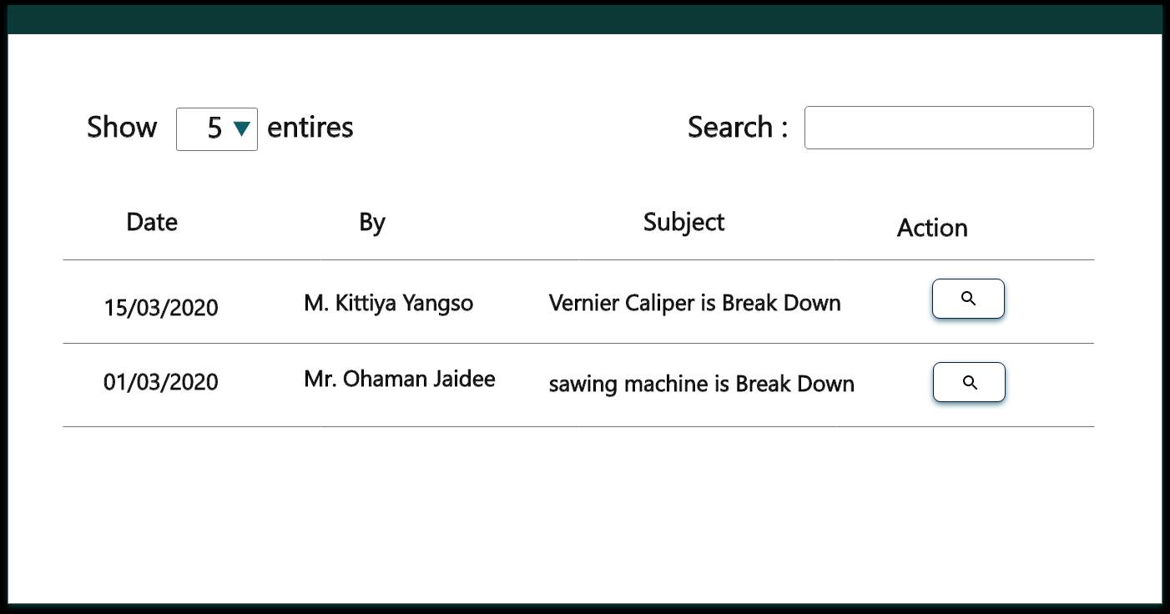
Process Change Report System
Change Process
Approval
Report
Approval

Slide 8


Process Change Report System
Change Process
Approval
Report
Approval
Issue No. 111
Annual plan no. 21
Change Type : New
Part name : Vernier Caliper
Checking Point : modify machine
Part number : 2365
Checking Point : modify machine
Subject : Vernier Break Down
Reason : Break Down
Process : Inspection

Slide 9
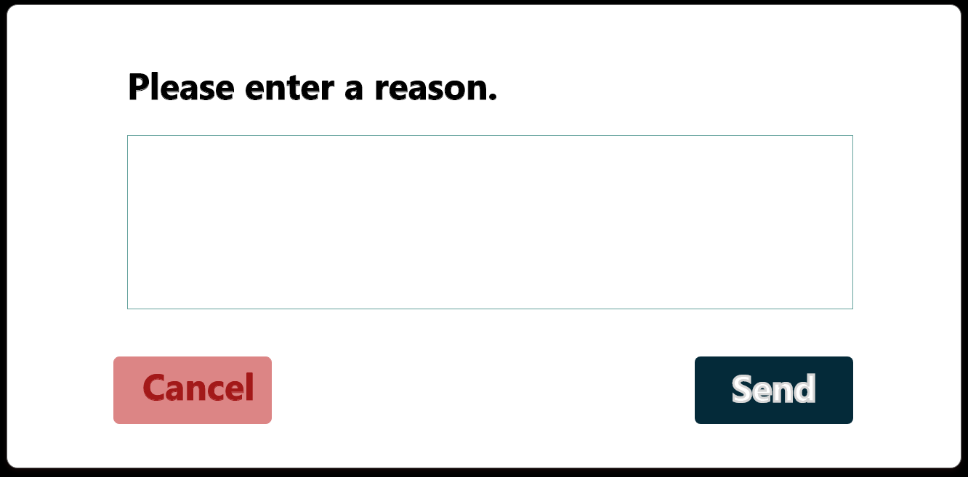
Process Change Report System
Change Process
Approval
Report
Process Change Report
Issue No. 111
Annual plan no. 21
Change Type : New
Part name : Vernier Caliper
Checking Point : modify machine
Part number : 2365
Checking Point : modify machine
Subject : Vernier Break Down
Reason : Break Down
Process : Inspection

Slide 10
Process Change Report System
Change Process
Approval
Report
Process Change Report
Issue No. 111
Annual plan no. 21
Change Type : New
Part name : Vernier Caliper
Checking Point : modify machine
Part number : 2365
Checking Point : modify machine
Subject : Vernier Break Down
Reason : Break Down
Process : Inspection

Slide 11


Process Change Report System
Change Process
Approval
Report
Please select a department
Please select year
Report
No. | Number Change | Subject | Date start | Date finished
1 | xxxxxxxx | xxxxxxxx | 20/10/2020 | 25/10/2020
2 | xxxxxxxx | xxxxxxxx | 20/10/2020 | 25/10/2020
3 | xxxxxxxx | xxxxxxxx | 20/10/2020 | 25/10/2020
4 | xxxxxxxx | xxxxxxxx | 20/10/2020 | 25/10/2020

Slide 12


Process Change Report System
Change Process
Approval
Report
Report
5 | xxxxxxxx | xxxxxxxx | 19/10/2020 | 25/10/2020
6 | xxxxxxxx | xxxxxxxx | 19/10/2020 | 25/10/2020
7 | xxxxxxxx | xxxxxxxx | 19/10/2020 | 25/10/2020
8 | xxxxxxxx | xxxxxxxx | 19/10/2020 | 25/10/2020
9 | xxxxxxxx | xxxxxxxx | 19/10/2020 | 25/10/2020
10 | xxxxxxxx | xxxxxxxx | 19/10/2020 | 25/10/2020

Slide 13
Process Change Report System
Change Process
Approval
Report

Slide 14
Process Change Report System
Change Process
Approval
Report

Slide 15
Process Change Report System

Slide 16
Process Change Report System

Slide 17
Process Change Report System

Slide 18
Process Change Report System

Slide 19
Process Change Report System

