Slide 1
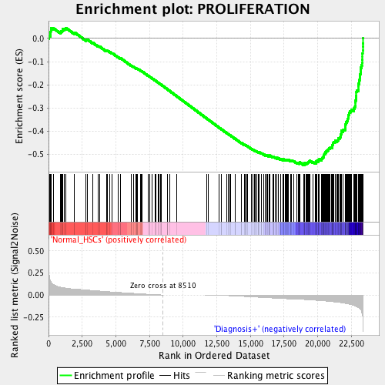
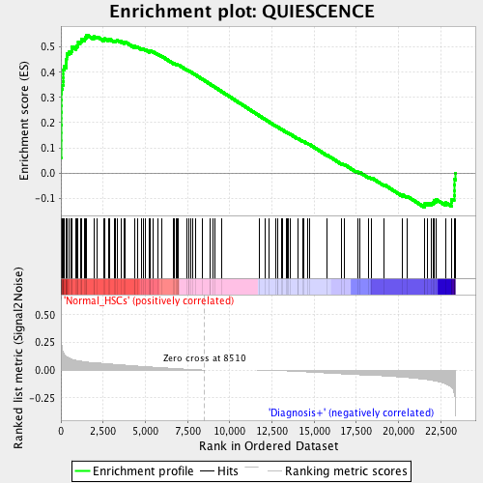
Proliferation
Normal HSC
BCR-ABL+
NES -2.03, p-value 0.0, FDR q-value 0.0020
Quiescence
Normal HSC
BCR-ABL+
NES 2.096, p-value 0.0, FDR q-value 0.0

