Slide 1
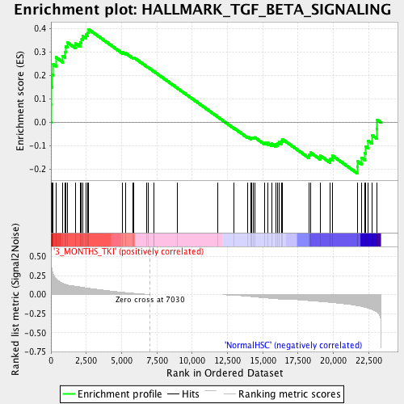
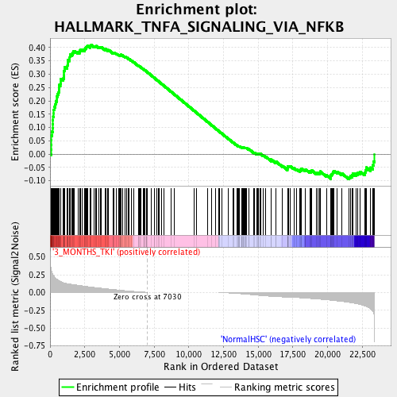
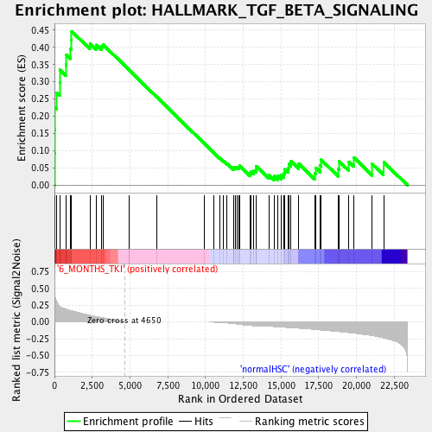
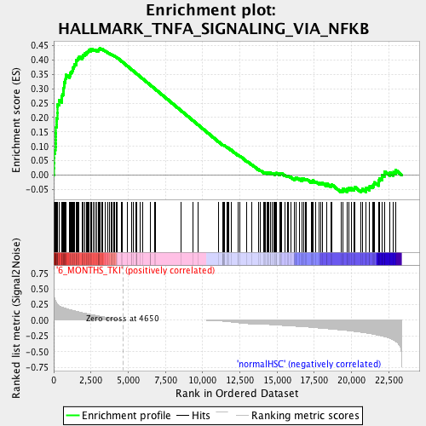
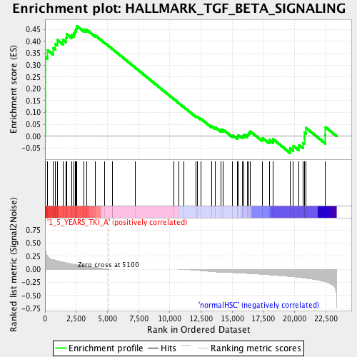
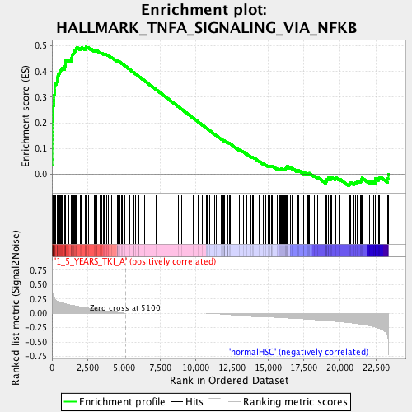
TGF BETA SIGNALING
TNFA SIGNALING VIA NFKB
3 months TKI
Normal HSC
Normal HSC
Remission class A
Remission class A
NES 1.34; p-value 0.033; FDR q-value 0.14
NES 1.57; p-value 0.0; FDR q-value 0.044
6 months TKI
Normal HSC
Normal HSC
Remission class A
Remission class A
NES 1.51; p-value 0.004; FDR q-value 0.022
NES 1.66; p-value 0.0; FDR q-value 0.014
≥1 year TKI
Normal HSC
Normal HSC
Remission class A
Remission class A
NES 1.60; p-value 0.0; FDR q-value 0.016
NES 1.82; p-value 0.0; FDR q-value 0.0038

