Slide 1
EDA on Art Sales
Findings and Insights
Naresh Chandran B

Slide 2
Executive Summary
What affects the price of an art piece?
With increasing age, the price of an art piece seems to decrease
This may be due to increase in insurance price for the same
For established artists, critics’ ratings doesn’t seem to directly impact price
However, very low ratings can be detrimental to sales
Online auctions fetch higher prices
This behavior is consistent across categories and artists
Do most artists specialize with one type of brush style or art style?
The quality of art (measured by critic ratings) does not show significant variation across brush types
Which are the auction houses that give value for money ?
16% of Sotheby’s transactions have been rated as a good buy
What is the geographical distribution of the US art sales?
Texas has the highest trade volume
New Hampshire has the highest average price

Slide 3
With increasing age, the price of an art piece seems to decrease
What affects the price of an art piece ?
2012
2013
Findings
With increasing age, the price of an art piece seems to decrease
This could be due to increasing maintenance costs like insurance cost
Note: Based on US art sales data of 2012 and 2013

Slide 4
For established artists, critics’ ratings doesn’t seem to directly impact price
What affects the price of an art piece ?
MF Hussain
Pablo
Rembrandt
Findings
For established artists, critics’ ratings doesn’t seem to directly impact price
However, very low ratings can have a detrimental effect
Note: Based on US art sales data of 2012 and 2013

Slide 5
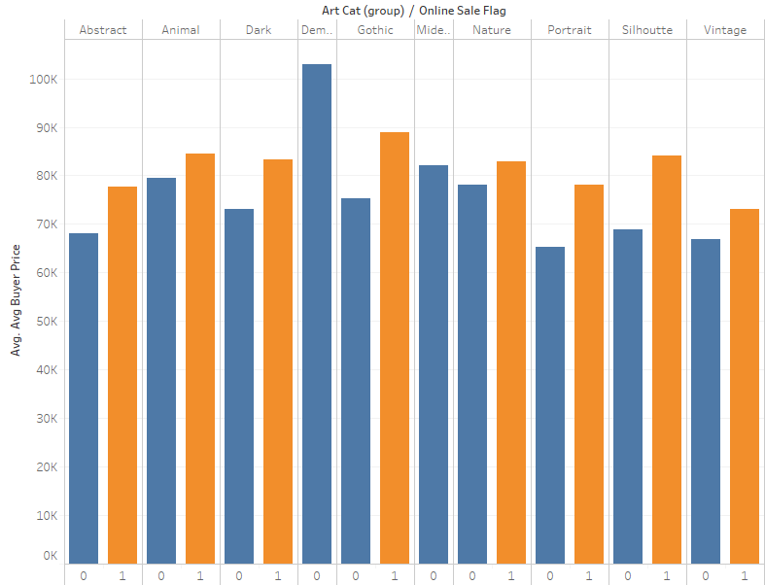
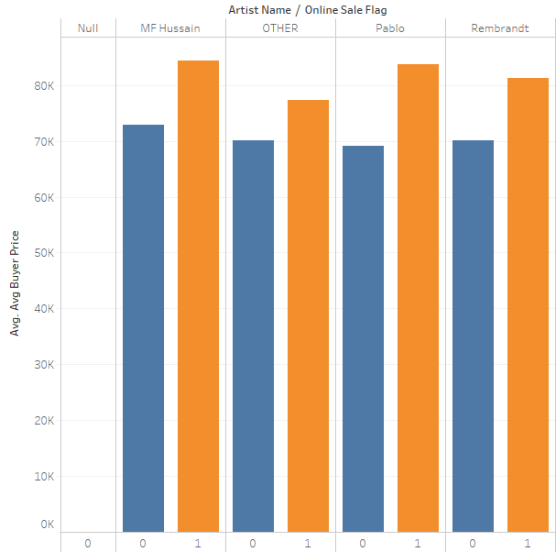
Online auctions fetch higher prices
What affects the price of an art piece ?
Offline
Online
Findings
Online Auctions fetch higher prices
This behavior is consistent across all art categories and artists
Note: Based on US art sales data of 2012 and 2013

Slide 6
The quality of art does not show significant variation across brush types for recognized artists
Do most artists specialize with one type of brush style?
MF Hussain
Pablo
Rembrandt
Findings
The quality of art (measured by critic ratings) does not show significant variation across brush types
Note: Based on US art sales data of 2012 and 2013 | Critics ratings have been reversed for ease of visualization : 1 is lowest and 12 is highest

Slide 7
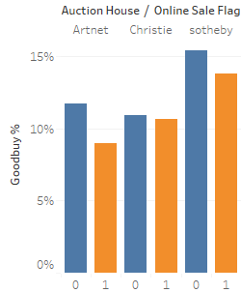
Sotheby offers high value for money
Which are the auction houses that give value for money ?
Findings
Sotheby has a higher proportion of good buys (approx., 16%) amongst the 3 houses
Note: Based on US art sales data of 2012 and 2013

Slide 8
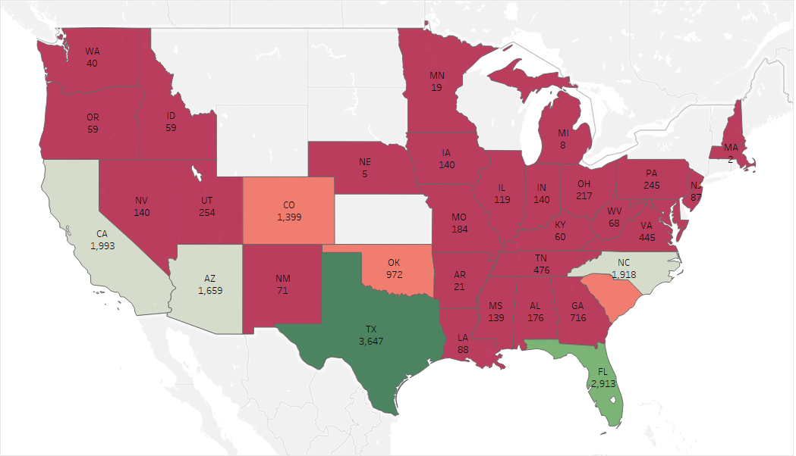
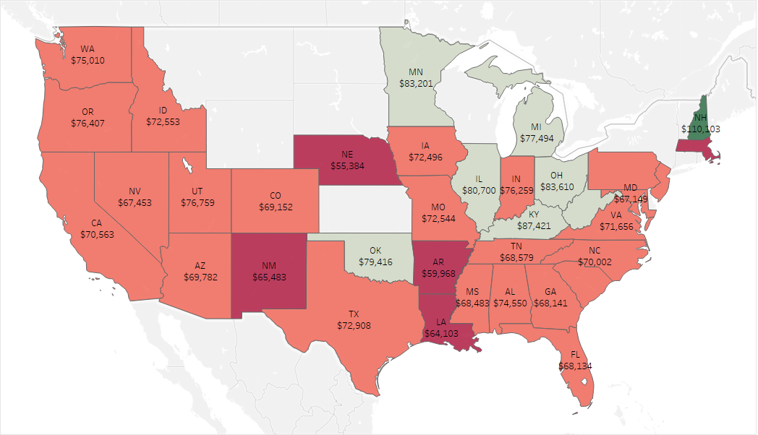
Texas has the highest trade volume, accounting for over 18% of entire US Trade
What is the geographical distribution of the US art sales?
Heat Map based on Trade Volume
Heat Map based on Average Price
Findings
Texas has the highest trade volume
New Hampshire has the highest average price
Note: Based on US art sales data of 2012 and 2013

