Slide 1
Case Study – Auction House Data EDA

Slide 2
Executive Summary
What affects the prices of art pieces?
Acquisition cost and selling price seems to decrease as age increases
The profit margin has also decreased with increase in age
This is consistent across all art houses and may indicate that the art pieces are not being maintained properly
For rating buckets with relevant number of orders, critic rating doesn’t seem to affect selling prices
What are the popular picks?
80% of the purchases are from Categories – Dark, Gothic, Silhouette, Abstract art
Rembrandt and MF Hussain are the top preferred artists
% Orders in Dark Arts is ~6 percentage points higher than Gothic category
For the most popular artist, Rembrandt, 68% of the paintings sold belong to Dark Arts I Category
How are different auction houses performing across different channels?
Sotheby is over-indexing in online purchases
However, Christie seems to be having a clear majority (56%) in overall order distribution
Across auction houses, offline channel brings in more trade volume when compared to online channel
How is a purchase categorized as a ‘Good Buy’?
The purchase seems to be a ‘good buy’ if the insurance and selling price belong to lower price buckets
Hence, we can safely assume that ‘Good Buy’ is from buyer’s perspective

Slide 3
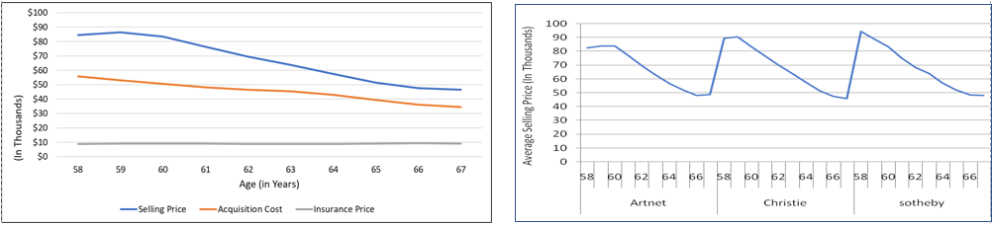
Selling price of the painting seems to decrease as age increases
Findings
Increase in age also seems to cause a decline in profit margins
This is consistent across all art houses and may indicate that the art pieces are not being maintained properly

Slide 4
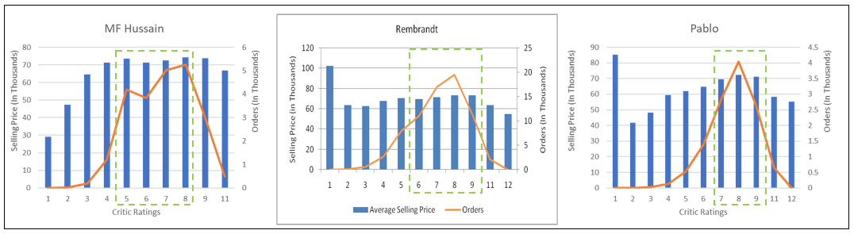
Critic Rating doesn’t seem to affect the selling prices of art pieces
Findings
For rating buckets with relevant number of orders, critic rating doesn’t seem to affect selling prices by a lot
Note: Highlighted in green are the rating buckets which has considerable number of orders and hence are reliable.

Slide 5
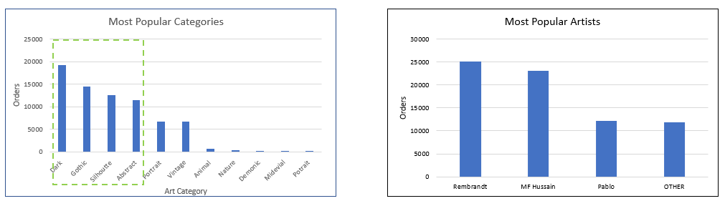
Dark Arts is the most popular category and Rembrandt most popular artist
Findings
80% of the purchases are from Categories – Dark, Gothic, Silhouette, Abstract art
Orders in Dark Arts is ~6 percentage points higher than Gothic category
For the most popular artist, Rembrandt, 68% of the paintings sold belong to Dark Arts I Category

Slide 6
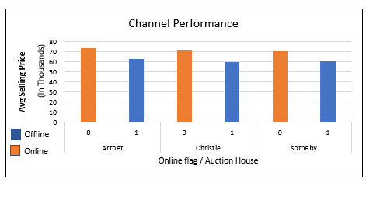
Sotheby seems to be performing the best in terms of providing good value for money
Auction House | Overall Order Distribution | Online Order Distribution | Online Distribution Index | Good Buy Distribution | Good Buy Distribution Index
Artnet | 24% | 22% | 0.91 | 23% | 0.96
Christie | 56% | 53% | 0.94 | 53% | 0.93
Sotheby | 20% | 25% | 1.29 | 24% | 1.23
Findings
Sotheby is over-indexing in online purchases and offering great value for money but has only 20% of the overall order distribution
However, Christie seems to be having a clear majority (56%) in overall order distribution
For all the auction houses, offline channel seems to be bringing in more trade volume when compared to online channel

Slide 7
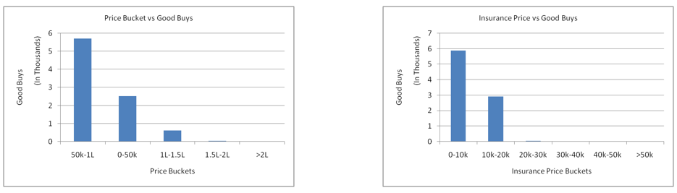
The decision of whether a purchase is a ‘Good Buy’ or not seems to be primarily dependent on insurance amount and average buyer price
Findings
The purchase seems to be a ‘good buy’ if the insurance and selling price belong to lower price buckets
Hence it can be safely concluded that ‘Good Buy’ is from buyer’s perspective

Slide 8
Appendix

Slide 9
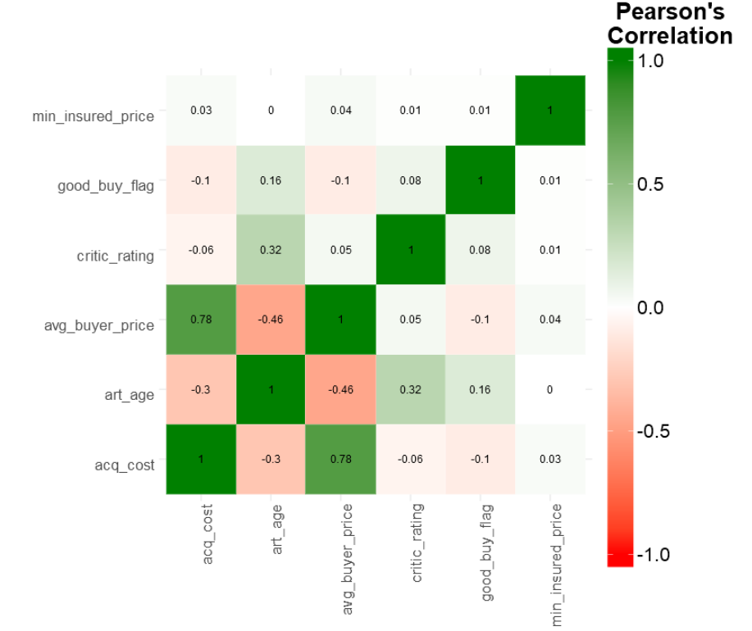
Pearson Correlation Matrix

