Slide 1
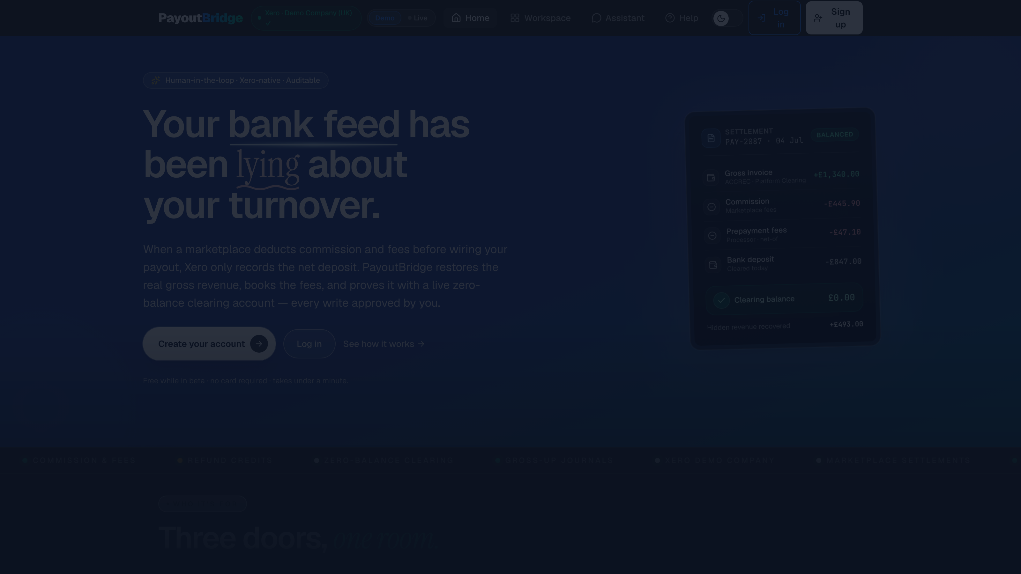
PayoutBridge
Books that match what HMRC already knows.
A Xero-native agent for marketplace payouts.

Slide 2
The bank feed lies about turnover
A salon owner sells £1,340 through a marketplace this week.
The platform keeps £445.90 commission and £47.10 in fees.
£847 lands in her bank. Her books call that revenue.
The platform reports her itemised earnings to HMRC.
Her turnover is understated. The fees never appear anywhere.
£493
vanished — 37% of the sale
£1,340
gross sale
→
−£493
kept by platform
→
£847
banked

Slide 3
HMRC can see the gap. She can't.
3.99m
£55bn
online sellers reported to HMRC for 2025
of earnings in those reports
~£19,000
Up to 30%
backdated VAT in the worked example
failure-to-notify penalty; 20–70% if deliberate
Nudge letters are already going out. Book the net every week and the £90,000 VAT line disappears from view.
Her books read £89,044. True turnover: £114,680.
Sources: gov.uk CC/FS11 · gov.uk CC/FS7a · BDO, Mar 2026

Slide 4
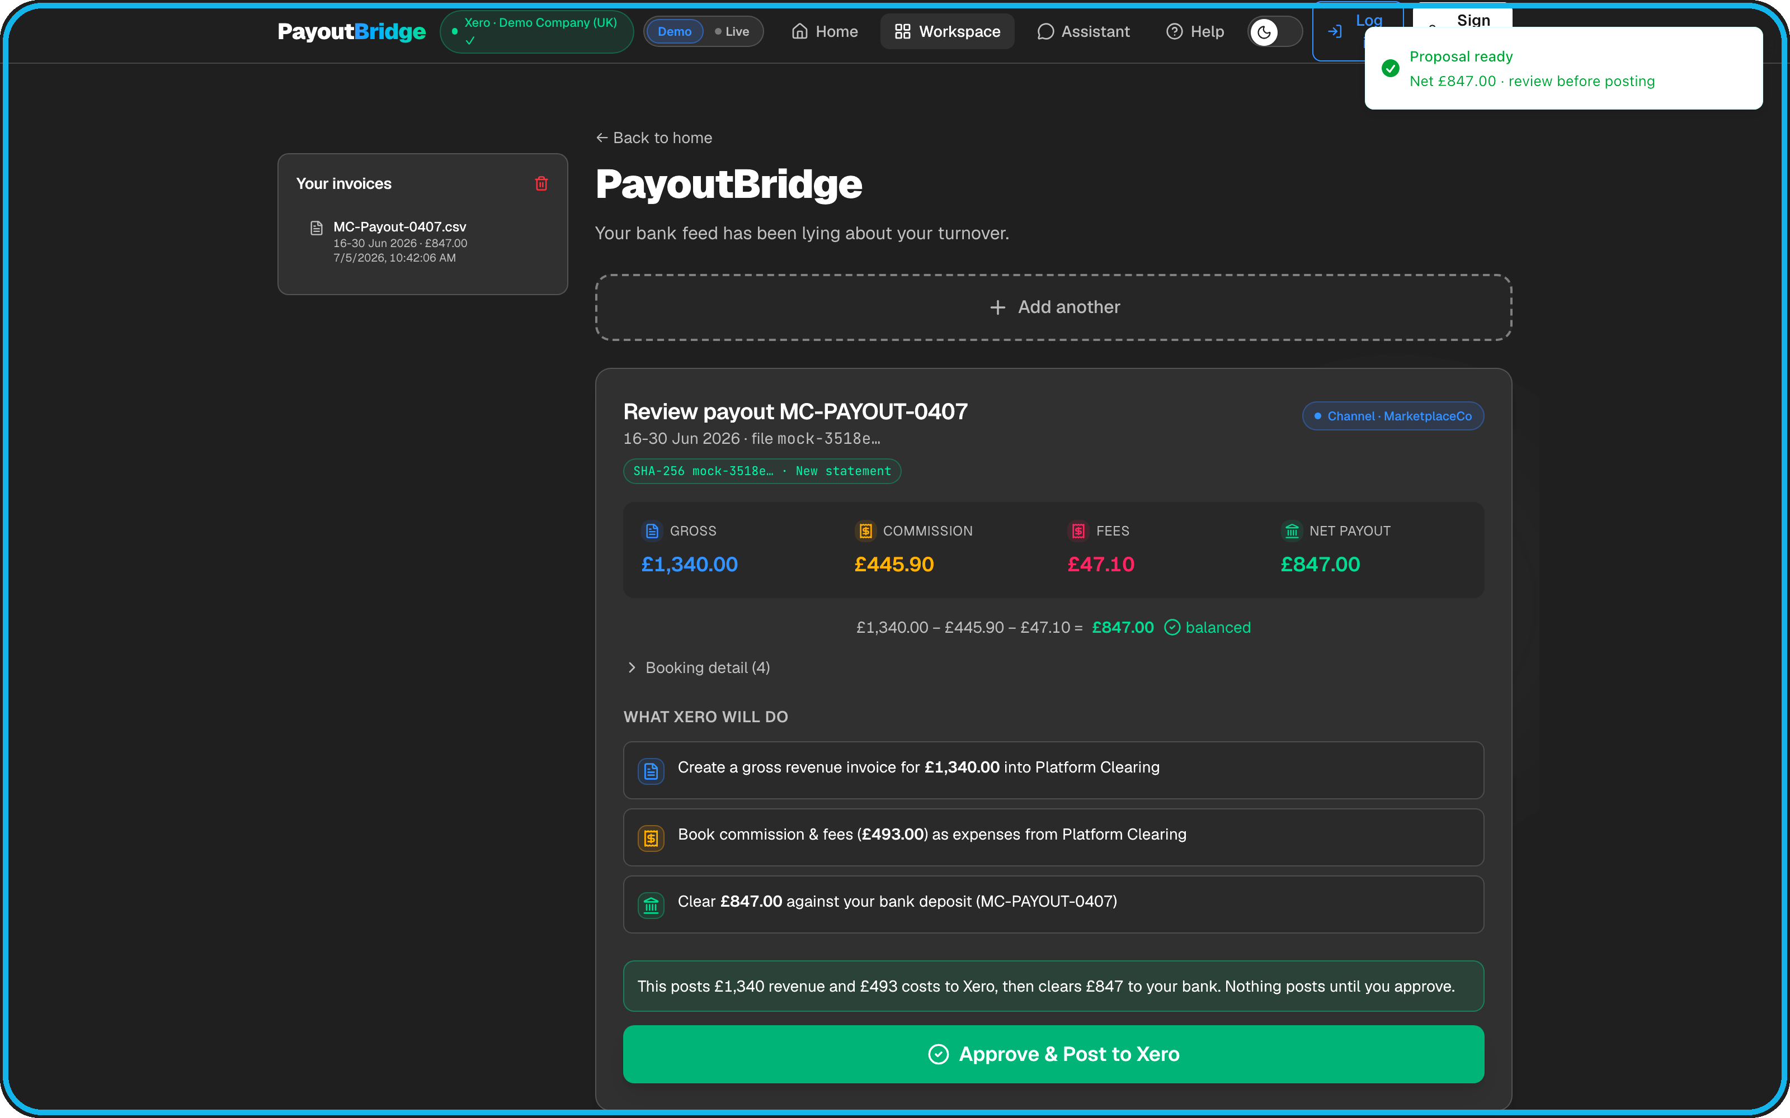
Statement in. Truth in Xero.
1
Ingest the settlement CSV. Deterministic parser; no LLM touches the numbers.
2
Propose the gross-up plan. If the invariant fails, it refuses to post.
3
A human approves every write. Nothing auto-posts.
4
Three Xero writes, then proof: clearing account at exactly £0.00.
Crash after write one? It resumes at write two. No double-posting.
1,340.00 − 445.90 − 47.10 − 0.00 = 847.00

Slide 5
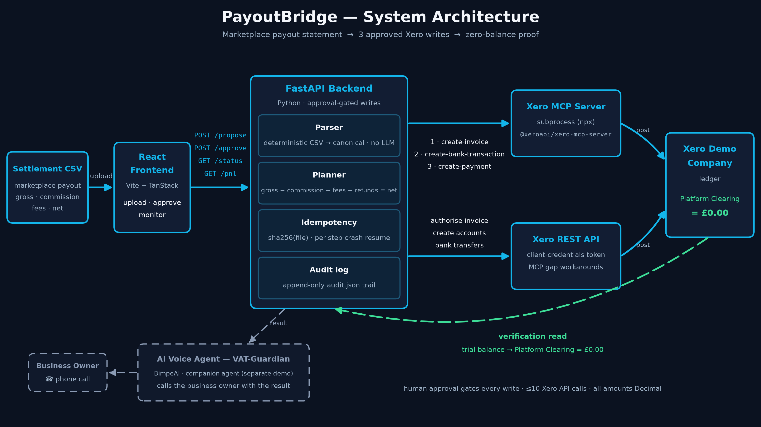
How it works

Slide 6
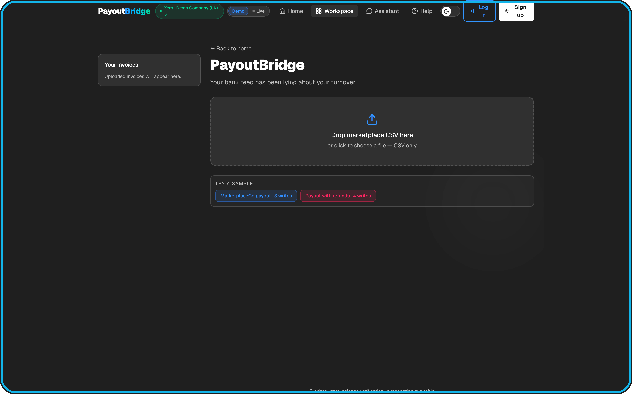
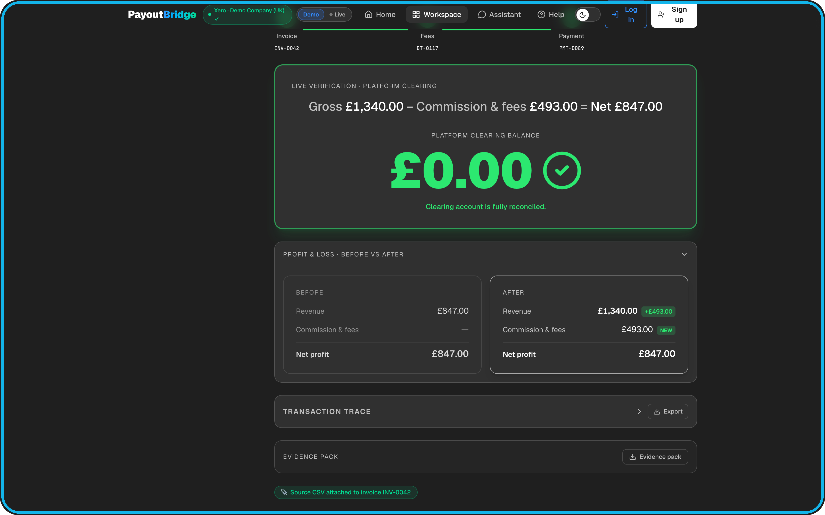
From upload to proven zero
Upload: drag the settlement CSV in; duplicate files are caught by hash.
Approve: every entry itemised, one explicit human yes.
Verified: clearing account at £0.00, read live from Xero.
£0.00

Slide 7
LIVE DEMO
CSV to a zero-balance clearing account in Xero, in under a minute.

Slide 8
The agent calls you
Your books don't wait for you to open a laptop.
VAT Guardian phones her: only £847 of £1,340 reached her books.
It warns her turnover is edging toward the £90,000 line.
She asks where the £493 went. It explains.
The fix is one spoken yes into the same approval flow.

Slide 9

Why this wins
~4m
Xero-native: MCP plus raw REST where MCP can't reach.
Deterministic accounting: Decimal, invariant-checked, proven to £0.00 on a live tenant.
Every write approved by a human. Idempotent per step.
Next: hosted backend, OAuth for any Xero org, refund path live-verified.
Ask: pick PayoutBridge; help us onto the Xero App Store.
reported sellers.
Every one carries this gap.
37% of her sale was invisible. Now it isn't.

