Slide 1
Input image
Skin Color Detector
Template Matching
Detected Faces

Slide 2
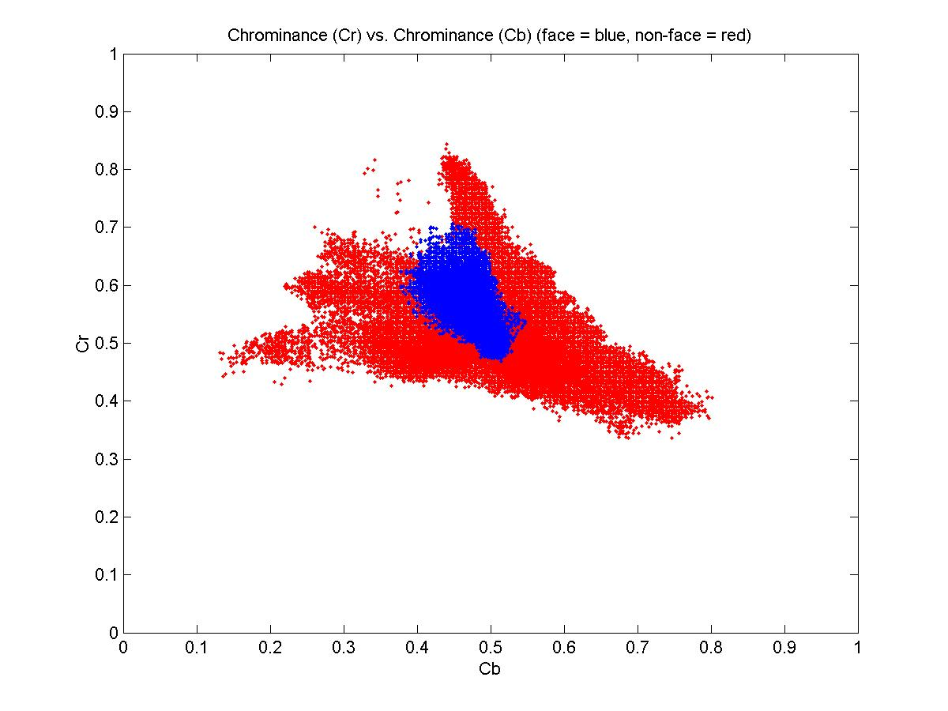
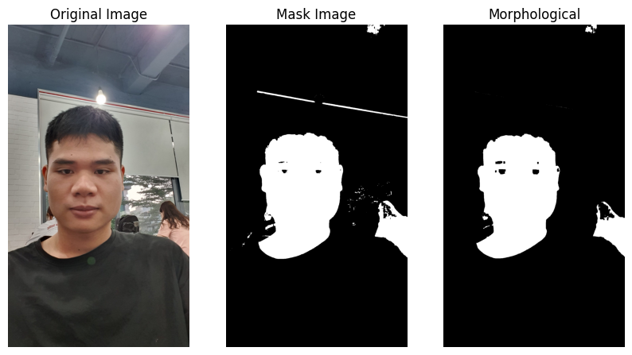
Input image
RGB to YCrCb
Threshold
Skin Color Detector
Morphological
Faces & Non Faces

Slide 3
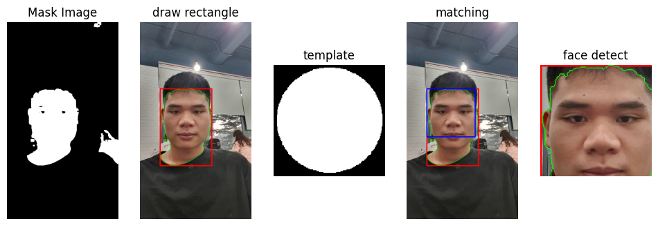
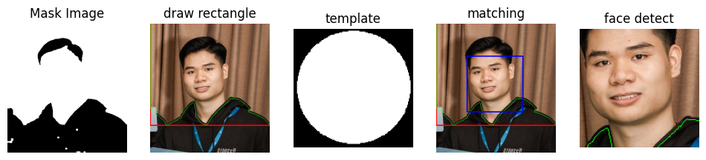
Input Image
Face & Non Face
R = region with largest area
Template Matching in R
Detected Face

Slide 4
Input image
Processing
Skin Color Detector
Template Matching
Camera
Detected Faces
Feature Based - SIFT
DATABASE
KNN
RECOGINTION
Information

