Slide 1
Face Detection
Group 1: Gary Chern
Paul Gurney
Jared Starman

Slide 2
Our Algorithm
4 Step Algorithm
Runs in 30 seconds for test image
Color Based Mask Generation
Region Finding and Separation
Maximal Rejection Classifier (MRC)
Duplicate Rejection and “Gender Recognition”
Input Image

Slide 3
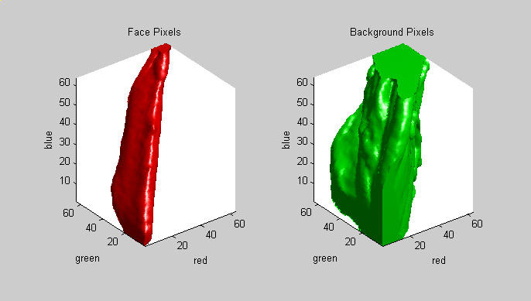
3-D RGB Color Space
Noticeable overlap between face and non-face pixels
Quantized RGB vectors from 0-63 (not 0-255)

Slide 4
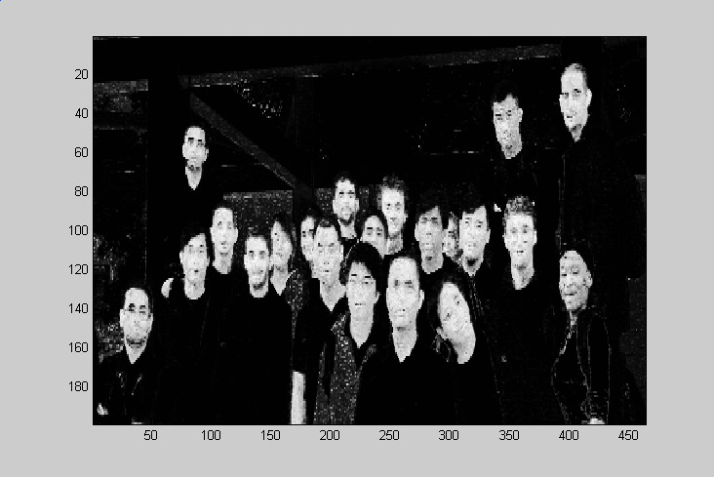
Probable Face Pixels
Lighter pixels mean higher probability of being a face pixel.
Filter with oval structuring element – removes background speckle.

Slide 5
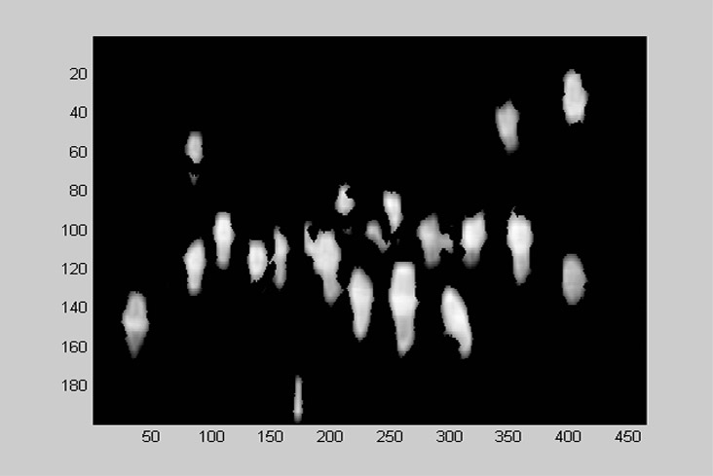
Color Segmented Mask
Mask produced from thresholding the filtered probability image

Slide 6
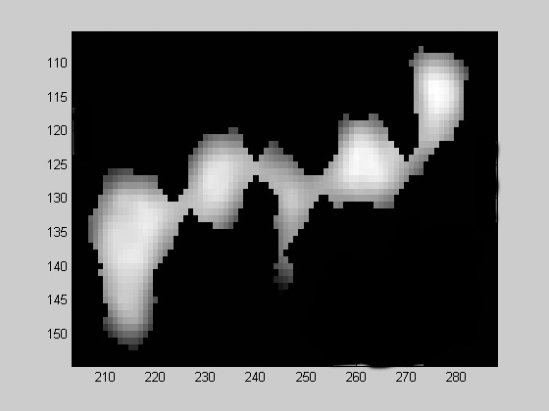
Still have Connected Regions
Erosion and dilation separates most faces, but not all
Further processing is required

Slide 7
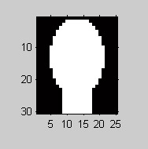
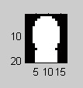
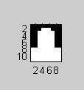
Head and Neck Templates
To separate faces, convolve regions with head-and-neck templates.
Find locations with highest correlation, remove region, and repeat.
Repeat with several sized head-and-neck templates.

Slide 8
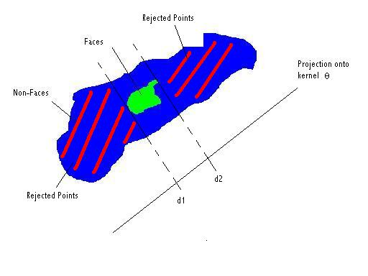
MRC Model-Review
As discussed in class, find projection of image set that minimizes # of non-faces selected
Gather lots of θ’s

Slide 9
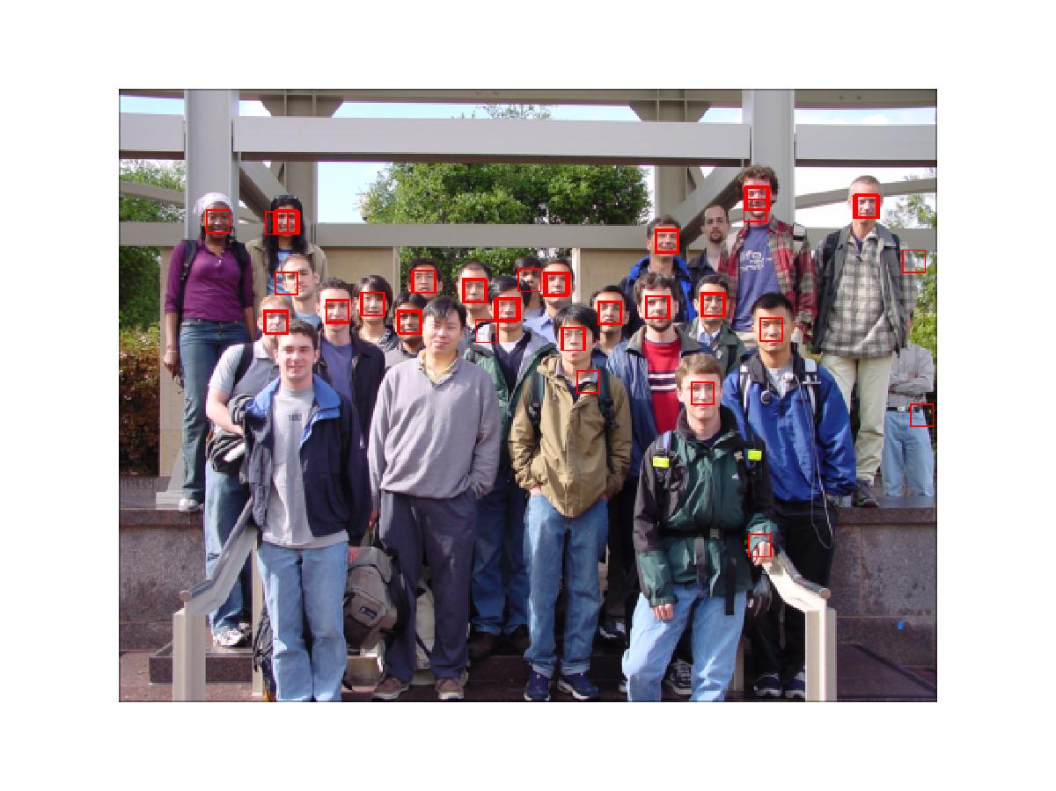
MRC w/out Color Segmentation
Computationally more intensive
Training wasn’t perfect so we still get non-faces
False detections usually aren’t face-colored in MRC

Slide 10
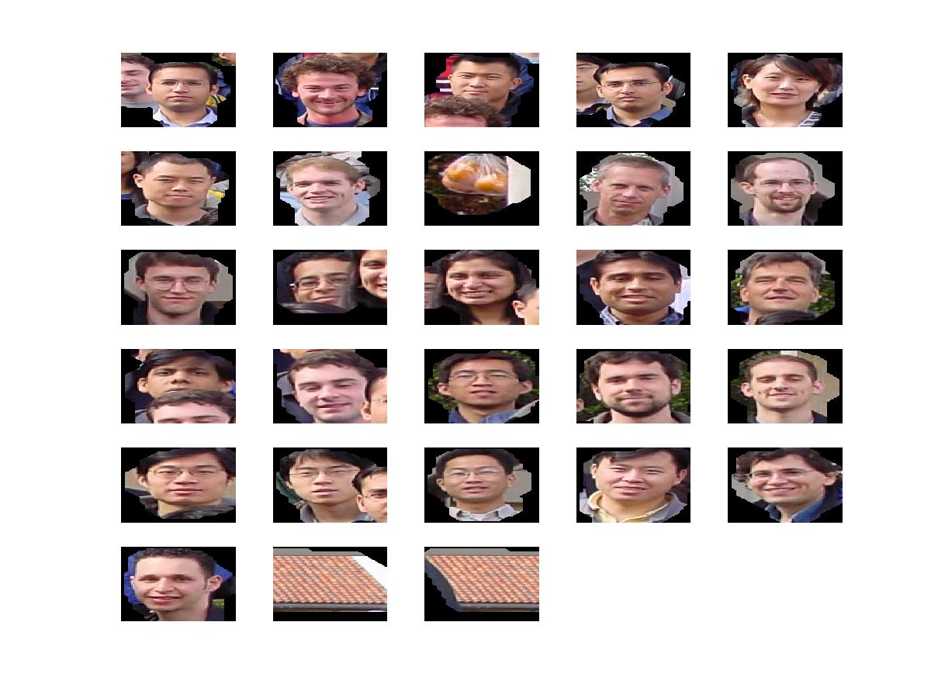
Potential Faces Input to MRC
Our idea: Just do MRC on color-segmented/separated regions
Notice bag of oranges and two roof pictures are the only non-face inputs.
MRC only has to remove those 3 pictures.

Slide 11
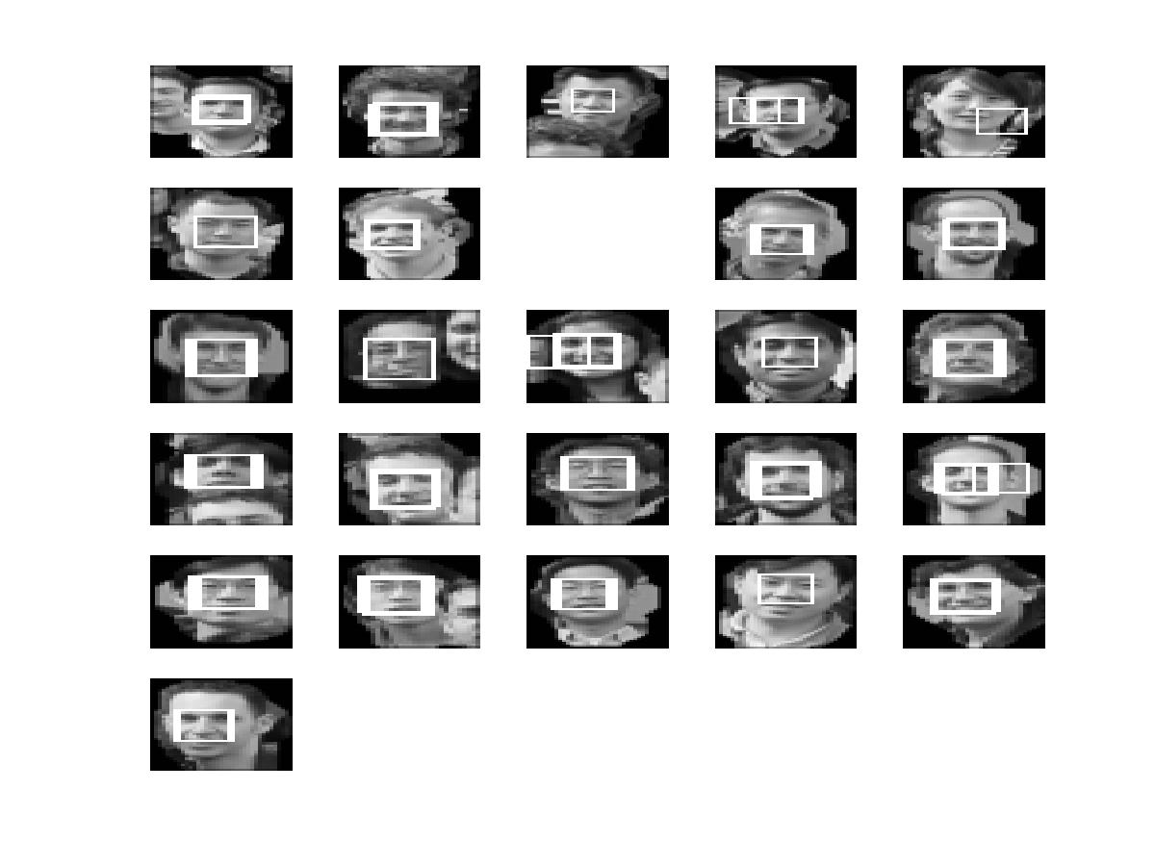
Output of MRC
And it does!!!

Slide 12
Duplicate Rejection and Gender
If two detected faces are too close, we throw out the second face.
We search for the lowest average valued (darkest) detected face and label that as female.

Slide 13
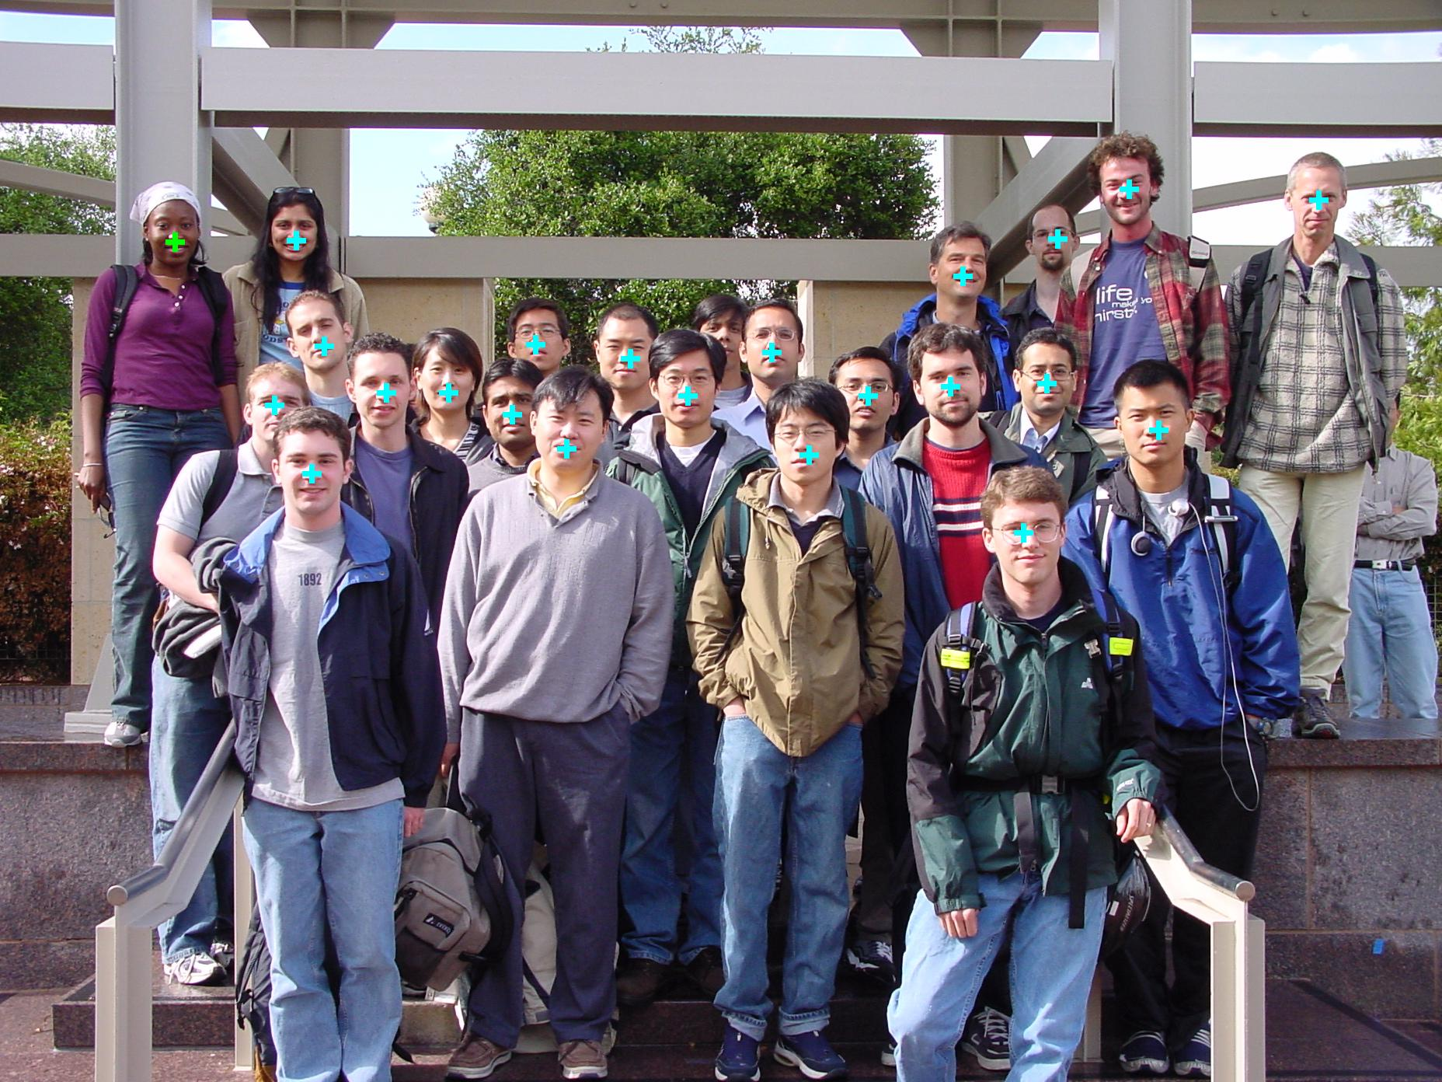
Results (1)
Obstructed Face
We found all faces but one obstructed in this test image. Also found 1 female

Slide 14
Results (2)
Image #
#Faces Detected
#Faces in Image
Percentage
Correct
# Repeated Faces and False Positives
Bonus
1
20
21
95%
0
1
2
23
24
96%
0
1
3
25
25
100%
0
0
4
23
24
96%
0
0
5
21
24
88%
0
0
6
23
24
96%
0
0
7
22
22
100%
0
0

Slide 15
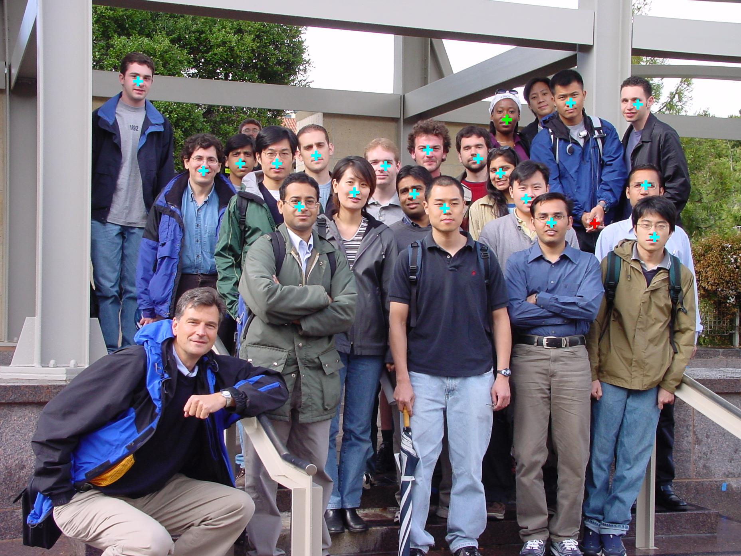

Slide 16
