Slide 1
Face Detection on Similar Color Images
Scott Leahy
EE368, Stanford University
May 30, 2003

Slide 2
Problem Statement
Goal: Find faces in an image
  All images are in color
  Images all contain a similar background
  Images have a similar number of faces
  Faces are all on approximately the same scale
Design an algorithm which takes advantage of these facts

Slide 3
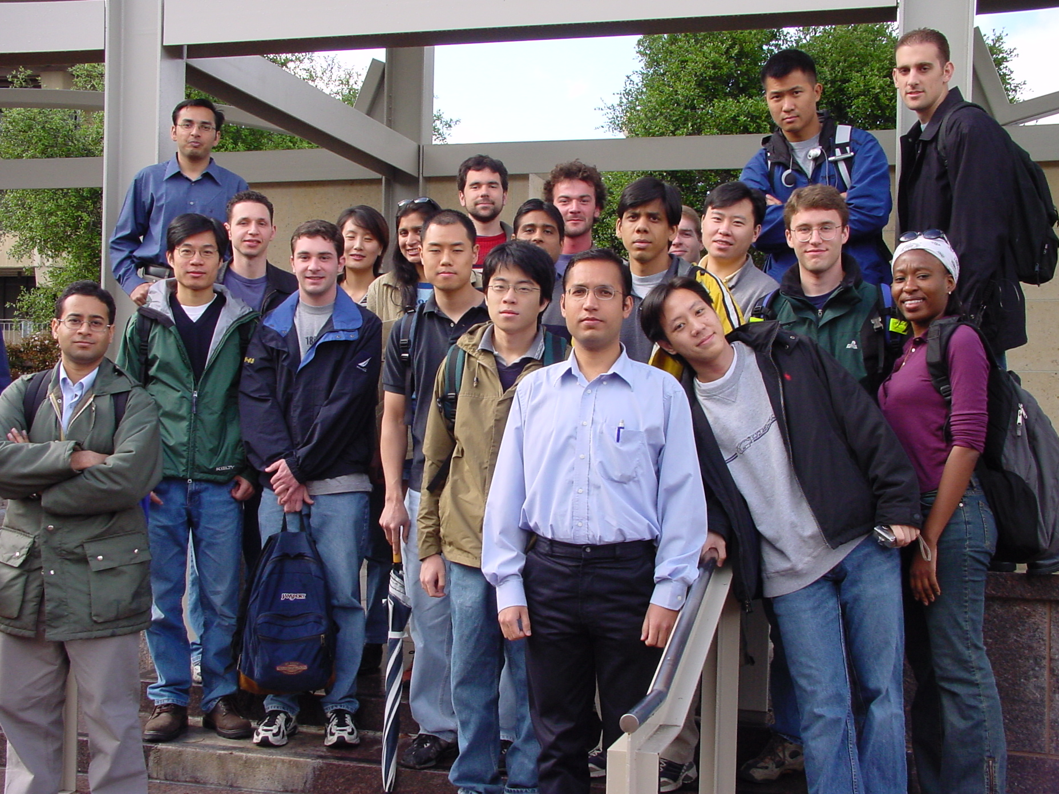
Sample Image

Slide 4
Detection Procedure
Steps Involved:
  Skin Detection
  Morphological Processing
  Template Matching
  Face Coordinate Selection

Slide 5
Skin Detection
?
i
v
Pixel by pixel, make a decision on the input based on the output
  i = {skin, non-skin}
  v = vector in color space (HSV, RGB, …)
Treat the problem like a digital communications problem
  Create a MAP Detector

Slide 6
Skin Detection (cont’d)
MAP Detection
  Minimize probability of error:
    Maximize p(i|v) over all inputs i
  Often p(i|v) is not known, but:
    p(i|v) = p(v|i) * p(i) / p(v) (Bayes’ Rule)
  p(v|i) and p(i) are more often known in a system

Slide 7
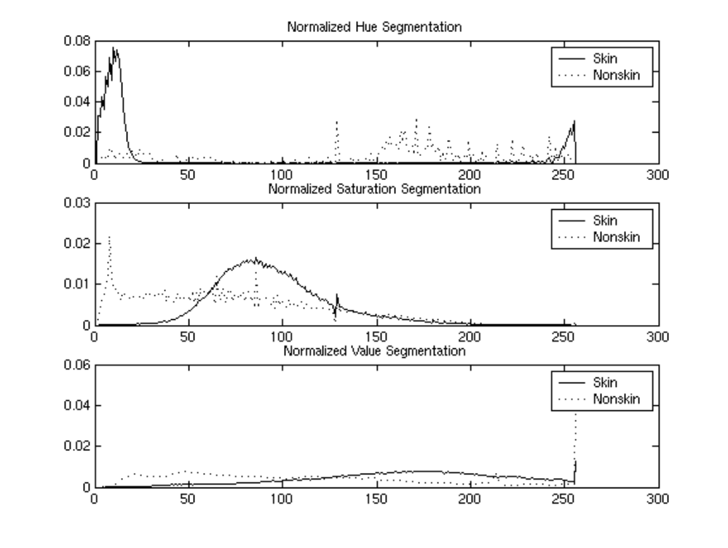
Histograms

Slide 8
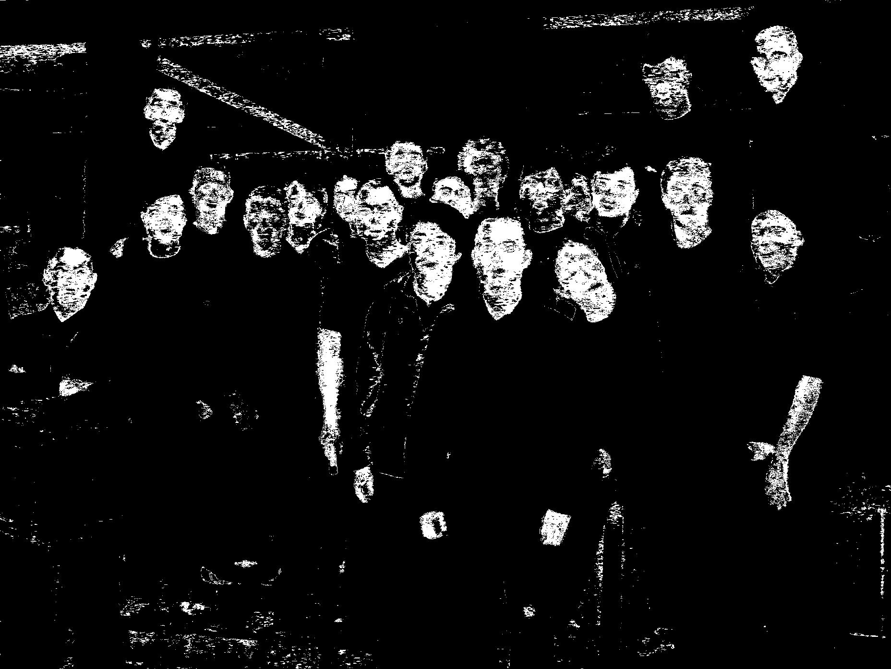
2 Dimensional PDF
Used only Hue and Saturation for MAP detector

Slide 9
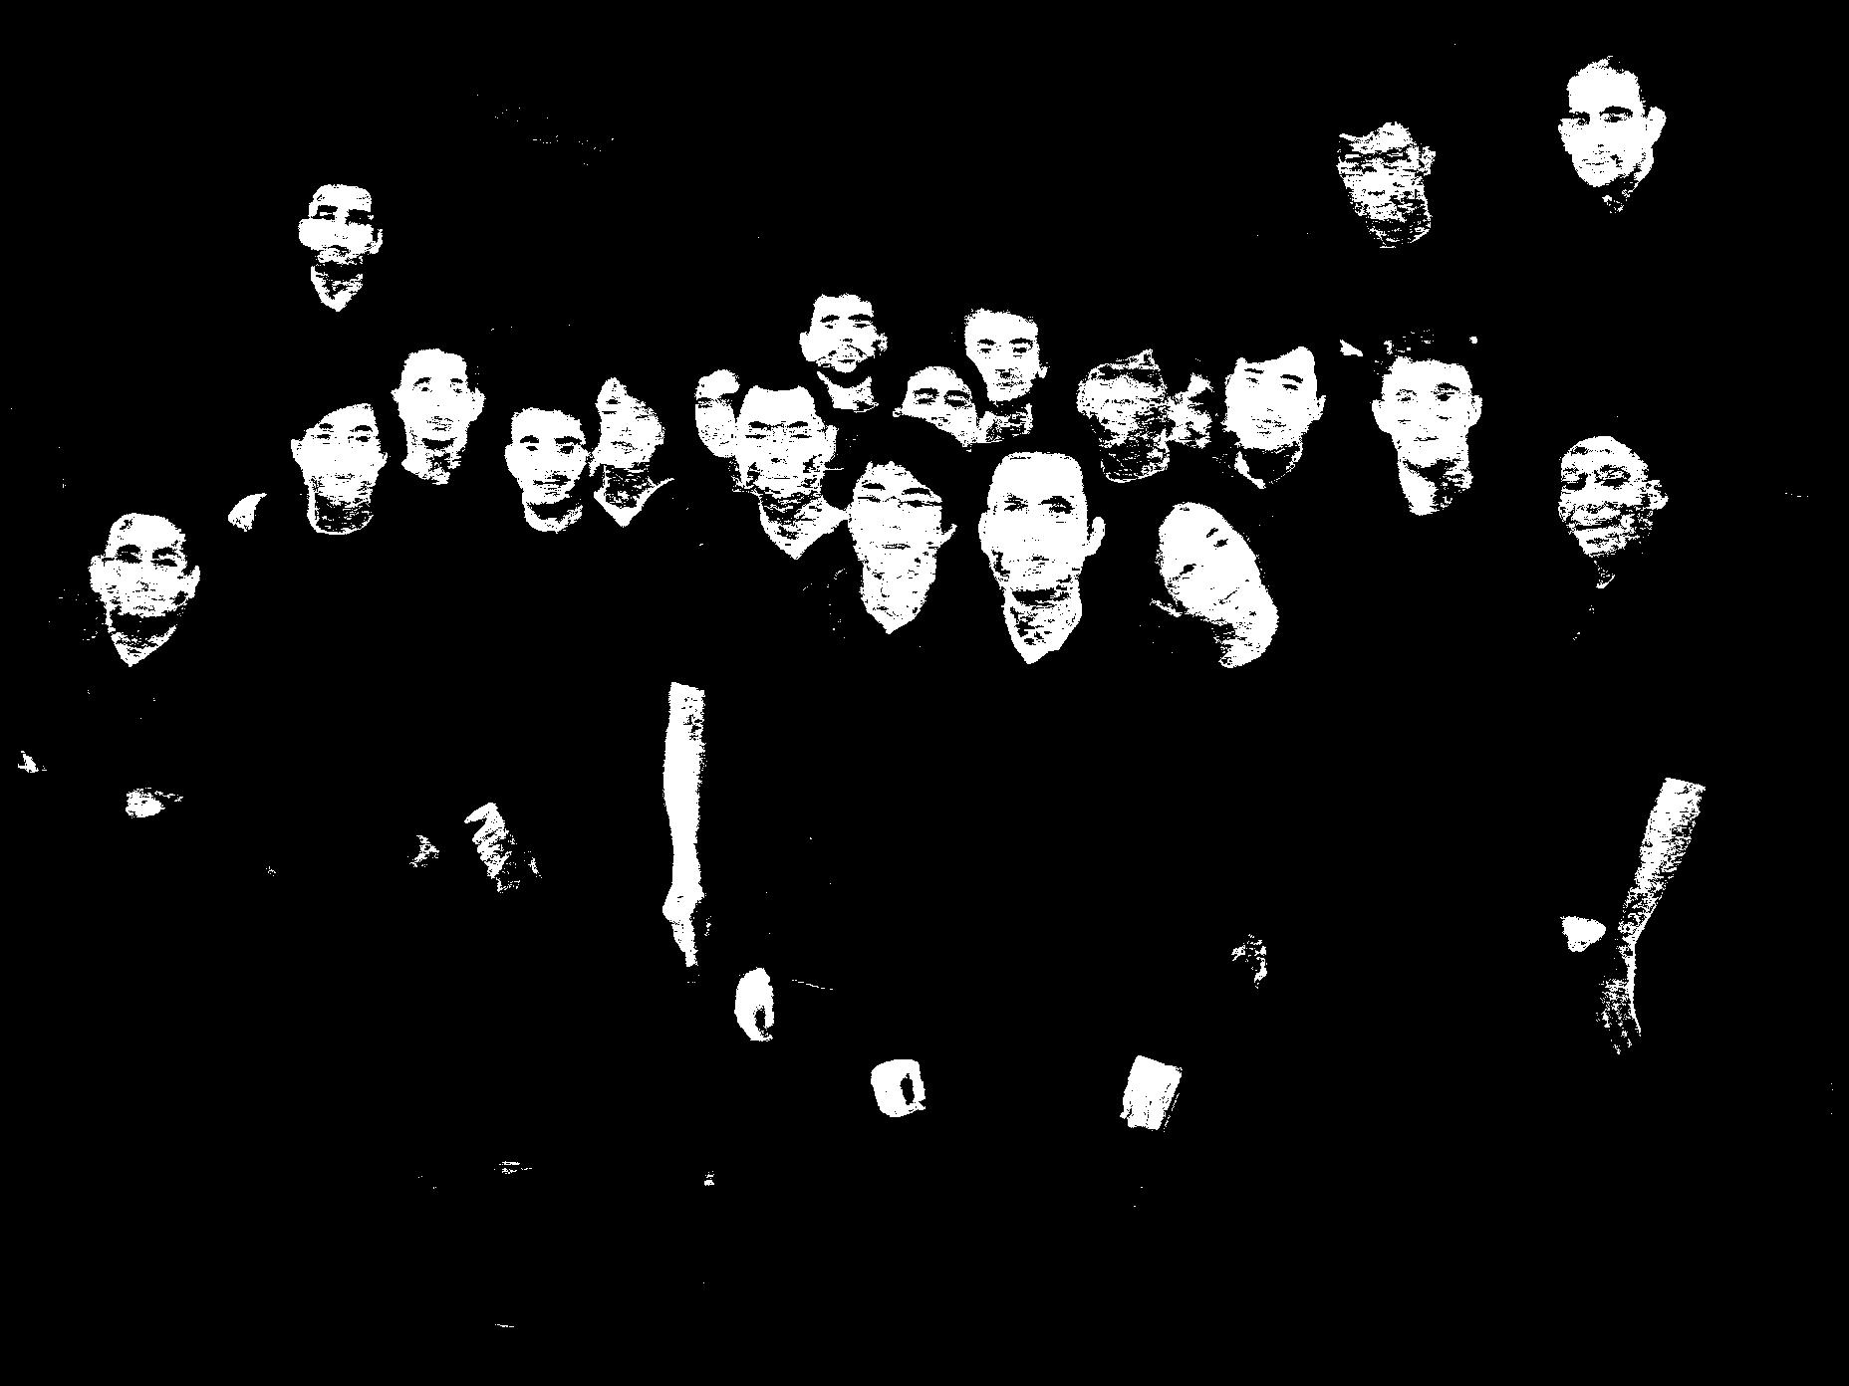
3 Dimensional PDF
Used all 3 coordinates for MAP detector

Slide 10
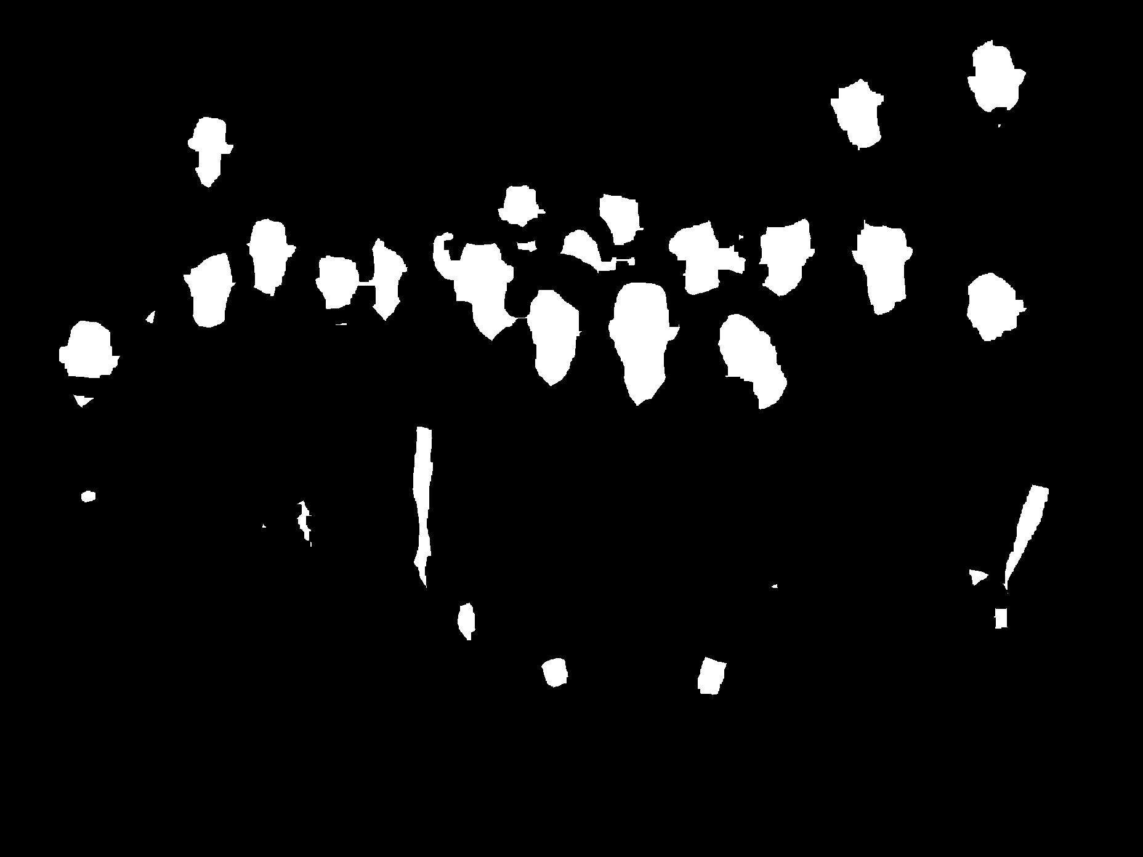
“Closing” Step
Pseudo-Closing Step:
  Dilation
  Filling
  Erosion

Slide 11
Template Matching
Template matching involves convolving the image with some template
  The average of the image being tested must be subtracted to eliminate biasing toward brighter areas
Only one template used due to similar size and shape of faces in all images

Slide 12




Trial Templates
Tried 4 templates, tweaking threshold until the best results were obtained

Slide 13
Face Selection
Labeled all regions
Selected only regions with areas bigger than some threshold
Found the centers of the remaining regions and returned those as the results of the algorithm

Slide 14
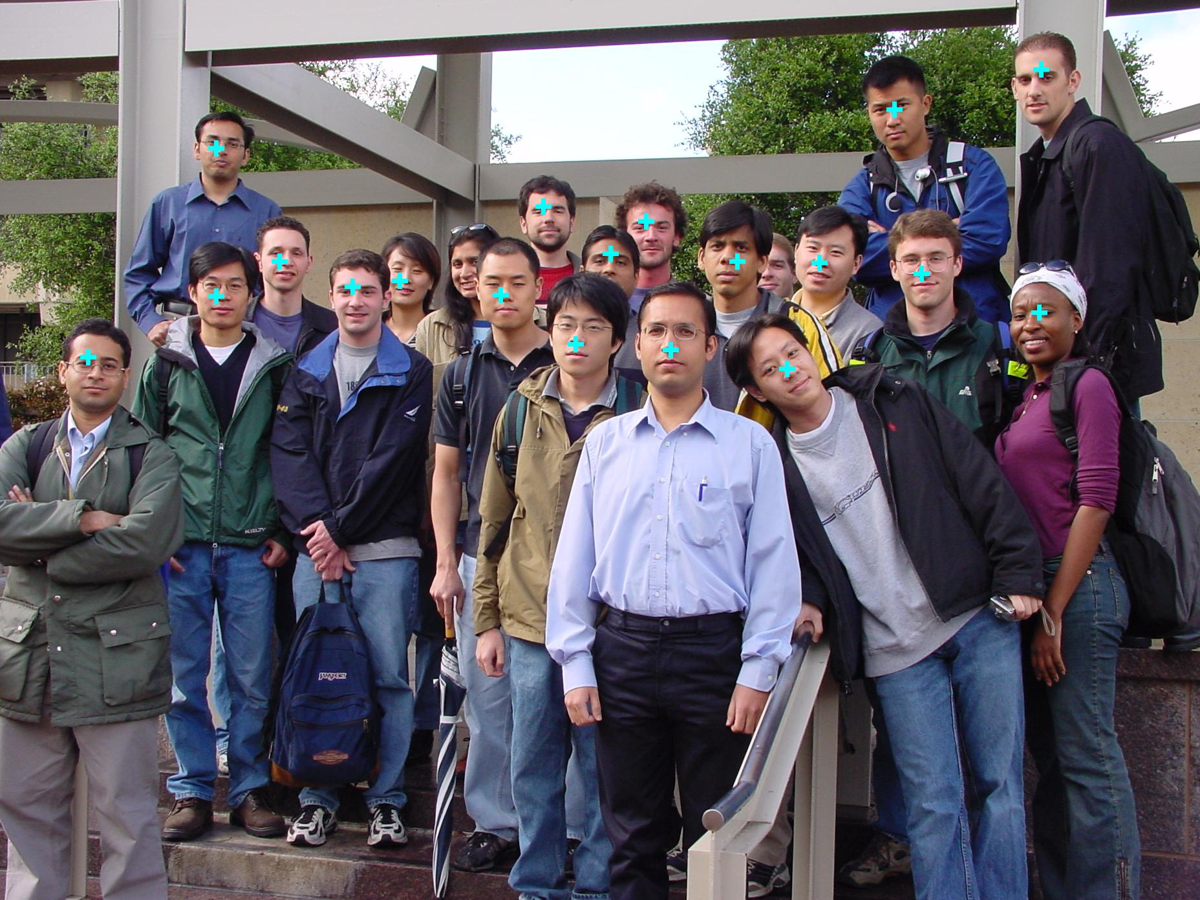
Results

Slide 15
Conclusions
Skin Detection and Closing
  Takes advantage of images being in color
  Takes advantage of similar statistics in the images
Template Matching and Face Selection
  Takes advantage of similar size and shape to faces
Result: ~85% success rate

Slide 16
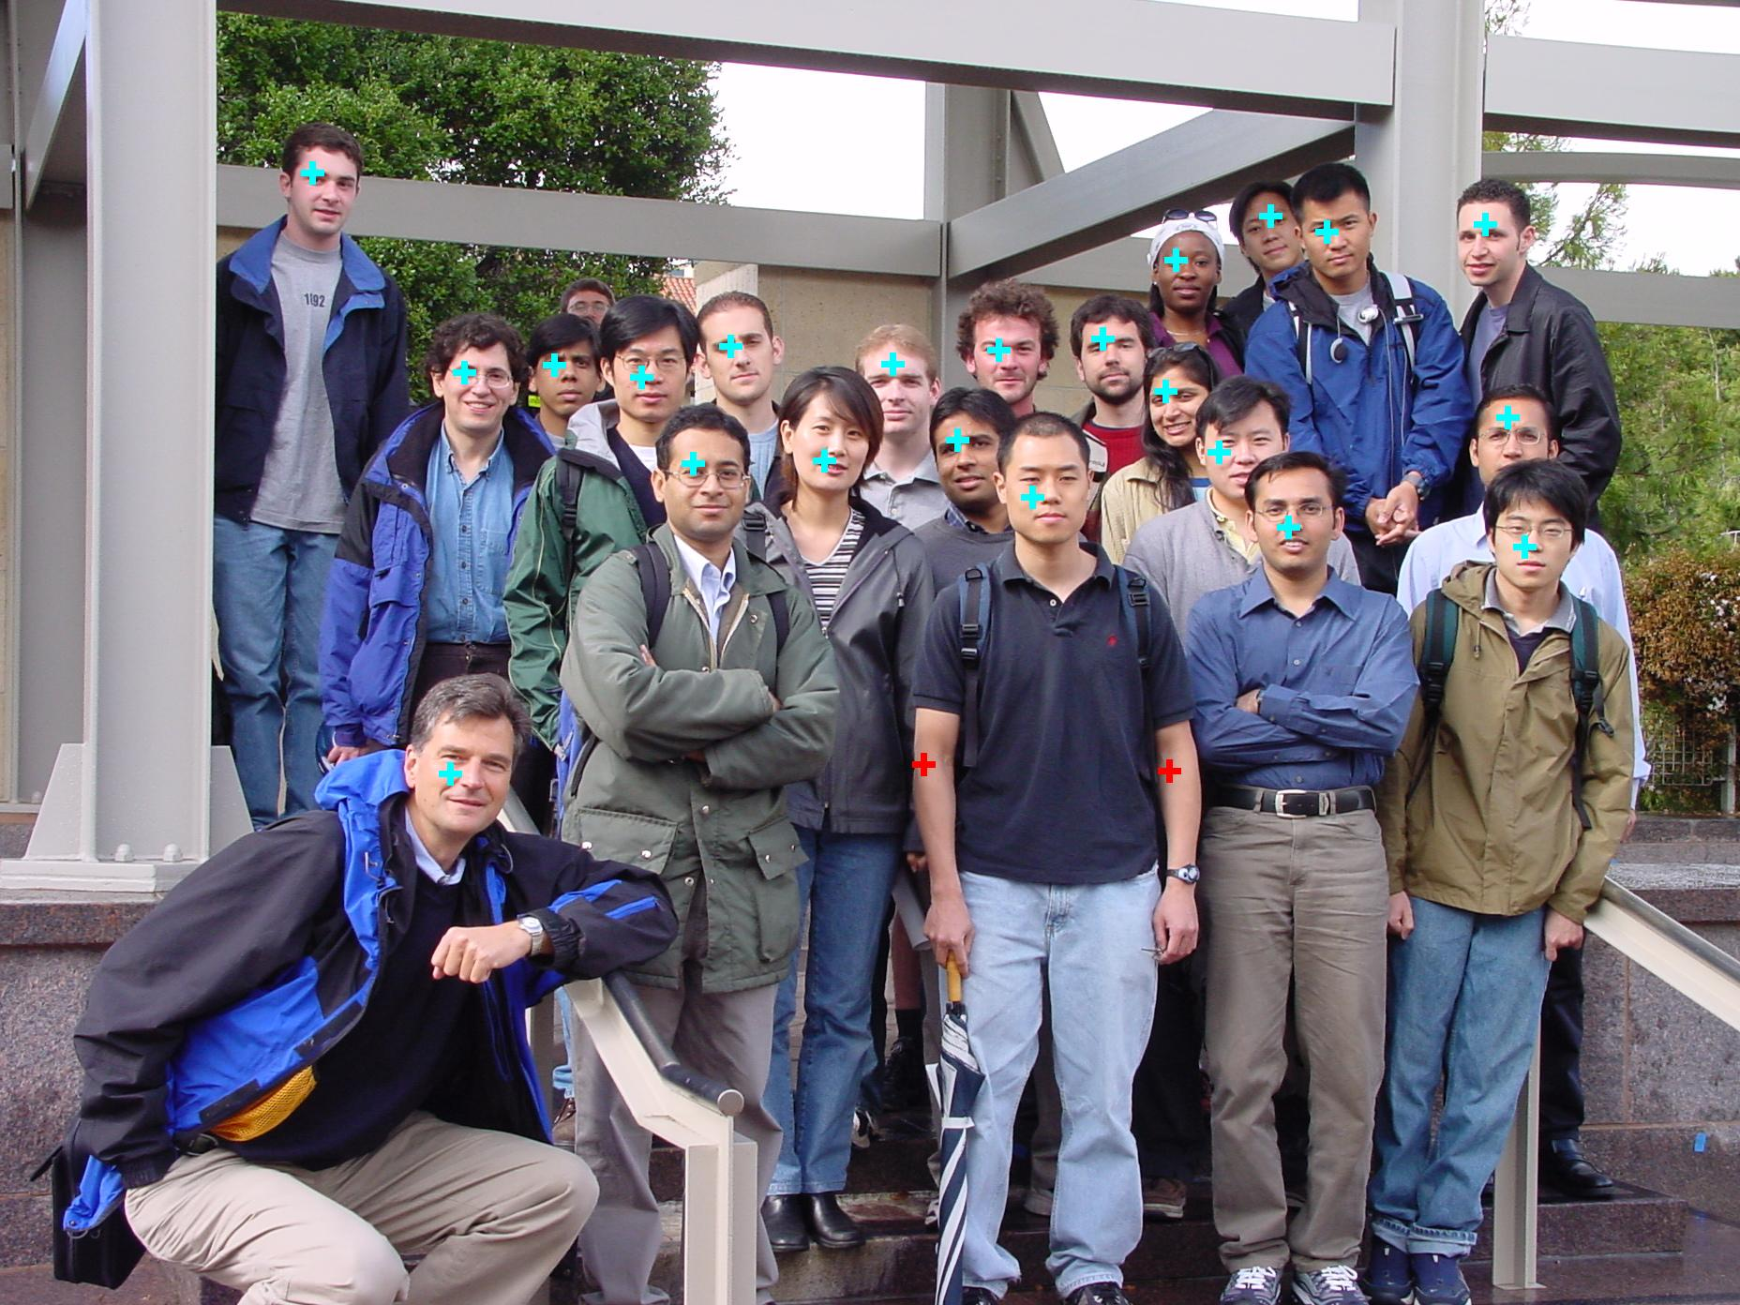

Slide 17
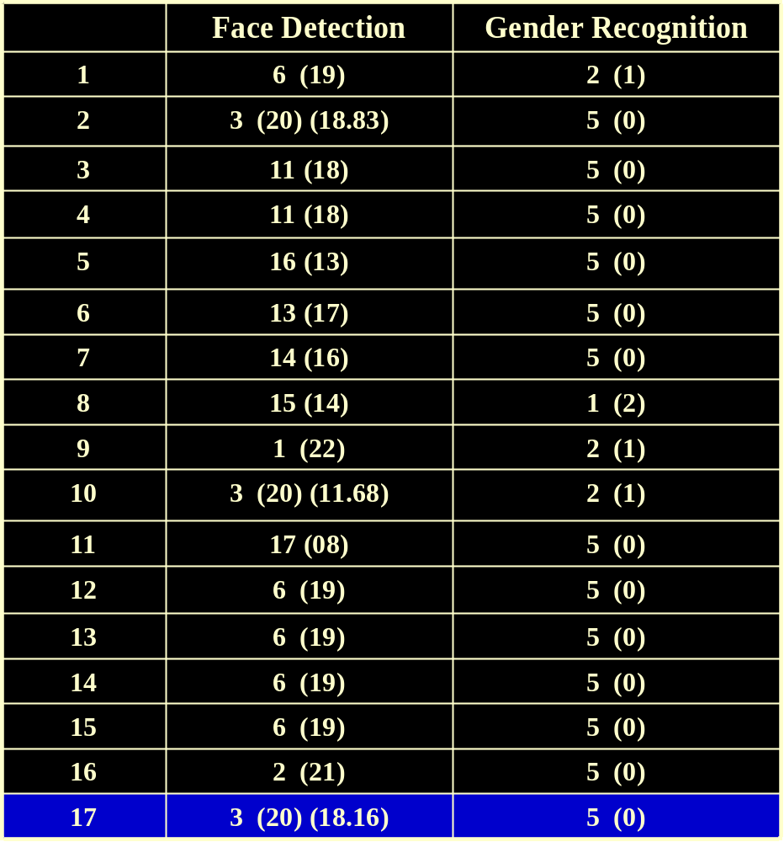

Slide 18
