Slide 1
Topic
FSH 507 Fall 2019 Your Name

Slide 2
R Markdown

Slide 3
Getting Started
This is an R Markdown presentation. Markdown is a simple formatting syntax for authoring HTML, PDF, and MS Word documents. For more details on using R Markdown for presentations see https://bookdown.org/yihui/rmarkdown/presentations.html.
When you click the Knit button a document will be generated that includes both content as well as the output of any embedded R code chunks within the document.

Slide 4
Slide with Bullets
Bullet 1
Bullet 2
Bullet 3

Slide 5
Slide with R Output
summary(cars)
## speed dist ## Min. : 4.0 Min. : 2.00 ## 1st Qu.:12.0 1st Qu.: 26.00 ## Median :15.0 Median : 36.00 ## Mean :15.4 Mean : 42.98 ## 3rd Qu.:19.0 3rd Qu.: 56.00 ## Max. :25.0 Max. :120.00

Slide 6
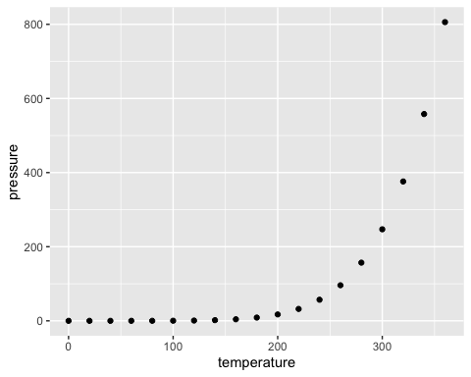
Slide with Plot

Slide 7
Materials

Slide 8
Suggested Topics
Feel free to adapt anything you’d like from my purrr tutorial
https://www.weirdfishes.blog/blog/practical-purrr/
I’ve included the code for that in the presentations folder
Given short amount of time, I don’t recommend trying to teach both the apply suite (apply, lapply, sapply) and purrr in depth. I’ve found people have an easier time learning map over apply, mostly because the syntax is the same across all map_ functions, as oppoesd to apply (e.g. first argument to apply are the data, first to mapply is a function); map seems to make it easier to focus on whats happening an not the function structure. purrr is also much more consistent about the type of object produced by the function. So I might recommend focusing on purrr and showing an example or two using base apply so that thaty have that to compare to.

Slide 9
Suggested Topics
Writing functions
pure functions
http://adv-r.had.co.nz/Functions.html
Debugging functions
browser, breakpoints, etc.
using purrr::safely
Applying functions
basic use of function in map/apply
annonymous functions (in map at least)
map, map2, pmap
with different kinds of outputs, e.g. map_chr vs map_dbl

Slide 10
Suggested Topics
Manipulating lists
Using purrr to access/modify parts of deeply nested lists (https://github.com/jennybc/repurrrsive)
Organizing list objects in tibbles
creating and accessing elements of list-columns
Putting it all together
e.g. the regression example in my tutorial
use a tibble to organize candidate models
create list column of fitted models
use map to extract things RMSE for each model, adding results as a double column

