Slide 1
GIt and Github
FSH 507 Fall 2019 Your Name

Slide 2
R Markdown
Getting Started
This is an R Markdown presentation. Markdown is a simple formatting syntax for authoring HTML, PDF, and MS Word documents. For more details on using R Markdown for presentations see https://bookdown.org/yihui/rmarkdown/presentations.html.
When you click the Knit button a document will be generated that includes both content as well as the output of any embedded R code chunks within the document.
Slide with Bullets
Bullet 1
Bullet 2
Bullet 3
Slide with R Output
summary(cars)
## speed dist ## Min. : 4.0 Min. : 2.00 ## 1st Qu.:12.0 1st Qu.: 26.00 ## Median :15.0 Median : 36.00 ## Mean :15.4 Mean : 42.98 ## 3rd Qu.:19.0 3rd Qu.: 56.00 ## Max. :25.0 Max. :120.00
Slide with Plot

Slide 3
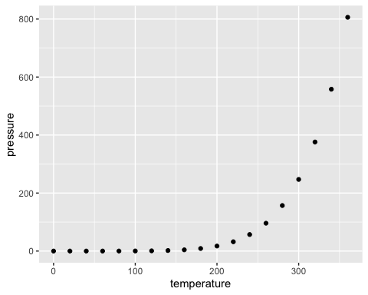

Slide 4
Materials

Slide 5
Resources
Happy Git and Github for the useR
Oh Sh*t, Git! - Dangit, Git! if you’re so inclined
git documentation itself isn’t bad

Slide 6
Fun Resources
Commits From Last Night
git manual page generator
starwars intro you commit history!

