Slide 1
Topic
FSH 507 Fall 2019 Your Name

Slide 2
R Markdown

Slide 3
Getting Started
This is an R Markdown presentation. Markdown is a simple formatting syntax for authoring HTML, PDF, and MS Word documents. For more details on using R Markdown for presentations see https://bookdown.org/yihui/rmarkdown/presentations.html.
When you click the Knit button a document will be generated that includes both content as well as the output of any embedded R code chunks within the document.

Slide 4
Slide with Bullets
Bullet 1
Bullet 2
Bullet 3

Slide 5
Slide with R Output
summary(cars)
## speed dist ## Min. : 4.0 Min. : 2.00 ## 1st Qu.:12.0 1st Qu.: 26.00 ## Median :15.0 Median : 36.00 ## Mean :15.4 Mean : 42.98 ## 3rd Qu.:19.0 3rd Qu.: 56.00 ## Max. :25.0 Max. :120.00

Slide 6
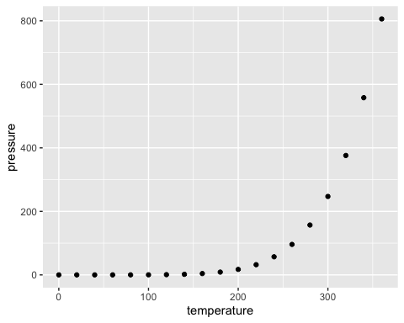
Slide with Plot

Slide 7
Materials

Slide 8
Suggested Topics
understanding the philosophy of the grammar of graphics
mapping data to aesthetics, displaying aesthetics with geometries
Messing with attributes of one geometry
what goes into aes and what goes outside
adding aes() inside ggplot call vs inside geom_XX call
Different geometries for different kinds of data
discrete vs. continuous etc.
Themes!
basic structure of theme argument (e.g. element_text, element_rect, etc.)
using themes customize appearance of plots
change fonts, colors, sizes, etc.

Slide 9
Suggested Topics
Faceting
facet_wrap vs facet_grid
customizing facets with grid
Layering multiple geometries /plots
discrete + continuous layers
controlling aesthetics across multiple layers
Multiple plots with patchwork/cowplot
Exporting ggplot objects
saving as .rds
explorting to pdf/png/tiff etc.
ggplot2 extensions
gganimate
ggplotly
the list goes one

Slide 10
Helpful things
I’ve put a very old seminar I did on ggplot in the presentations folder
the ggplot2 cheatsheet is great!
Another ggplot2 tutorial from Melanie Frazier at NCEAS
https://github.com/eco-data-science/VisualizingData/blob/master/ggplot2_intro.Rmd
Hadley’s book
https://r4ds.had.co.nz/data-visualisation.html
https://towardsdatascience.com/murdering-a-legendary-data-story-what-can-we-learn-from-a-grammar-of-graphics-ad6ca42f5e30
https://cedricscherer.netlify.com/2019/08/05/a-ggplot2-tutorial-for-beautiful-plotting-in-r
https://socviz.co/index.html#preface

