Slide 1

SNLI Decomposable Attention Network
Yanjun Shao
School of Data Science, Fudan
April 14, 2022

Slide 2
The Stanford Natural Language Inference (SNLI) Corpus [1][2]
Text | Judgments | Hypothesis
A man inspects the uniform of a figure in some East Asian country. | contradiction C C C C C | The man is sleeping
An older and younger man smiling. | neutral N N E N N | Two men are smiling and laughing at the cats playing on the floor.
A black race car starts up in front of a crowd of people. | contradiction C C C C C | A man is driving down a lonely road.
A soccer game with multiple males playing. | entailment E E E E E | Some men are playing a sport.
A smiling costumed woman is holding an umbrella. | neutral N N E C N | A happy woman in a fairy costume holds an umbrella.
…… | ...... | ……
Training pairs: 550152, Dev pairs: 10000, Test pairs: 10000, Total pairs: 570152
'entailment': 183416, 'neutral': 182764, '-': 785, 'contradiction': 183187

Slide 3
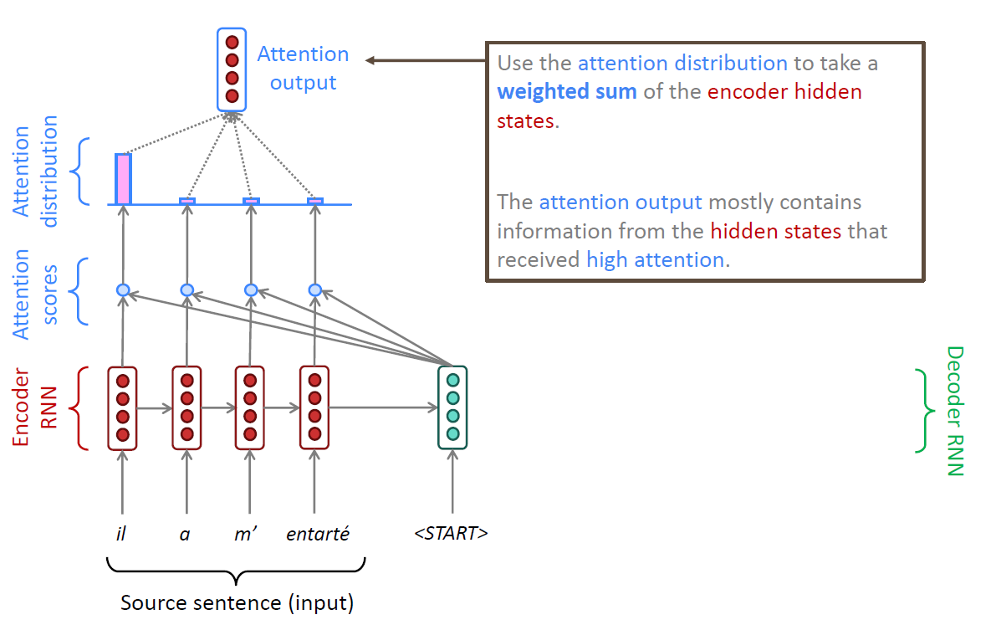
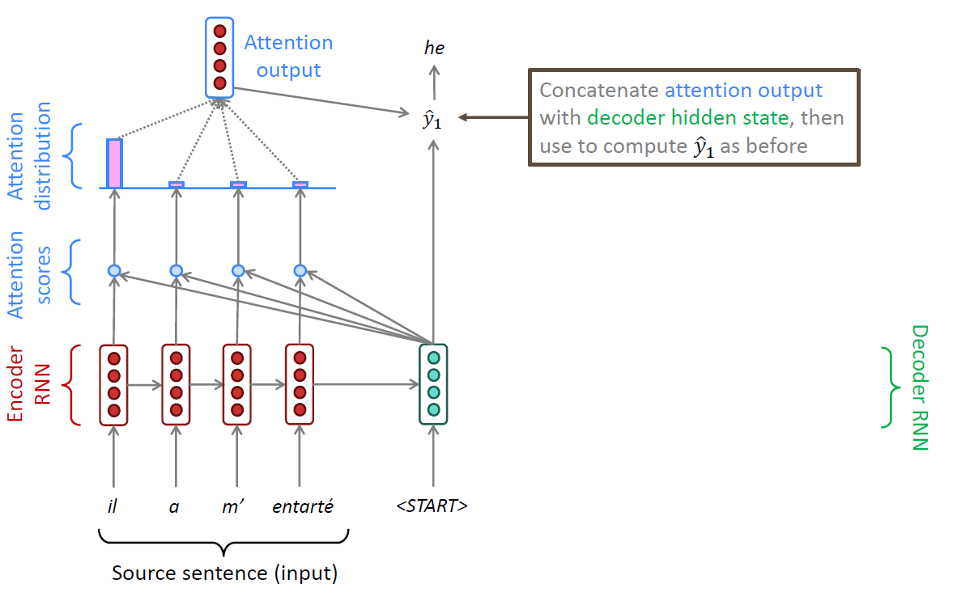
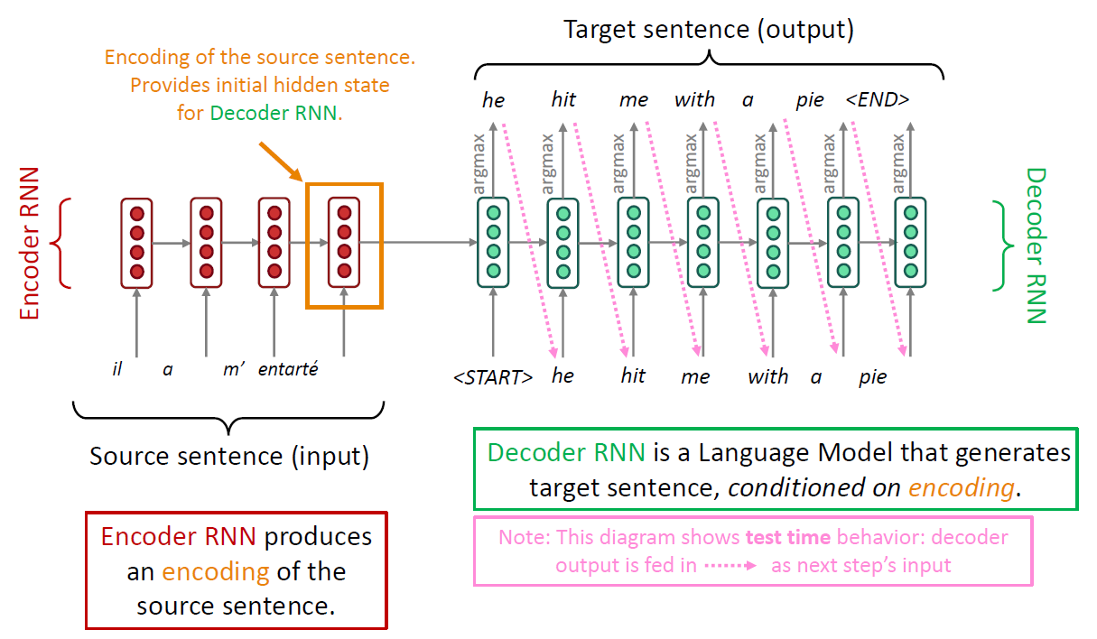
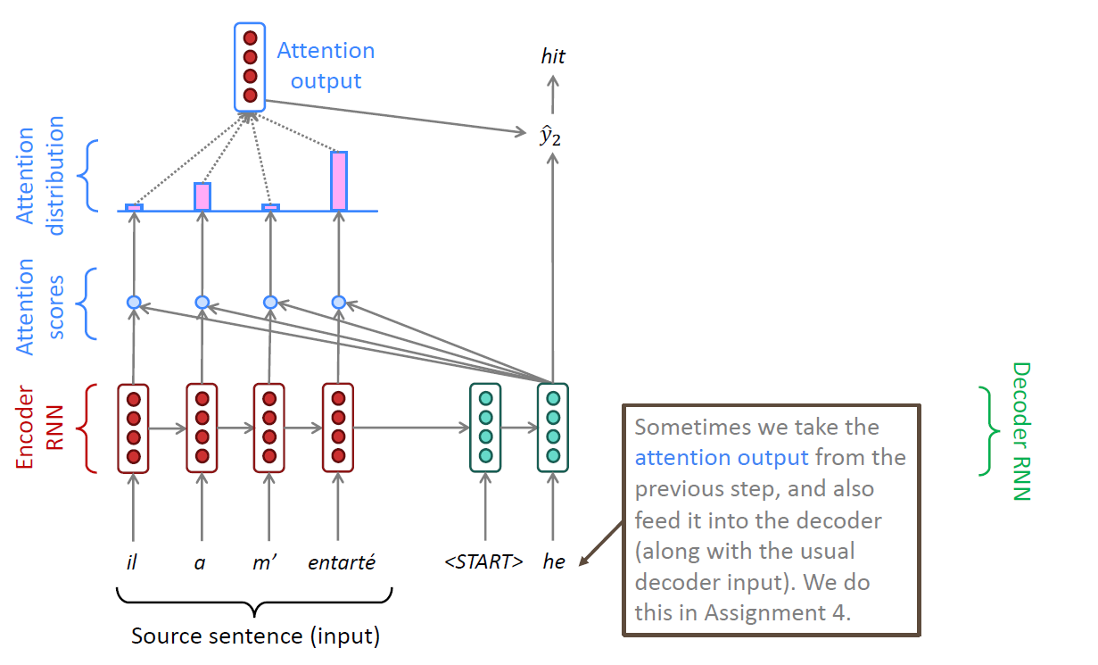
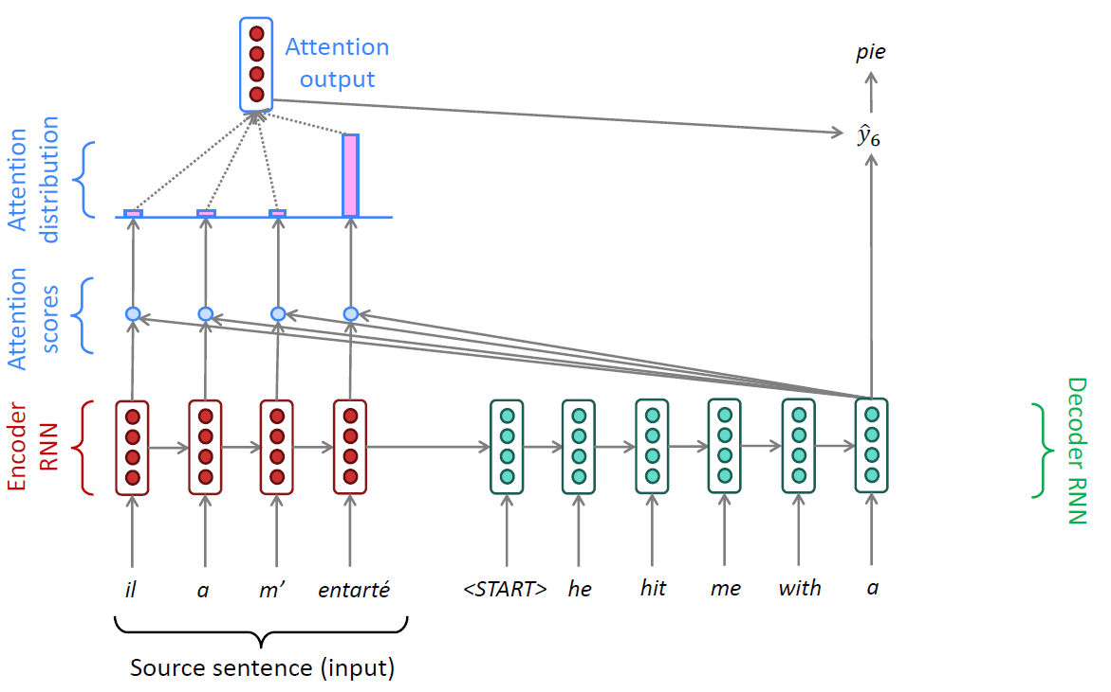
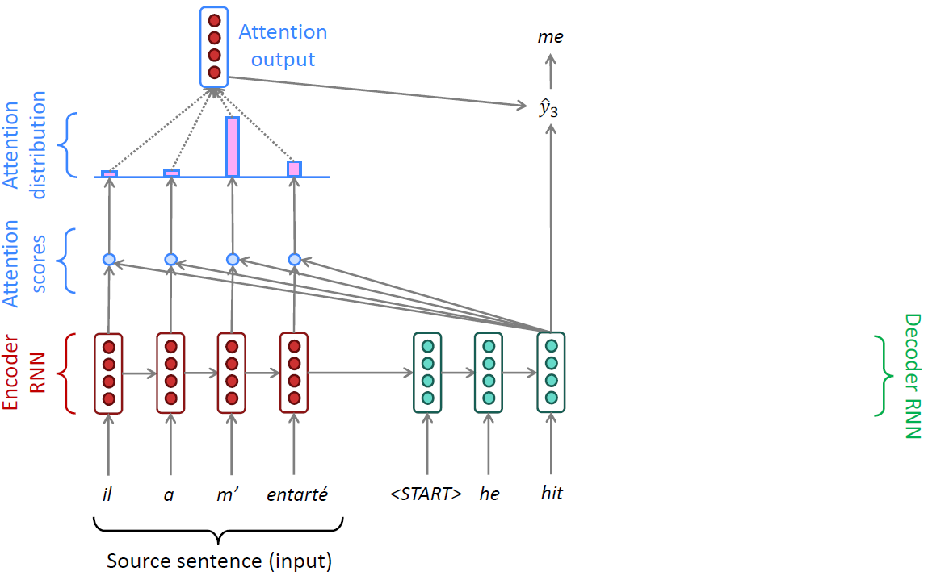
Neural Machine Translation by Jointly Learning to Align and Translate [1]

Slide 4
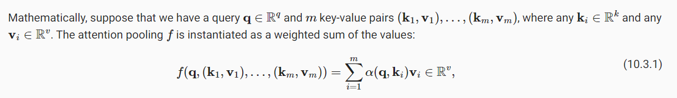
Attention

Slide 5
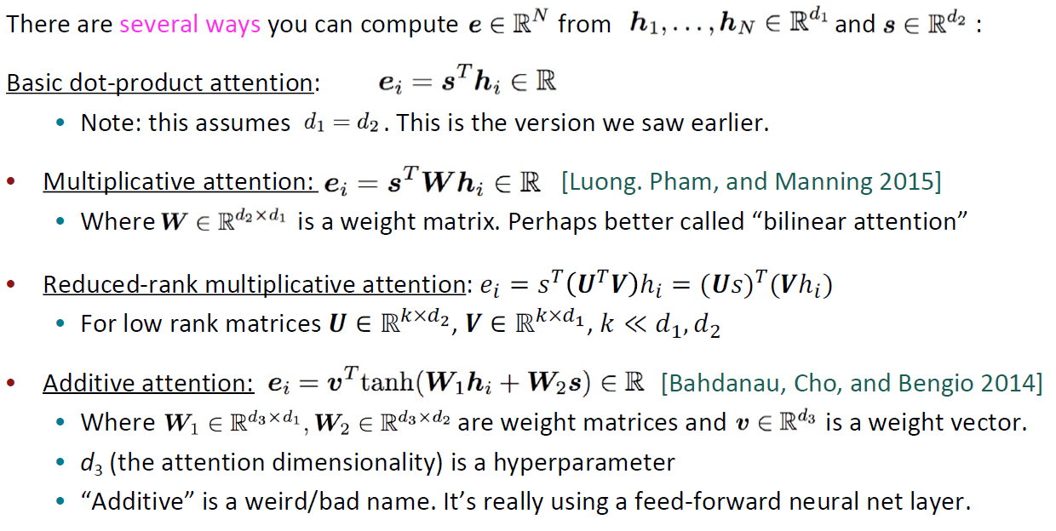
Attention Variants

Slide 6
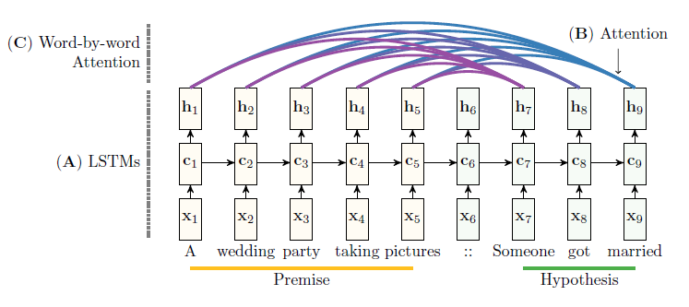
Reasoning about Entailment with Neural Attention [1]

Slide 7
Enhanced LSTM for Natural Language Inference [1]
Parikh et al. (2016) propose a relatively simple but very effective decomposable model. The model decomposes the NLI problem into subproblems that can be solved separately.
In this paper, we first revisit this problem and show that enhancing sequential inference models based on chain networks can actually outperform all previous results.

Slide 8
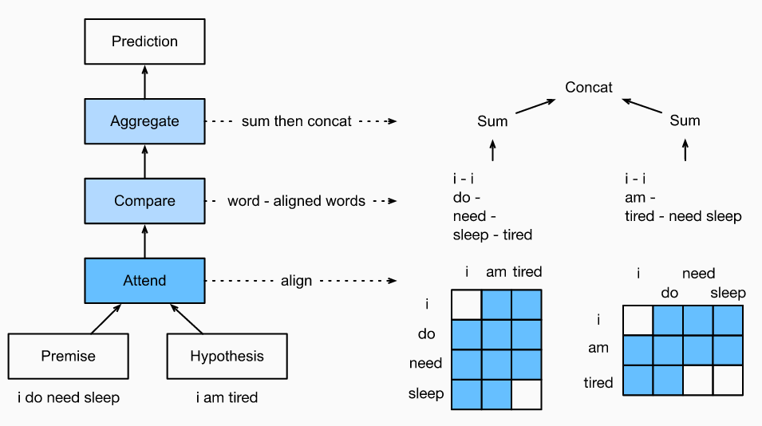
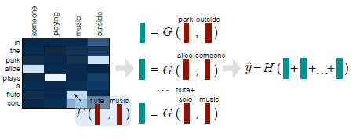
A Decomposable Attention Model for Natural Language Inference [1]
While these approaches have yielded impressive results, they are often computationally very expensive, and result in models having millions of parameters (excluding embeddings).

Slide 9

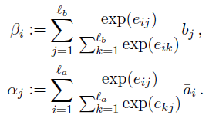
1. Attend
Denote by A=(a1, …, am) and B=(b1, …, bn) the premise and hypothesis
Decomposable Attention Model

Slide 10

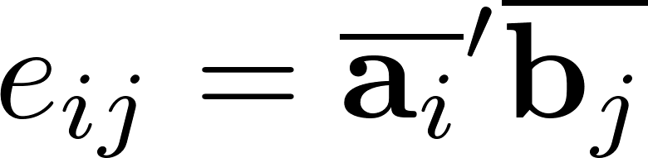
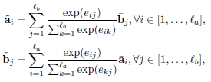
1. Attend
Denote by A=(a1, …, am) and B=(b1, …, bn) the premise and hypothesis
ESIM

Slide 11


2. Compare
Decomposable Attention Model
ESIM

Slide 12

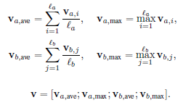
3. Aggregate
Decomposable Attention Model
ESIM
We consider that summation (Parikh et al., 2016) could be sensitive to the sequence length and hence less robust. We instead suggest the following strategy: compute both average and max pooling, and concatenate all these vectors to form the final fixed length vector v.
?

Slide 13

4. Softmax Layer

Slide 14
Summary
Layers | Decomposable | ESIM | 我的-1 | 我的-2
Padding | True | ? | True | True
Embeddings | 300d-GloVe, frozen | 300d-GloVe, frozen | 50d-GloVe, trainable | 50d-GloVe, trainable
Encoder | Fully-Connected Layers x2 | BiLSTM | BiLSTM | Fully-Connected Layers x2
Attend | Dot Product | Dot Product | Dot Product | Dot Product
Compare | G(v_1, v_2) | [m_11, m_12, m_11-m_12, m_11 · m_12] | [m_11, m_12, m_11-m_12, m_11 · m_12] | [m_11, m_12, m_11-m_12, m_11 · m_12]
Aggregate | Summing up | Combined Poolings | Combined Poolings | Combined Poolings
Parameters | 382K | 4.3M | 没数 | 没数
Training | 50m batches | 40 hours | 2 epochs | 2 epochs
Accuracy | 86.3 | 88.0 | 69.3 | 65.1

Slide 15
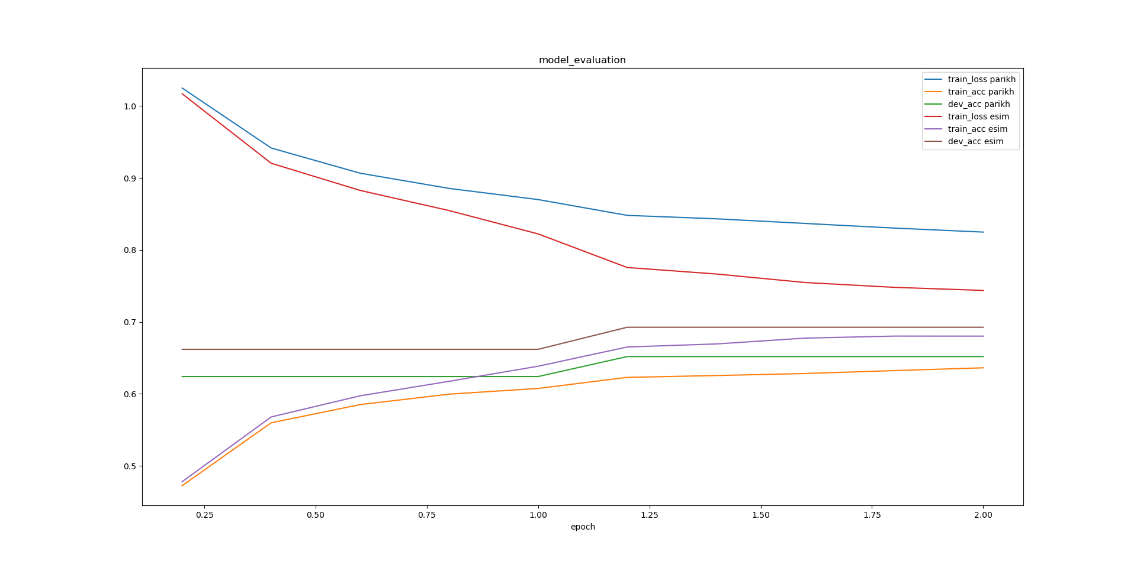
Summary

