Slide 1

Softmax Regression for Text Classification
Yanjun Shao
School of Data Science, Fudan
March 10, 2022

Slide 2


Dataset for Sentiment Analysis
The Rotten Tomatoes movie review dataset is a corpus of movie reviews used for sentiment analysis, originally collected by Pang and Lee[1].
We are asked to label phrases on a scale of five values: negative(0), somewhat negative(1), neutral(2), somewhat positive(3), positive(4).
Fudan
[1] Pang and L. Lee. 2005. Seeing stars: Exploiting class relationships for sentiment categorization with respect to rating scales. In ACL, pages 115–124.

Slide 3
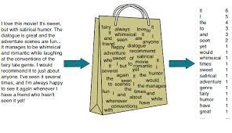
Bag-of-Word
In traditional NLP, we regard words as discrete symbols. Such symbols for words can be represented by one-hot vectors,
motel = [0 0 0 0 0 0 0 0 0 0 1 0 0 0 0]
hotel = [0 0 0 0 0 0 0 1 0 0 0 0 0 0 0]
Drawbacks
These two vectors are orthogonal.
There is no natural notion of similarity for one-hot vectors.
Alternatives
Principal Component?
Word Embeddings?
Fudan

Slide 4
Bag-of-Word for Dataset
PhraseID | A | series | of | Escapades | demonstrating | the | adage | that | Sentiment
1 | 1 | 1 | 1 | 1 | 1 | 1 | 1 | 1 | 1
2 | 1 | 1 | 0 | 0 | 0 | 0 | 0 | 0 | 1
3 | 0 | 1 | 1 | 1 | 0 | 0 | 0 | 0 | 2
4 | 0 | 0 | 0 | 1 | 1 | 1 | 1 | 0 | 3
5 | 0 | 0 | 0 | 0 | 0 | 1 | 1 | 1 | 2
Fudan

Slide 5
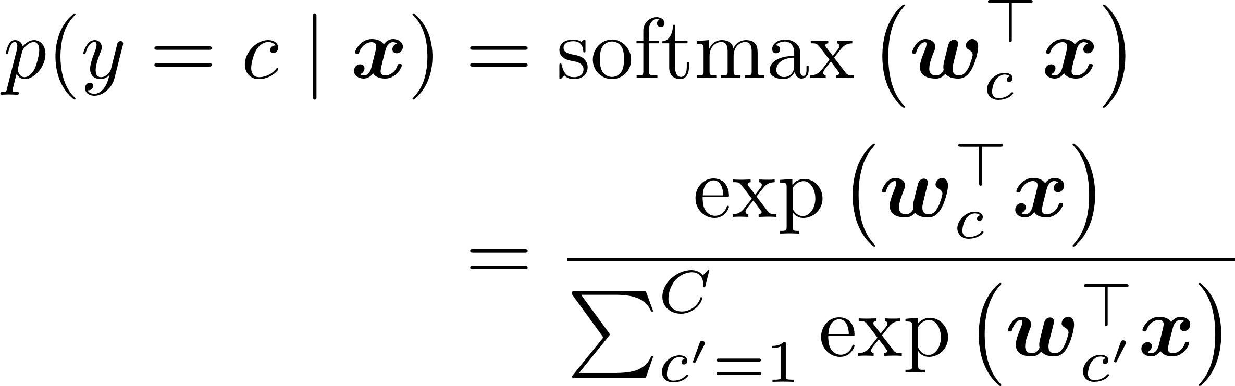
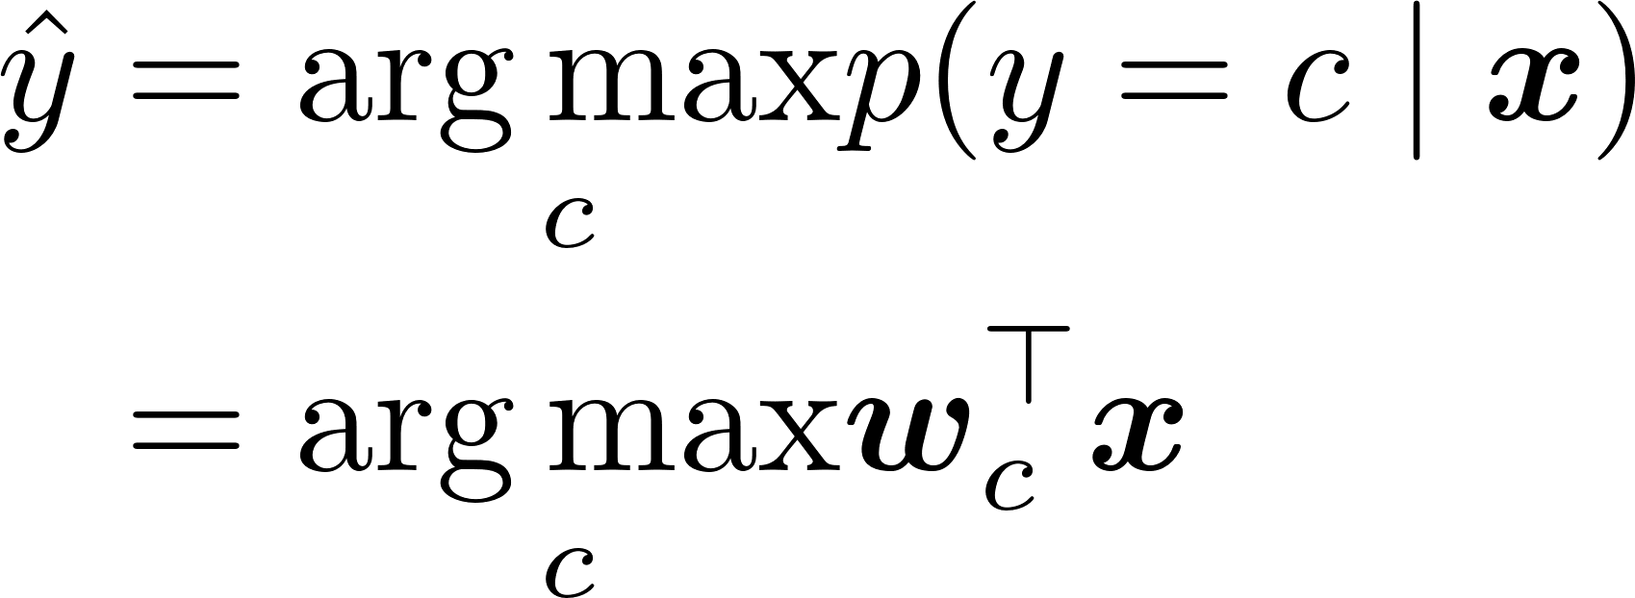
Softmax Regression
The probability of a given sample X belonging to class c is given by
And the output should be
Fudan

Slide 6
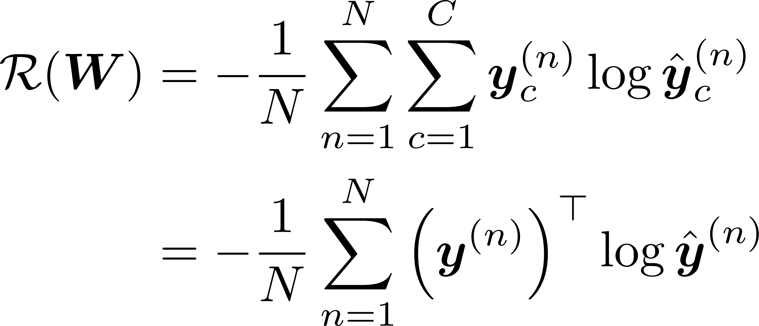
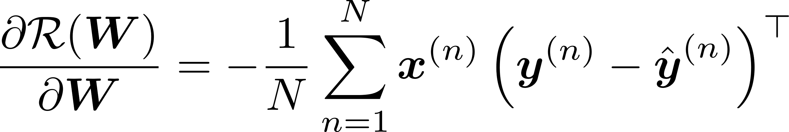
Softmax Regression (Cont.)
We use cross-entropy loss for optimization, and the loss function can be formulated as
Compute gradient of R(W) for W
Fudan

Slide 7
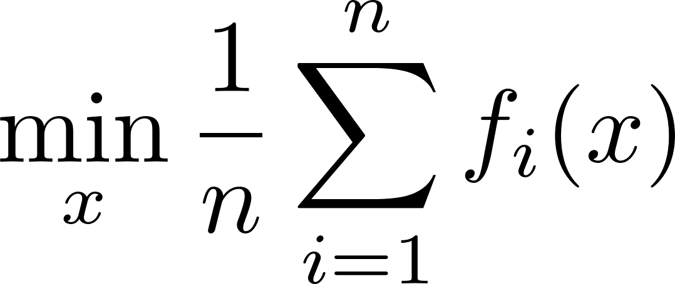
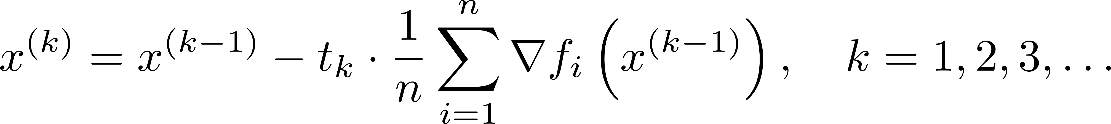
Gradient Descent
Consider minimizing an average of functions
The full gradient descent step is given by
E
w
Fudan

Slide 8
How the gradient descent goes wrong
If the learning rate is big, this oscillation diverges.
If the dataset is highly redundant, the gradient on the first half is almost identical to the gradient on the second half.
We would like to achieve:
Move quickly in directions with small but consistent gradients.
Move slowly in directions with big but inconsistent gradients.
Fudan

Slide 9
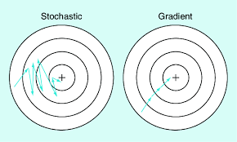

Stochastic Gradient Descent
Stochastic Gradient Descent repeats,
where $i_{k}$∈ {1, ..., n} is a randomly chosen index at iteration k.
Fudan

Slide 10
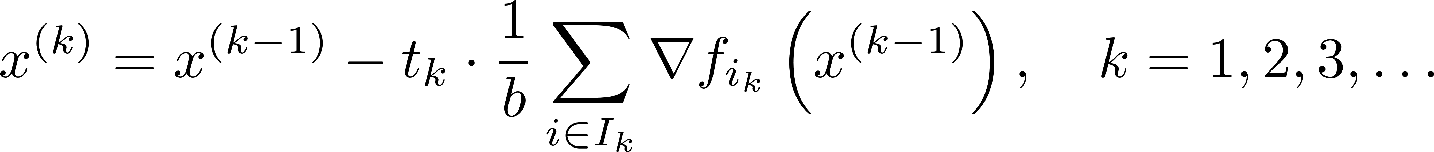
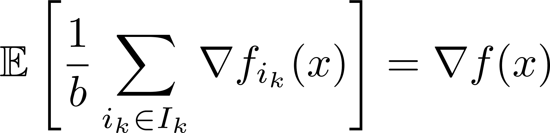
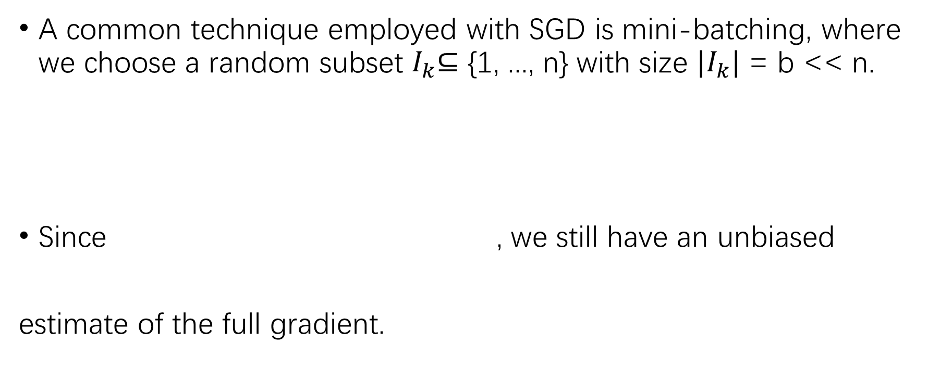
Mini-batch Gradient Descent
A common technique employed with SGD is mini-batching, where we choose a random subset $I_{k}$⊆ {1, ..., n} with size $|I_{k}|$ = b << n.
Since , we still have an unbiased
estimate of the full gradient.
Fudan

