Slide 1
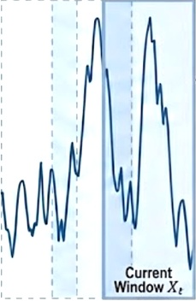

FCM-MoE Framework Architecture
Time Series Input& Sliding Window
State Vector Calculation
PCA Dimensionality Reduction
FCM Clustering(Fuzzy, K=3)
Warm-Start Initialization
Prediction Output
Cluster 0(Low irradiance)
Cluster 1(Clear Sky)
Global Pre-trained GRU
图
28-dim
Copy weights
8D output
28D input
Cluster 2(Cloudy)
Expert 0
GRU
Hard Routing（argmax)
Expert 1
Forecast
t-2
t-1
GRU
Sliding Direction
Expert 2
GRU

