Slide 1
Book online-shopping website
For IWD Assignment 2

Slide 2
Introduction
Book online-shopping website
Provide lots of books for book lovers to buy
Structure:
Home page
Product page
Signup page
About page

Slide 3
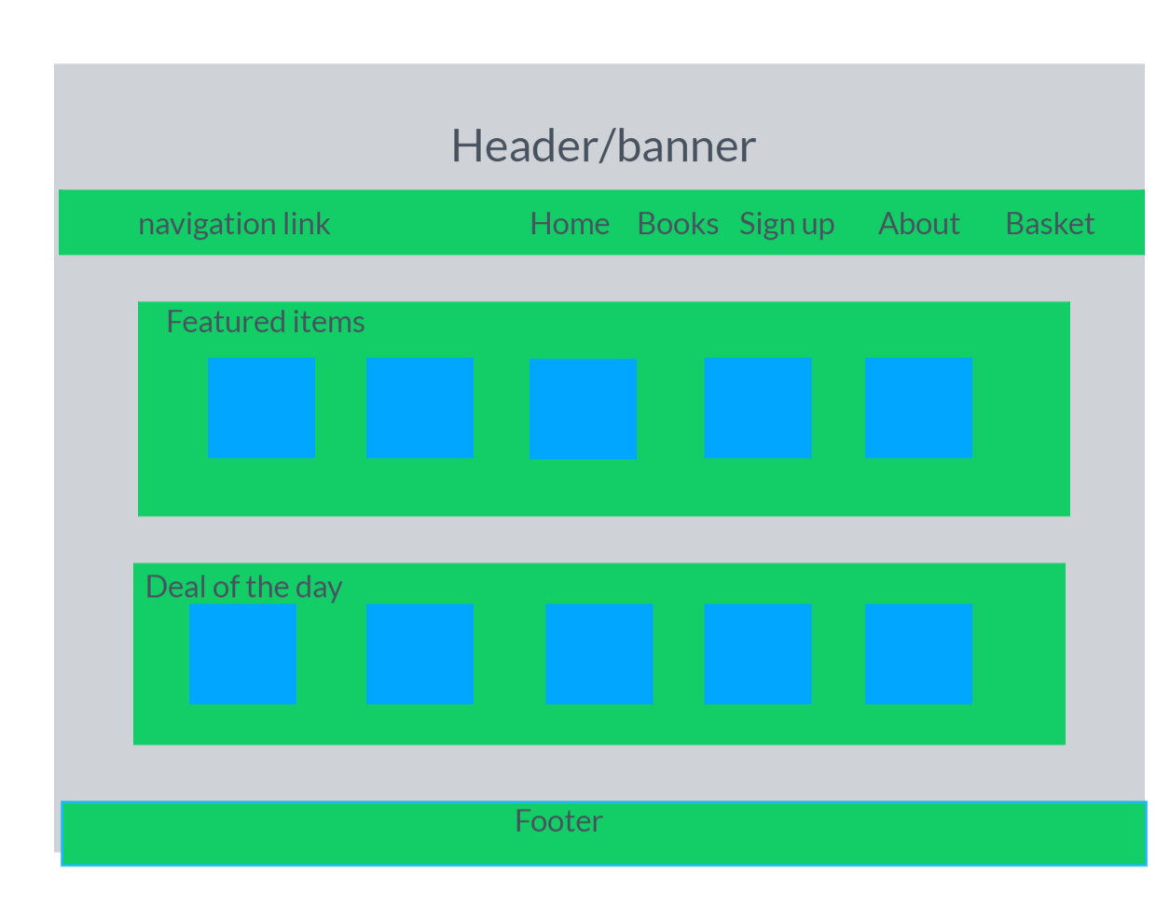
Home Page

Slide 4
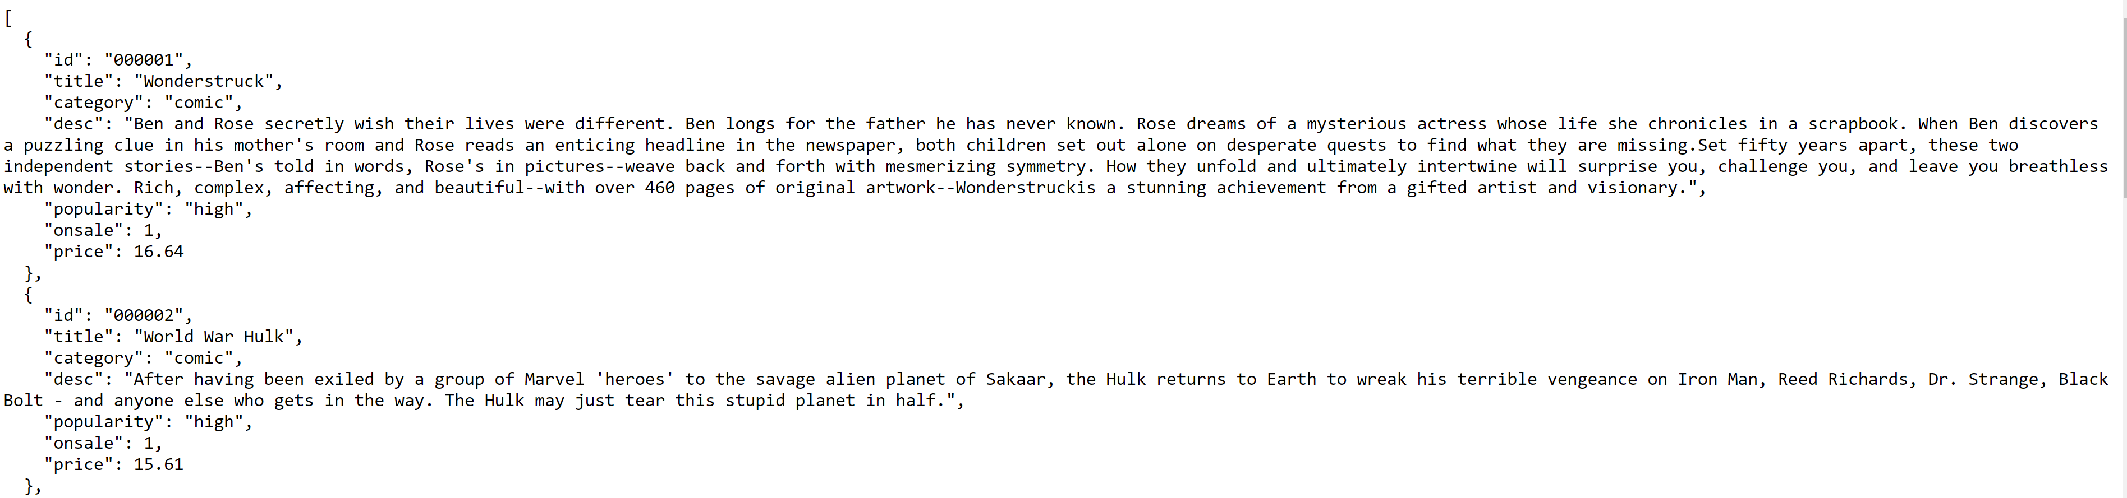
Creating of JSON file
It has the following structure

Slide 5
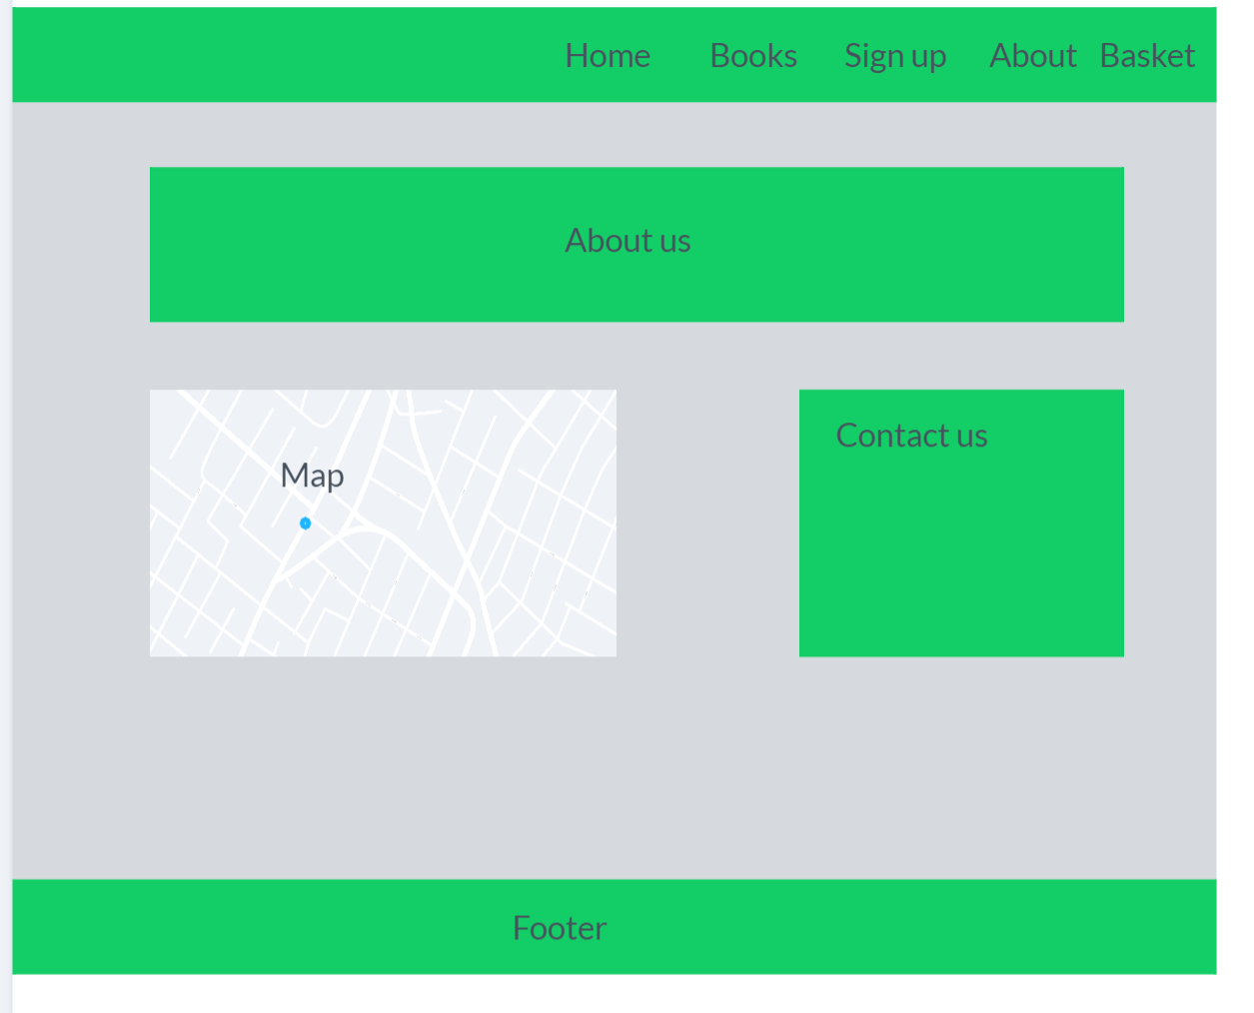
About Page

Slide 6
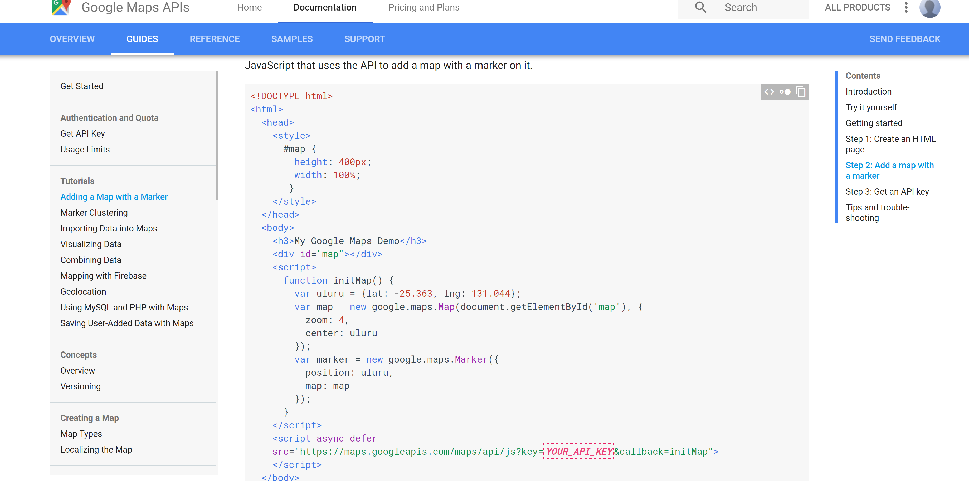
Instructions for adding map with marker
https://developers.google.com/maps/documentation/javascript/adding-a-google-map#step_1_create_an_html_page

Slide 7
Product page layout
Dynamically From recommended.json
Recommended products
Filter area | Products list
Dynamically From products.json
Dynamically From products.json

Slide 8
ProductDetail page layout
Picture | Information
 | Description
Add to cart

Slide 9
Shopping Cart
index | title | quantity | price | del
1 | A | 1 | $12.00 | X
2 | B | 2 | $11.00 | X
3 | C | 3 | $10.00 | X
Total Price：$33.00
Buy All

Slide 10
Technical details
JSON: Upload to GitHubGist, two json files, products.json and recommended.json
Jquery, Ajax:
var productList= $.ajax({url:"",async:false}).responseText;
Lodash: A modern JavaScript utility library delivering modularity, performance & extras.

Slide 11
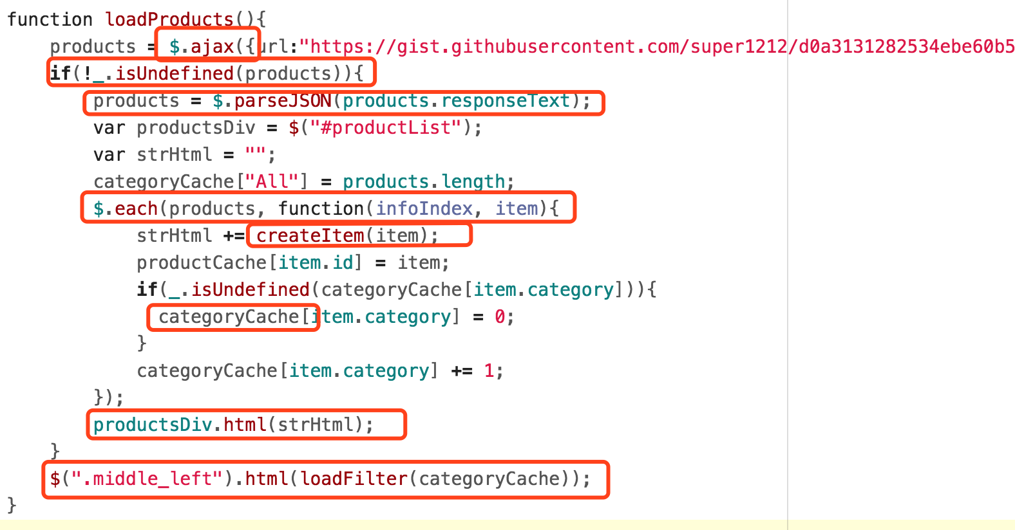
Code example

Slide 12
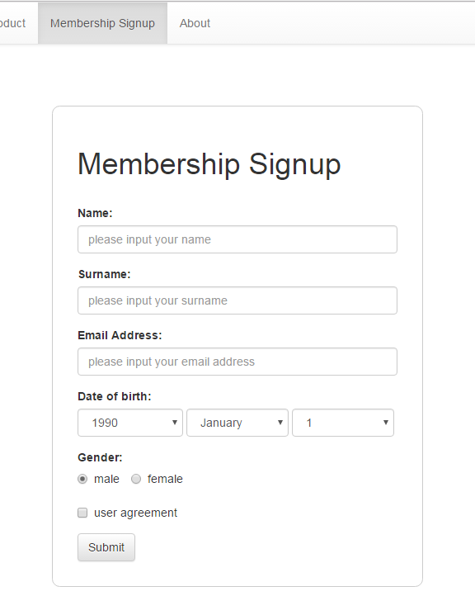
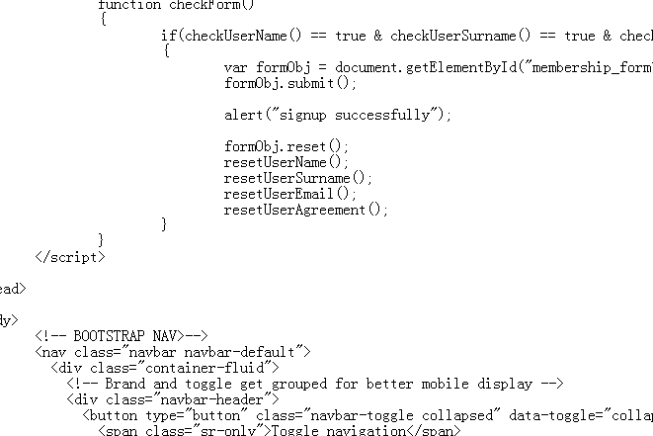
Signup Page
Provide a form for user to sign up

Slide 13
Conclusion
Team work：
Task division
Group discussion：page layout, bootstrap, xml or json, ajax, collect products , share one header and footer etc.
Discussion once a week

Slide 14
Conclusion
Challenges ：
Team work, different people have different opinions, how to reach a consensus?
Technology, Read local AJAX file, from local file to online file.
Merge and debug

Slide 15
Conclusion
Improvement：
Information retrieval, more conditions
More information about the products
Intelligent recommended books

