Slide 1
Deep Matrix Factorization Models for Recommender Systems∗
Hong-Jian Xue, Xin-Yu Dai, Jianbing Zhang, Shujian Huang, Jiajun Chen
National Key Laboratory for Novel Software Technology; Nanjing University, Nanjing 210023, China Collaborative Innovation Center of Novel Software Technology and Industrialization, Nanjing 210023, China xuehj@nlp.nju.edu.cn, {daixinyu,zjb,huangsj,chenjj}@nju.edu.cn
（IJCAI-2017）

Slide 2
Contribution:
• We propose novel deep matrix factorization models with a neural network that map the users and items into a common low-dimensional space with non-linear projections. We use a matrix including both explicit ratings and non-preference implicit feedback as the input of our models.
• We design a new loss function to consider both explicit ratings and implicit feedback for better optimization.
• The experimental results show the effectiveness of our proposed models which outperform other state-of-the- art methods in top-N recommendation.

Slide 3
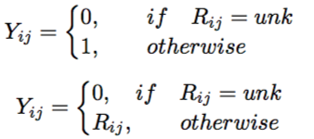
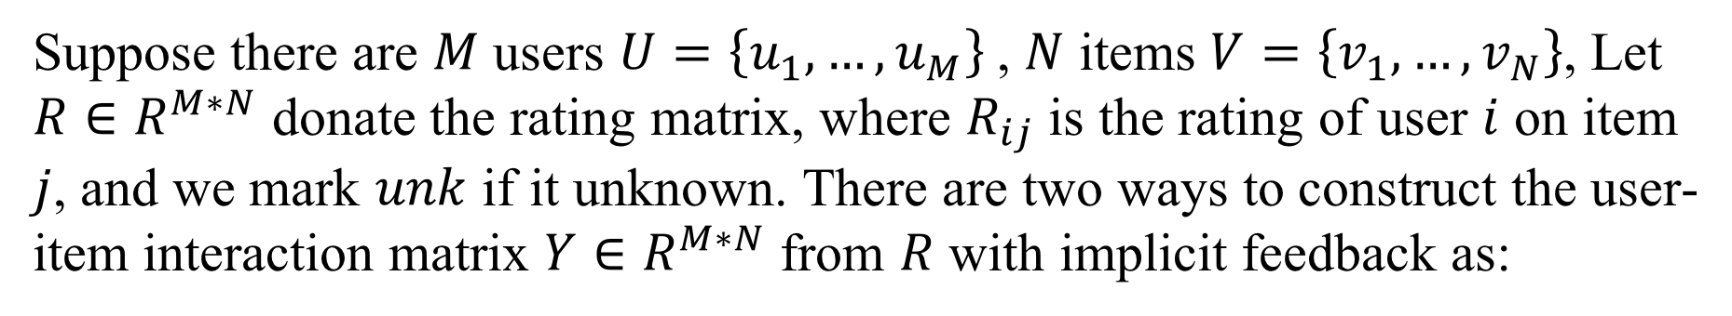
Problem Statement
Suppose there are $M$ users $U=\left\{u_{1},…,u_{M}\right\}$, $N$ items $V=\left\{v_{1},…,v_{N}\right\}$, Let $R∈R^{M∗N}$ donate the rating matrix, where $R_{ij}$ is the rating of user $i$ on item $j$, and we mark $unk$ if it unknown. There are two ways to construct the user-item interaction matrix $Y∈R^{M∗N}$ from $R$ with implicit feedback as:
作者发现，近些年推荐系统与深度学习相结合的模型，很多都只使用的隐式反馈。（可能因为在很多情况下推荐系统的目的都是为了预测用户是否会对一个物品感兴趣，因此隐式反馈这种0-1矩阵形式与其更加契合。作者认为显示反馈是非常有意义的，即便是用在用户是否感兴趣问题上也需要利用以上信息），这里作用使用的是第二个公式。

Slide 4


Problem Statement
The recommender systems are commonly formulated as the problem of estimating the rating of each unobserved entry in Y , which are used for ranking the items. Model-based approaches has an underlying model which can generate all ratings as follows.
Now, the next question is how to define such a function$F$. Latent Factor Model (LFM) simply applied the dot product of $p_{i}$, $q_{j}$ to predict the $\hat{Y_{ij}}$ .

Slide 5
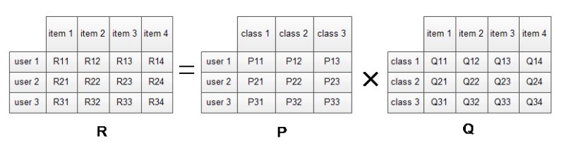


LFM（隐语义模型）

Slide 6
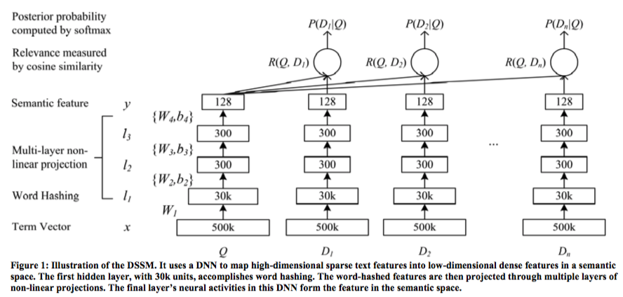
Learning Deep Structured Semantic Models for Web Search using Click-through Data
（CIKM-2013）

Slide 7
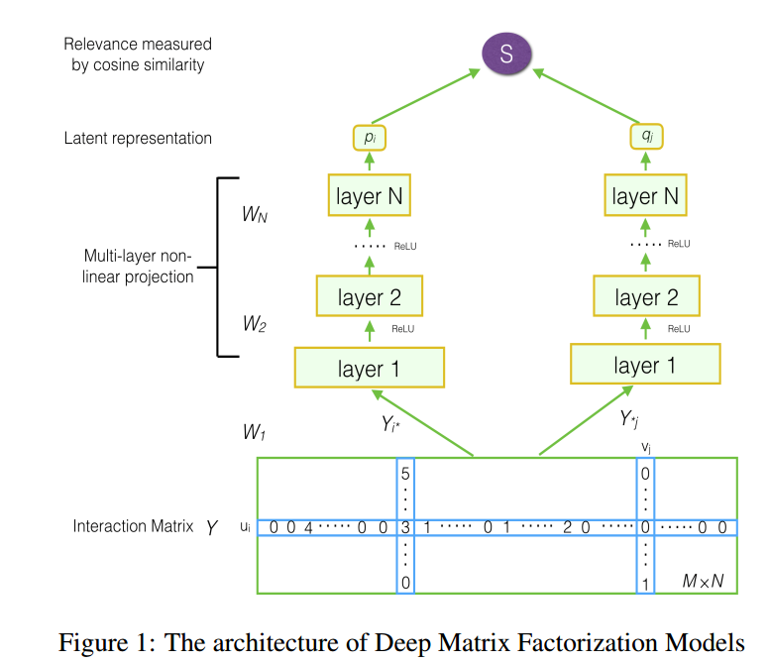
Proposed Model

Slide 8

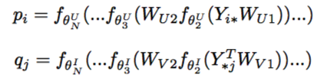

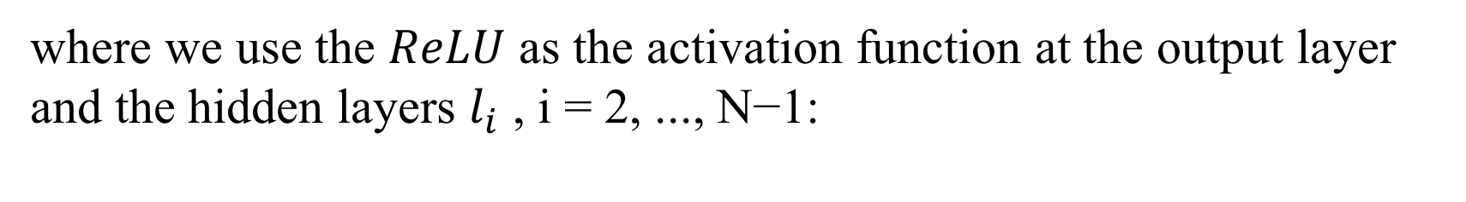
Proposed Model
where we use the $ReLU$ as the activation function at the output layer and the hidden layers $l_{i}$ , i = 2, ..., N−1:

Slide 9




Loss Function
A general objective function is as follows :
Squared loss is largely performed in many existing models :
A loss function which pays special attention to the binary property of implicit data was proposed by [He et al., 2017] as follows :
New loss as normalized cross entropy loss :

Slide 10
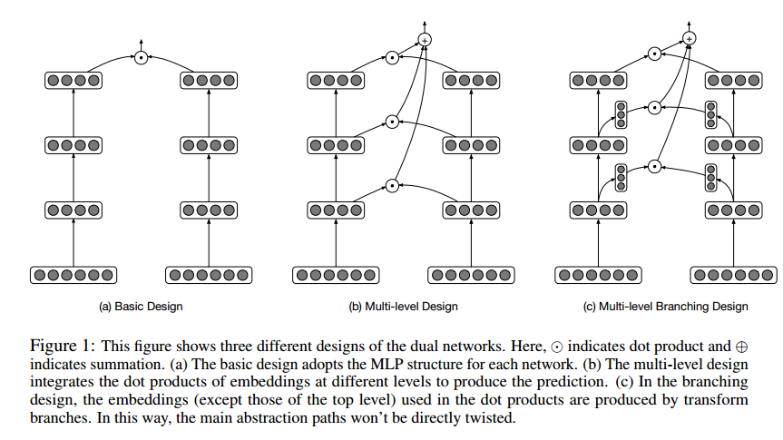

Collaborative Deep Embedding via Dual Networks
（ICLR）

Slide 11
