Slide 1
EE201C Final Presentation
Endi Xu 005030030
Lu shijun 905035448

Slide 2
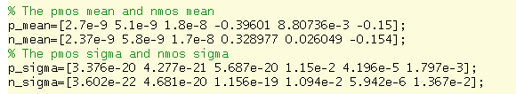
Dimension Reduction
Based on the mean and sigma provided, the first 3 columns can be ignored. Then, we try to see the weights of the influences of the rest 3 columns.
The conclusion is that the Vth is the dominate parameter. So, the original 360 dimension can be reduced to 2 dimension.

Slide 3
Proposed Method
Pre-Sampling
Points Reduction
Find the final failure points
Get the results

Slide 4
Pre-sampling
Set the threshold delay time at 1.35e-10
Set the FOM at 0.08
The failure probability is 0.057

Slide 5
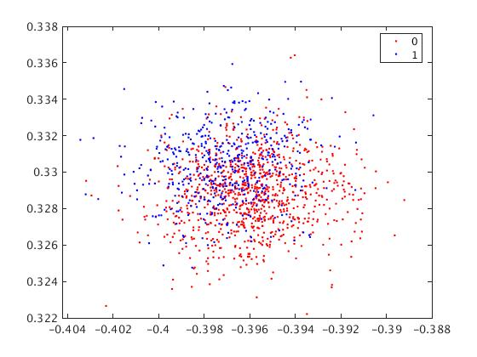
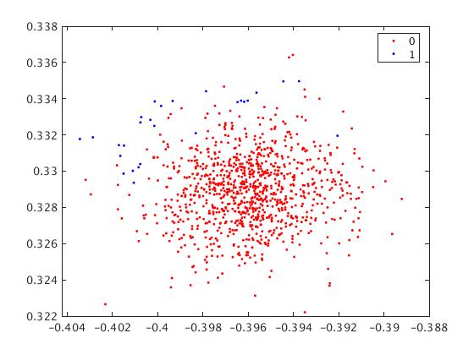
Remove Useless Point
Based on the failure date and pass data collected above. For each case, the PMOS Vth mean and the NMOS Vth mean can be plot on one plot.
We need to decide which cases will lead to the failure
The algorithm is the following:
For each failure cases
For each pass cases
Find the Euclidean distance between a failure point and its closest pass point
end
For each failure cases
Find the Euclidean distance between a failure case and its closest failure point
end
end
Remove failure points that is too close to pass points and failure points that is too fat to other failure points

Slide 6
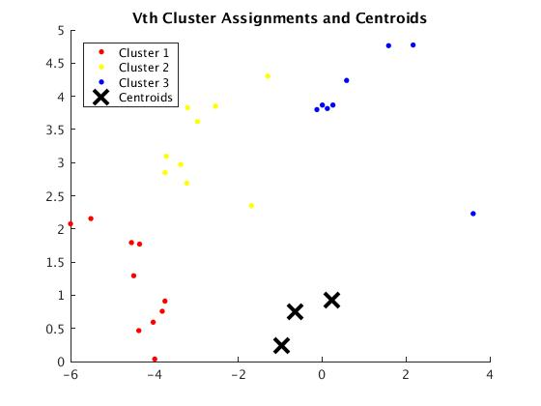
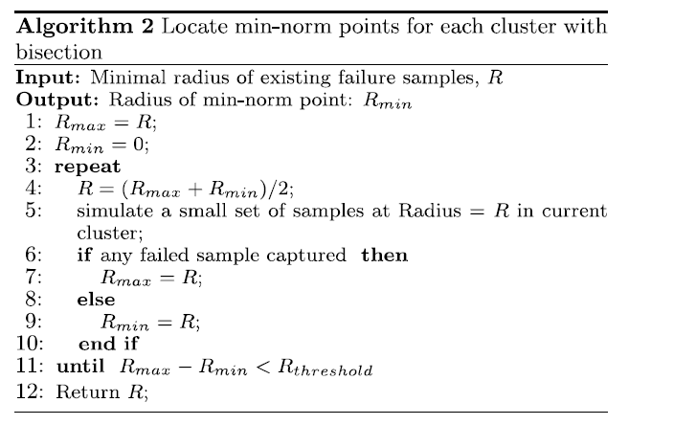
Find Centroid Point
After remove useless points, we can use K-mean algorithm to find the cosine centroid points.
Then, follow the cosine points, we can find the point which can find enough failure cases.
The final point is the following:
-0.4062 0.3407
-0.4131 0.3333
-0.3910 0.3497

Slide 7
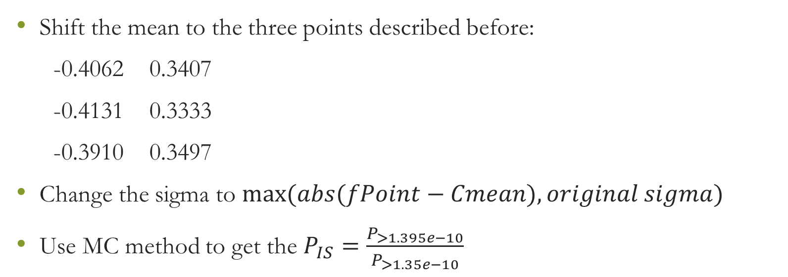
Important Sampling
Shift the mean to the three points described before:
-0.4062 0.3407
-0.4131 0.3333
-0.3910 0.3497
Change the sigma to $max⁡(abs(fPoint−Cmean), original sigma)$
Use MC method to get the $P_{IS}=\frac{P_{>1.395e−10}}{P_{>1.35e−10}}$

Slide 8
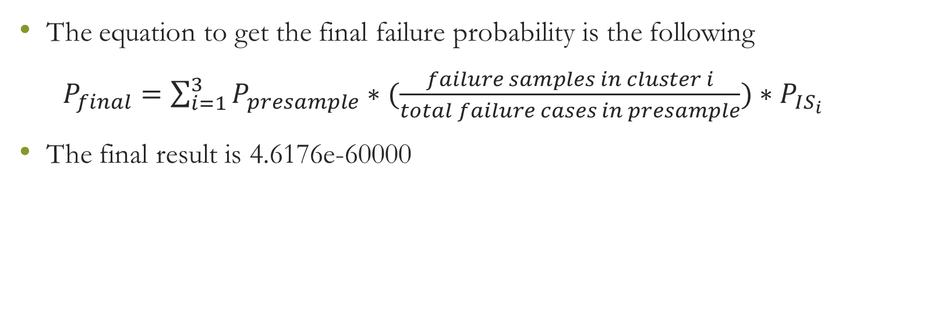
Final Result
The equation to get the final failure probability is the following
$P_{final}=\sum_{i=1}^{3}{P_{presample}∗(\frac{failure samples in cluster i}{total failure cases in presample})}∗P_{IS_{i}}$
The final result is 4.6176e-60000

Slide 9
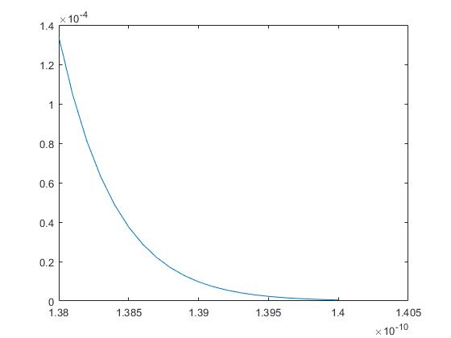
Conclusion
Total Samples needed 30K – 40K
Probability Range: 4e-6 – 7.5e-6
Delay time distribution tail-event

Slide 10
Reference
Wei Wu, Srinivas Bodapati, and Lei He. "Hyperspherical clustering and sampling for rare event analysis with multiple failure region coverage." Proceedings of the 2016 on International Symposium on Physical Design. ACM, 2016.
Wei Wu, Fang Gong, Gengsheng Chen, Lei He. “A Fast and Provably Bounded Failure Analysis of Memory Circuits in High Dimensions” 19th Asia and South Pacific Design Automation Conference, (ASP-DAC), 2014.

