Slide 1
deep learning for supervised changepoint detection
Weiheng su

Slide 2
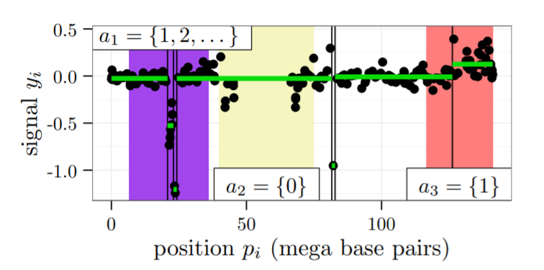
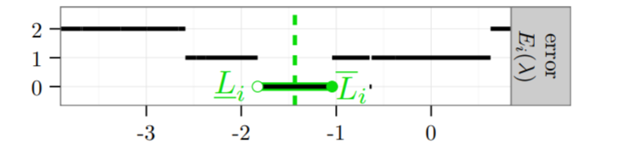
Project description
What our profiles data looks like:
For each sequcenceID, it has different number of signals on different position
Left: black points show one signal (pi, yi) in one sequence id.
Right: the interval target which drawn in green is the error of one sequence id i.
Link: http://proceedings.mlr.press/v28/hocking13.pdf

Slide 3
What is deep learning?
Deep learning is an artificial intelligence (AI) function that imitates the workings of the human brain in processing data and creating patterns for use in decision making.
Deep learning is a subset of machine learning that has networks capable of learning from unstructured or unlabeled data.
Also known as deep neural learning or deep neural network.
Link: https://www.investopedia.com/terms/d/deep-learning.asp

Slide 4
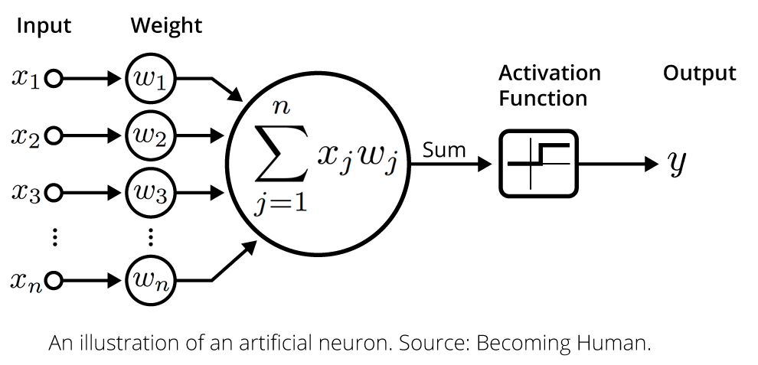
How deep learning work
Y = Activate( sum (x_{j}w_{j} ) ) ( j is from 1 to n)

Slide 5
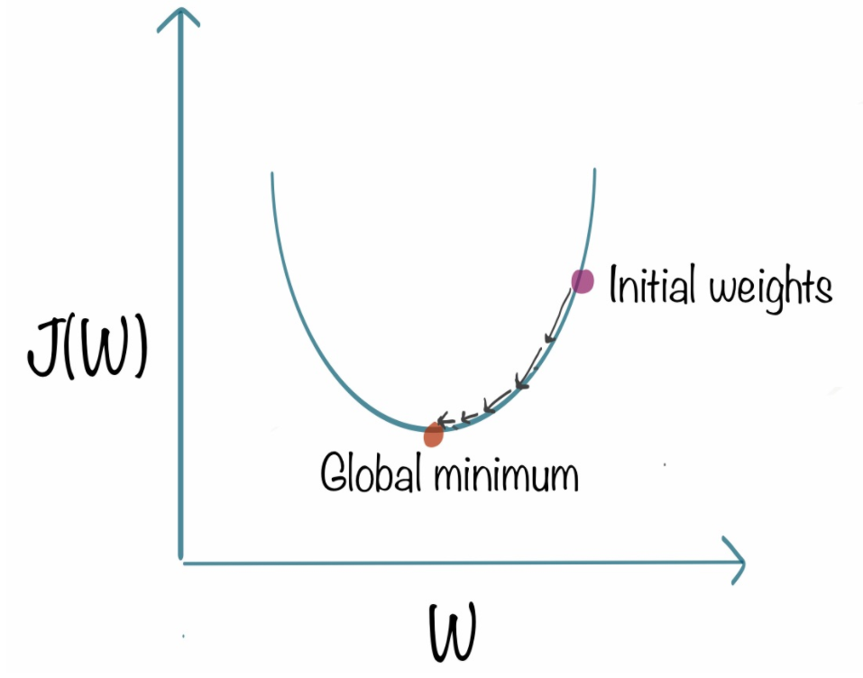
Gradient descent
Aim:
To find the best w which minimize the Loss function
How it work:
1.Init Activated function f(), loss function L(), epoches = number of steps, w = initial weights, x = inputs,
y = labels, step = small value, EX 0.01
2.Loop through epoches
Get the output Y from our network. Y = f(wx)
Compute Loss = L(output ,y)
Compute delta = derivate(Loss) with respect to w
Update w by w = w – delta*step
Link: https://www.kdnuggets.com/

Slide 6
early stop regularization
Aim: avoid overfitting
How it work:
Split data to train sets and test sets
Split train sets to subtrain sets and validation sets
3. Save initial weight w
4. Loop through epoches:
Subtrain_Output = Network( subtrain )
Compute Subtrain_loss corresponding to Subtrain_Output and do gradient
descent
Save weights of model and subtrain loss.
Validation_Output = Network( validation ), use the weight we save.
Compute and save the validation loss.
5. When loop stop, compare subtrain loss and validation loss

Slide 7
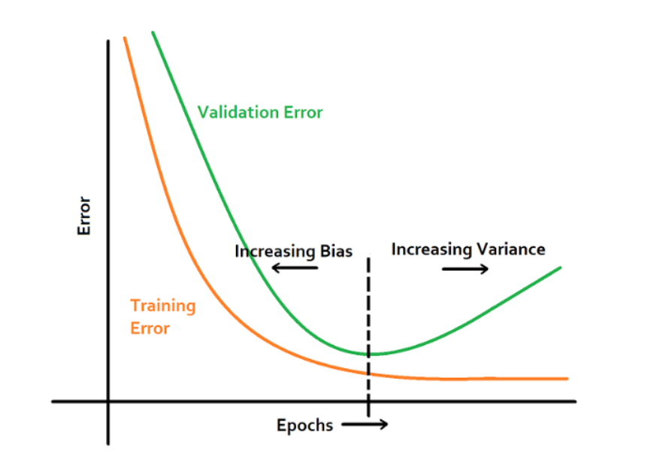
underfitting
overfitting
Link: http://fouryears.eu/
5. Choose the best number of epoch ,best_epoch
6. Loop through best_epoch
train_Output = Network( train ) with initial w
Do gradient descent
save the weight of model after training
7. test_Output = Network( test ) use the weight we saved, compare test_Output with labels, get accuracy.

Slide 8
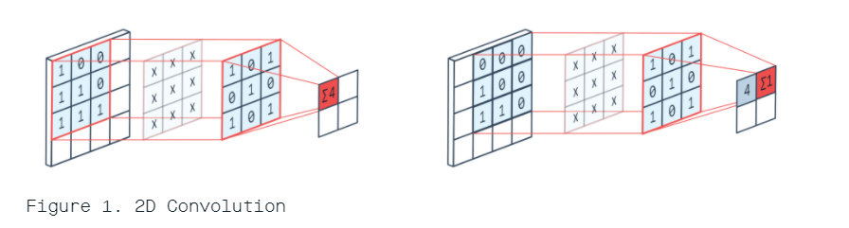
Convolutional network
What is convolution:
convolution performing a matrix multiplication operation between kernel and the portion of the image over which the kernel is hovering.
Sum(1*1, 0*0, 1*0, 0*1, 1*1, 0*0, 1*1, 0*1, 1*1) = 4
Sum(1*0, 0*0, 1*0, 0*1, 1*0, 0*0, 1*1, 0*1, 1*0) = 1
Link: https://peltarion.com/

Slide 9
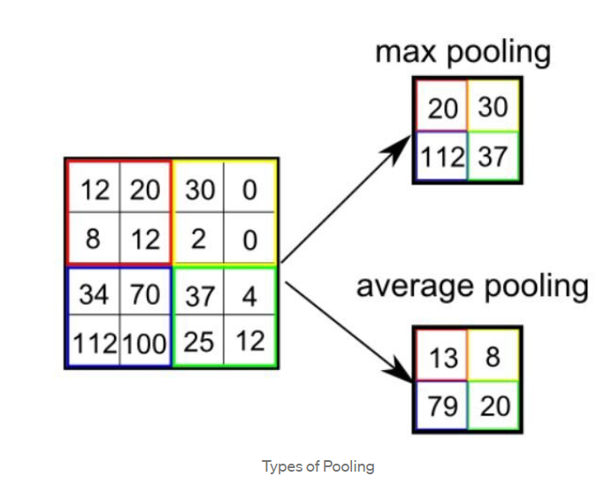
What is pooling:
There are two types of Pooling: Max Pooling and Average Pooling.
Max Pooling returns the maximum value from the portion of the image covered by the Kernel.
Average Pooling returns the average of all the values from the portion of the image covered by the Kernel.
Aim: reduce parameter
Link:https://towardsdatascience.com/

Slide 10
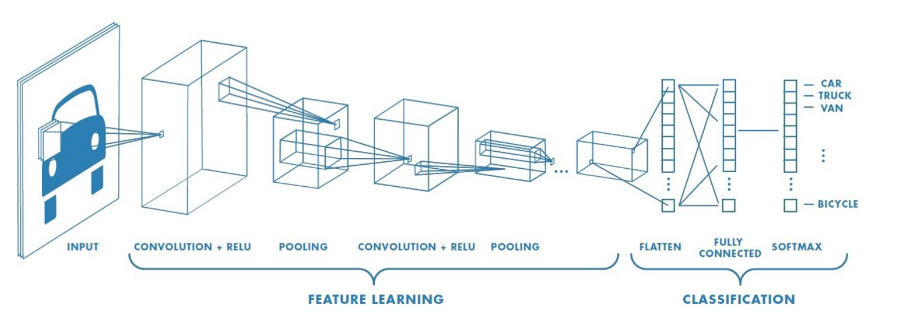
How convolutional network looks like:
Link:https://towardsdatascience.com/

Slide 11
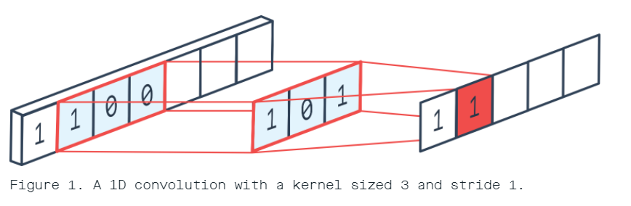
convolution1D network
Stride 1 : move filters by 1 element at a time
Compare with convolution2D, kernel is a vector and only move one direction
Difference table | convolution2D | convolution1D
kernel | matrix | vector
direction | Two direction | One direction

Slide 12
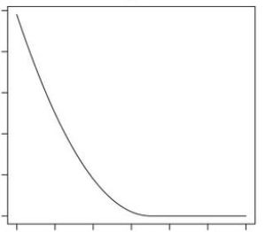
Square hinge loss function
Init: output from network, label
( the label of our data is an interval, mark as label_down, label_up)
Compute: gap_down = output - label_down, gap_up = label_up – output.
Loss_down = ifelse(gap_down <1,(gap_down -1)^2,0)
Loss_up = ifelse(gap_up <1,(gap_up -1)^2,0)
Loss = Loss_down + Loss_up
Link: https://www.researchgate.net/

Slide 13
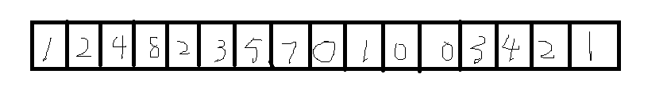
Spatial pyramid pooling
Why need spatial pyramid pooling
Traditional convolutional network need fixed input
By using spatial pyramid pooling, convolutional network support input of arbitrary sizes
Max each 16/16 elements: 1 2 4 8 2 3 5 7 0 1 0 0 3 4 2 1
Max each 16/4 elements: 8 7 1 4
Max each 16/1 elements: 8
Concatenate: 1 2 4 8 2 3 5 7 0 1 0 0 3 4 2 1 8 7 1 4 8
Have 4 + 16 + 1 = 21 elements
how it work in convolution 1D:

Slide 14
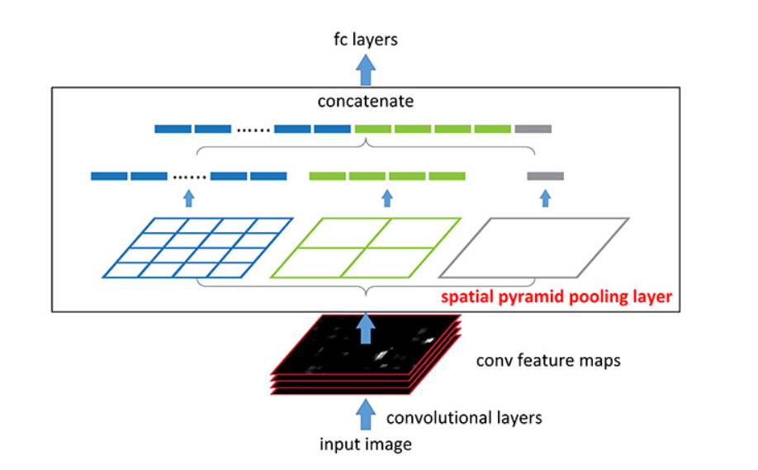
how it work in convolution 2D:
Arbitrary size
Link: http://kaiminghe.com/eccv14sppnet/index.html

Slide 15
Pytorch
What is pytorch
PyTorch is an open source machine learning library based on the Torch library, used for applications such as computer vision and natural language processing, primarily developed by Facebook's AI Research lab (FAIR). It is free and open-source software released under the Modified BSD license.
Show code how it work

Slide 16
Model 1
1.Feature engineering approach: (already coded and evaluated)
input layer = raw variable length feature vectors
---compute by Toby's-fixed-feature-function called penaltyLearning::featureVector--->
first "hidden" layer = fixed size feature vector (117) (FIXED)
2.How model 1 looks like:
nn.Linear(117, 1)
3.Do early stop regulization on linear model
117

Slide 17
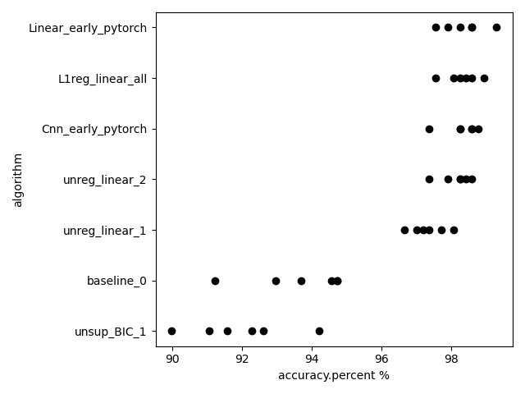
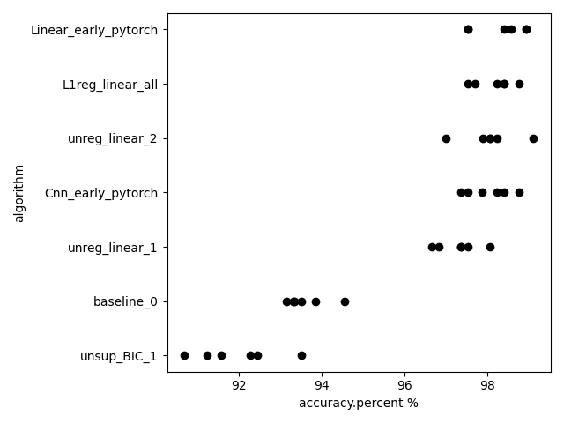
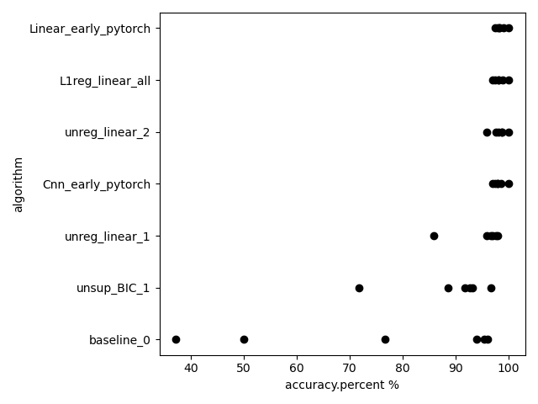
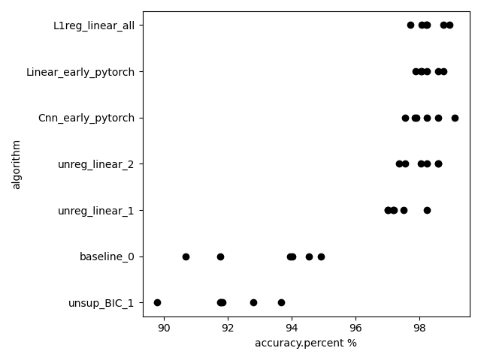

Slide 18
Model 2
1.Feature average approach: ( not finish coding )
for bigger sizes of data points, take average over several data points to get a single input unit. EX: s_i=2000, 10 data points per unit. mean of first 10 data points = first input unit, mean of second 10 data points = second input unit, etc.
for smaller sizes of data points, repeat data values in multiple input units. EX: s_i=100, first input unit = second input unit = first data point, third input unit = 4th input unit = second data point, etc.
2.How model 2 looks like:
input layer = 200 units.
--convolutional layer--> hidden layer of conv units.(MORE CONV OR FULLY CONN LAYERS)
-- fully connected layer--> 100 hidden units
-- weight vector / linear model -->
one predicted output value.
3.Do early stop regulization on Model2

Slide 19
Model 3
1. Padding with zeros approach(already coded and not evaluate)
In out data, 5937 is the largest feature size. then input units are equal to the data for the first s_i unit, and 0 after that. EX: s_i=100, first 100 input units come from data, others 5837 after that are zero. EX: s_i=200, first 200 input units come from data, other 5737 are zero.
2. How model 1 looks like:
input layer = (1 x 1 x 5937 )
--convolutional layer: inputs = nn.Conv1d(1, 4, 9)--> hidden layer of conv units (1 x 4 x 5929).
--pooling layer: F.max_pool2d(inputs, (2,4))--> hidden layer of conv units (1 x 2 x 1482).
--convolutional layer: inputs = nn.Conv1d(2, 2, 9)--> hidden layer of conv units (1 x 2 x 1474).
--pooling layer: F.max_pool2d(inputs, (2,3))--> hidden layer of conv units (1 x 1 x 491).
--flatten--> fully connected layer--> 491 hidden units (LEARNED)
-- fully connected layer: Linear(491, 120) --> 120 hidden units
-- fully connected layer: Linear(120, 1) --> one predicted output value.
3.Do early stop regulization on Model3

Slide 20
Model 4
1.spatial pyramid approach. adaptive size window (already coded and evaluating)
assume kernel width 10, channel size 5.
last convolution layer + spatial pyramid pooling.
EX:s_i=100 -> 91 x 5 units -> pooling to a uniform number of units, say 21 x 5
s_i=2000 -> 1991 x 5 units. -> pooling to a uniform number of units, say 21 x 5
2. How model 1 looks like:
input layer = (1 x 1 x feature)
--convolutional layer: inputs = nn.Conv1d(1, 6, 9)--> hidden layer of conv units (1 x 6 x feature - 8).
--pooling layer: F.max_pool2d(inputs, (2,4))--> hidden layer of conv units (1 x 3 x (feature – 8)/4).
--convolutional layer: inputs = nn.Conv1d(3, 5, 9)--> hidden layer of conv units (1 x 5 x (feature – 8)/4 - 8).
--spp pooling layer: spp(inputs) --> hidden layer of linear units ( 1 x (1 + 4 + 16) * 5) )
-- fully connected layer: Linear(105, 1) --> one predicted output value.
3.Do early stop regulization on Model4

Slide 21
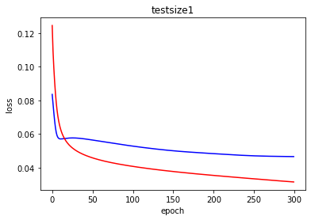
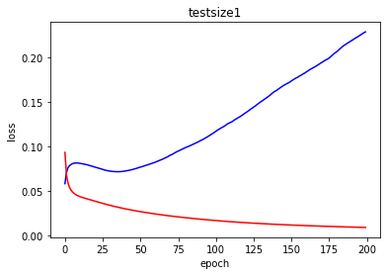
Epoch: 300
Step: 0.001
Epoch: 200
Step: 0.01

Slide 22
Thank you

