Slide 1
A Cache-Friendly Approach to
Throughput Computing on x86
CK Luk, Ryan Newton, William Hasenplaugh,
Mark Hampton, Geoff Lowney
SSG/DPD/TPI
2010 July 9

Slide 2
Background: Modern x86 Architecture
CPU
Core-1
Observations:
Multiple levels of hardware parallelism
Multiple levels of caches
T0
T1
CPU
I$
D$
SIMD-0
SIMD-1
L2 Cache
Socket-0
Socket-1
Core-0
Core-1
Core-4
Core-5
=> Software must exploit both parallelism and locality
Core-2
Core-3
Core-6
Core-7
Shared L3 cache
Shared L3 cache
Main memory

Slide 3
Outline
Our Approach
Case Studies
Evaluation
Conclusion

Slide 4
Our Approach
Basic Idea: Divide-And-Conquer
Steps:
Use Cache-oblivious Techniques to divide a large problem into smaller subproblems
Perform Compiler-based Simdization on the basecase
Use Autotuning to tune the parameters in Steps (1) and (2)

Slide 5
Step 1: Cache-Oblivious Task Parallelization
Recursively divide a problem into smaller subproblems until:
  Data needed by a subproblem is small enough to fit in any reasonable cache
  No need to explicitly specify the cache size in the algorithm
Compute data-independent subproblems with task parallelism
Optimal cache-oblivious algorithms guarantee minimum number of cache misses
  Nevertheless, non-optimal cache-oblivious algorithms may work equally well (or better) in practice

Slide 6
Example: Strassen’s Matrix-Multiplication Algorithm
C
=
A
x
B
C₁₁
C₁₂
A₁₁
A₁₂
B₁₁
B₁₂
=
x
C₂₁
C₂₂
A₂₁
A₂₂
B₂₁
B₂₂
Strassen’s Algorithm:
P₁ = ( A₁₁ + A₂₂ ) x ( B₁₁+ B₂₂ )
P₂ = ( A₂₁ + A₂₂ ) x B₁₁
P₃ = A₁₁ x ( B₁₂ - B₂₂ )
P₁ to P₇ can be computed in parallel
P₄ = A₂₂ x ( B₂₁- B₁₁ )
P₅ = ( A₁₁ + A₁₂ ) x B₂₂
P₆ = ( A₂₁ – A₁₁ ) x ( B₁₁+ B₁₂ )
P₇ = ( A₁₂ - A₂₂ ) x ( B₂₁+ B₂₂ )
C₁₁ = P₁ + P₄ - P₅ + P₇
C₁₁ to C₂₂ can be computed in parallel once P₁ to P₇ are available
C₁₂ = P₃ + P₅
C₂₁ = P₂ + P₄
C₂₂ = P₁ – P₂ + P₃ + P₆

Slide 7
Step 2: Simdization
The software step that extracts parallelism from an application which can be mapped to the SIMD units
Example
void Multiply(int N, float* A, float* B, float* C) {
for (int i=0; i<N; i++)
C[i] = A[i] * B[i];
}
Potentially 4x speedup
Without Simdization
With Simdization
Cycle
Instruction Executed
Cycle
Instruction Executed
0
C[0] = A[0] * B[0]
0
C[0..3] = A[0..3] * B[0..3]
1
C[1] = A[1] * B[1]
1
C[4..7] = A[4..7] * B[4..7]
2
C[2] = A[2] * B[2]
3
C[3] = A[3] * B[3]
N/4-1
C[N-4..N-1] = A[N-4..N-1] * B[N-4..N-1]
N-1
C[N-1] = A[N-1] * B[N-1]

Slide 8
Compiler-based Simdization
Simdization should be best done by compiler instead of programmer
Simdization support in Intel Compiler:
Auto-simdization
Programmer-directed
CEAN Array Notation
SIMD Intrinsics (We don’t encourage)
Ease of use

Slide 9
Auto-Simdization
void Multiply(int N, float* A, float* B, float* C) {
for (int i=0; i<N; i++)
C[i] = A[i] * B[i];
}
Potential aliasing problem
void Multiply(int N, float* A, float* B, float* C) {
// Compiler inserts following runtime check
if (_OverlappedAddressRanges(N, A, B, C)) {
// non-SIMDized version of the loop
for (int i=0; i<N; i++)
C[i] = A[i] * B[i];
} else {
// SIMDized version of the loop
...
}
}

Slide 10
Programmer-Directed Simdization
void Multiply(int N, float* A, float* B, float* C) {
for (int i=0; i<N; i++)
C[i] = A[i] * B[i];
}
Inform the compiler that it is safe and beneficial to simdize the following loop
void Multiply(int N, float* A, float* B, float* C) {
#pragma simd
for (int i=0; i<N; i++)
C[i] = A[i] * B[i];
}

Slide 11
CEAN Array Notation
CEAN is a new feature in ICC v12
Perform operations on arrays instead of scalars
void Multiply(int N, float* A, float* B, float* C) {
for (int i=0; i<N; i++)
C[i] = A[i] * B[i];
}
Apply the operation to each array element
(hence eliminating the for-loop)
void Multiply(int N, float* A, float* B, float* C) {
// Rewrite the loop in CEAN
// Notation A[0:N] represents elements A[0]
// to A[N-1]
C[0:N] = A[0:N] * B[0:N];
}

Slide 12
Step 3: Tuning
To maximize performance, we can tune the parameters in Steps (1) and (2):
  Basecase size in a cache-oblivious algorithm
  Degree of parallelism:
    E.g., How many threads to use?
  Level of parallelism:
    Distribution of work over TLP, ILP, and SIMD
  Scheduling policy and granularity

Slide 13
Autotuning
Produces efficient and portable code by:
  Generating many variants of the same code and then empirically finding the best performing variant on the target machine
Developed an autotuning tool called XTune:
  Programmer adds directives to the program specifying:
    Where in the program requires tuning
    What parameters need tuning and how
  XTune then automates the following steps:
    Code variant generation
    Performance comparison of these variants
    Generate the optimal code variant in the source form

Slide 14
XTune Example
Tuning the block sizes in blocked matrix multiply:
void BlockedMatrixMultiply(float* A, float* B, float* C, int n) {
#pragma xtune tunable metric(performance) variable(blk_i,(32, 256, 16)) variable(blk_j,(32, 256, 16)) variable(blk_k,(32, 256, 16)) search(independent) importance(1.0)
const int blk_i = 64;
const int blk_j = 64;
const int blk_k = 64;
for (int i=0; i<n; i+=blk_i)
for (int j=0; j<n; j += blk_j)
for (int k=0; k<n; k += blk_k)
for (int ii=i; ii<MIN(i+blk_i, n); ii++)
for (int jj=j; jj<MIN(j+blk_j, n); jj++)
for (int kk=k; kk<MIN(k+blk_k, n); kk++)
C[ii*n+jj] += A[ii*n+kk]*B[kk*n+jj];
}

Slide 15
Outline
Our Approach
Case Studies
    Stencil Computations
    Binary-tree Search
Evaluation
Conclusion

Slide 16
Case Study 1: Stencil Computations
Stencil computations are very common:
  Scientific computing, image processing, geometric modeling
A n-dimension stencil:
  The computation of an element in an n-dimensional spatial grid at time t as a function of neighboring grid elements at times t-1, … , t-k

Slide 17
Lattice Boltzman Method (LBM)
The stencil problem used in this case study:
  Lattice Boltzman Method (LBM) from SPEC’06
    Performs numerical simulation in computational fluid dynamics in the 3D space
LBM is a 19-point stencil:
NT
z
WT
T
ET
x
ST
y
NW
N
NE
W
E
SW
C
S
NB
SE
WB
B
EB
SB
Grid of cells
1 cell (with 19 velocity fields)

Slide 18
Original LBM Code
Performance Issues:
FLOP/BYTE ratio = 1.8
=> Totally Bandwidth Bound
typedef enum {
C=0, N, S, E, W, T, B,
NE, NW, SE, SW, NT, NB,
ST, SB, ET, EB, WT, WB,
FLAGS, N_CELL_ENTRIES
} CELL_ENTRIES;
typedef LBM_Grid[(PADDING + SIZE_Z * SIZE_Y * SIZE_X) * N_CELL_ENTRIES];
void LBM_performStreamCollide(LBM_Grid* src, LBM_Grid* dst) {
for (z=0; z<SIZE_Z; z++)
for (y=0; y<SIZE_Y; y++)
for (x=0, x<SIZE_X; x++) {
// Compute dst[]’s as functions of src[]’s
}
}
Sweep through the grid in every time step
srcGrid
dstGrid
void main() {
LBM_Grid* srcGrid, *dstGrid;
srcGrid = AllocateGrid();
dstGrid = AllocateGrid();
…
for (int t=1; t<= nTimeSteps; t++) {
LBM_performStreamCollide(*srcGrid, *dstGrid);
LBM_swapGrids(&srcGrid, &dstGrid);
}
}
f
Swap the srcGrid and dstGrid after each time step

Slide 19
Our LBM Optimization Strategy
Subdivide the 4D space (x,y,z,t) using Frigo and Strumpen’s cache-oblivious algorithm:
  Maximize data reuse in all 4 dimensions
Simdize the cache-oblivious basecase with #pragma simd
Autotune the parameters in their algorithm

Slide 20
LBM: Cache-Oblivious + Autotuned Version
int NPIECES=2; int dx_threshold=32; int dy_threshold=2; int dz_threshold=2; int dt_threshold=3;
#pragma xtune tuning measure(start_timing, end_timing) scope(start_scope, end_scope) variable(NPIECES,(2, 8, 1)) variable(dx_threshold, (2, 128, 1)) variable(dy_threshold, (2, 128, 1)) variable(dz_threshold, (2, 128, 1)) variable(dt_threshold, (2, 128, 1))
#pragma xtune marker(start_scope)
void CO(int t0, int t1, int x0, int dx0, int x1, int dx1,
int y0, int dy0, int y1, int dy1, int z0, int dz0, int z1, int dz1) {
int dt = t1-t0; int dx = x1-x0,
int dy = y1-y0; int dz = z1-z0;
if (dx >= dx_threshold && dx >= dy && dx >= dz &&
dt >= 1 && dx >= 2 * dt * NPIECES) {
int chunk = dx / NPIECES; int i;
for (i=0; i<NPIECES-1; ++i)
cilk_spawn CO(t0, t1, x0+i*chunk, 1, x0+(i+1)*chunk, -1,
y0, dy0, y1, dy1, z0, dz0, z1, dz1);
cilk_spawn CO(t0, t1, x0+i*chunk, 1, x1, -1,
y0, dy0, y1, dy, z0, dz0, z1, dz1);
cilk_sync();
…
} else if (… /* Subdivide in y dimension? */)
…
} else if (… /* Subdivide in z dimension? */)
…
} else if (… /* Subdivide in t dimension? */)
…
} else { /* call the basecase */
BaseCase(t0, t1, x0, dx0, x1, dx1, y0, dy0, y1, dy1, z0, dz0, z1, dz1);
}
}
#pragma xtune marker(end_scope)

Slide 21
Case Study 2: Binary-Tree Search
Search a query based on its key in a database organized as a packed binary tree
Original Breath-first layout
Corresponding Search Code
The number shown in each node is the key
Number in []is the memory location of the node
int Keys[numNodes]; // keys organized as a binary tree
int Queries[numQueries]; // input queries
int Answers[numQueries]; // output if the query is found
void ParallelSearchForBreadthFirstLayout() {
// Search the queries in parallel
cilk_for (int q=0; q<numQueries; q++) {
const int searchKey = Queries[q];
// Look for searchKey in the binary tree
for (int i=0; i<numNodes; ) {
const int currKey = Key[i];
if (searchKey == currKey) {
Answers[q] = 1;
break; // found
}
else if (searchKey < currKey)
i = 2*i + 1;
else
i = 2*i + 2;
}
}
}
[0]
7
[1]
[2]
3
11
[3]
[4]
[5]
[6]
1
5
9
13
0
2
4
6
8
10
12
14
[7]
[8]
[9]
[10]
[11]
[12]
[13]
[14]

Slide 22
Optimization Opportunities
Two optimization opportunities:
    Reducing cache misses
    Simdizing the search
Our strategy:
  Use cache-oblivious tree layout
    A variant of the Van Emde Boas layout that also facilitates simdization
  Use CEAN to simdize
    1 SIMD lane processes 1 query
  Use autotuning to distribute work over TLP, ILP, and SIMD
Cache-oblivious layout
Number in each node is the key
Number in []is the memory location of the node
= a subtree
[0]
7
[1]
[2]
3
11
[3]
[6]
[9]
[12]
13
1
5
9
0
2
4
6
8
10
12
14
[4]
[5]
[7]
[8]
[10]
[11]
[13]
[14]

Slide 23
#pragma xtune tuning scope(start_scope, end_scope) measure(start_timing, end_timing)
variable(SUBTREE_HEIGHT, [4,6,8,12])
#pragma xtune tuning scope(start_scope, end_scope) measure(start_timing, end_timing)
variable(BUNDLE_SIZE, (8,64,1)) variable(VLEN, (4,64,4)) search(dependent)
void ParallelSearchForCacheOblivious() {
int numNodesInSubTree = (1 << SUBTREE_HEIGHT) - 1;
int bundleSize = BUNDLE_WIDTH * VLEN; int remainder = numQueries % bundleSize;
int quotient = numQueries / bundleSize; int numBundles = ((remainder==0)? quotient : (quotient+1));
cilk_for (int b=0; b < numBundles; b++) {
int q_begin = b * bundleSize; int q_end = MIN(q_begin+bundleSize, numQueries);
for (int q = q_begin; q < q_end; q += VLEN) {
int searchKey[VLEN] = Queries[q:VLEN]; int* array[VLEN] = Keys;
int subTreeIndexInLayout[VLEN] = 0; int localAnswers[VLEN] = 0;
for (int hTreeLevel=0; hTreeLevel < HierTreeHeight; ++hTreeLevel) {
int i[VLEN] = 0;
for (int levelWithSubTree = 0; levelWithSubTree < SUBTREE_HEIGHT; ++levelWithSubTree) {
int currKey[VLEN];
for (int k=0; k<VLEN; k++)
currKey[k] = (array[k])[i[k]];
bool eq[:] = (searchKey[:] == currKey[:]);
bool lt[:] = (searchKey[:] < currKey[:]);
localAnswers[:] = eq[:]? 1: localAnswers[:];
i[:] = localAnswers[:]? i[:]: ((lt[:])? (2*i[:]+1): (2*i[:]+2));
}
int whichChild[VLEN] = i[:] - numNodesInSubTree;
subTreeIndexInLayout[:] = localAnswers[:]? subTreeIndexInLayout[:] :
(subTreeIndexInLayout[:]<<SUBTREE_HEIGHT + whichChild[:] + 1);
array[:] = localAnswers[:]? array[:] :
(Keys + subTreeIndexInLayout[:] * numNodesInSubTree);
}
Answers[q:VLEN] = localAnswers[:];
}
}
}
autotune SUBTREE_HEIGHT, BUNDLE_SIZE, and VLEN
each thread processes a bundle of queries
Simdized with CEAN; each SIMD lane processes a query

Slide 24
Outline
Our Approach
Case Studies
Evaluation
Conclusion

Slide 25
Experimental Framework
Architecture | Intel Nehalem
Core Clock | 2.27 GHz
Number of Cores | 8 cores (on 2 sockets)
Memory Size | 12 GB
Memory Bandwidth | 22.6 GB/s
Compiler | ICC v12 -fast
OS | 64bit CentOS 4
Benchmark | Description
3dfd | 3dfd finite difference computation
Bilateral | Bilateral image filtering
LBM | Lattice Boltzman Method
MatrixMultiply | Dense matrix multiplication
Search | Searching a binary tree
Sort | Sorting

Slide 26
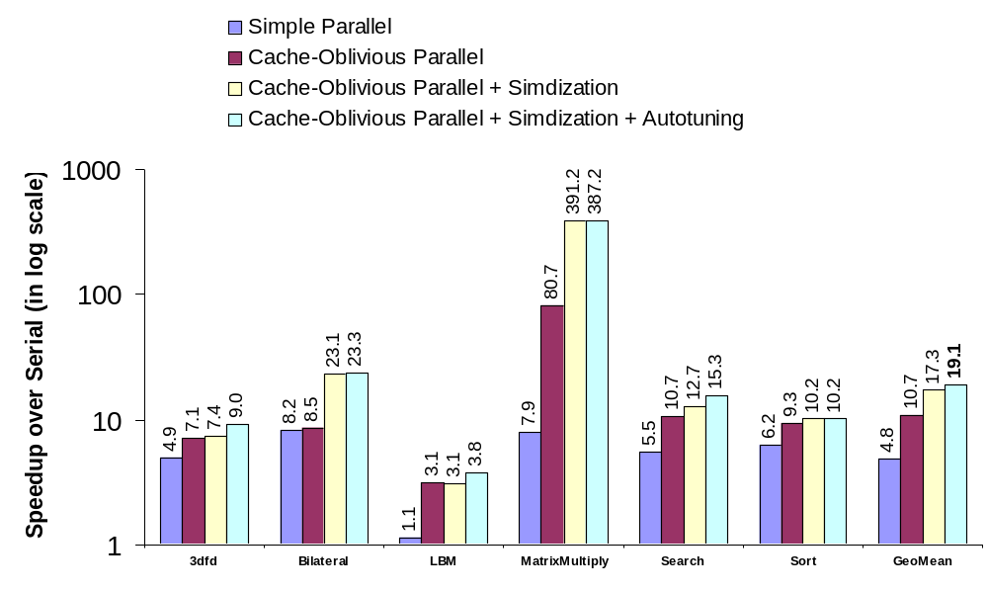
Overall Performance Results
Our approach is 19x faster than best serial or 4x faster than simple parallel

Slide 27
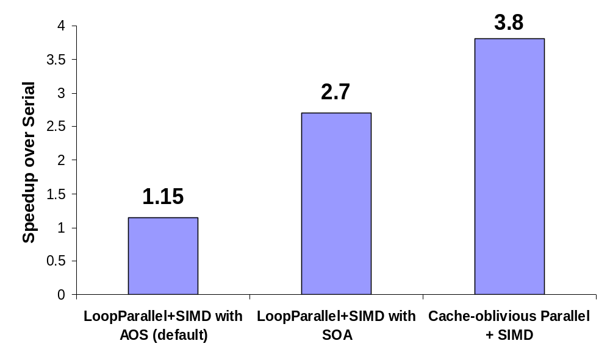
LBM Detailed Results
Other researchers have applied the AOS-to-SOA optimization onto LBM
So, how does our approach perform against the SOA optimization?

Slide 28
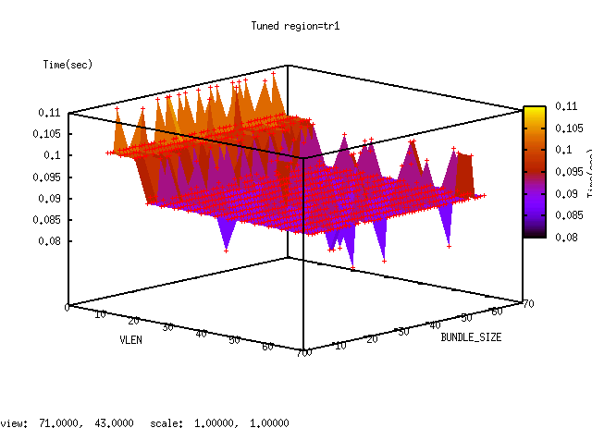
TreeSearch Detailed Results
How did autotuning help?
Best configuration found VLEN=48, BUNDLE_SIZE=32

Slide 29
Conclusions
Developed an integrated approach for Throughput Computing on x86:
    Cache-oblivious parallelization
    Compiler-based simdization
    Autotuning
Achieved significant speedups:
  19x faster than serial with 8 cores
  4x faster than simple parallelization
Working on releasing the benchmarks and XTune to public

