Slide 1
Rewrite
Take out Tensorflow from the code. And use mostly torch to tune the network. Using parallel computing to implement PIAL1.
Reasons: 1. multiple backend makes the code low in efficiency. 2. Easier to modifier later. 3. Using for loop for PIAL1 is low in efficiency as well.
Results: the training time decreases from 7 hours to no more than 1 hour ( The device I used, Tesla P100, may contribute a lot)

Slide 2
Problem setup
Using DeepONet trains on Diffusion Reaction Equation.
100 data pretrain and selecting the first 20 data with the largest PINN loss from 100 data.

Slide 3
Repeat the result on Overleaf
I’ve figured out some important technics that would make a difference of accuracy (L2 relative error).
Activation, if we use Relu for the branch network, the L2 relative error is larger. The reason is not the depth of network.
Dataset length scale, the same as Min’s paper, using multiple LS could have better accuracy.
The result is sometime better than the article
Activation | L2 relative error (one test only)
Relu | 1.60e-2
Gelu | 4.33e-3

Slide 4
Experience
Some mentionable mistakes I made that could cause training failure.
1. Data sampling Replacement. If we sample the data randomly and they might repeat within a single loop.
e.g. a = [1, 2, 3], step = 3. Without repeat: 3, 1, 2; With repeat: 3, 1, 3.
The accuracy would be worse.
2. The result of using all data (1,000 input functions, LS = [0.1, 1]) is worse than PIAL1. One possible reason maybe the quality of data increases)

Slide 5
More tries
I also tested the code using (1.) MSE between pd and gt (2.) 0.1 times PINN loss only (because the PINN loss is much larger than the MSE) (3.) 0.05 times PINN loss + MSE loss
Their results are slightly different. One possible reason is the gradient norm after adding PINN loss is larger. So the parameters could be updated more efficiently.

Slide 6
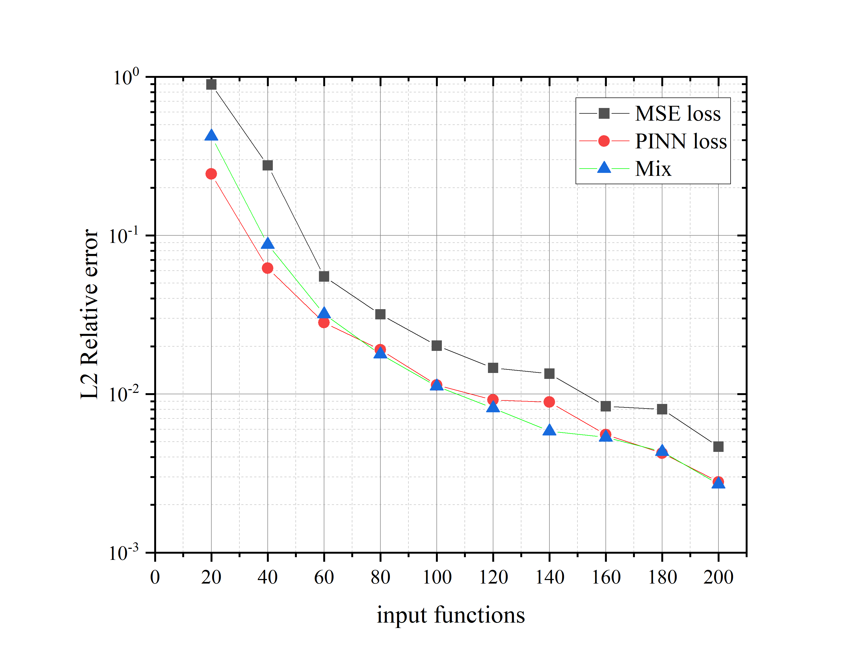
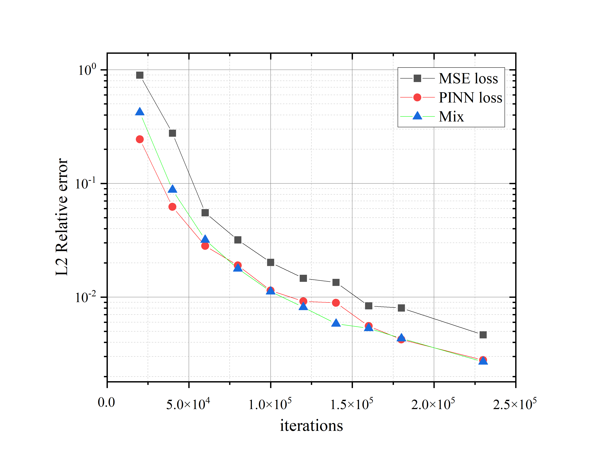

Slide 7
