Slide 1

Price
Size
Price
x
y
‘neuron’
Size of house

Slide 2
Size
Family Size
#Bedrooms
Walkability
Price
Postal Code
y
School quality
Wealth
x

Slide 3
x₁
x₂
y
x₃
x₄
Input layer
Hidden layer
Output layer
Notes:
Question
True or false? As explained in this lecture, every input layer feature is interconnected with every hidden layer feature. T

Slide 4
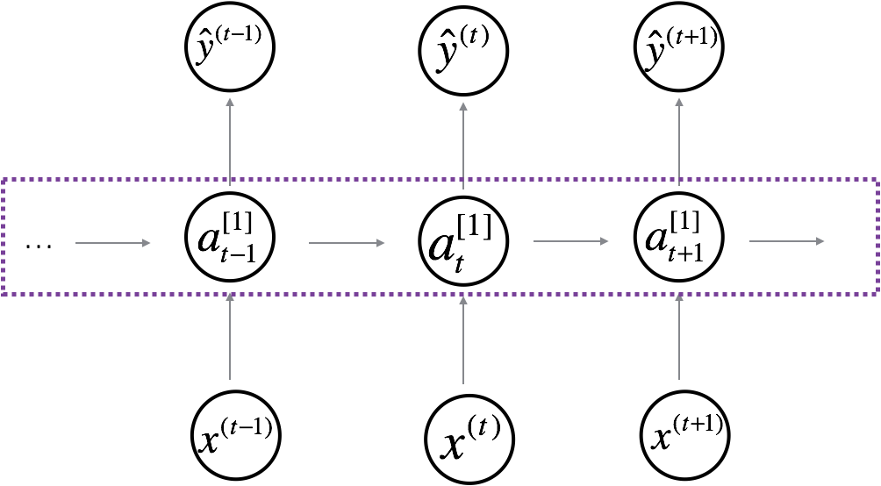
x₁
x₂
y
x₃
x₄
Standard NN
Convolutional NN
Recurrent NN
Notes:
Question
True or false? As explained in this lecture, every input layer feature is interconnected with every hidden layer feature. T

Slide 5
Convolutional NN
Notes:
Question
True or false? As explained in this lecture, every input layer feature is interconnected with every hidden layer feature. T

Slide 6
Recurrent NN

Slide 7

255 | 134 | 93 | 22
123 | 94 | 83 | 2
34 | 44 | 187 | 30
34 | 76 | 232 | 124
34 | 76 | 232 | 142
255 | 134 | 202 | 22
123 | 94 | 83 | 4
34 | 44 | 187 | 192
34 | 76 | 232 | 34
34 | 76 | 232 | 94
255 | 231 | 42 | 22
123 | 94 | 83 | 2
34 | 44 | 187 | 92
34 | 76 | 232 | 124
34 | 76 | 232 | 124
Blue
Green
Red
5×4×3

Slide 8
a
u = a * b
b
v = a * c
J = u + v - w
c
w = b + c
a
u = a * b
b
v = a + c
J = u - v + w
c
w = b * c

Slide 9

x₁
x₂
$$\hat{y}$$
x
x₃
w
z = w^{T} x +b
a = σ(z)
L(a, y)
b

Slide 10
[1]
x₁
[2]
x₂
y
x₃
x
W^{[1]}
z^{[1]} = W^{[1]} x +b^{[1]}
a^{[1]} = σ(z^{[1]})
z^{[2]} = W^{[2]} a^{[1]}+b^{[1]}
a^{[2]} = σ(z^{[2]})
L(a^{[2]}, y)
b^{[1]}
W^{[2]}
b^{[2]}

Slide 11


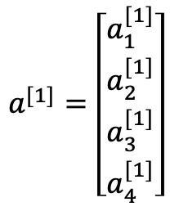


a^{[0]} = x
a^{[1]}
x₁
$$a_{1}^{[1]}$$
$$a_{2}^{[1]}$$
x₂
a^{[2]}
y
= a^{[2]}
$$a_{3}^{[1]}$$
$$a^{[1]}=\left[\left.\begin{aligned}a_{1}^{[1]} \\ a_{2}^{[1]} \\ a_{3}^{[1]} \\ a_{4}^{[1]}\end{aligned}\right]\right.$$
x₃
$$a_{4}^{[1]}$$
Input layer
Hidden layer
Output layer
2 layer NN

Slide 12
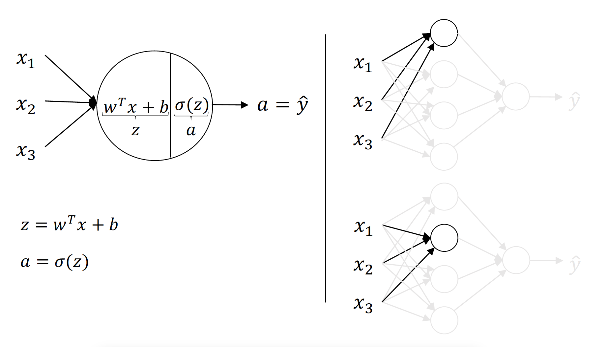
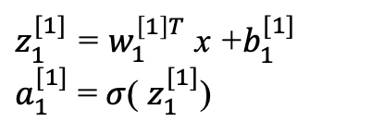
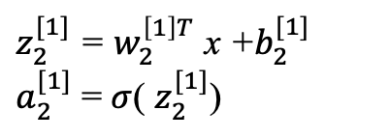

$z_{1}^{[1]}$ = $w_{1}^{\left[1\right]T}$ x +$b_{1}^{[1]}$
$a_{1}^{[1]}$ = $σ$( $z_{1}^{[1]}$)
$$a_{i}^{[l]}$$
layer
i-th node in layer
$z_{2}^{[1]}$ = $w_{2}^{\left[1\right]T}$ x +$b_{2}^{[1]}$
$a_{2}^{[1]}$ = $σ$( $z_{2}^{[1]}$)

Slide 13


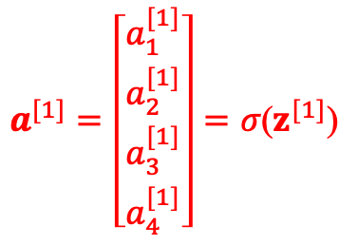

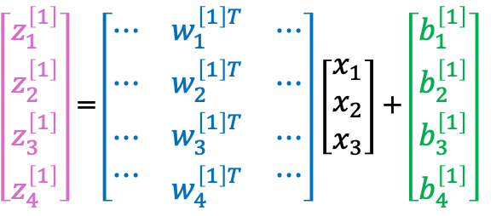


a^{[0]} = x
a^{[1]}
x₁
$$a_{1}^{[1]}$$
$z_{1}^{[1]}$ = $w_{1}^{\left[1\right]T}$ x +$b_{1}^{[1]}$ $a_{1}^{[1]}$ = $σ$( $z_{1}^{[1]}$)
$z_{2}^{[1]}$ = $w_{2}^{\left[1\right]T}$ x +$b_{2}^{[1]}$ $a_{2}^{[1]}$ = $σ$( $z_{2}^{[1]}$)
$$a_{2}^{[1]}$$
$z_{3}^{[1]}$ = $w_{3}^{\left[1\right]T}$ x +$b_{3}^{[1]}$ $a_{3}^{[1]}$ = $σ$( $z_{3}^{[1]}$)
x₂
a^{[2]}
$\hat{y}$
= a^{[2]}
$z_{4}^{[1]}$ = $w_{4}^{\left[1\right]T}$ x +$b_{4}^{[1]}$ $a_{4}^{[1]}$ = $σ$( $z_{4}^{[1]}$)
$$a_{3}^{[1]}$$
x₃
$$a_{4}^{[1]}$$
$\left[\begin{matrix}z_{1}^{\left[1\right]} \\ z_{2}^{\left[1\right]} \\ \begin{aligned}z_{3}^{\left[1\right]} \\ z_{4}^{\left[1\right]}\end{aligned}\end{matrix}\right]$ = $\left[\begin{matrix}⋯ & w_{1}^{\left[1\right]T} & ⋯ \\ ⋯ & w_{2}^{\left[1\right]T} & ⋯ \\ \begin{aligned}⋯ \\ ⋯\end{aligned} & \begin{aligned}w_{3}^{\left[1\right]T} \\ w_{4}^{\left[1\right]T}\end{aligned} & \begin{aligned}⋯ \\ ⋯\end{aligned}\end{matrix}\right]\left[\begin{matrix}x_{1} \\ x_{2} \\ x_{3}\end{matrix}\right]$ + $\left[\begin{matrix}b_{1}^{\left[1\right]} \\ b_{2}^{\left[1\right]} \\ \begin{aligned}b_{3}^{\left[1\right]} \\ b_{4}^{\left[1\right]}\end{aligned}\end{matrix}\right]$
$$a^{[1]}=\left[\left.\begin{aligned}a_{1}^{[1]} \\ a_{2}^{[1]} \\ a_{3}^{[1]} \\ a_{4}^{[1]}\end{aligned}\right]\right.=σ\text{(}z^{[1]}\text{)}$$
(4, 1)
z^{[1]} = W^{[1]} x + b^{[1]}
(4, 1) (4, 3) (3, 1) (4,1)

Slide 14








a^{[0]} = x
a^{[1]}
x₁
$$a_{1}^{[1]}$$
z^{[1]} = W^{[1]} x + b^{[1]}
$$a_{2}^{[1]}$$
$$a^{[1]}=σ\text{(}z^{[1]}\text{)}$$
x₂
a^{[2]}
$\hat{y}$
z^{[2]} = W^{[2]} $a^{[1]}$ + b^{[2]}
= a^{[2]}
$$a_{3}^{[1]}$$
$$a^{[2]}=σ\text{(}z^{[2]}\text{)}$$
x₃
$$a_{4}^{[1]}$$

Slide 15









for i = 1 to m:
z^{[1] ( i )} = W^{[1]} x^{( i )} + b^{[1]}
Z^{[1]} = W^{[1]} X+ b^{[1]}
$$a^{[1]}\text{(} \text{i} \text{)}=σ\text{(}z^{[1]}\text{(} \text{i} \text{)}\text{)}$$
$$A^{[1]}=σ\text{(}Z^{[1]}\text{)}$$
z^{[2] ( i )} = W^{[2]} $a^{[1]}$ ^{( i )} + b^{[2]}
Z^{[2]} = W^{[2]} $A^{[1]}$+ b^{[1]}
$$a^{[2]}\text{(} \text{i} \text{)}=σ\text{(}z^{[2]}\text{(} \text{i} \text{)}\text{)}$$
$$A^{[2]}=σ\text{(}Z^{[2]}\text{)}$$
$$\text{X} \text{=}\left[\begin{matrix}⋮ & ⋮ & ⋮ \\ x^{(1)} & x^{(2)} & ⋯ \\ ⋮ & ⋮ & ⋮\end{matrix} \begin{matrix}⋮ \\ x^{(m)} \\ ⋮\end{matrix} \right]$$
$$\text{Z}\text{[1]} \text{=}\left[\begin{matrix}⋮ & ⋮ & ⋮ \\ z^{[1](1)} & z^{[1](2)} & ⋯ \\ ⋮ & ⋮ & ⋮\end{matrix} \begin{matrix}⋮ \\ z^{[1](m)} \\ ⋮\end{matrix} \right]$$
(n_{x} , m)
training examples
$$\text{A}\text{[1]} \text{=}\left[\begin{matrix}⋮ & ⋮ & ⋮ \\ a^{[1](1)} & a^{[1](2)} & ⋯ \\ ⋮ & ⋮ & ⋮\end{matrix} \begin{matrix}⋮ \\ a^{[1](m)} \\ ⋮\end{matrix} \right]$$
hidden units

Slide 16
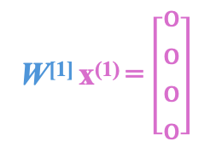
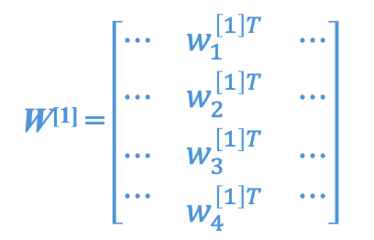
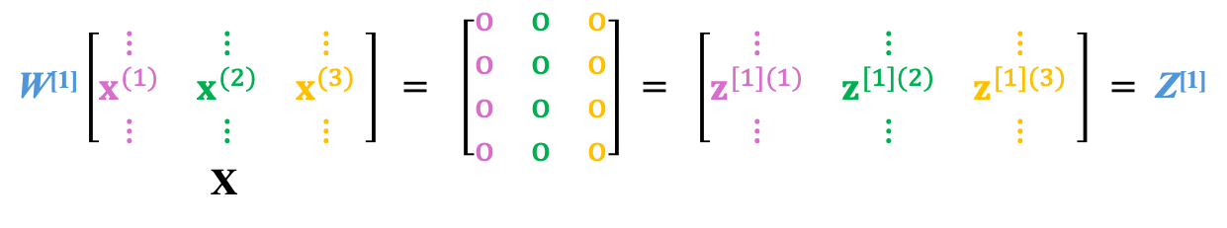
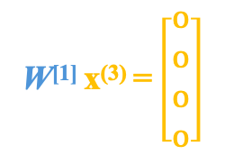
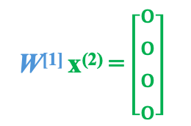
z^{[1] (1)} = W^{[1]} x ⁽¹⁾ + b^{[1]}
z^{[1] (2)} = W^{[1]} x ⁽²⁾ + b^{[1]}
z^{[1] (3)} = W^{[1]} x ⁽³⁾ + b^{[1]}
0
0
0
W^{[1]} = $\left[\begin{matrix}⋯ & w_{1}^{\left[1\right]T} & ⋯ \\ ⋯ & w_{2}^{\left[1\right]T} & ⋯ \\ \begin{aligned}⋯ \\ ⋯\end{aligned} & \begin{aligned}w_{3}^{\left[1\right]T} \\ w_{4}^{\left[1\right]T}\end{aligned} & \begin{aligned}⋯ \\ ⋯\end{aligned}\end{matrix}\right]$
W^{[1]} x⁽¹⁾ = $\left[\begin{matrix}o \\ o \\ o \\ o\end{matrix}\right]$
W^{[1]} x⁽²⁾ = $\left[\begin{matrix}o \\ o \\ o \\ o\end{matrix}\right]$
W^{[1]} x⁽³⁾ = $\left[\begin{matrix}o \\ o \\ o \\ o\end{matrix}\right]$
$\text{W}\text{[1]}\left[\begin{matrix}⋮ & ⋮ & ⋮ \\ x^{(1)} & x^{(2)} & x^{(3)} \\ ⋮ & ⋮ & ⋮\end{matrix} \right]$ $=$ $\left[\begin{matrix}o & o & o \\ o & o & o \\ o & o & o \\ o & o & o\end{matrix}\right] = \left[\begin{matrix}⋮ & ⋮ & ⋮ \\ z^{[1](1)} & z^{[1](2)} & z^{[1](3)} \\ ⋮ & ⋮ & ⋮\end{matrix} \right] = \text{Z}\text{[1]}$
X

Slide 17
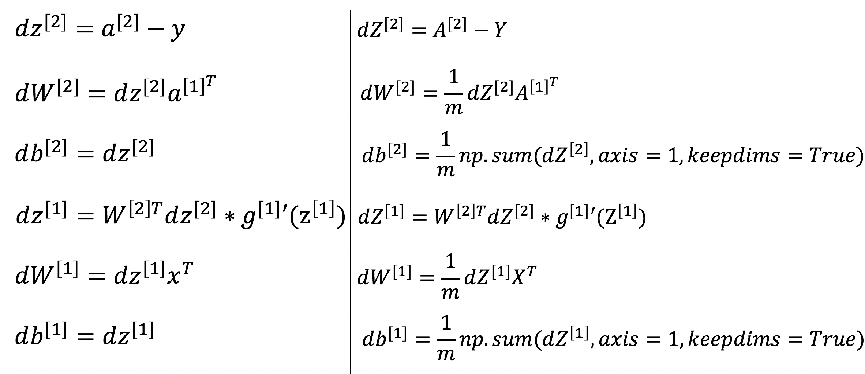

Slide 18
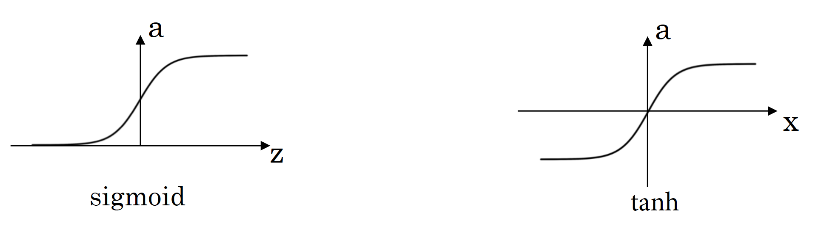

Slide 19



x₁
x₁
x₂
$$\hat{y}$$
x₂
$$\hat{y}$$
x₃
x₃
Logistic regression
1 hidden layer
x₁
x₁
x₂
$$\hat{y}$$
x₂
$$\hat{y}$$
x₃
x₃
2 hidden layers
5 hidden layers

Slide 20

[1]
[2]
[3]
x₁
[4]
x₂
$$\hat{y}$$
x₃
4 layer NN

Slide 21

[2]
[1]
[3]
[4]
x₁
[5]
$$\hat{y}$$
x₂

Slide 22











x₁
layer l
x₂
$$\hat{y}$$
$$w^{[l]}$$
$$b^{[l]}$$
x₃
$$a^{[l−1]}$$
$$a^{[l]}$$
x₄
cache
$$z^{[l]}$$
$$w^{[l]}$$
$$b^{[l]}$$
$${da}^{[l−1]}$$
$${da}^{[l]}$$
$${dz}^{[l]}$$
$${dw}^{[l]}$$
$${db}^{[l]}$$

Slide 23



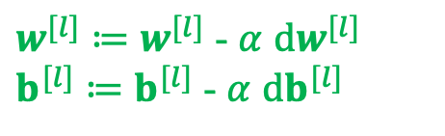


































layer 1
layer 2
layer 3
layer l
$$w^{[1]}$$
$$b^{[1]}$$
$$a^{[1]}$$
$$w^{[2]}$$
$$b^{[2]}$$
$$a^{[2]}$$
$$w^{[3]}$$
$$b^{[3]}$$
$$a^{[3]}$$
$$a^{[l−1]}$$
$$w^{[l]}$$
$$b^{[l]}$$
……
$$a^{[0]}$$
$$a^{[l]}$$
$$x$$
$$\hat{y}$$
Starting from x
cache
$$z^{[1]}$$
cache
$$z^{[2]}$$
cache
$$z^{[3]}$$
cache
$$z^{[l]}$$
$$w^{[1]}$$
$$b^{[1]}$$
$${da}^{[1]}$$
$$w^{[2]}$$
$$b^{[2]}$$
$${da}^{[2]}$$
$$w^{[3]}$$
$$b^{[3]}$$
$${da}^{[3]}$$
……
$${da}^{[l−1]}$$
$$w^{[l]}$$
$$b^{[l]}$$
$${da}^{[l]}$$
$${dz}^{[1]}$$
$${dz}^{[2]}$$
$${dz}^{[3]}$$
$${dz}^{[l]}$$
$${dw}^{[1]}$$
$${dw}^{[2]}$$
$${dw}^{[3]}$$
$${dw}^{[l]}$$
$${db}^{[1]}$$
$${db}^{[2]}$$
$${db}^{[3]}$$
$${db}^{[l]}$$
$w^{[l]}≔$ $w^{[l]}$ - $α$ ${dw}^{[l]}$
$b^{[l]}≔$ $b^{[l]}$ - $α$ ${db}^{[l]}$

Slide 24
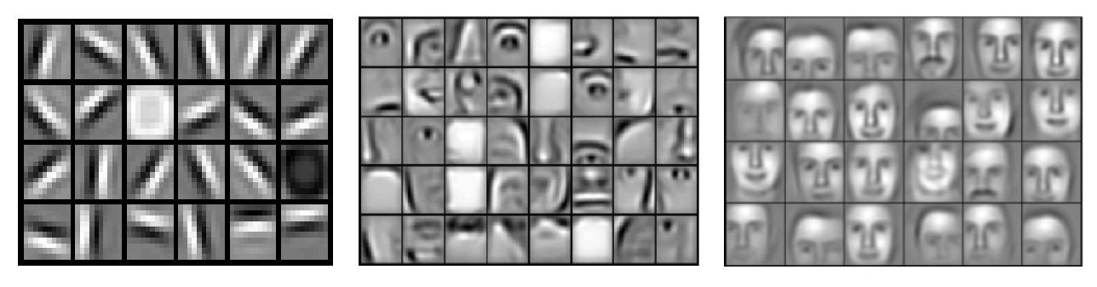

A
B
C
x₁
x₂
$$\hat{y}$$
x₃

Slide 25









x₁
$$a_{1}^{[1]}$$
$$a_{1}^{[2]}$$
x₂
$$a_{2}^{[1]}$$
$$a_{2}^{[2]}$$
a^{[3]}
$\hat{y}$
x₃
$$a_{3}^{[1]}$$
$$a_{3}^{[2]}$$
x₄
$$a_{4}^{[1]}$$
x₁
x₂
$\hat{y}$
x₃
x₄

Slide 26
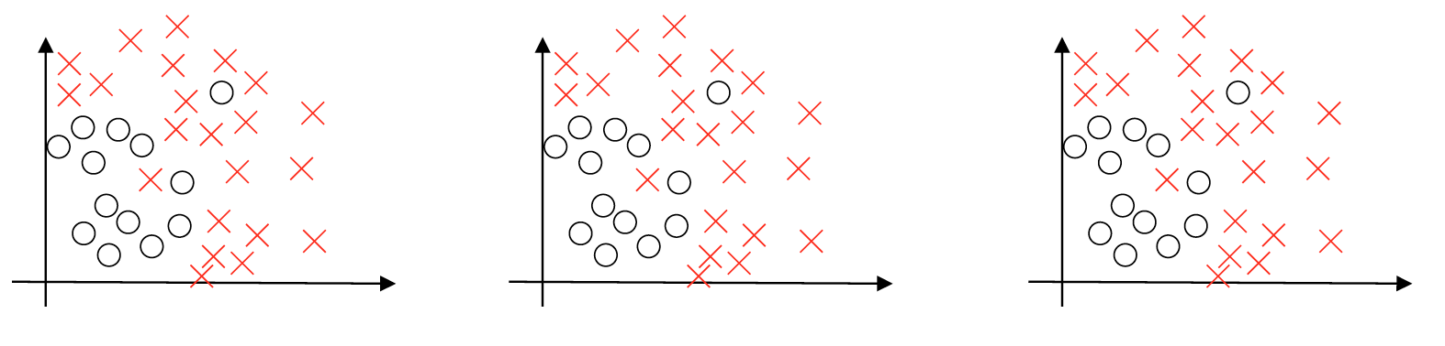
High bias
‘just right’
High variance
High bias and high variance

Slide 27
High bias
(Training data performance:
Not fitting training dataset well)
Bigger network (more hidden layers / more hidden units)
Training longer
(Find a new neural network architecture)
No
High variance
(Dev data performance:
Pretty good training set,
however poor dev set performance)
More data
Regularization
(Find a new neural network architecture)
No
Done

