Slide 1
Course project final report: Generating Panoramic Image
CS5240 Theoretical Foundations in Multimedia
School of Computing, NUS
Presented by: Group P04
Members: Cao Qi, Wang Qinyi, Zhang Chen, Zhao Yuan
Nov. 16, 2019

Slide 2
OUTLINE
Project Objective
Problem Formulation
Problem Definition
Algorithm
Summary
Notes:
Our presentation today will be divided into 4 main parts.
First of all, I will give you some background information for our project.
And state the objective of our project.
Then, I will present the problem formulation of our project.
Zhao Yuan will continue to describe the formal problem definition of our project.
After that, Zhang Chen will introduce the algorithms we developed for our project.
And lastly, Cao Qi will give in depth explanations about the function and algorithm we used in our project and draw a conclusion.

Slide 3
PROJECT OBJECTIVE

Slide 4
PROJECT OBJECTIVE
Point 1
Point 2
Point 3

Slide 5
PROBLEM FORMULATION

Slide 6
PROBLEM FORMULATION
Point 1
Point 2
Point 3
Notes:
Traditional automatic speech recognition (ASR) systems are comprised of an acoustic model (AM), a language model (LM), and a pronunciation lexicon.
All of these components are independently trained, and often manually designed, on different datasets
AMs take acoustic features and predict a set of subword units, typically context-dependent or context-independent phonemes.
Next, a hand-designed lexicon (the PM) maps a sequence of phonemes produced by the acoustic model to words.
Finally, the LM assigns probabilities to word sequences.
The above modules are optimized separately with different objectives, which may result in incoherence in optimization, where each module is not trained to match the other modules.
Decoding has to be performed by integrating all modules. Although this integration is often efficiently handled by finite state transducers, the construction and implementation of well-optimized transducers are very complicated
To factorize acoustic and language models well, we need to have a lexicon model to map word to phoneme sequences. phonemes are designed using linguistic knowledge, they are subject to human error that a fully data-driven system might avoid.
attention-based methods use an attention mechanism to perform alignment between acoustic frames and recognized symbols
connectionist temporal classification (CTC) uses Markov assumptions to efficiently solve sequential problems by dynamic programming

Slide 7
PROBLEM DEFINITION
Notes:
Now lets move to the conclusion part

Slide 8
PROBLEM DEFINITION
Point 1
Point 2
Point 3

Slide 9
Alignment Algorithm
Give two images A and B with features
Match features between A and B
Compute homography between A and B using least squares on the set of matches

Slide 10
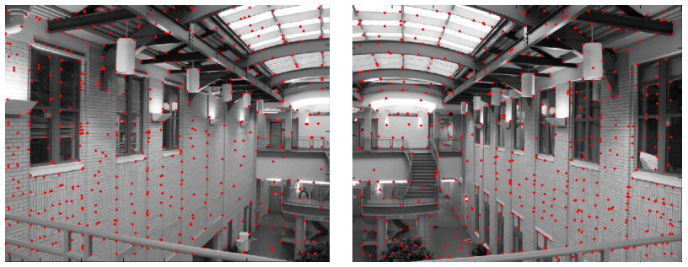

Feature matching
Exhaustive search
For each feature in A, look at all the other features in B, find the point min$\left\|u_{i}−v_{j} \right\|$

Slide 11
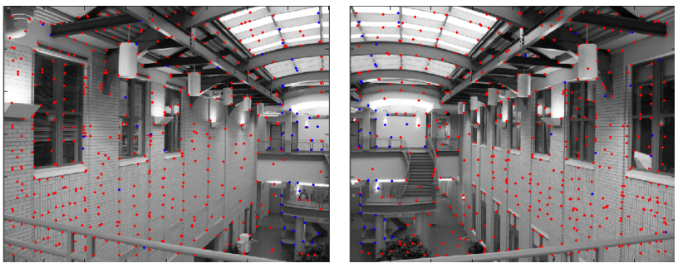

outlier rejection
Not match all features, but only these that have “similar enough” matches
min$\left\|u_{i}−v_{j} \right\|<threshold$
Still too many outliers

Slide 12
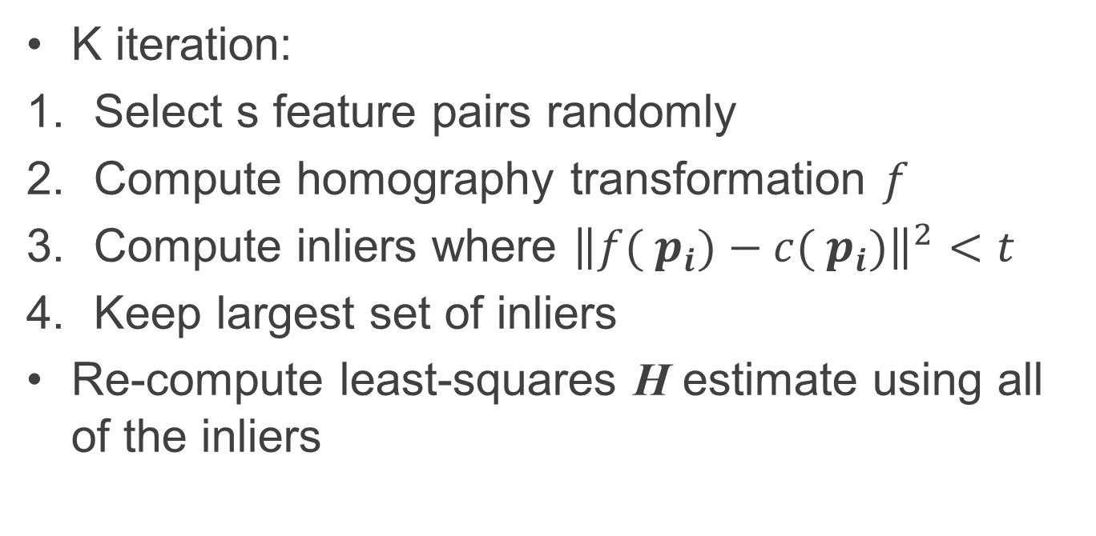
RANSAC
K iteration:
Select s feature pairs randomly
Compute homography transformation $f$
Compute inliers where ${\left\|f( p_{i})−c( p_{i})\right\|}^{2}<t$
Keep largest set of inliers
Re-compute least-squares H estimate using all of the inliers

Slide 13
RANSAC
Select four feature pairs randomly
Compute homography H and count inliers

Slide 14
RANSAC
Keep largest set of liners

Slide 15
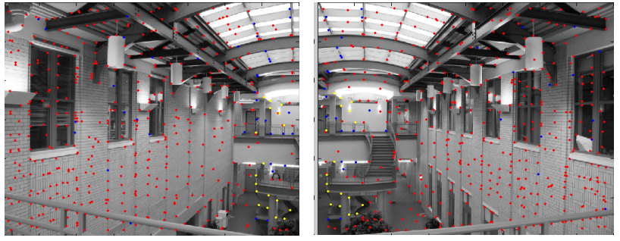
RANSAC
Red points: no match
Blue points: “good” match but outliers
Yellow points: correct match (the largest set)

Slide 16
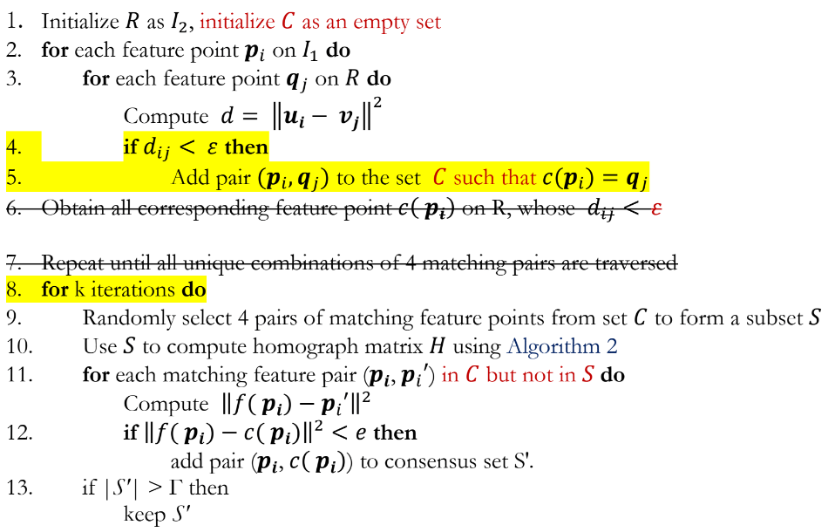
Algorithm

Slide 17
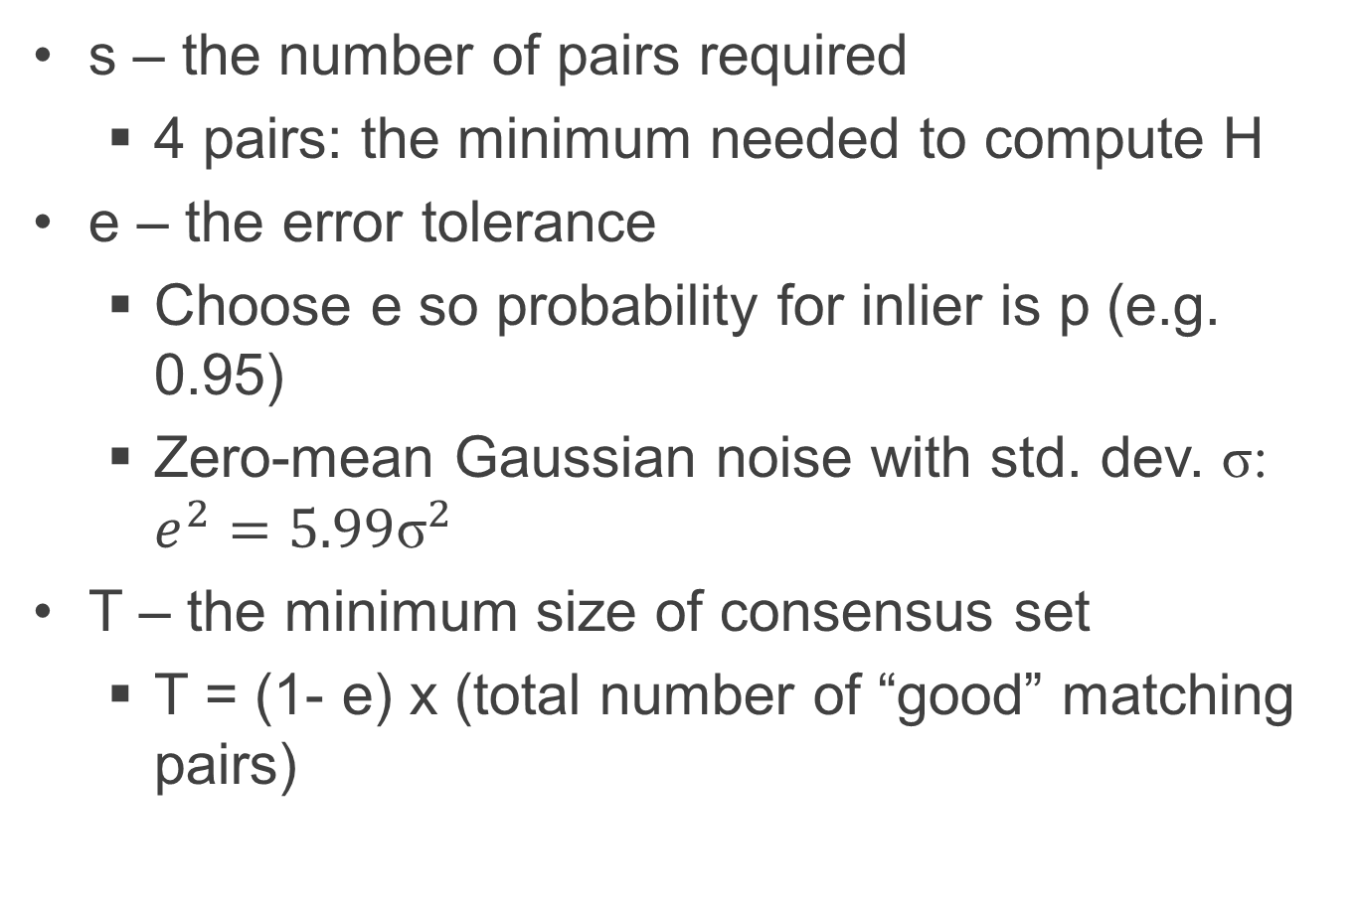
Parameters
s – the number of pairs required
4 pairs: the minimum needed to compute H
e – the error tolerance
Choose e so probability for inlier is p (e.g. 0.95)
Zero-mean Gaussian noise with std. dev. σ: $e^{2}=5.99{\text{σ}}^{2}$
T – the minimum size of consensus set
T = (1- e) x (total number of “good” matching pairs)

Slide 18
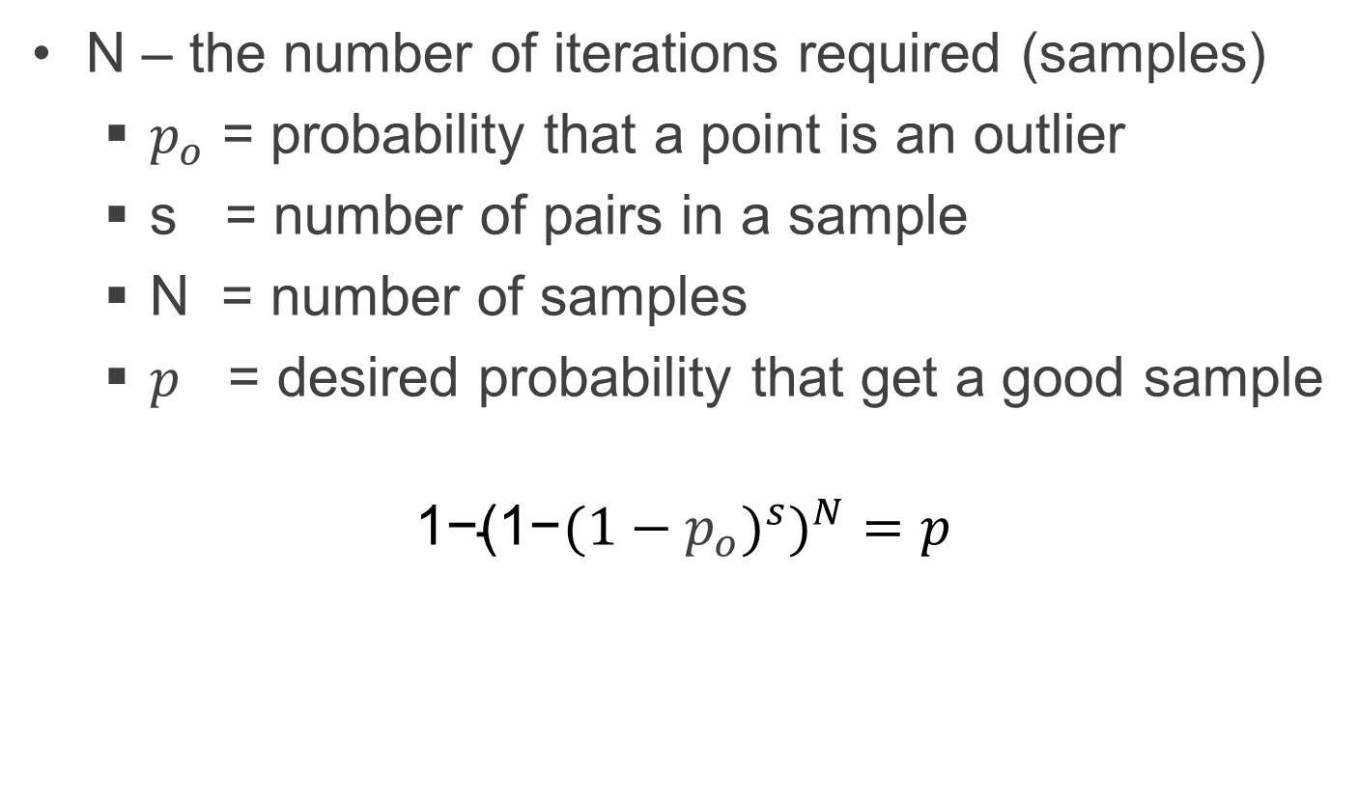
Parameters
N – the number of iterations required (samples)
$p_{o}$ = probability that a point is an outlier
s = number of pairs in a sample
N = number of samples
$p$ = desired probability that get a good sample
$${\text{1−(1−}{(1−p_{o})}^{s})}^{N}=p$$

Slide 19
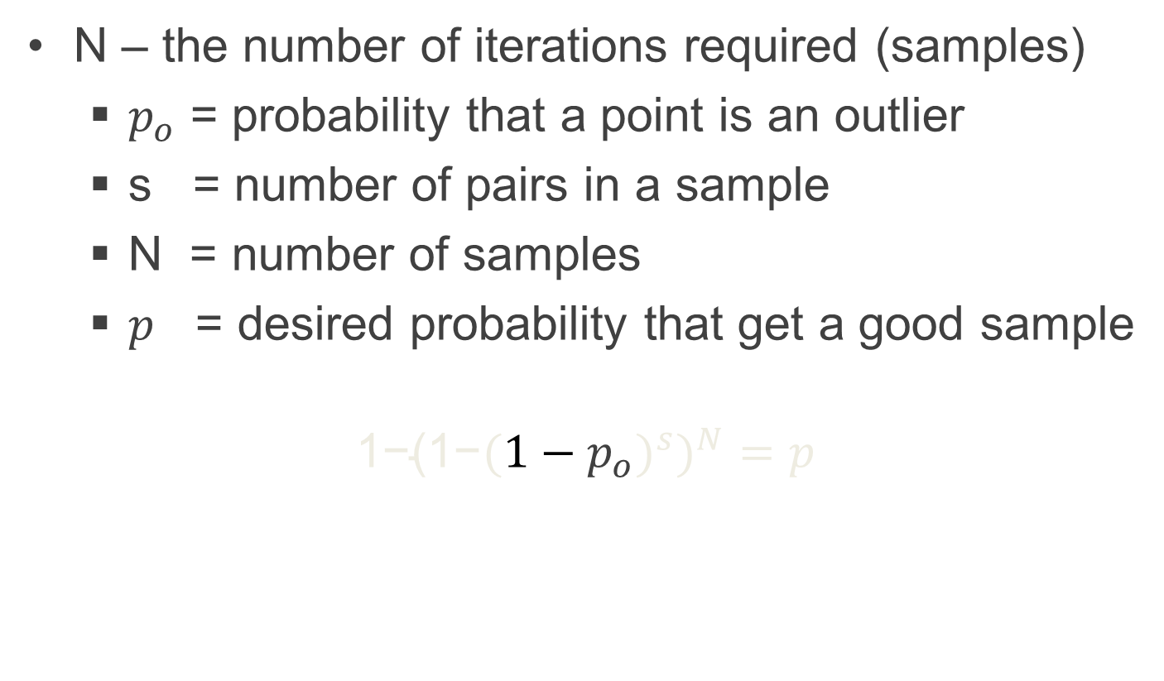
Parameters
N – the number of iterations required (samples)
$p_{o}$ = probability that a point is an outlier
s = number of pairs in a sample
N = number of samples
$p$ = desired probability that get a good sample
$${\text{1−(1−}{(1−p_{o})}^{s})}^{N}=p$$
a point is a inlier

Slide 20
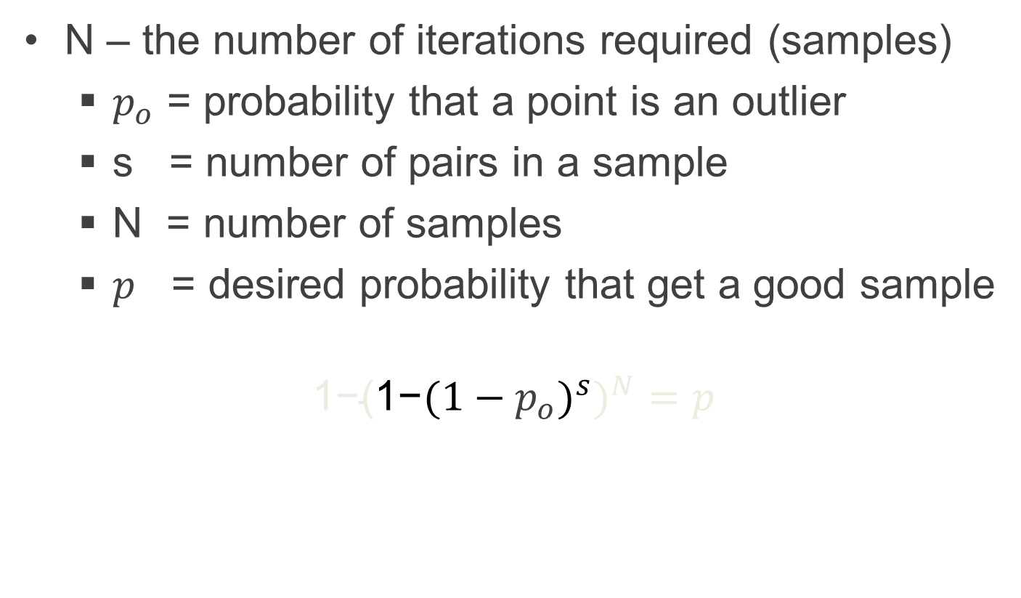
Parameters
N – the number of iterations required (samples)
$p_{o}$ = probability that a point is an outlier
s = number of pairs in a sample
N = number of samples
$p$ = desired probability that get a good sample
$${\text{1−(}\text{1−}{(1−p_{o})}^{s})}^{N}=p$$
one or more chosen pairs are outliers

Slide 21
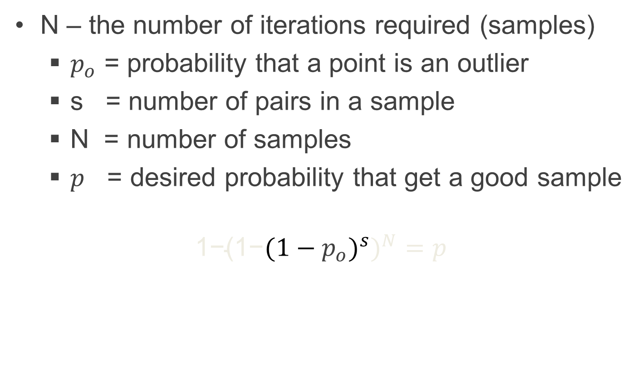
Parameters
N – the number of iterations required (samples)
$p_{o}$ = probability that a point is an outlier
s = number of pairs in a sample
N = number of samples
$p$ = desired probability that get a good sample
$${\text{1−(1−}{(1−p_{o})}^{s})}^{N}=p$$
chosen pairs are all inliers

Slide 22
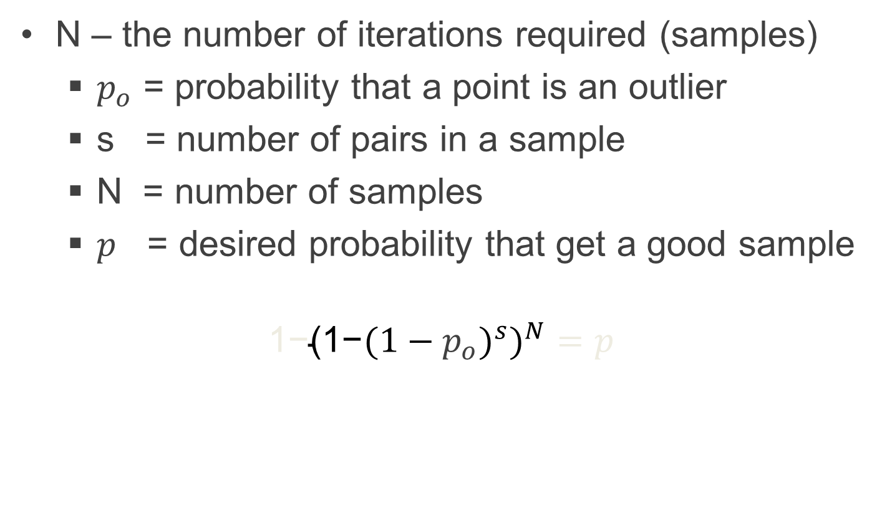
Parameters
N – the number of iterations required (samples)
$p_{o}$ = probability that a point is an outlier
s = number of pairs in a sample
N = number of samples
$p$ = desired probability that get a good sample
$${\text{1−}\text{(1−}{(1−p_{o})}^{s})}^{N}=p$$
all samples are not good

Slide 23
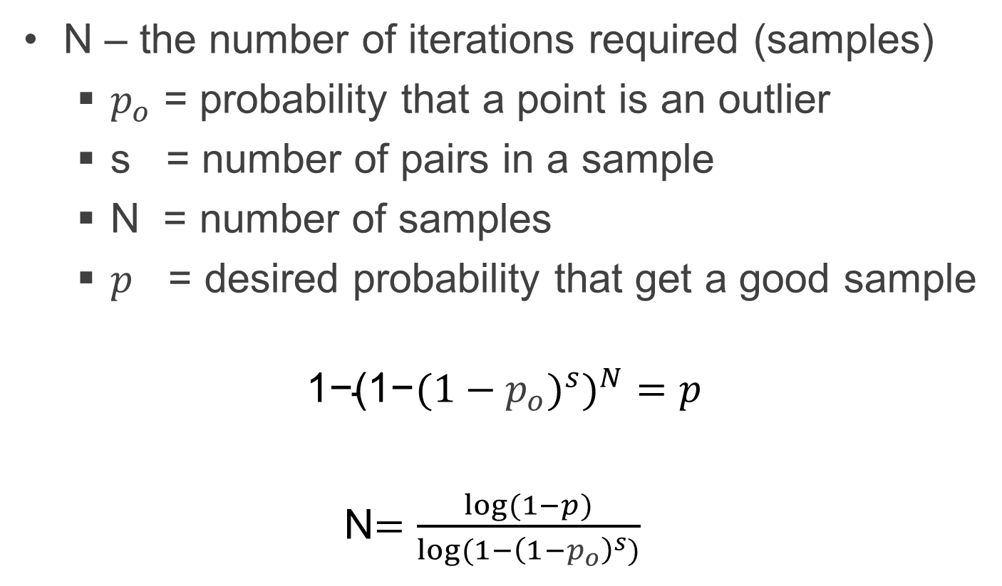
Parameters
N – the number of iterations required (samples)
$p_{o}$ = probability that a point is an outlier
s = number of pairs in a sample
N = number of samples
$p$ = desired probability that get a good sample
$${\text{1−}\text{(1−}{(1−p_{o})}^{s})}^{N}=p$$
N$=\frac{log⁡(1−p)}{log⁡(1−{\left(1−p_{o}\right)}^{s})}$

Slide 24

How many samples to choose
$p$ = 99.99%
$p_{o}$ = 50%
s = 4
N$=\frac{log⁡(1−p)}{log⁡(1−{\left(1−p_{o}\right)}^{s})}$ ≈143

Slide 25
Pros and cons
Pros
Simple and general
Applicable to many different problems
Often works well in practice
Cons
Lots of parameters to tune
Doesn’t work for low inlier ratios

Slide 26
ALGORITHM

Slide 27
ALGORITHM 1
Point 1
Point 2
Point 3

Slide 28
ALGORITHM 2
Point 1
Point 2
Point 3

Slide 29
EXPLANATION 1
Point 1
Point 2
Point 3

Slide 30
EXPLANATION 2
Point 1
Point 2
Point 3

Slide 31
SUMMARY

Slide 32
SUMMARY
Point 1
Point 2
Point 3

Slide 33
THANK YOU
Questions?
Notes:
That’s all for our presentation today.
Thank you for your attention.
We will be happy to answer any questions you have.

