Slide 1


Training ImageNet-1K in 1 Hour Accurate, Large Minibatch SGD
Priya Goyal Facebook AI Research (FAIR)
Notes:
Hi everyone, I am Priya Goyal and I am a research engineer at Facebook AI Research and I am excited to talk about how we scaled distributed training to a very large batch size and accurately training Imagenet in 1 hour

Slide 2




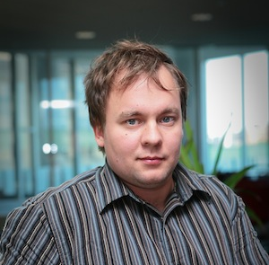
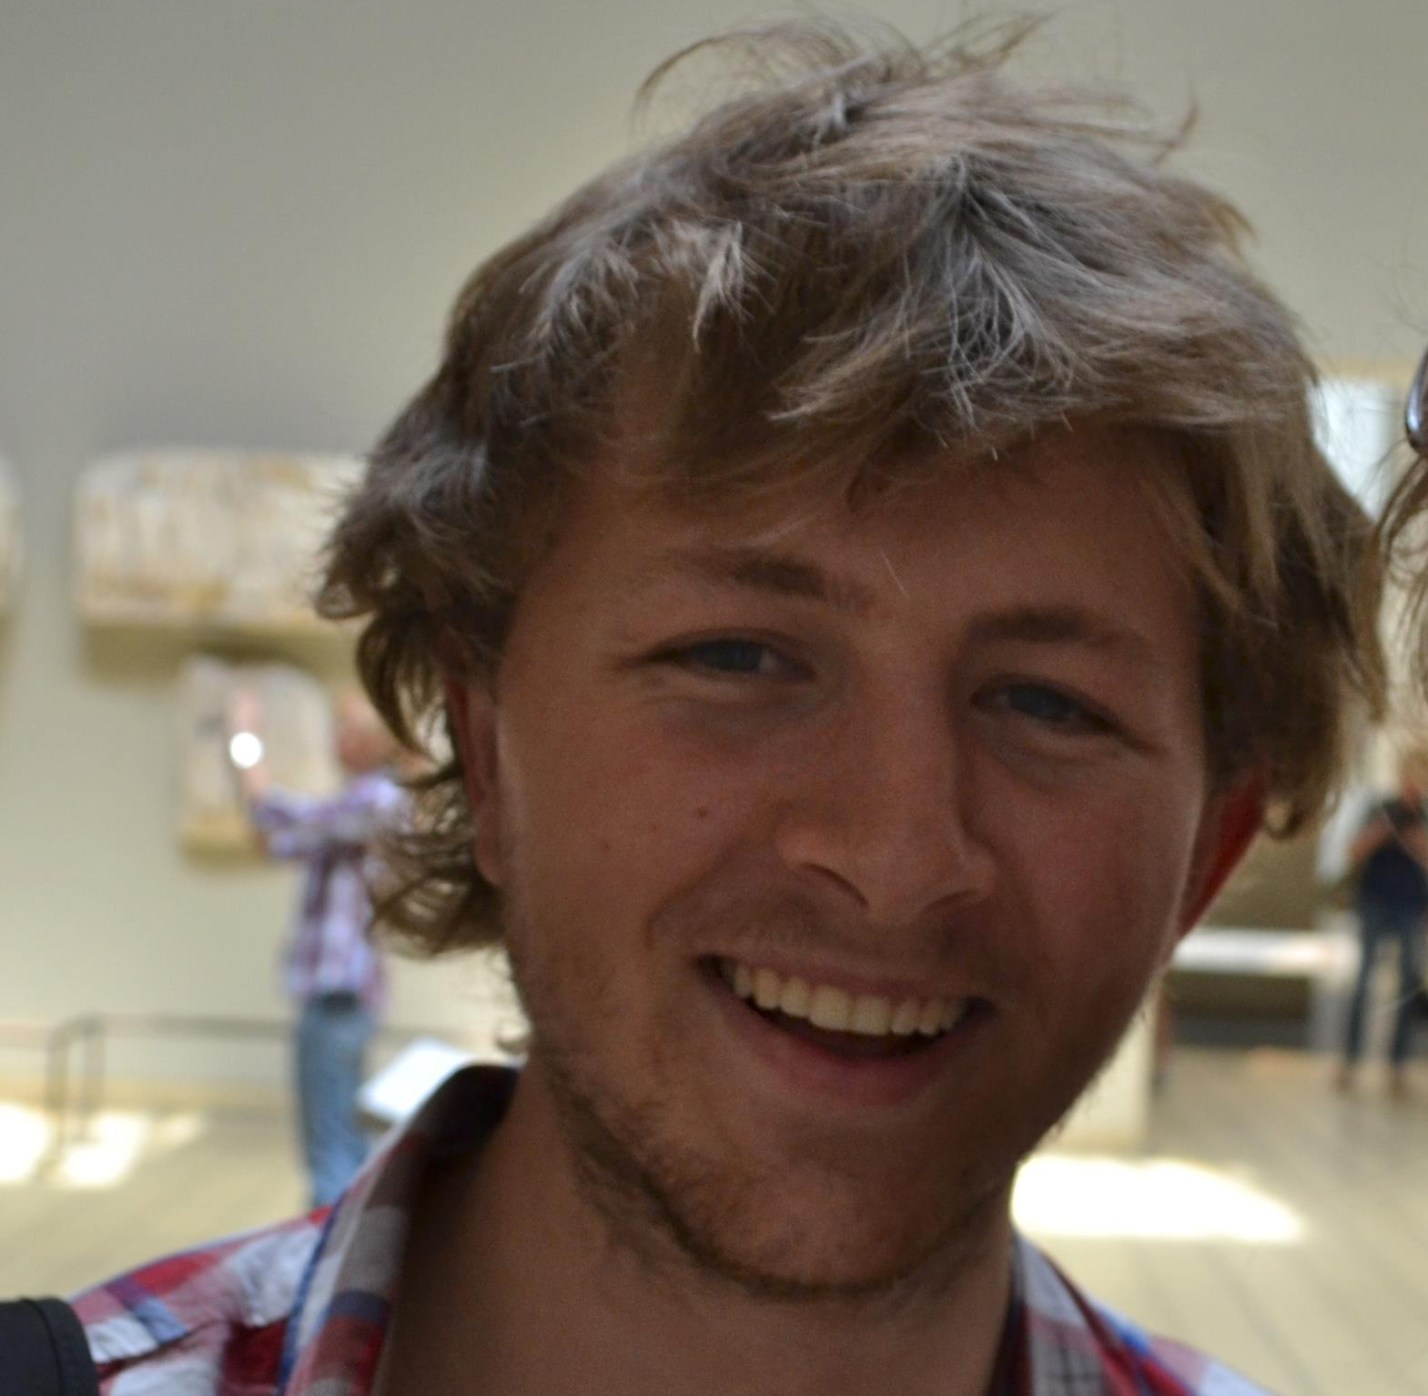
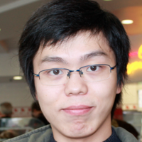
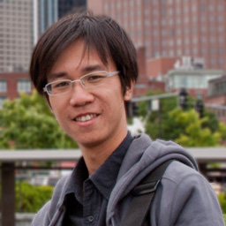

Piotr Dollár
Ross Girshick
Pieter Noordhuis
Lukasz Wesolowski
Aapo Kyrola
Andrew Tulloch
Yangqing Jia
Kaiming He
a p p l i e d m a c h i n e l e a r n i n g
Notes:
This work was done in joint collaboration with people from FAIR and applied machine learning group at facebook

Slide 3

Motivation
More data + bigger models -> higher accuracy
Computer Vision, Speech, Natural Language Processing (NLP)
So does training time...
Design and Planning
Analyze
Perform Experiment
Notes:
First of all, why do we need to scale distributed training?
In deep learning, accuracy scales with data and model size
A lot of research in computer vision, speech and nlp shows that as the model size or the data size is increased, accuracy increases
but bigger data or models means longer training time…
This is what a typical research/innovation cycle looks like where we have an idea, we design and plan experiments, perform experiments, wait for their results, analyze the results/build new hypothesis and iterate. Now what if this performing experiment part takes weeks/months to finish? That’s a lot of time before you can iterate on next idea leading to a very slow research cycle.

Slide 4
Internet-scale data / Videos
months?
*measured on NVIDIA M40 8-gpus
Notes:
Motivate here that for academia and industry
For instance, let’s look at the training time for a few image classificiation models also used in variety of computer vision applications. On 8 maxwell 40 gpus, a resnet50 model would take 2 days to train, a deeper resnet101 would take 4 days, recent resnext models would take 7 days and a better configuration of resnext model trained on larger dataset would take 14 days and what if you want to train on internet scale data where millions/billions of photos and videos are being uploaded to websites like facebook/google etc. every single day, that’ll probably take months before we can get something out of this data. So in deep learning, as the data or the model size increases, its important to keep the training time reasonable.

Slide 5
Deep Learning Workloads
INPUT
Repeat Many times
With Dependency
FUNCTION PARAMETERS
PARAMETERS
OUTPUT
EXPECTED
=
GRADIENTS
VS
Notes:
Let’s look at the challenges involved with big data or model size in deep learning workloads
In a deep learning scenario, we have some input data to start from and let’s call this input as a minibatch, we apply some functions on this minibatch where functions could be convolution, elementwise operation etc. and then we get the output, compare that output with the expected result, obtain the gradients and update the function parameters. Now this was just one single step of training process and in practice, we have to do multiple of these steps with dependency

Slide 6
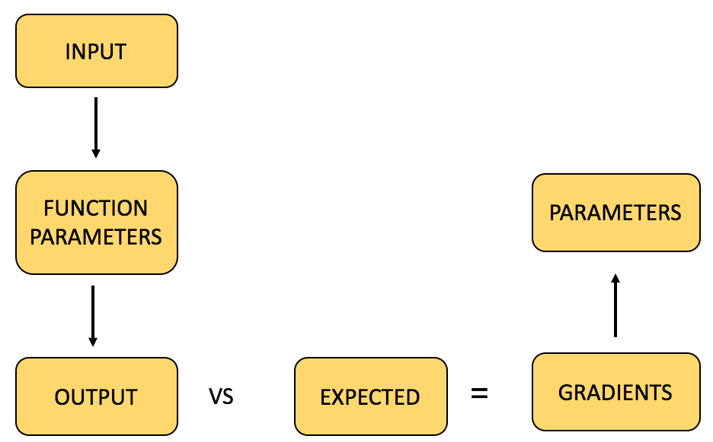
Deep Learning Workloads
Repeat Many times
With Dependency
...
ITERATION 1
ITERATION 2
ITERATION 3
ITERATION N
Notes:
Let’s call a single step as one training iteration,
then we have to perform multiple iterations where each iteration is dependent on the output of previous iteration.
The iterations typically depend on the data size and the speed of iteration depends on the model speed.
The overall training is going to be very slow if we have to perform large number of iterations where each iteration takes considerable amount of time.
So how do we speed the overall training?

Slide 7
Deep Learning Workloads
Distributed Training Inside Each Iteration
ITER 2 WORKER 1
ITER 2 WORKER 2
...
ITERATION 1
ITER 2 WORKER 3
ITERATION 3
ITERATION M
...
ITER 2 WORKER N
Notes:
One way to achieve this up is to perform distributed training inside each iteration and process more data fast enough

Slide 8
Use Synchronous SGD and weak scaling
Notes:
And so out of many ways to do distributed training, we chose to do synchronous SGDand weak scaling that can allow us to scale to a very large batch size.

Slide 9
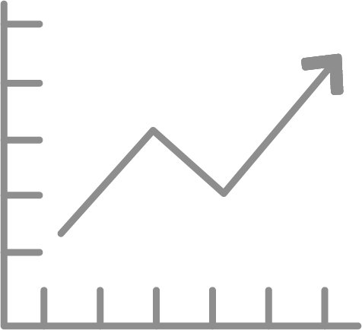


Scalable Distributed Training
Industry leading performance on ImageNet (ResNet-50)
Scale up input batch size
from 256 up to 8192
Match accuracy
Use 256 NVIDIA P100 GPUs
(90% scaling efficiency)
Notes:
In distributed training, as we scale to a very large batch sizes, various optimization issues arise which lead to poor accuracy on large batch sizes. So we develop various techniques that can help us to scale to a very large batch size for example 8192 and using these techniques, we can also match the accuracy on large batch sizes while requiring no hyper-params search and these techniques are very generalizable even if you are scaling from say 1–gpu tp 2-gpu training or more. At facebook, given the access to a large number of gpus, we use these techniques to scale to a large batch size of 8192 spread over 256 gpus and using caffe2 based resnet50 trainer, we achieve top performance on imagenet dataset by training it in 1 hour.
Now, let’s look into details of some of these techniques.

Slide 10
Challenges
Accuracy
Scale efficiently
Notes:
Before that, I want to highlight the two challenges that we have to solve:
Match accuracy as we scale up to large batch size
Scaling up efficiently to many machines

Slide 11
Accuracy of Large Minibatch SGD
Notes:
Let’s first see what are the challenges involved in matching accuracy of a large minibatch training and how we solved them in our work

Slide 12
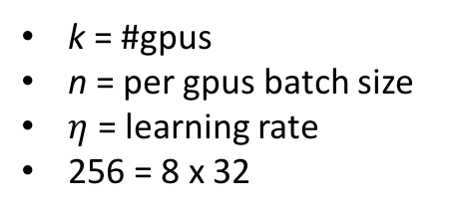
Large Minibatch SGD - Baseline
k = #gpus
n = per gpus batch size
$η$ = learning rate
256 = 8 x 32
Notes:
Let’s first establish the baseline for a ResNet50 model trained on 8 gpus with learning rate 0.1 and minibatch size 32 images per gpu. The orange curve is the training curve and the test set accruacy is 23.60 with small standard deviation.

Slide 13
Naïve Scaling
8192 = 256 x 32
#gpus
per gpu batch
Notes:
As a first step let’s just increase the batch size to 8192 spread over 256 gpus and keeping everything else in the training same as the baseline. The training curve looks very different and the error on test set almost doubles. So we need to do something to fix this.

Slide 14
Sqrt LR scaling
Notes:
There is a theory that suggests that as you scale up the batch size, you should scale up the learning rate by sqrt of scaling factor. So here we scaled the minibatch size by 32 and we scale the learning rate by sqrt 32. and this is what the training looks like, the training curbe looks more acceptabe but still doesn’t match the shape and the error on the test set is also high.

Slide 15
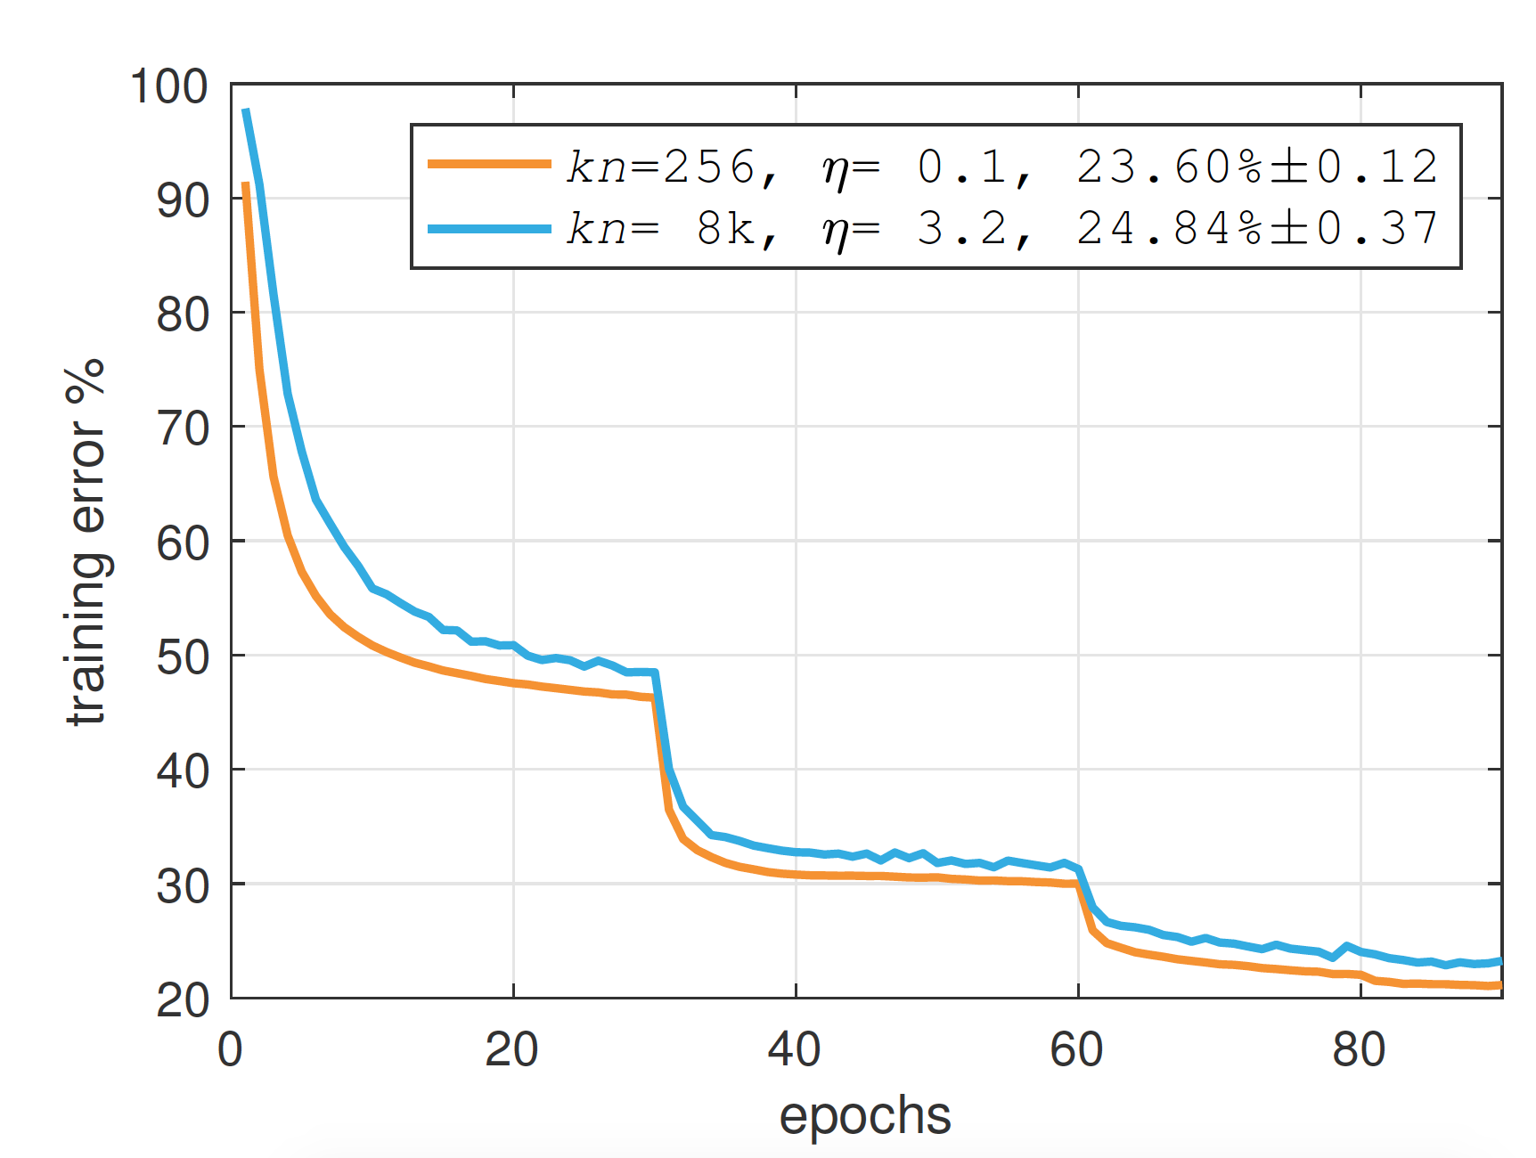
Linear LR scaling
Linearly scale Learning Rate (LR) with batch size
Optimization difficulty
Notes:
Next, we try out a very naive rule that we also use very frequently in our daily workflows. And this was proposed in some earlier research but it’s limit were not tested on such large batch size. The rule is very simple: as we increase the batch size, scale the learning rate linearly with it. So here as we scale batch size 32 times, we also increase the learning rate from 0.1 to 3.2
As we see form these curves, the shape of the small minibatch and large minibatch training curves can almost match but there is still some gap. This means that there are optimizations issues caused by large minibatch size which also lead to poor generalization. So how do we fix this?
To begin, we scale the learning rate with batch size. We found this rule to be surprisingly effective for a broad range of minibatch sizes and as we see in the figure, it can largely help us to match training curve. However, there is still an optimization issue.

Slide 16
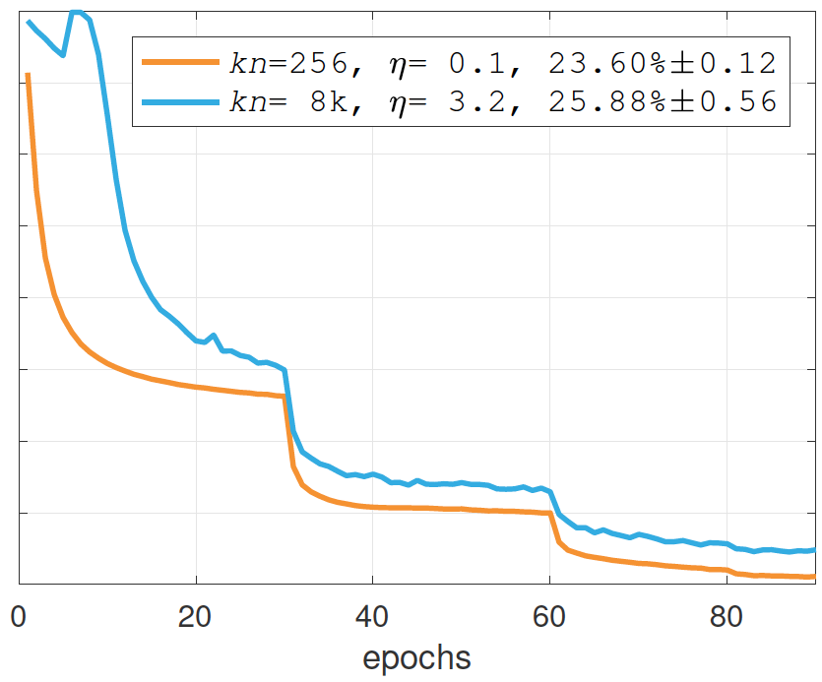
Constant LR warmup
Rapid changes in network in the beginning of training-> use small LR for first few epochs
Notes:
From our experience, we notice that in the early phases of training, network changes very rapidly and we hypothesized that a large learning rate at the beginning of training can lead to these optimizations issues. So we apply a constant learning rate warmup where we keep the learning rate constant to 0.1 for the first 5 epochs and then jump to the normal learning rate of 3.2
This didn’t work as we expected and infact made things worse. As the learning rate returns to the normal 3.2 lr, training error jumps and it can never recover during rest of the training.

Slide 17
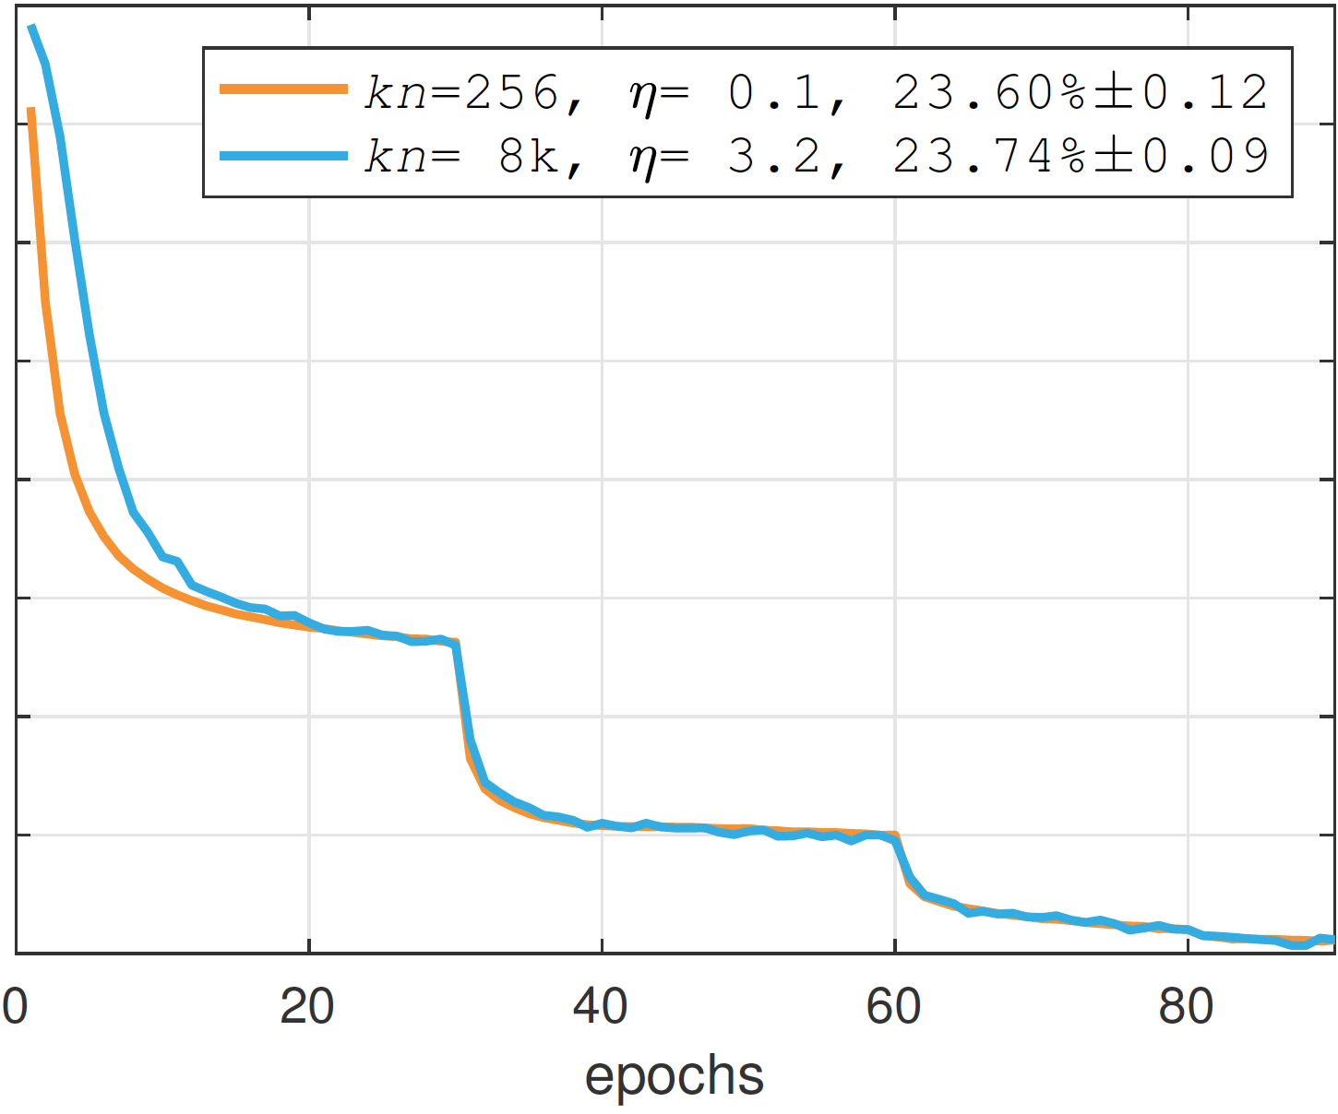
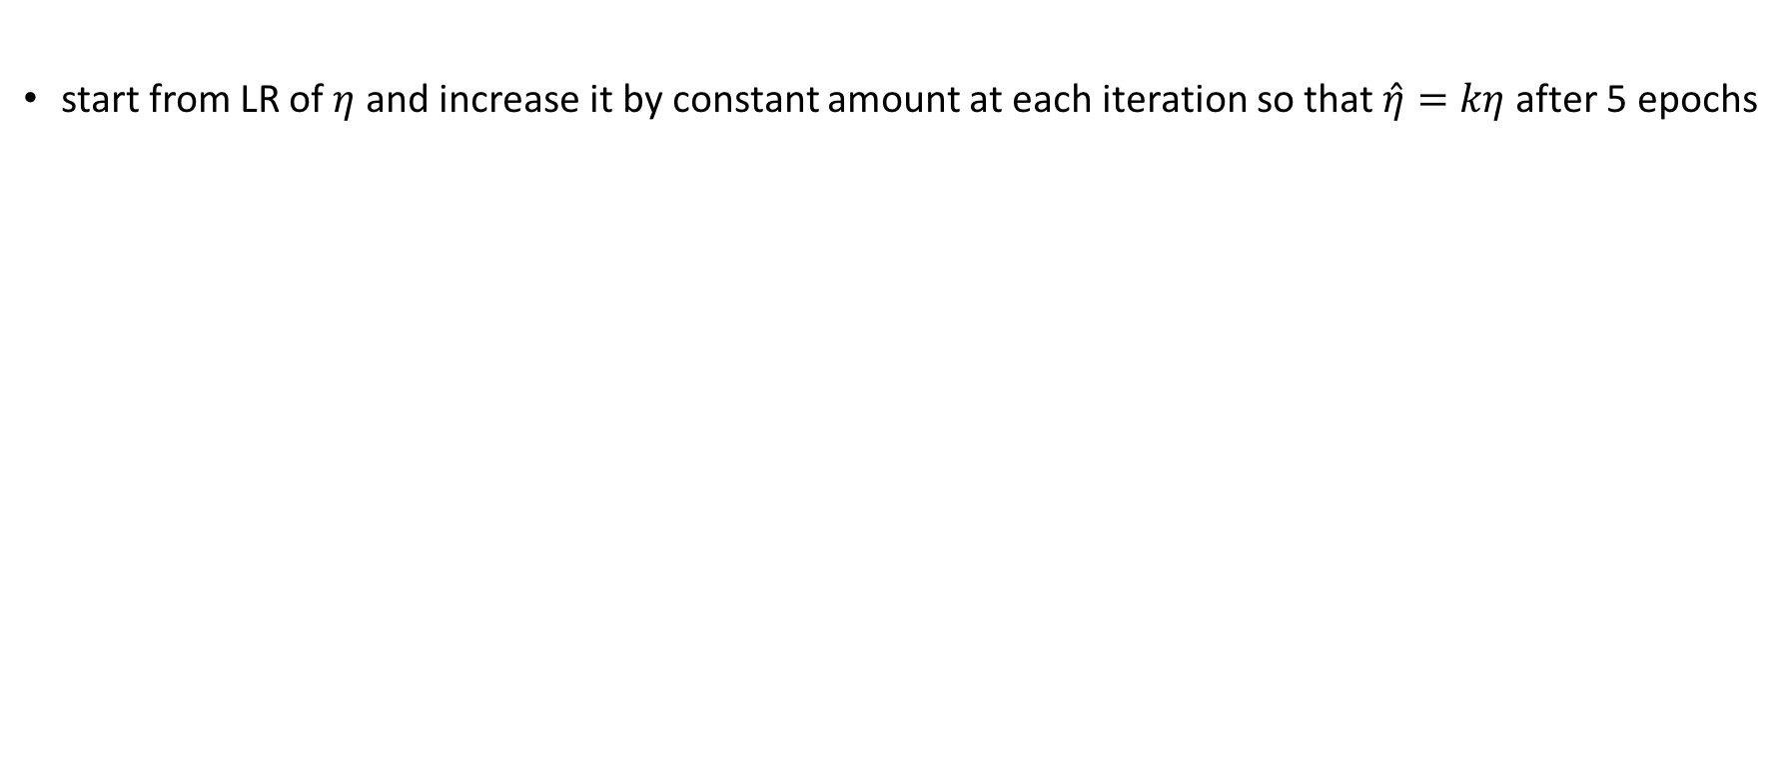
Gradual LR warmup
start from LR of $η$ and increase it by constant amount at each iteration so that $\hat{η}=kη$after 5 epochs
Notes:
Next we tried to increase learning rate gradually. We start from a learning rate of 0.1 and increase it by a very small magnitude of 0.003 at every single iteration for the next 5 epochs until it returns to 3.2
And we found that to solve optimization issue and also match the accuracy on test set within some std dev. This gradual warmup generalizes well over large range of minibatch size.

Slide 18
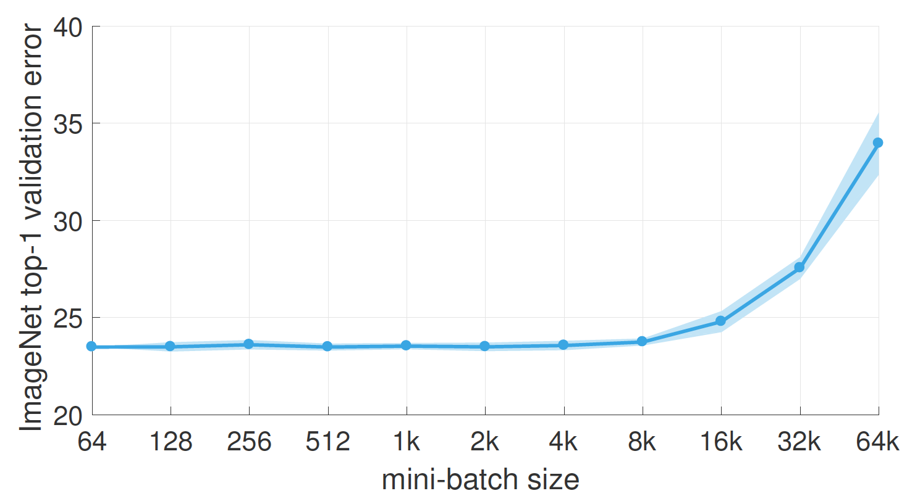
Accurate, Large Minibatch SGD
“Accurate, Large Minibatch SGD: Training ImageNet in 1 Hour”, June 2017 https://arxiv.org/abs/1706.02677
Notes:
Using this simple technique, we can scale to very large batch while matching small minibatch accuracy. it that it allows us to seamlessly transition between all mb sizes (up to a certain point) and this required no hyper-param search.
This was one of the key strategies for matching accuracy on large batch sizes but there are many other strategies that are important and details for them can be found in the paper.

Slide 19
Scaling Efficiently
Notes:
So we have seen how we match accuracy for a large batch size, now let’s move on to our next challenge of scaling efficiently to a large number of machines and how we achieved that in our work

Slide 20
Data Pipeline
DOWNLOAD
DECODE
AUGMENT
Queueing needs to keep-up with compute (GV100, GP100) etc.
BATCHING
QUEUE
DOWNLOAD
DECODE
AUGMENT
256 x 256
224 x 224 crop
HORIZONTAL FLIP
Notes:
A very important component of scaling efficiently is the data input pipeline. For a standard resnet50 baseline model, this pipeline involves getting the image from data source, decode the raw image and augment it like crop it, flip it and adding other noise, then we have to apply the same step to other images in training step and batch the images into a minibatch and put the minibatch on gpu queue. And want we want is the training data to be available at all the times i.e. a minibatch should be ready for training at all times and training shouldn’t wait for a minibatch to become available. As the compute increases with the new accelerators like NVIDIA Volta gpus etc. the queuing needs to keep pace with the compute otherwise it can become a serious bottleneck
Data input pipeline is an important component of scaling up. For a standard resnet50 baseline model, we have do get the image from data source, decode the raw image and augment it like crop it, flip it and adding other noise, then we batch the images and put them on gpu queue. The training data should be available at all the times i.e. a minibatch should be ready for training at all times.

Slide 21
Multi-node Training
Inter-machine
Intra-machine
G1
G2
…..
G8
G1
G2
…..
G8
G1
G2
…..
G8
………..
G1
G2
…..
G8
AllReduce
G1 + G2 + …..+ G8
G1 + G2 + …..+ G8
G1 + G2 + …..+ G8
G1 + G2 + …..+ G8
Node-1
Node-2
Node-3
Node-K
AllReduce is important to scale efficiently
Notes:
Now we have our data, let’s look at what actually happens in a distributed training. let’s say we have k machines. Each machine has 8-gpus. Each gpu will have its own copy of network parameters and their gradients. Now we have to synchronize these gradients within a machine and also across the machines and then only we can proceed to next iteration of training. This synchronizing operation is also called allreduce and we note that it’s the key component for scaling to multiple gpus efficiently. And this operation is very challenging because it needs to be fast and also scale to large number of gpus.

Slide 22
latency bound
bandwidth bound
Small buffers
Large buffers
Notes:
But there is also another challenge. In any given iteration, we have various different buffer sizes to synchronize and these buffers can vary greatly in size. Some can be small say a few kilobytes and some can be as large as few megabytes. These small buffers are always latency bound while the large buffers are bandwidth bound. So we need communication algorithms that are efficient both in terms of latency and bandwidth. At Facebook, we have developed a library which provides implementation of state-of-the art communication algorithms. This library is called Gloo and is available with Caffe2.

Slide 23
Gloo for Communication
Wraps NCCL for intra-node reductions
Inter-node collective communication algorithms on top of POSIX sockets API
Notes:
At Facebook, we have developed a library which provides implementation of state-of-the art communication algorithms. This library is called Gloo and supports Caffe2 out of the box
Gloo wraps NCCL for intra-node communication
For inter-node communication, it provides implementations via POSIX API.
It also solves various communication issues that we see in the traditional approaches.

Slide 24
Collective Execution with Gloo
LAYER N
gradient 1
LAYER (N -1)
AllReduce
gradient 2
LAYER (N -2)
AllReduce
gradient 3
AllReduce
LAYER 3
LAYER 2
LAYER 1
Notes:
This is what the communication looks like with Gloo. Once we have done the forward pass in the network, in the backward pass we overlap communication with compute. As soon as the gradient of a layer becomes available, we start all reduce on it and keep doing the backward pass. So we can have multiple all reduce threads running.

Slide 25
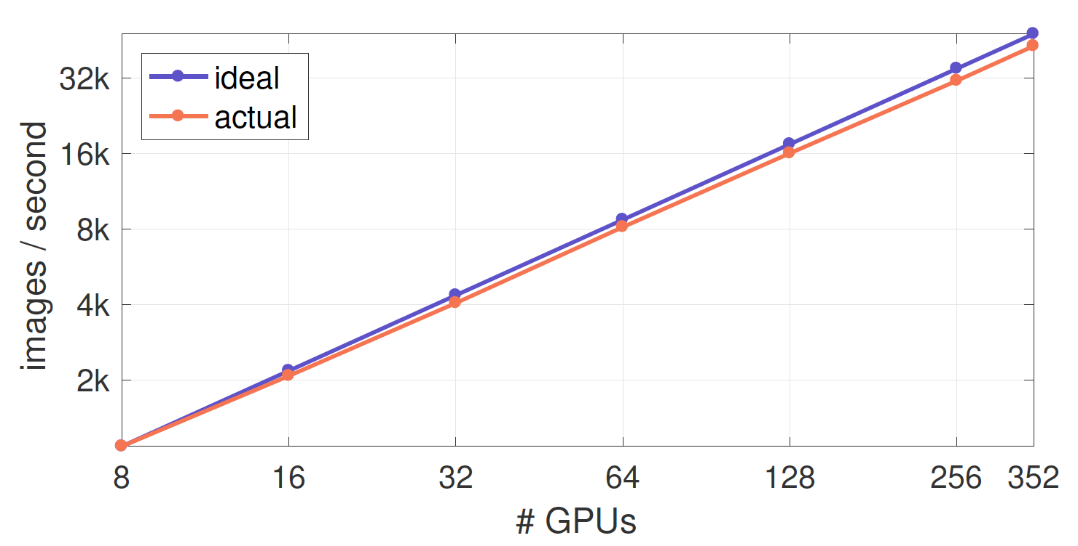
Using 100% open source commodity hardware/software stack, 90% scaling efficiency
Distributed Synchronous SGD throughput
Notes:
And finally, using Caffe2, Gloo, our batch size scaling techniques and 100% commodity hardware, we achieved 90% scaling efficiency on 256 gpus training

Slide 26
25 Million parameters in ResNet-50
~4 Gflops/image
1.28M images in ImageNet processed ~100 times
Overall ~0.5 Exaflops to train classifier
Notes:
to highlight the amount of compute involved in 90% efficiency on resnet50 with 25 Million params, and for an imagenet dataset which has about 1.28 Miliion images, we have to process all the images entirely about 100 times to achieve the accuracy. This gives us about 0.5 exaflops to compute and we could do it all in 1 hour with very simple scaling rules and commodity open-source hardware/software stack

Slide 27

github.com/facebookincubator/gloo
caffe2.ai
opencompute.org/
https://arxiv.org/abs/1706.02677
Notes:
Here are various links. Gloo is open-sourced and so is caffe2, the hardware specs can be found at opencompute.org and the paper link

Slide 28
Thank you!
Notes:
Thank you!

