Slide 1
PALO ALTO

Slide 2
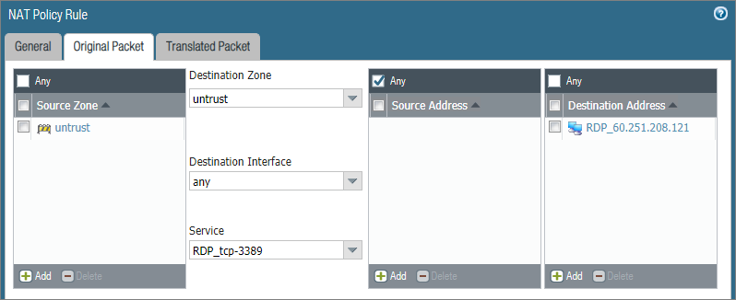





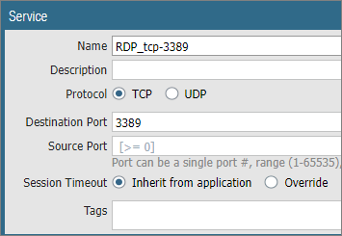
DNAT
unTrust
WAN IP
Source From unTrust
unTrust
Destination To Trust
Access Server WAN IP
Trust
Private IP
Service

Slide 3
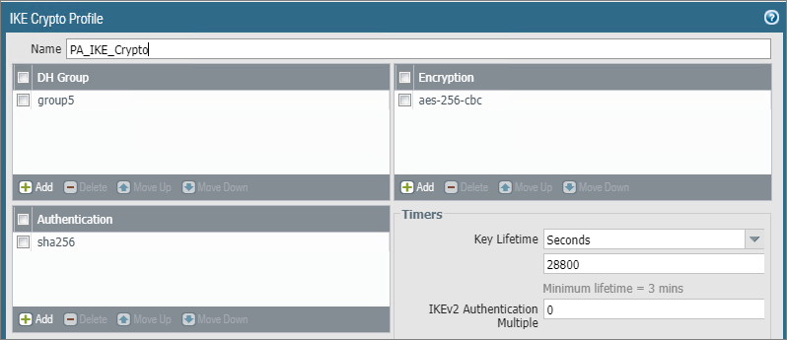

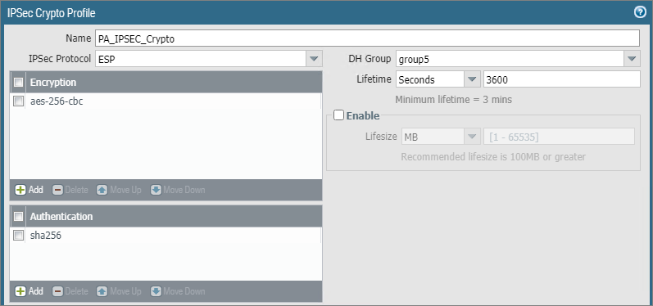
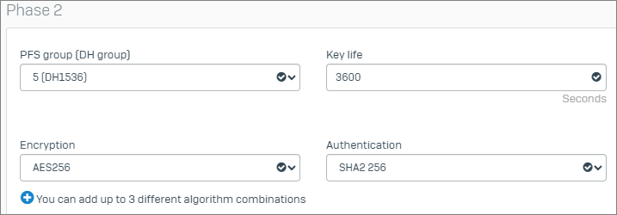
PA – Sophos XG IPSec VPN -1
PA-IKE1
PA-IKE2

Slide 4
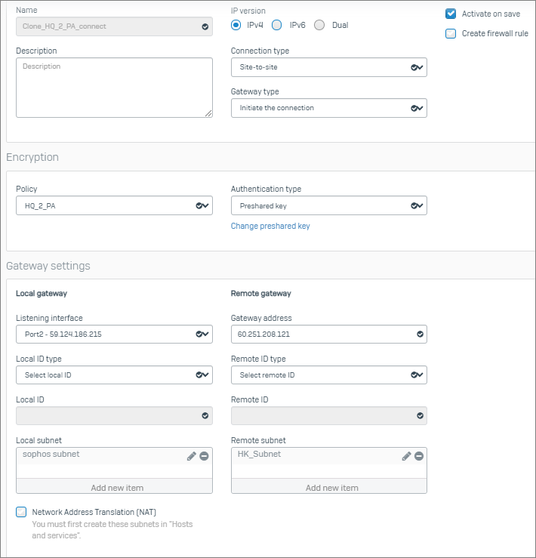
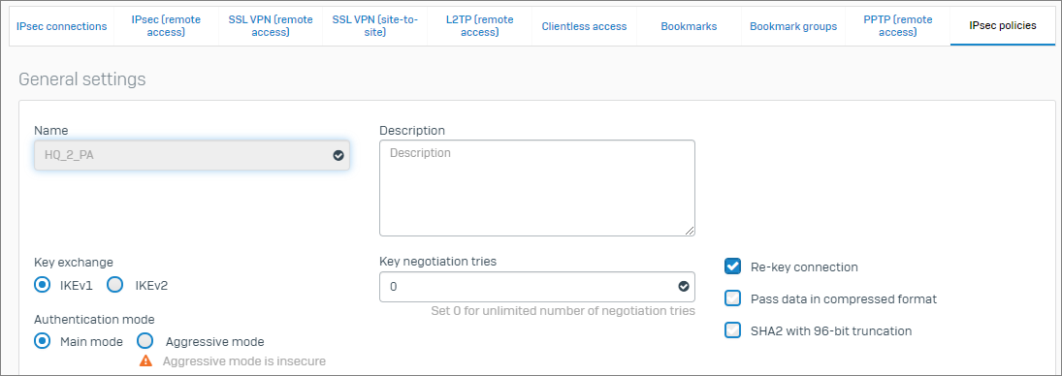
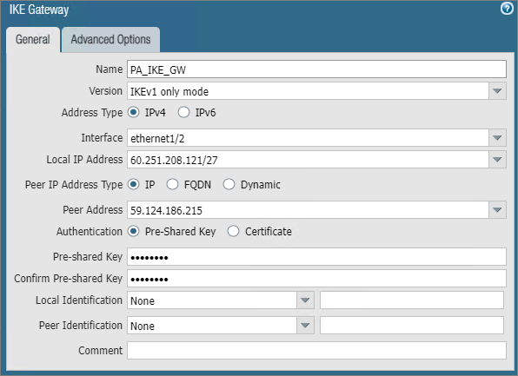
PA – Sophos XG IPSec VPN -2

Slide 5
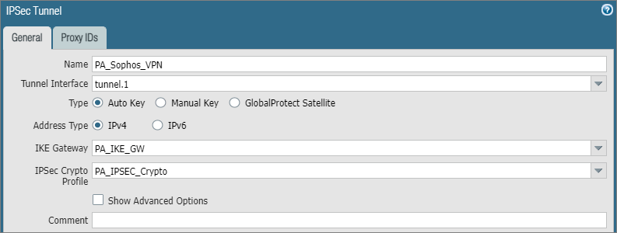
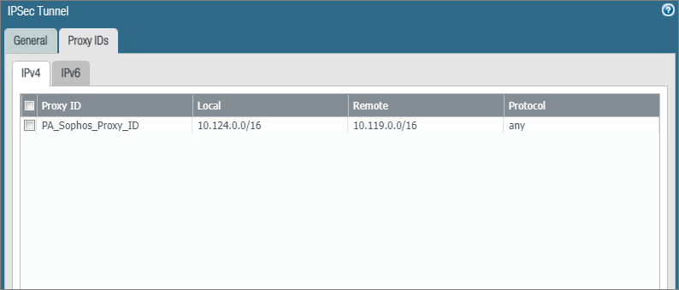
PA – Sophos XG IPSec VPN -3

