Slide 1
Sequential Imaging
Consecutive frame subtraction:
    Capture a frame
    Capture a second frame
    OpenCV function cv::absdif(Mat Frame1, Mat Frame2, Mat Difference);

Slide 2
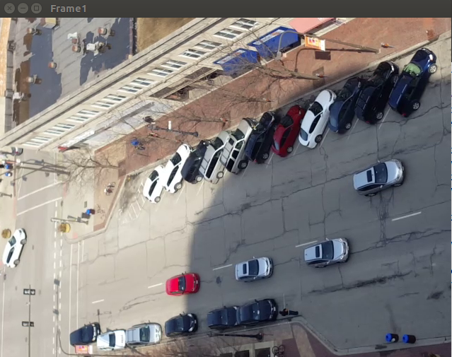
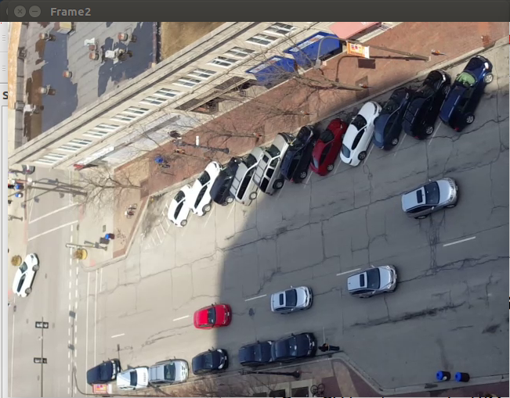
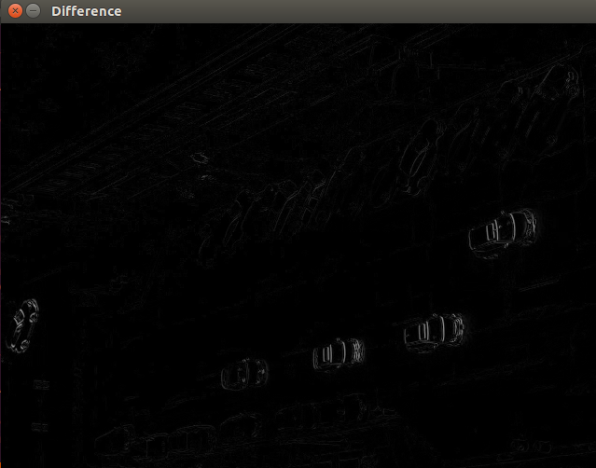
Sequential Imaging

Slide 3
Sequential Imaging

