Slide 1


.NET FRAMEWORK
Trần Thuận Nghĩa
Senior Developer at SmartLog

Slide 2
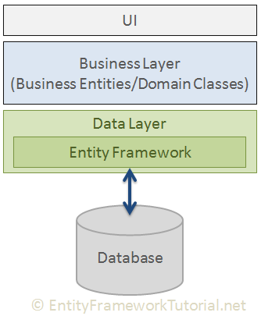
ENTITY FRAMEWORK

Slide 3
ENTITY FRAMEWORK
Cross-platform
Modelling
Querying
Change Tracking
Saving
Concurrency
Transactions
Caching

Slide 4
KEY WORDS
Nuget Package
ConnectionString
DbContext
DbSet
enable-migrations
add-migration <name>
update-database
Foreign Key
Include
Lazy Loading
http://www.entityframeworktutorial.net/

Slide 5
CODE FIRST
Aggregate
GroupBy
Join
GroupJoin

Slide 6

Question

Slide 7

practice

Slide 8
Thank You !

