Slide 1


Angular/TypeScript
Trần Thuận Nghĩa
Senior Developer at SmartLog

Slide 2
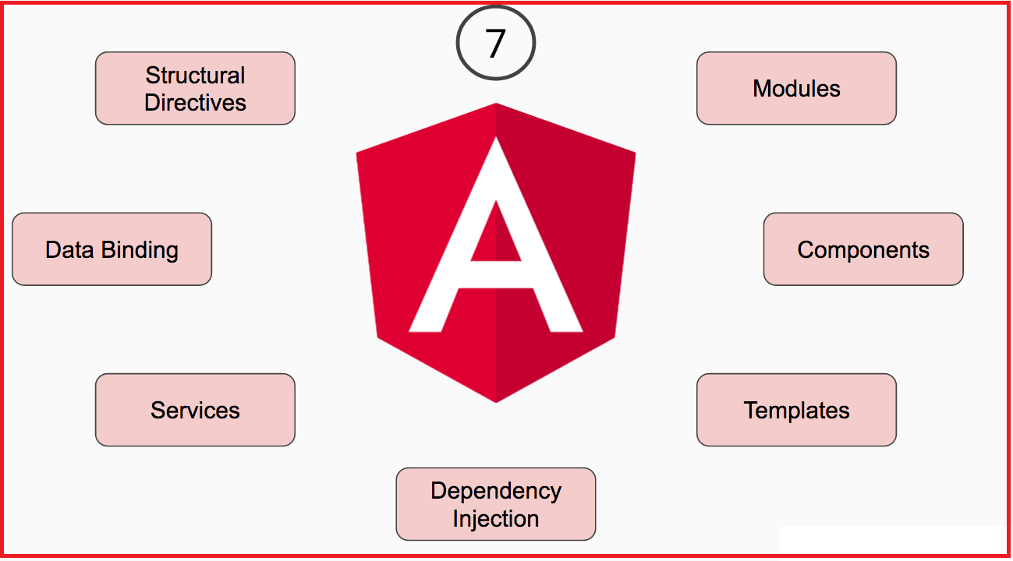
Notes:
Component trong module
Service

Slide 3
Contents
1
Install
2
Module
3
Component
4
Bindding
5
SPA

Slide 4
Install
1. Angular CLI: npm install -g @angular/cli
2. New App: ng new app_name
3. Run App: ng serve [--port 1234]
4. Stop App: Ctrl + C

Slide 5
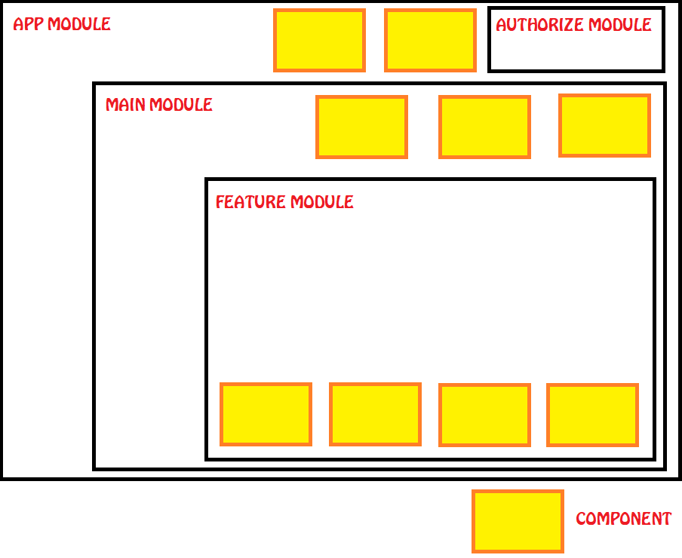
Module

Slide 6
Module
1. Browser Module
2. Forms Module
3. Http Module

Slide 7
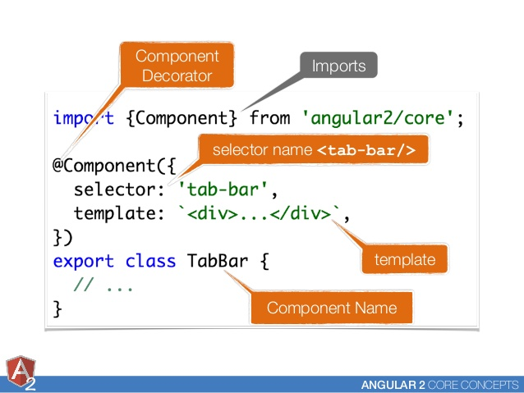
component

Slide 8
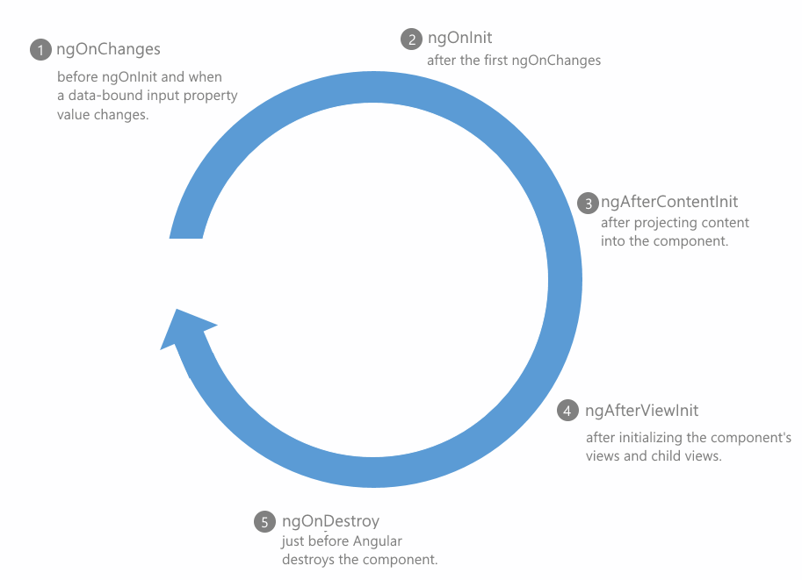
component

Slide 9
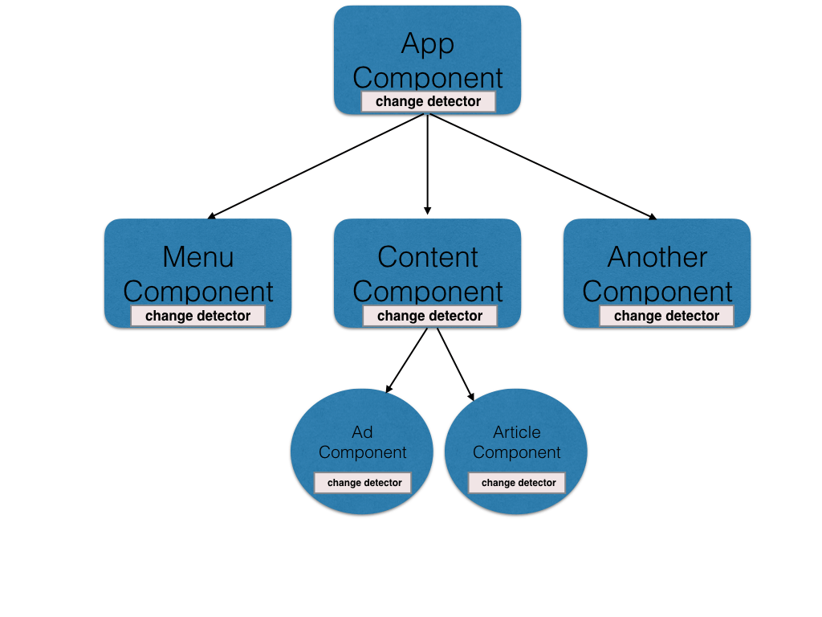
component

Slide 10
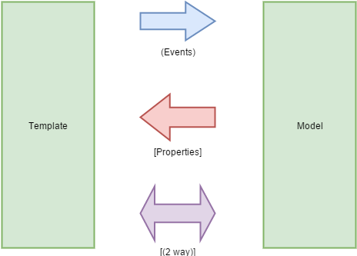
Bindding

Slide 11
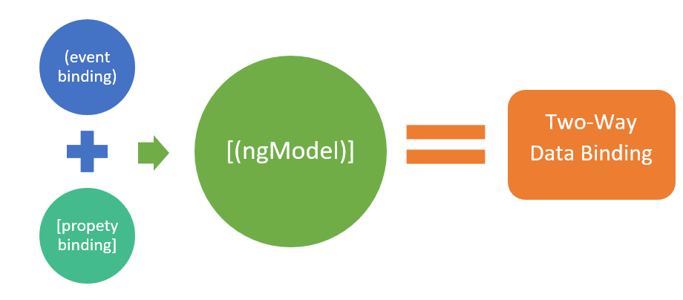
Bindding

Slide 12
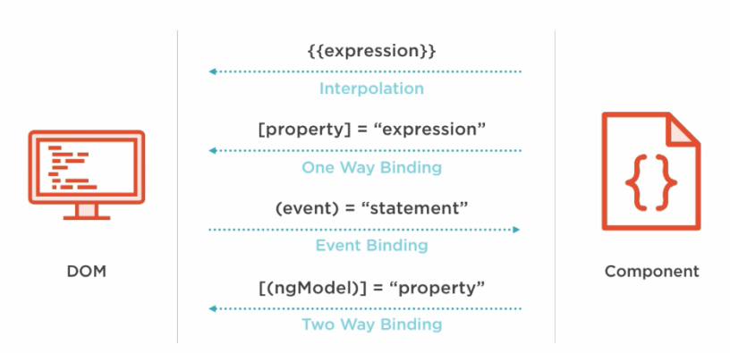
Bindding

Slide 13

practice

Slide 14
Thank You !

