Slide 1
Awesome Murio Uncle
2D Platformer
By Ryan Pierce, Dean Antel, and Kylie Beasley

Slide 2
Original Concept
Emulate the original Super Mario Bros.
Involve Enemies, PowerUps, Physics
Have multiple Levels
Different World styles

Slide 3
Key Elements
Basic Physics Engine (velocity, acceleration)
Scroll Left
Add/Remove from LevelObject Array
Collision
HUD
ImageArray Builder
Parallax Scrolling

Slide 4
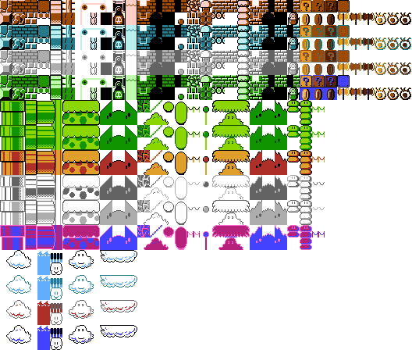
ImageArrays

Slide 5
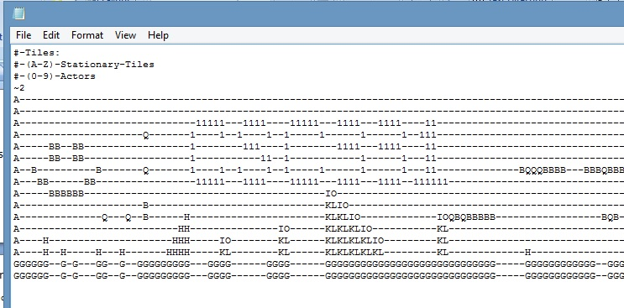
Creating A Text Level

Slide 6
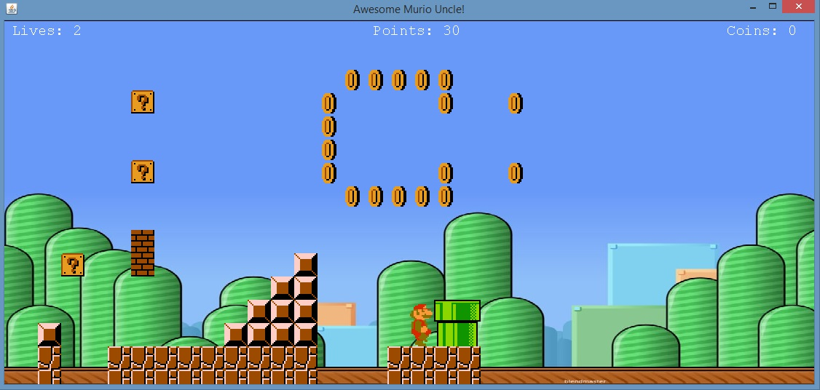
LevelObject Loading/Unloading

Slide 7
For the Future…
Enemies
Animations
Splash Screen
Web-based Build you Own Murio Game

