Slide 1

UNIVERSITÀ DEGLI STUDI DI SALERNO · SOFTWARE DEPENDABILITY
Rated
Software Dependability Report
Bruno Nesticò · Francesco Rao · Roberto Fiorenza
10 September 2026
github.com/superfra01/Rated-Dependability

Slide 2
OUTLINE OF THE PRESENTATION
Index
1
The Rated project: context, architecture, technologies
2
GitHub workflows: Continuous Integration and Continuous Delivery
3
Formal verification with OpenJML
4
Docker environment configuration
5
Testing activities: JaCoCo code coverage and PIT mutation testing
6
Performance testing: JMH and Creedengo static analysis
7
Security: native GitHub features, SonarQube, GitGuardian, Snyk
8
Final considerations

Slide 3
The Rated project
1

Slide 4
1 · APPLICATION CONTEXT
The Rated project
▸ Domain: web platform that enables users to rate and review movies and TV series
▸ For users: navigate through the catalog (movies and series), explore in detail every title presented in the catalog, see its data sheet, score its overall impression with stars, and compose a written review on it. Furthermore, a user is be able to rate, comment, and leave their opinion on other users' reviews, as well as on the reviews' replies. During browsing, users are able to also access the profiles of other users. ▸ For administrators: catalog management (insertion, modification and removal of titles) and moderation of comments alongside user account control.
▸ Three-tier architecture: clear separation between presentation layer, application logic and persistence management, guaranteeing maintainability and scalability.
– Frontend: HTML5, CSS3, JavaScript
– Backend: Java (Servlet and JSP), Tomcat 9
– Database: MySQL, accessed through JDBC and a JNDI DataSource

Slide 5
1 · SUMMARY
Evaluation criteria and Results
Criterion | Result
Application buildable in CI/CD and locally | Ci.yml and continous delivery on every push/PR
Formal JML specification verified with OpenJML | 27 annotated files and formal verification successful
Docker image ready to be orchestrated | docker-push.yml and dockerization for both amd64 and arm64
Significant number of test cases | 361 tests in 94 classes (unit and integration)
Code coverage analyzed with JaCoCo | 96% instructions and 93% branches (from 58% / 41%)
Mutation testing campaign with PIT | 98% mutation coverage · 98% test strength
JMH microbenchmarks on demanding components | 7 service suites · up to −22.7% ns/op
Security mechanisms implemented in CI/CD | GitGuardian, Snyk, SonarQube, Dependabot
Security analyzed with the three tools | 97 → 0 issues; remaining findings = false positives
No vulnerabilities in the web application | Security Rating A · 0 security issues

Slide 6
GitHub workflows
2

Slide 7
2 · GITHUB WORKFLOWS
Continuous Integration - ci.yml
▸ Trigger: every push and every pull request on the main branch.
▸ Checkout and setup: the repository is checked out and the correct JDK 17 is installed
▸ Build and test: the mvn verify stage performs a full build of the project, executes all the tests, and generates the code coverage report with JaCoCo.
▸ Mutation testing: PIT evaluates the ability of the current test suite to detect defects in the project's code.
▸ Upload of the reports: the JaCoCo coverage report and the PIT mutation testing report are published as artifacts.
▸ Secret scanning: GitGuardian scans the code for secrets, API keys, tokens, and credentials.
▸ Dependency analysis: Snyk performs SCA on the Maven dependencies on the main branch with a fairly strict severity threshold, and Snyk SAST scans the code
▸ Static analysis: SonarQube analyzes the code base and pushes the analysis to SonarCloud, in order to detect bugs, vulnerabilities, code smells, etc.
▸ Containerization: the Docker image is built and tagged with the current commit hash, for full traceability of the artifact.

Slide 8
2 · GITHUB WORKFLOWS
Continuous Delivery - docker-push.yml
▸ Trigger: a push to the main branch (or eventually manual execution)
▸ Checkout and JDK 17: the Java environment setup of the CI workflow is replicated.
▸ Builder setup: a Docker Buildx multi-architecture builder is initialized.
▸ Authentication: the workflow authenticates to Docker Hub using the corresponding GitHub Secrets.
▸ Build and push: the multi-architecture image is built for both linux amd64 and arm64.

Slide 9
Formal verification with OpenJML
3

Slide 10
3 · FORMAL VERIFICATION
OpenJML: objectives and scope
▸ What it is: OpenJML is a framework for formal specification and verification of Java programs, supporting ESC and RAC.
▸ OpenJML provides JML specifications for part of the Java standard library, so application contracts are checked together with the available library models.
▸ Scope: about 27 Java files, providing a model specification for all the business logic (model, dao, service).
10 Model classes
10 DAO classes
5 Services + 2 Utilities
FilmBean, FilmGenereBean, GenereBean, InteresseBean, PreferenzaBean, RecensioneBean, ReportBean, UtenteBean, ValutazioneBean, VistoBean Annotated with class invariants and contracts for constructors, getters and setters.
FilmDAO, FilmGenereDAO, GenereDAO, InteresseDAO, PreferenzaDAO, RecensioneDAO, ReportDAO, UtenteDAO, ValutazioneDAO, VistoDAO Preconditions on parameters, frame conditions, nullability and minimal properties of returned objects and collections.
CatalogoService, RecensioniService, AutenticationService, ModerationService, ProfileService — modular reasoning about domain objects and DAOs. FieldValidator and PasswordUtility: validation and hashing contracts, implementations treated as trusted boundaries.

Slide 11
3 · FORMAL VERIFICATION
OpenJML application strategy
▸ Approach: We verified the code bottom-up: first the model classes, then the DAOs, then the services. Each class and method was annotated with contracts (what must hold before it runs, what it guarantees afterwards, and what must always be true of the object). OpenJML then proves the code respects them.
▸ Model: the contracts say when an object is valid (for example, a film cannot have a negative duration) and the constructors make it impossible to create an invalid one.
▸ DAO: the contracts say what a method needs in order to work, what it gives back, and whether it changes the database.
▸ Service: the same reasoning applied to operations such as catalog, reviews, authentication, moderation.

Slide 12
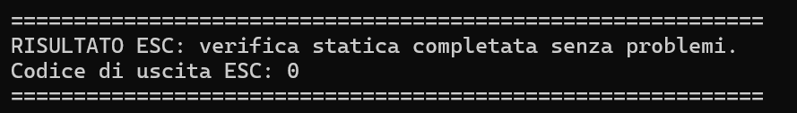
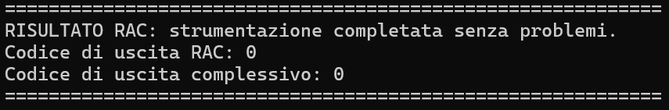
3 · FORMAL VERIFICATION
OpenJML verification results
▸ Complete ESC verification: all 27 annotated Java files analyzed with OpenJML and the verification terminates with exit code zero.
▸ RAC compilation: completed successfully on the same 27 files, producing instrumented class files for runtime assertion checking.
▸ Conclusion: the correctness of the core business logic is effectively guaranteed by formal verification, not by tests alone.

Slide 13
Docker environment configuration
4

Slide 14
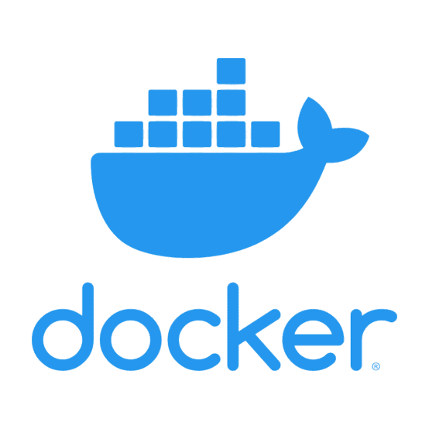
4 · DOCKER ENVIRONMENT
The whole stack in containers
▸ The application and its database are packaged as Docker containers and started together from a single Compose file.
▸ One identical, reproducible environment on every machine
Reproducible image
The application is compiled inside the image and only the runtime is shipped, so the build never depends on what is installed on the developer's machine.
Isolated services
Application server and database run as two separate containers on a private network, each with its own health check and restart policy.
Built by the pipeline
The delivery workflow builds the image for both amd64 and arm64 and publishes it to Docker Hub on every push to main.

Slide 15
4 · DOCKER ENVIRONMENT
Inside the image: build and runtime
▸ The image is built in two stages: the application is compiled in the first, and only what is needed to run it is carried into the second so the compiler and the build tools never end up in the shipped image.
STAGE 1 · BUILD
▸ Maven 3.9 compiles the application and packages it into a single deployable file.
▸ The dependencies are downloaded before the sources are copied, so they are re-used from cache as long as the dependency list doesn't change.
▸ Nothing needs to be installed on the developer's machine: no JDK, no Maven.
STAGE 2 · RUNTIME
▸ Only the packaged application crosses over from the first stage.
▸ Tomcat's default applications are removed, so the image contains nothing but what the project actually needs.
▸ Nothing needs to be installed on the developer's machine: no JDK, no Maven.
rated-app.war
The database credentials are never written in the code or baked into the image but they are injected when the container starts.

Slide 16
4 · DOCKER ENVIRONMENT
Deployment architecture
▸ Only the application is reachable from the host, the database is not.
rated-network · private Docker network
webapp
Tomcat runtime serving the Rated application.
The only container published to the host.
db_service
MySQL database with the Rated schema.
Not published to the host.
Browser
host machine
HTTP · 8080
JDBC
db_data named volume

Slide 17
Testing activities
5

Slide 18
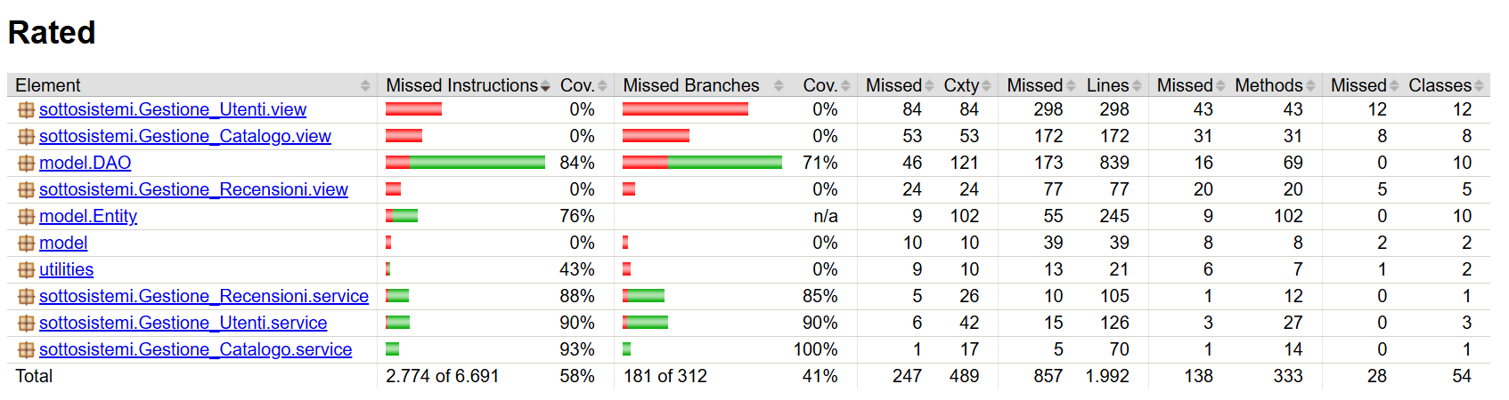
5 · TESTING ACTIVITIES
Code coverage with JaCoCo
Threshold set at 80% code and branch coverage
BEFORE · 58% instructions · 41% branches · 857 missed lines out of 1,992

Slide 19
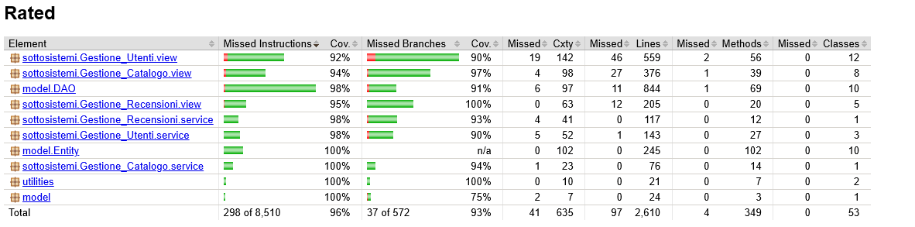
5 · TESTING ACTIVITIES
Code coverage with JaCoCo
Threshold set at 80% code and branch coverage
AFTER · 96% instructions (298 missed of 8,510) · 93% branches (37 of 572)

Slide 20
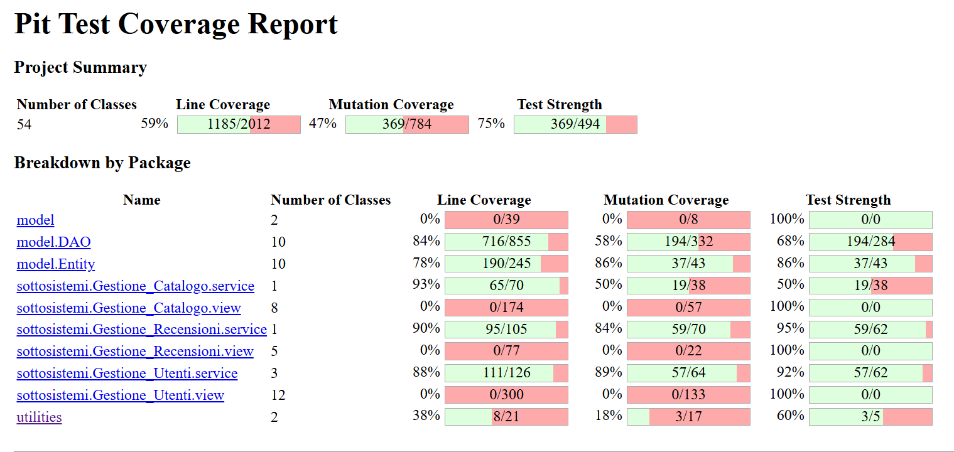
5 · TESTING ACTIVITIES
Mutation testing with PIT
BEFORE
▸ Baseline: line coverage 59% (1,185/2,012), mutation coverage 47% (369/784), test strength 75% (369/494)
▸ Interventions: new tests for previously unconsidered combinations of conditions, more accurate verification of return values and side effects, tightened assertions.
▸ Final results: line coverage 99% (2,558/2,590), mutation coverage 98% (976/999), test strength 98% (976/997).

Slide 21
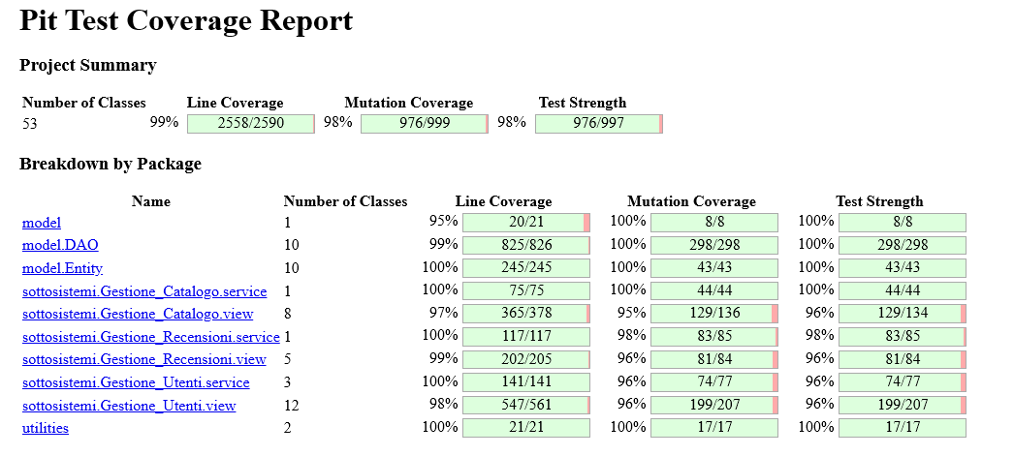
5 · TESTING ACTIVITIES
Mutation testing with PIT
AFTER
▸ Baseline: line coverage 59% (1,185/2,012), mutation coverage 47% (369/784), test strength 75% (369/494)
▸ Interventions: new tests for previously unconsidered combinations of conditions, more accurate verification of return values and side effects, tightened assertions.
▸ Final results: line coverage 99% (2,558/2,590), mutation coverage 98% (976/999), test strength 98% (976/997).

Slide 22
Performance testing
6

Slide 23

6 · PERFORMANCE TESTING
How we approached performance
▸ The platform had already been optimized for the Software Sustainability exam, but it grew with the features added for the Advanced Techniques exam, so the whole cycle was repeated on the current codebase.
▸ Method: measure first, change only what the measurement justifies, then measure again under identical conditions.
STEP 1 · MEASURE
JMH
Microbenchmarks on the service layer establish a repeatable baseline in ns/op.
STEP 2 · DIAGNOSE
Creedengo
Static analysis points at the code patterns that waste CPU, memory and database I/O.
STEP 3 · ACT
Impact-driven fixes
Findings are prioritized by their real cost, not by how often they occur.
STEP 4 · VERIFY
JMH re-run
The same benchmarks, the same configuration: the before / after gap is the evidence.

Slide 24
6 · PERFORMANCE TESTING
JMH microbenchmarks — measurement criteria
▸ Configuration: Mode.AverageTime, NANOSECONDS unit (ns/op), warmup 15 iterations of 1 s, measurement 40 iterations of 1 s, fork 2.
– The 15 warmup iterations were selected after testing several combinations: the optimal value for stabilizing AverageTime, reducing variability from JIT compilation, profiling and caching.
▸ Components measured: CatalogoService, RecensioniService, AutenticationService, ProfileService, ModerationService, FieldValidator, PasswordUtility.
▸ Constant operating conditions: Lenovo laptop with AMD Ryzen 5 5500U, 8 GB RAM, Windows 11 (24H2), JDK 17, MySQL 9.2.0.
▸ Traceability: all results exported to txt and versioned in the repository, split into before and after directories.
15 + 40
fork 2
7
warmup + measurement iterations
independent JVMs per benchmark
benchmark suites versioned

Slide 25
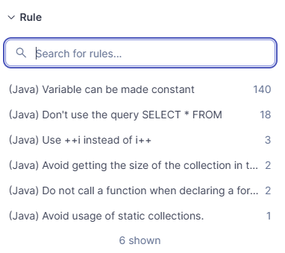
6 · PERFORMANCE TESTING
Static analysis with Creedengo
▸ 166 violations across 6 categories: Creedengo's goal is not style cleanup, but detecting patterns that introduce resource waste.
▸ SELECT * FROM (18) — high priority: the most critical violation; retrieves unnecessary columns, inflating disk I/O, network transfer and memory consumption.
– Fix: queries rewritten listing only the required fields explicitly.
▸ Static collections (1) — high priority: persist in memory throughout the entire application lifecycle.
– Fix: converted into an instance/local variable, memory released by the GC at the end of the request.
▸ Loop micro-optimizations (7) — high priority: ++i instead of i++, collection size evaluated in the loop condition, function calls in the for declaration.
– Fix: invariant calls and .size() extracted outside the loop, computed once and reused.
▸ Variables that can be final (140) — low priority: 84% of the cases; immediate impact limited by JIT optimizations, but it affects the overall energy footprint. Resolved with the IDE's automated refactoring.

Slide 26

6 · PERFORMANCE TESTING
Validation: before / after comparison
Static analysis re-run with the same Quality Profile: total resolution of all violations tagged with Creedengo.
ProfileService benchmark | Before (ns/op) | After (ns/op) | Reduction
benchmarkAggiungiAllaWatchlist | 4,540.797 | 3,607.234 | −20.56%
benchmarkPasswordUpdate | 9,982.091 | 7,716.780 | −22.69%
benchmarkProfileUpdate | 14,696.992 | 11,558.612 | −21.35%
Excerpt: the repository contains the full suite of measurements for the other services (JMH/before and JMH/after directories).

Slide 27
Security
7

Slide 28
7 · SECURITY
Native GitHub security: shift left model
Goal: identify and mitigate security risks at the earliest possible stage, stopping vulnerabilities before the code is ever released.
Supply Chain Security
Secret Protection
Vulnerability Reporting
Dependency Graph + Dependabot
Secret Scanning + Push Protection
Private Vulnerability Reporting
Project dependencies are analyzed automatically and continuously cross-referenced against up-to-date vulnerability databases. Dependabot generates corrective pull requests, also in grouped format: this reduces the likelihood of incorporating compromised libraries and accelerates response to external security events.
Proactive scanning for patterns matching sensitive credentials: tokens, API keys and private secrets. Push protection acts as a preventive gatekeeper, blocking pushes when secrets are detected: credentials never enter the git history, avoiding revocation and rotation procedures.
A dedicated, secure channel lets users and researchers privately report potential security concerns. It establishes a responsible disclosure framework: the team can analyze and resolve vulnerabilities confidentially before public disclosure.

Slide 29
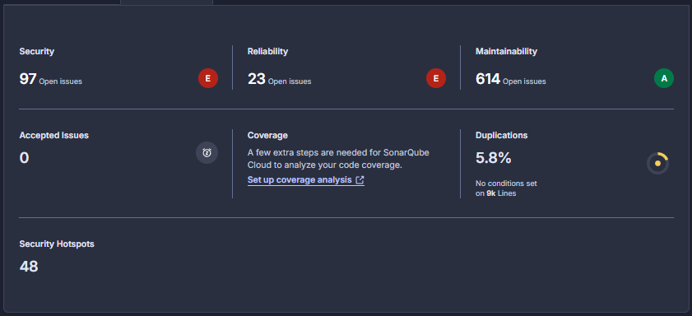
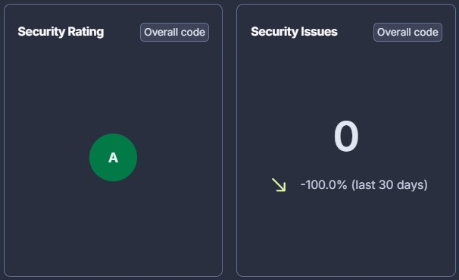
7 · SECURITY
SonarQube: from 97 to 0 security issues
▸ Explicit, measurable objective: zero security vulnerabilities across all adopted tools.
▸ Single recurring root cause: forward calls executed without explicitly handling ServletException and IOException.
▸ Potential impact: flow interruptions, inconsistent state responses or accidental exposure of detailed error stack traces, compromising overall robustness.
▸ Applied fix: all forward calls encapsulated within try/catch blocks, so errors are handled in a controlled and secure manner.
before
after

Slide 30
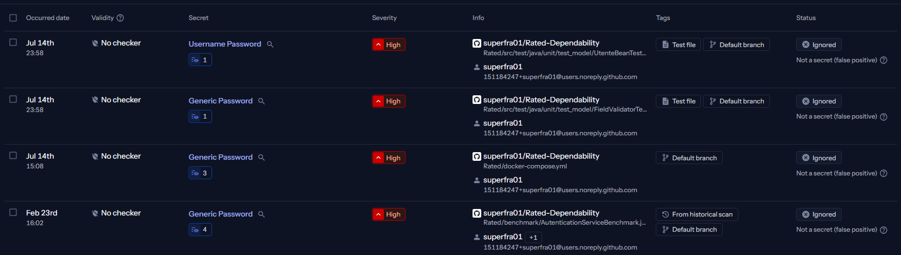
7 · SECURITY
GitGuardian — secret detection
4 findings raised on the repository, all of them manually reviewed and confirmed as false positives.
GitGuardian scan results: every finding marked as "Not a secret (false positive)"
▸ Findings 1–2: dummy credentials used strictly for testing activities.
▸ Finding 3: it is Bash and Docker Compose parameter expansion, which halts execution and prints the message if DB_PASSWORD is null or unset. It is in fact a validation check, flagged only because the scanner detected the keyword PASSWORD.
▸ Finding 4: a benchmarking script, with no security risk.

Slide 31
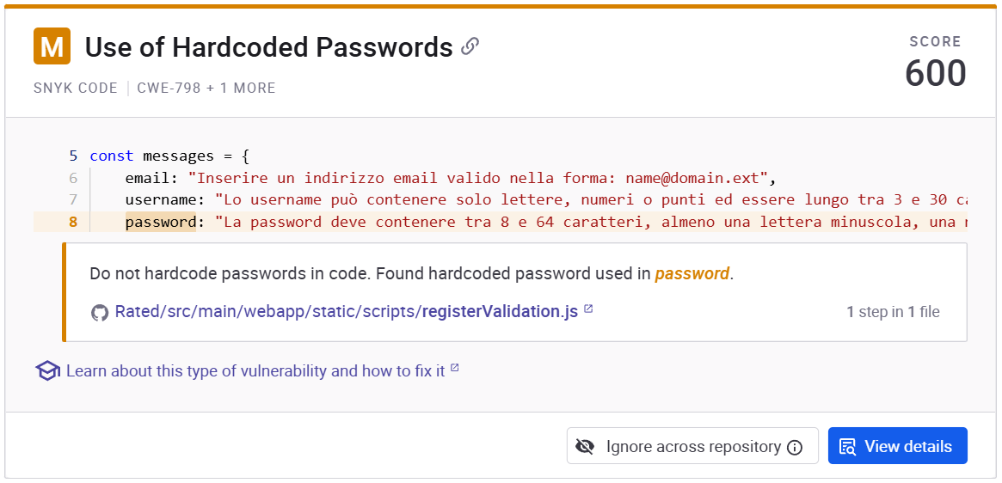
7 · SECURITY
Snyk Code: static application security testing
▸ Objective: zero issues, eliminating any potentially vulnerable pattern identified in the initial run.
▸ Result: a single finding, manually verified as a false positive and the scanner detected the word "password" in a non-sensitive context.
– The match is on the client-side validation messages of the registration form (registerValidation.js): no secret is exposed and no corrective action was required.
▸ Snyk in the CI pipeline: Open Source (SCA) on Maven dependencies with a strict minimum severity threshold, Monitor tracking dependency health on the main branch, Code (SAST) honouring the exclusions declared in the .snyk file.
Snyk Code — the only reported finding

Slide 32
Final considerations
8

Slide 33
8 · CONCLUSIONS
Final considerations
▸ Trough exhaustive tools use, a structured CI/CD pipeline, a rigorous focus on code quality and embedded automated security checks, we made the Rated project more dependable and reliable to the users.
▸ Every optimized metric, resolved vulnerability and automated validation step reinforces the application's stability, even when handling edge cases: the Rated architecture is now significantly more robust and maintainable.
96% / 93%
98%
0
−22.7%
0
instructions / branches (JaCoCo)
mutation coverage (PIT)
exit code of OpenJML ESC
ns/op on the best benchmark
security vulnerabilities

Slide 34
Thanks for your attention!

