Slide 1
RTNA 1.0
Streaming Engine Framework
From Zhang Ou/He Shan

Slide 2
Streaming definition
All streaming definition is not bind to any concreate data type, that means we can use GenericRecord or other class (AvroData currently) as data type in framework
Basic streams
Data stream:
No key stream corresponding to spark JavaDStream
Only be used for output from a data source
Only support split and transform
Keyed stream:
Keyed stream corresponding to spark JavaPairDStream
The main basic streaming used in running chart
All extended processor should be input/output depends on this stream.
Complex streams
Split stream
Used to output 2 streams from it
Correlate stream
Used to output 3 streams from it

Slide 3
Processor definition
All processor interface definition is not bind to any concreate data type, that means we can use GenericRecord or other class (AvroData currently) as data type in framework
Basic processors (support both data and keyed stream)
Source processor
Reading external data and output a data stream
Transform processor
Change key data schema, avro data schema and filter data
Split processor:
Besides split stream, the 2 output steams can have different key and filter configuration
Sink processor:
Export stream data into external system
Complex processors
Correlate processor
Correlate 2 stream according some criteria. The non-correlated record can be output to separated non-correlated streams.
Context processor
The input stream data will stored as context data, another stream will updated according to cached context then output.
Union processor
Union 2 streams with same key and avro data schema into one stream.

Slide 4
Data definition (May changed to GenericRecord and spark Tuple)
Key
Tuple
Support any dimension data
Lost generic type information for every dimension because we only store String
Data
AvroData
Store a byte array for avro raw data and a String array for key information. Quick serialization/deserialization than GenericRecord?
The based class for Spring EL: provide “field” method to XML writer.
AvroDataWrapper
The based class for Spring EL for following cases:
To transform avro data from one schema to another one
To merge more than one avro data into one
Method can be used for Spring EL: “get”, “getAll”, “searchOneByKey”, “searchByKey”
AvroPairData
The based class for Spring EL: Compare 2 AvroData when correlate or context cache updating

Slide 5
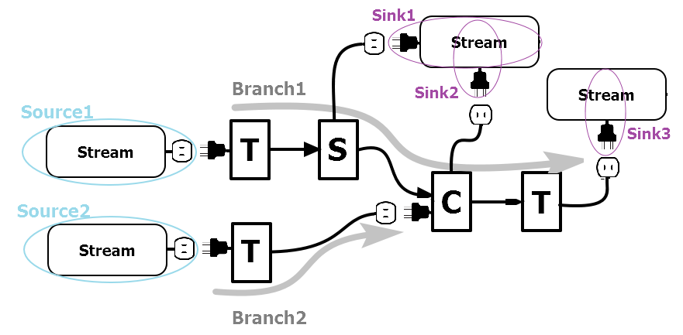
XML schema for SparkRunningChart
<sparkrunningchart>
-<sourceBuilderClass>
-<sinkBuilderClass>
-<sources>
-<branches>
-<sinks>
One chart contains three main parts: Input(sources),Processing Chain(branches),Output(sinks)
Each branch should be defined containing as many processors as possible and no common processor between two branches.
Branch1: T-S-C-T
Branch2: T

Slide 6
XML schema for SparkRunningChart
<source>
<outletId></outletId>
<kafka>
<topic></topic>
<brokerList></brokerList>
<groupId></groupId>
<avroPath></avroPath>
</kafka>
</source>
<sink>
<plugId></plugId>
<kafka>
<topic></topic>
<brokerList></brokerList>
<groupId></groupId>
<avroPath></avroPath>
</kafka>
<fileUrl></fileUrl>
</sink>
<branch>
<fromSource></fromSource>
<plugId></plugId>
<outletId></outletId>
<processors>
</processors>
</branch>
Every plugId must have a corresponding outletId in running chart definition to make them connected.
Every outlet can only have one plug, but can be no plug to connect.

Slide 7
XML schema for SparkRunningChart
<branch>
<processors>
<processor>
<actionType>transform</actionType>
……
</processor>
<processor>
<actionType>split</actionType>
<outlets></outlets>
……
</processor>
</processor>
Processors in a branch should be defined in sequence of the processing.
Four actionType supported just now: “split”, “transform”，“correlate” and “basiccount”. Which is easy to extend in the future for new processor type.

Slide 8
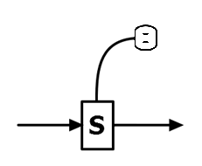
XML schema for SparkRunningChart
Split processor
outputRawData
<processor>
<actionType>split</actionType>
<outlets>
<outlet>
<id>outputRawData</id>
<key>
<expressions>
<expression>field('SendingNodeID')</expression>
<expression>field('M_TMSI')</expression>
</expressions>
</key>
<filter>
<booleanExpression>#long(field('NumRRCFailureRecords')) eq 0</booleanExpression>
</filter>
</outlet>
</outlets>
<key>
<expressions>
<expression>field('SendingNodeID')</expression> <expression>field('MmeUeS1apId')</expression>
</expressions>
</key>
<filter>
<booleanExpression>#long(field('NumRRCFailureRecords')) gt 0</booleanExpression>
</filter>
</processor>
If input is a key stream, then <key> part in <outlet> and <processor> can be ignored when output stream keeps key no change.
If input is a non-key stream, output <key> must be provided

Slide 9
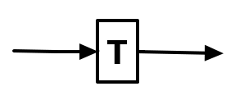
XML schema for SparkRunningChart
Transform processor
<processor>
<actionType>transform</actionType>
<key>
<expressions>
<expression>field('SendingNodeID')</expression> <expression>field('MmeUeS1apId')</expression>
</expressions>
</key>
<filter>
<booleanExpression>field('SendingNodeID') ne '0'</booleanExpression>
</filter>
</processor>

Slide 10
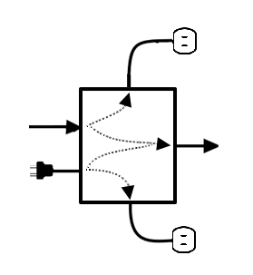
XML schema for SparkRunningChart
Correlate processor
<processor>
<plugIds>
<plugId>enbToCorrelate</plugId>
</plugIds>
<actionType>correlate</actionType>
<correlate>
<booleanExpression>(#long(data1.field('ProcedureStartTime')) le #long(data2.field('ProcedureStartTime'))) and ((#long(data1.field('ProcedureStartTime'))+#long(data1.field('ProcedureDuration'))*1000) ge #long(data2.field('ProcedureStartTime')))</booleanExpression>
</correlate>
<transform>
<avroPath>MMEPCMD_10.avsc</avroPath>
<fieldMappings>
<fieldMapping>
<name>PCMDid</name>
<expression>template.get('PCMDid') + '_' + sourceRoots[1].get('PCMDid')</expression>
</fieldMapping>
<fieldMapping>
<name>secondary</name>
<subRecordTriggers>
<subRecordTrigger>
<fieldMappings>
<fieldMapping>
<name>PGWid</name>
<expression>template.get('DefaultBearerID')</expression>
</fieldMapping>
</fieldMappings>
</subRecordTrigger>
</subRecordTriggers>
</fieldMapping>
</fieldMappings>
</transform>
<outlets>
<outlet>
<timeoutPolicy>
<longExpression>filed('ProcedureStartTime')</longExpression>
<timeout>500</timeout>
</timeoutPolicy>
<id>nocormme</id>
</outlet>
<outlet>
<timeoutPolicy>
<longExpression>filed('ProcedureStartTime')</expression>
<timeout>0</timeout>
</timeoutPolicy>
<id>nocorenb</id>
</outlet>
<outlets>
</processor>

Slide 12
Copyright and confidentiality
The contents of this document are proprietary and confidential property of Nokia. This document is provided subject to confidentiality obligations of the applicable agreement(s).
This document is intended for use of Nokia’s customers and collaborators only for the purpose for which this document is submitted by Nokia. No part of this document may be reproduced or made available to the public or to any third party in any form or means without the prior written permission of Nokia. This document is to be used by properly trained professional personnel. Any use of the contents in this document is limited strictly to the use(s) specifically created in the applicable agreement(s) under which the document is submitted. The user of this document may voluntarily provide suggestions, comments or other feedback to Nokia in respect of the contents of this document ("Feedback"). Such Feedback may be used in Nokia products and related specifications or other documentation. Accordingly, if the user of this document gives Nokia Feedback on the contents of this document, Nokia may freely use, disclose, reproduce, license, distribute and otherwise commercialize the feedback in any Nokia product, technology, service, specification or other documentation.
Nokia operates a policy of ongoing development. Nokia reserves the right to make changes and improvements to any of the products and/or services described in this document or withdraw this document at any time without prior notice.
The contents of this document are provided "as is". Except as required by applicable law, no warranties of any kind, either express or implied, including, but not limited to, the implied warranties of merchantability and fitness for a particular purpose, are made in relation to the accuracy, reliability or contents of this document. NOKIA SHALL NOT BE RESPONSIBLE IN ANY EVENT FOR ERRORS IN THIS DOCUMENT or for any loss of data or income or any special, incidental, consequential, indirect or direct damages howsoever caused, that might arise from the use of this document or any contents of this document.
This document and the product(s) it describes are protected by copyright according to the applicable laws.
Nokia is a registered trademark of Nokia Corporation. Other product and company names mentioned herein may be trademarks or trade names of their respective owners.

