Slide 2
Data:
4 subjects, 60 sec each of eyes closed (label 1) + 60 sec of eyes open (label 0), 4 channel data collected via Muse 2

Slide 3
raw: untouched original 4-channel signal
denoised: same 4 channels, but ZUNA regenerates the entire signal (all 4 channels masked in full, reconstructed from scratch)
zuna.reconstruct_fif(..., repair_channels=[TP9,AF7,AF8,TP10]) - All 4 real channels are masked in full, so there's no "untouched" region left full_reconstruction and hybrid end up nearly identical.
upsampled: real 4 channels kept untouched, plus 4 new ZUNA-hallucinated occipital/posterior channels (O1, O2, Oz, Pz) added on top - only the 4 new hallucinated channels are masked, the real 4 are never touched
zuna.reconstruct_fif(..., target_channel_count=[O1,O2,Oz,Pz])

Slide 4
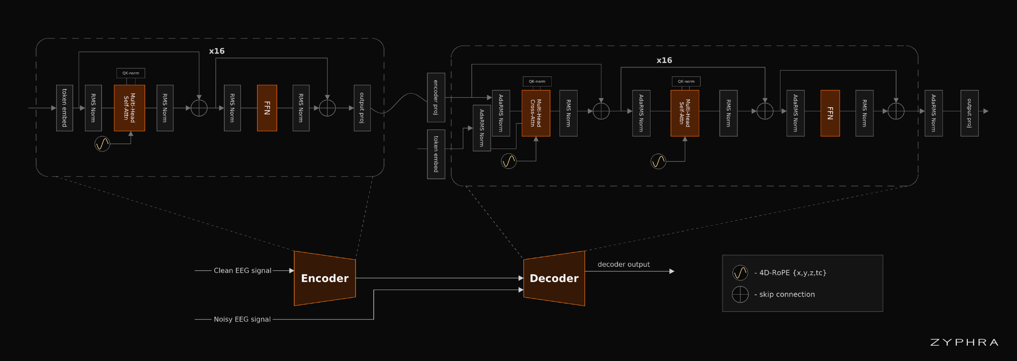
60-second recording —--> segment_sec=5.0 processing chunks —-> finer tokens
—-> denoised/upsampled 60s

Slide 5
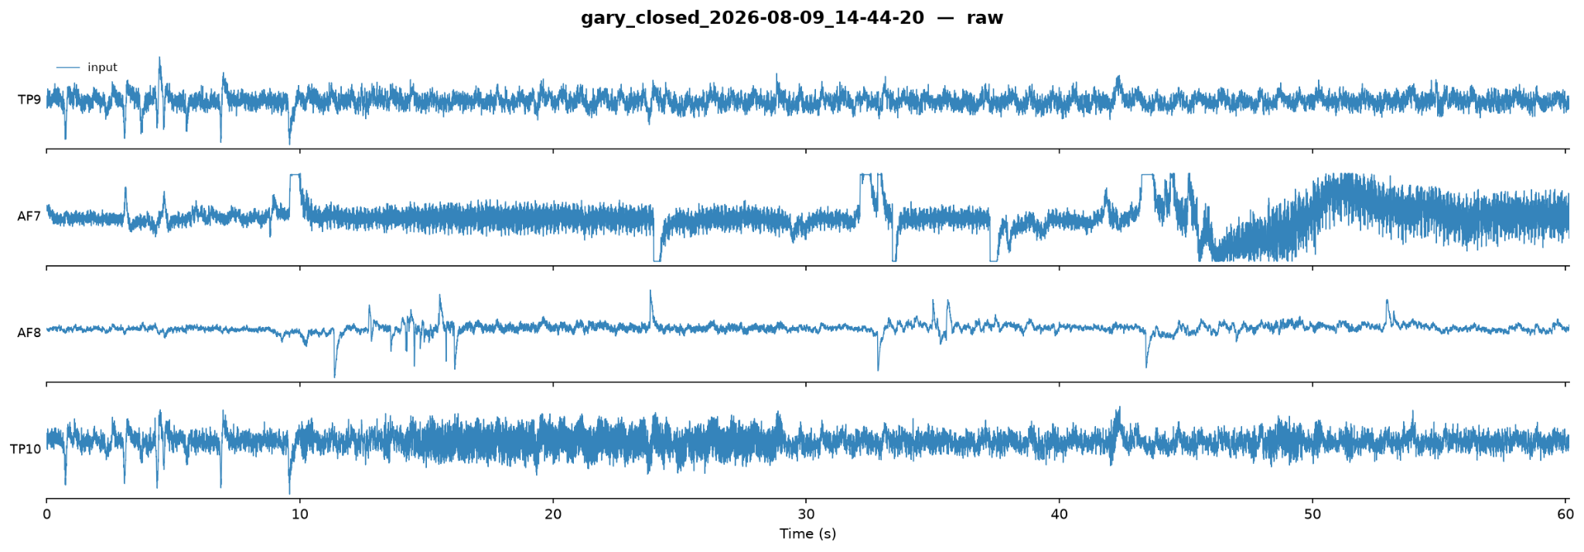
full_reconstruction: model output for every channel/timepoint, even ones that weren't masked.

Slide 6
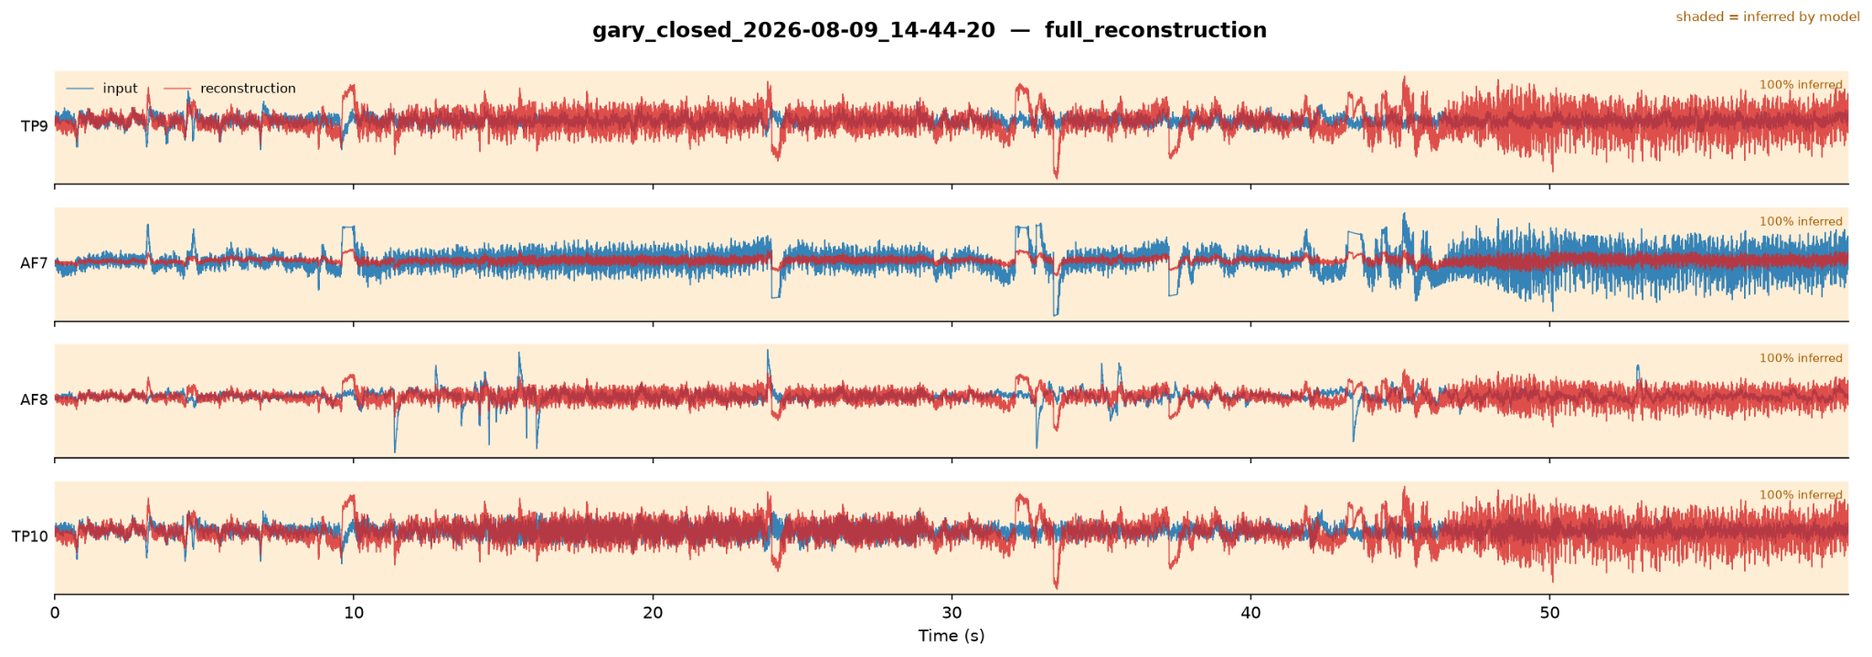
EC Denoised:

Slide 7
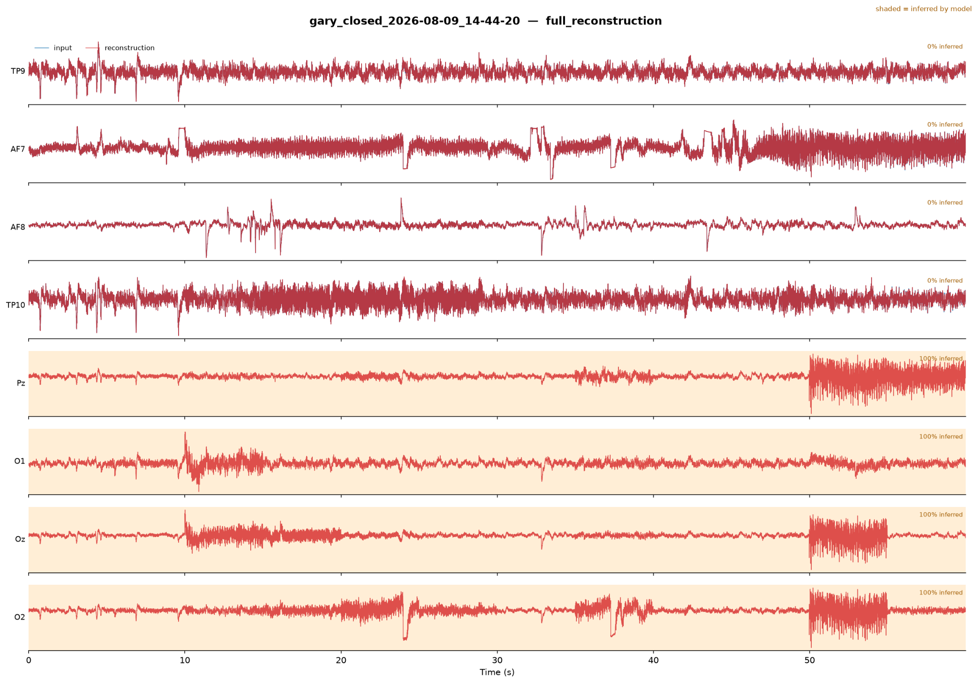
EC Upsampled:

Slide 8
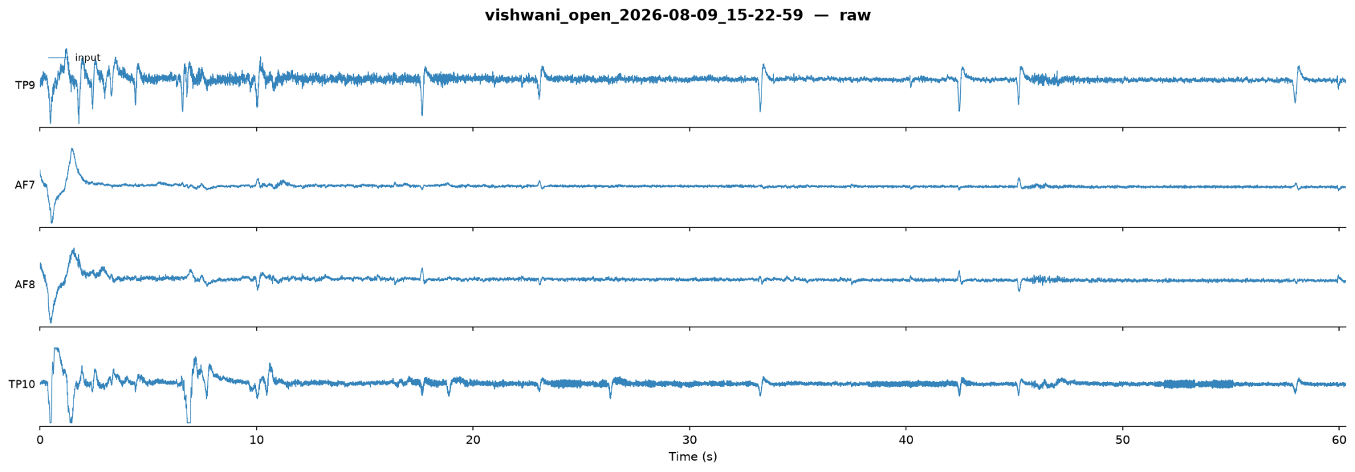
EO Raw:

Slide 9
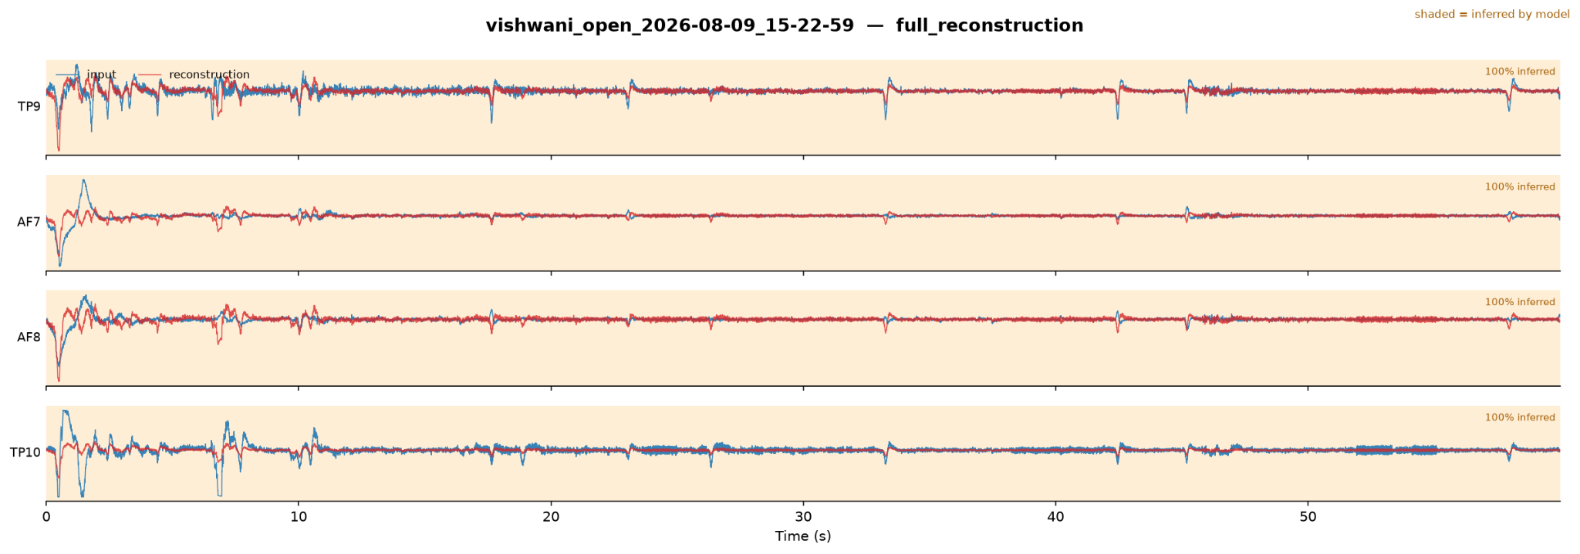
EO denoised:

Slide 10
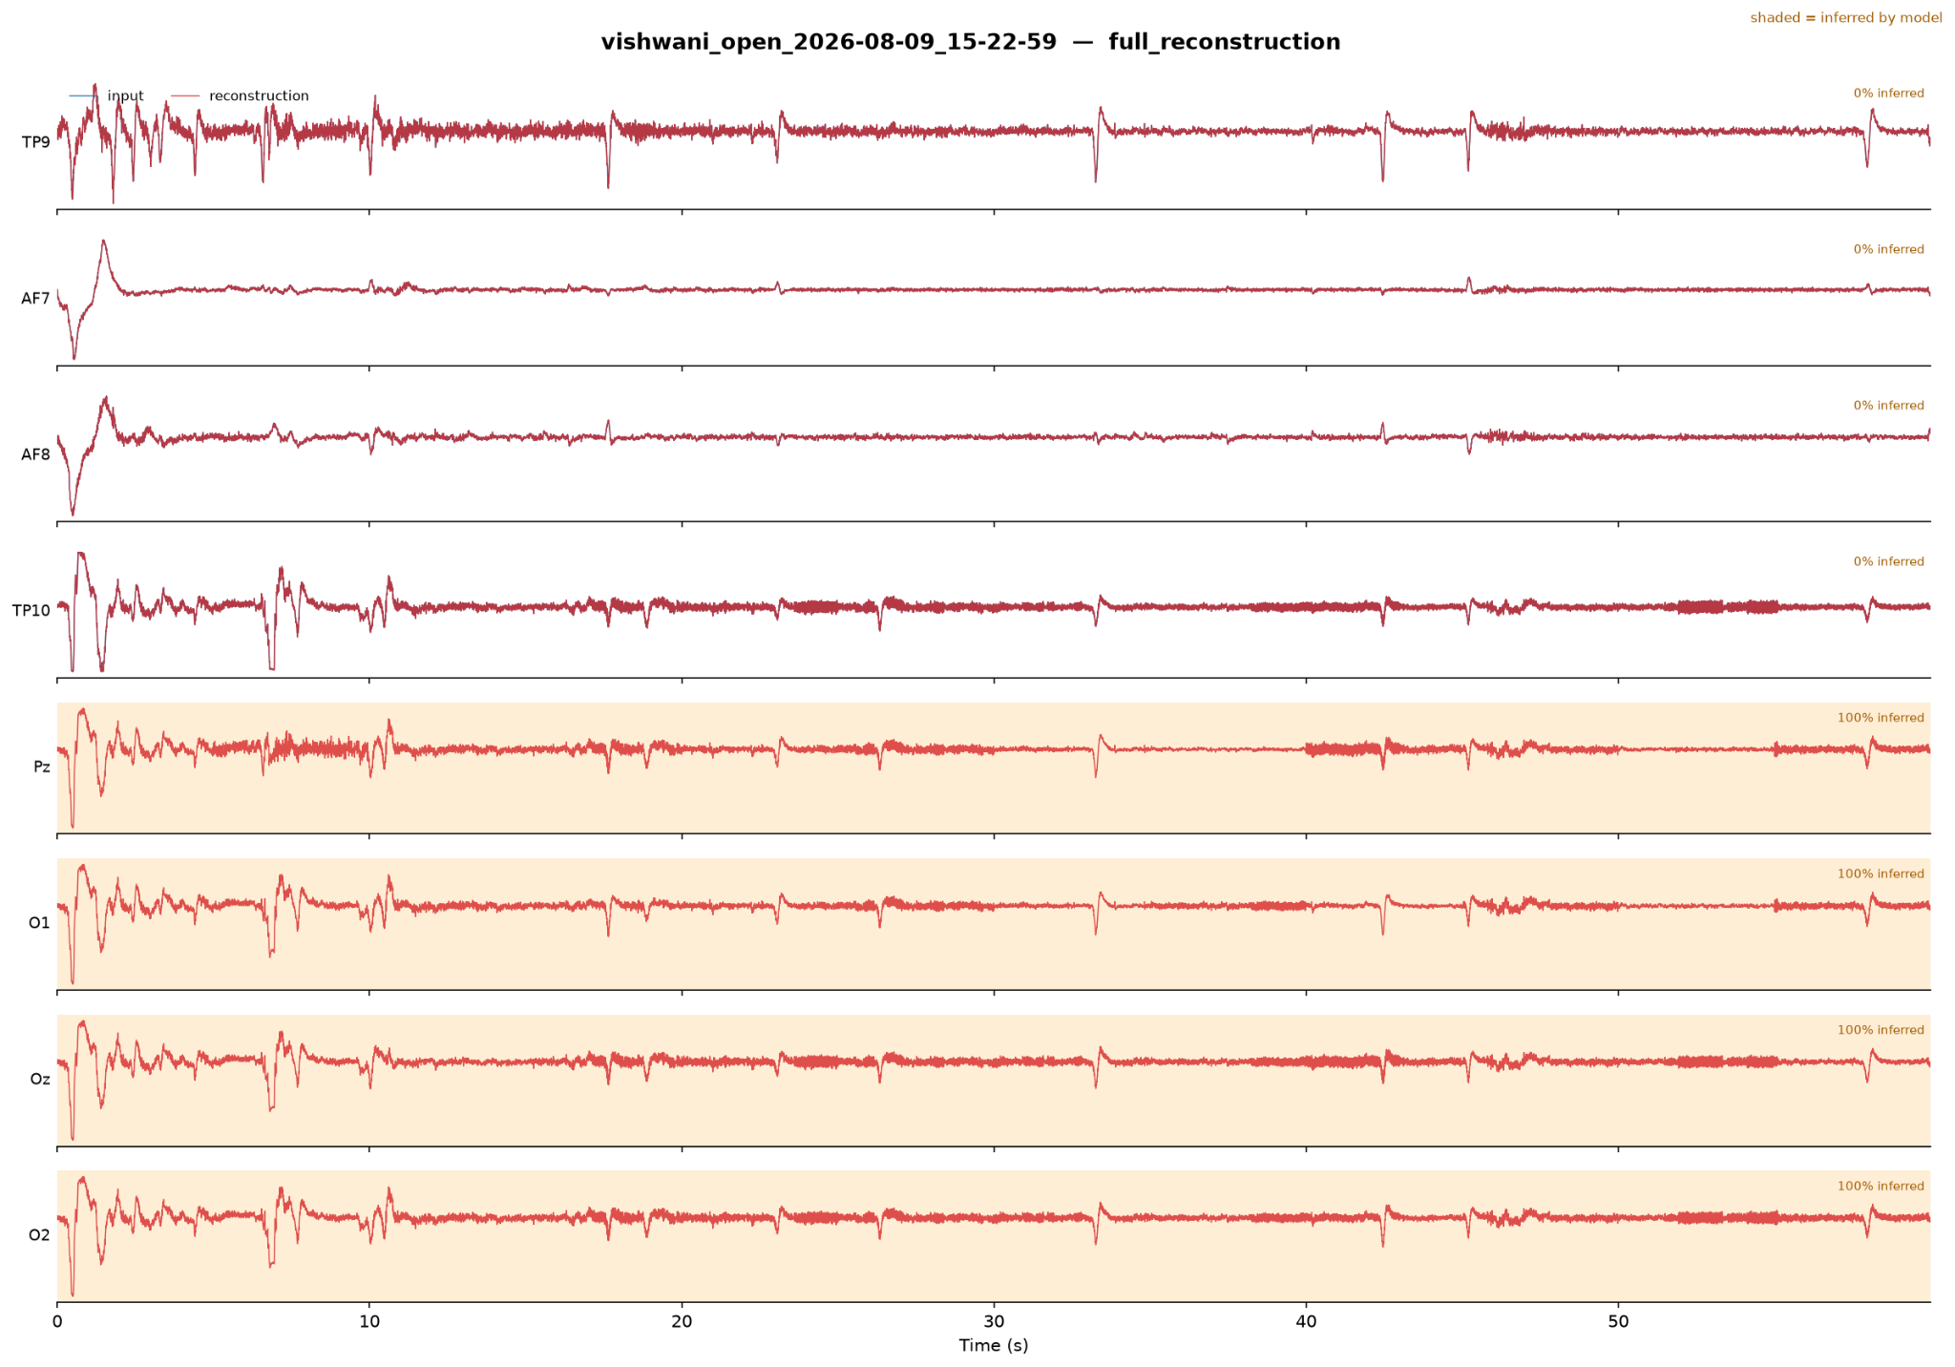
EO upsampled:

Slide 11
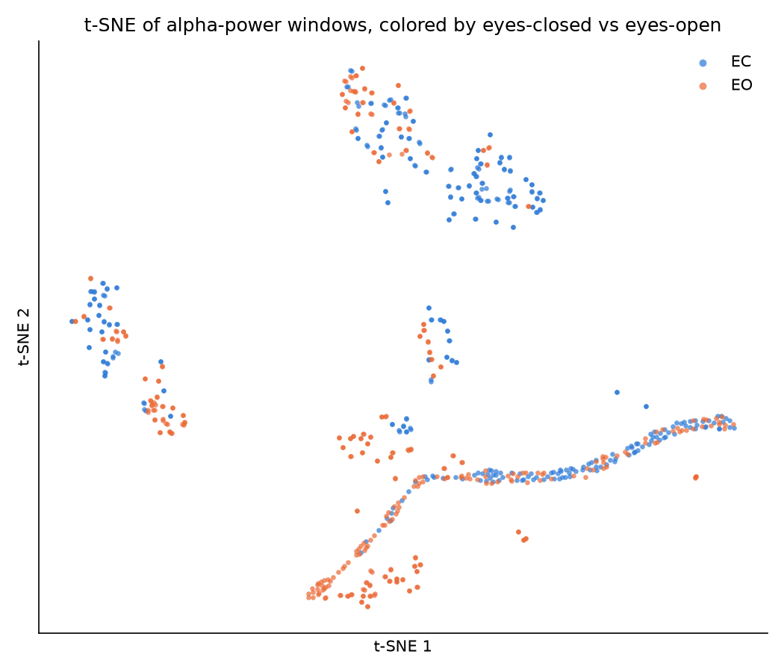

Slide 12
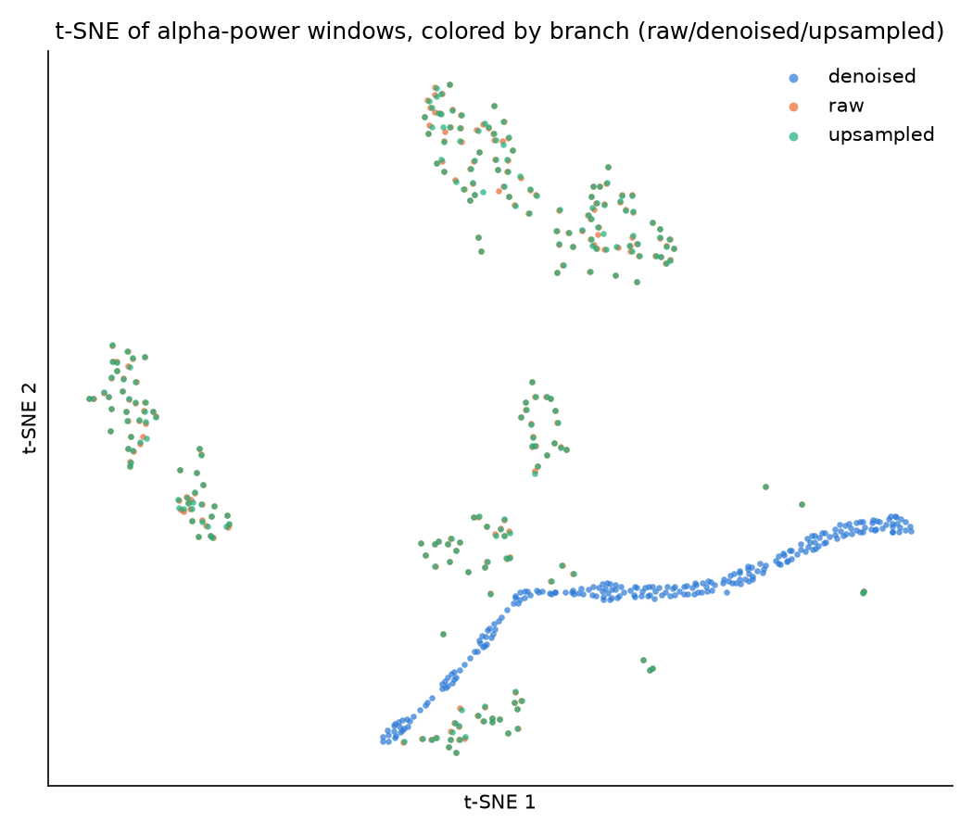

Slide 13
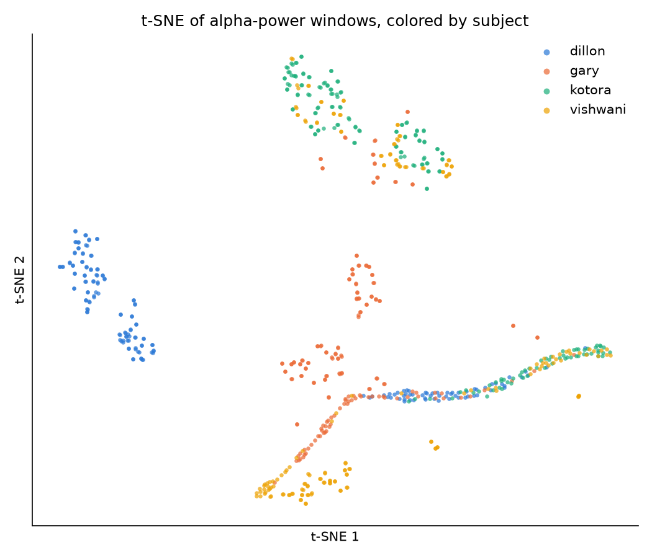

Slide 14
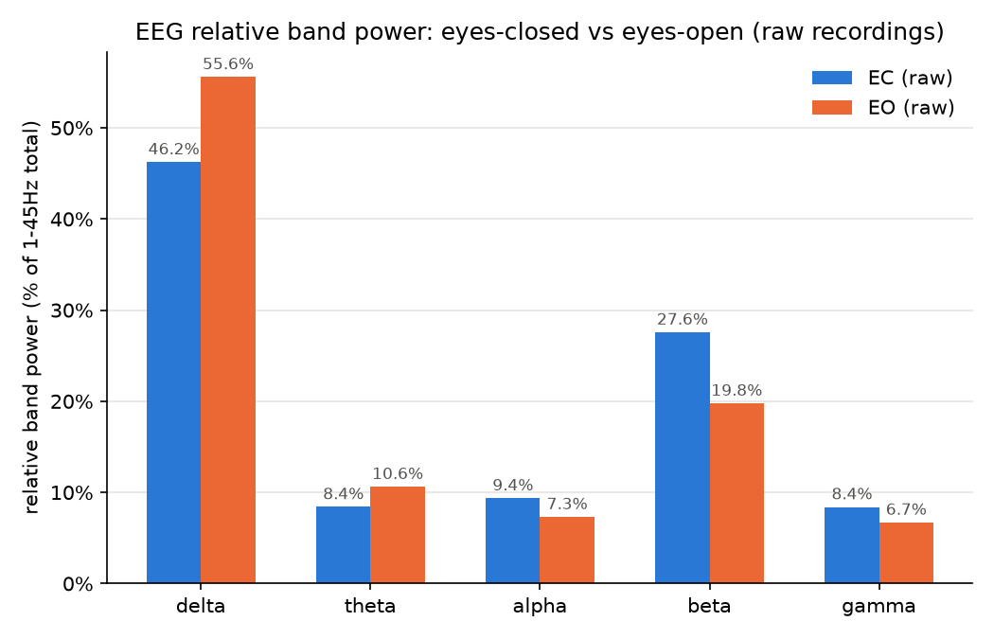

Slide 15
4 subjects × 2 conditions (EC/EO)
│
▼
60s each, each 60s recording into 30 non-overlapping 2s windows
│
▼
per window, per channel: Welch PSD → mean power in 8-13Hz → log
│
▼
8 recordings × 30 windows = 240 window-rows per branch
(4 channel-columns for raw/denoised, 8 for upsampled)
│
▼ classify.py, per branch, pivot to wide: rows = (recording, window), columns = channel → feature matrix X, label y = condition (EC=1 / EO=0), group = recording id (8 groups: 4 subjects × 2 conditions)
│
▼
GroupKFold(n_splits=5) — folds split by recording, never mixing windows from the same recording across train/test
│
▼
LogisticRegression fit per fold → accuracy per fold
│
▼
mean_acc, std_acc reported — ONE number pair per branch

Slide 16
Metrics:
spectral_check : per branch × channel: EC_minus_EO_db, the mean log-alpha-power difference between EC and EO, converted to dB. This is the sanity check: does the classic "more alpha with eyes closed" effect survive in this branch?
classify : per branch: mean_acc / std_acc from GroupKFold cross-validated logistic regression predicting EC vs EO from per-epoch alpha features, plus n_epochs. This is the real question: is EO/EC still decodable after ZUNA touched the data?

Slide 17
Spectral check: the alpha-suppression effect holds up everywhere, including on hallucinated channels:
branch real channels (EC−EO dB) hallucinated channels (EC−EO dB)
raw 1.9 – 6.1 —
denoised 3.9 (compressed, uniform across all 4) —
upsampled 1.9 – 6.0 (matches raw almost exactly) O1/O2/Oz/Pz: 0.7 – 3.2
The direction is positive everywhere (eyes-closed → more alpha), and upsampling didn't distort the real channels at all versus raw.

Slide 18
Classification accuracy:
branch mean_acc std_acc n_epochs
denoised 0.580 0.398 240
raw 0.443 0.274 240
upsampled 0.453 0.279 24

