Slide 1
Agenda
01 | Mental Model for Agentic Coworker
02 | Agentic Coworker Architecture
03 | Agentic Coworker Installation and and star us on GitHub: https://github.com/iservicebus/agentic-coworker
03 | Demo
 | Agent Onboarding Domain Agents – research, IT ops, biz ops Agentic Integration Agentic AI Readiness
04 | Q&A

Slide 2
Mental Model for the Agentic Coworker
B
Belief
D
Desire
Agents operate alongside humans as digital coworkers — not replacements — functioning within clearly defined governance boundaries.
Extend existing enterprise policy, risk, and compliance frameworks to AI agents, ensuring humans retain full ownership, accountability, and control over agent behavior.
I
Intent
A
Action
Empower employees to interact with enterprise systems through natural language, with agents securely executing tasks on their behalf.
Deliver seamless integration with existing enterprise applications and enable rapid, governed onboarding of agents.
Human-led • Governed • Secure
Notes:
This slide summarizes a mental model for “agentic coworkers” using four lenses: Belief, Desire, Intent, and Action. [Sources] - None (user-provided content).

Slide 3








Agentic Coworker Platform Architecture
Agent Studio
Agent Frameworks
Agent Factory
Agent Governance
Agent Skill Builder
Google ADK
Build & configure agents
Configure Agentic RBAC
Learn tools & skills
Social Apps
(e.g., LinkedIn, Gmail)
LangGraph
MCP
Enterprise Apps
AWS AgentCore
OAuth 2.0
MCP Services
Integrator
API Gateway
(e.g., SAP, ServiceNow)
(Keycloak)
(Traefik)
Semantic Kernel
In-house REST Apps
Claude Agent SDK
OpenAI Agent SDK
Knowledge Graph
Vector DB
(Neo4j)
(PostgreSQL)
Multi-tenants

Slide 4
Demo
&
QA

Slide 5











Agentic Coworker: A Governed Alternative to OpenClaw
Human Interaction
Chat Apps
S
Slack
Web Interface
D
Discord
T
MSFT Teams
Agentic Coworker Platform
Agentic Coworker Platform
Agentic Coworker Platform
Agent Factory
Agent Factory
MCP Gateway
Agent Factory
MCP Gateway
Agent Identity
MCP Gateway
Agent Identity
Agent Governance
Agent Identity
Agent Governance
Agent Skill Acquisition
Agent Governance
Agent Skill Acquisition
Agent Tool Annotator
Agent Skill Acquisition
Agent Tool Annotator
API Gateway
Agent Tool Annotator
Multi-tenants
API Gateway
API Gateway
Social Apps
Workplace Productivity
Enterprise Applications
e.g., LinkedIn, YouTube
e.g., Calendar, Gmail, GitHub
e.g., SAP, ServiceNow

Slide 6
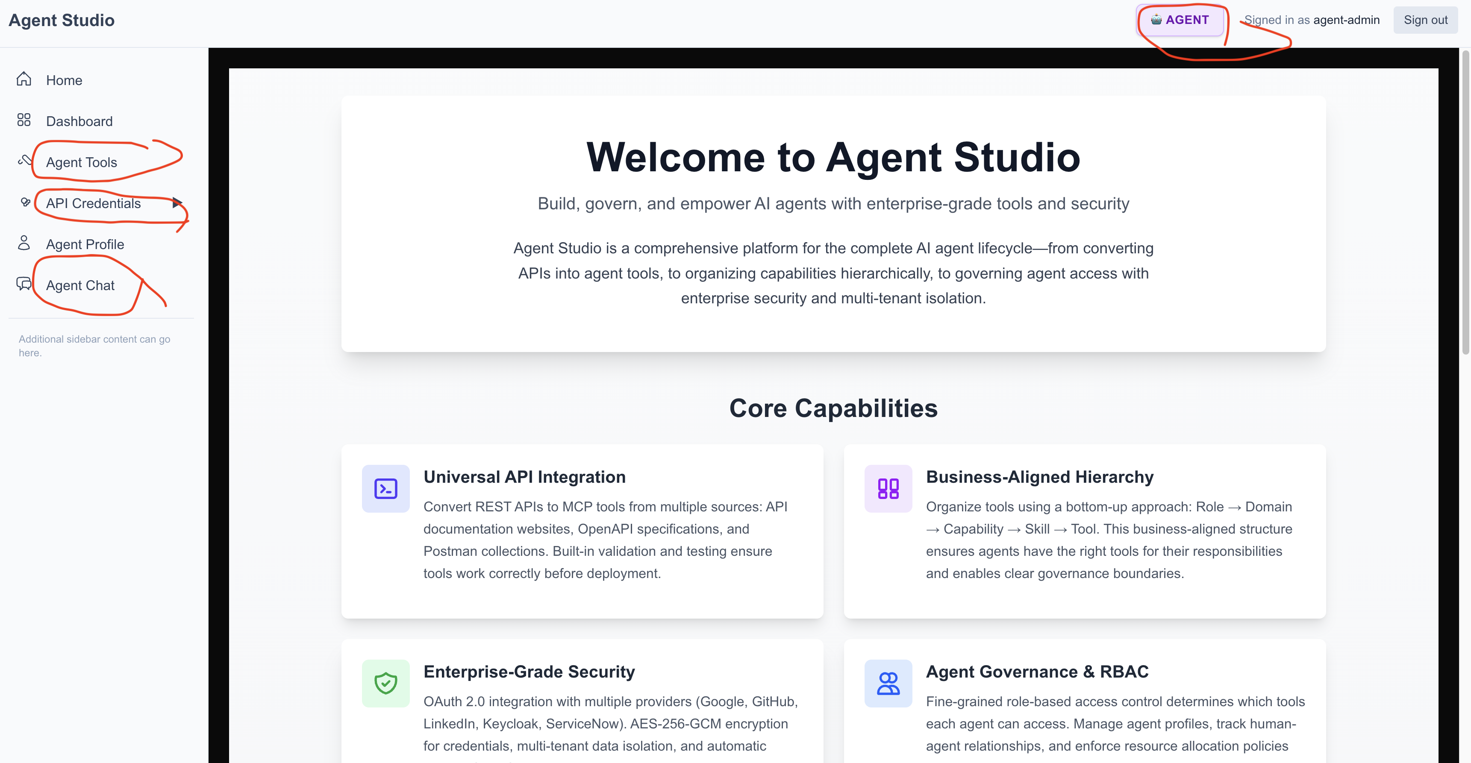
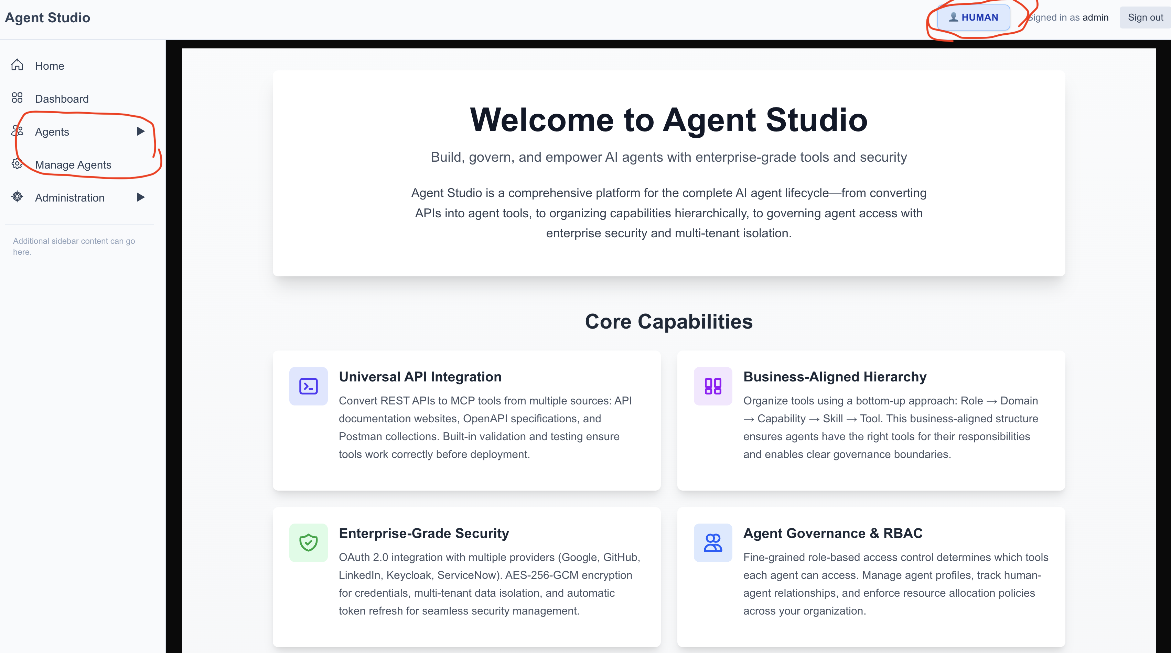
Agent Studio – Agent Management & Agentic Skill Acquisition

Slide 7
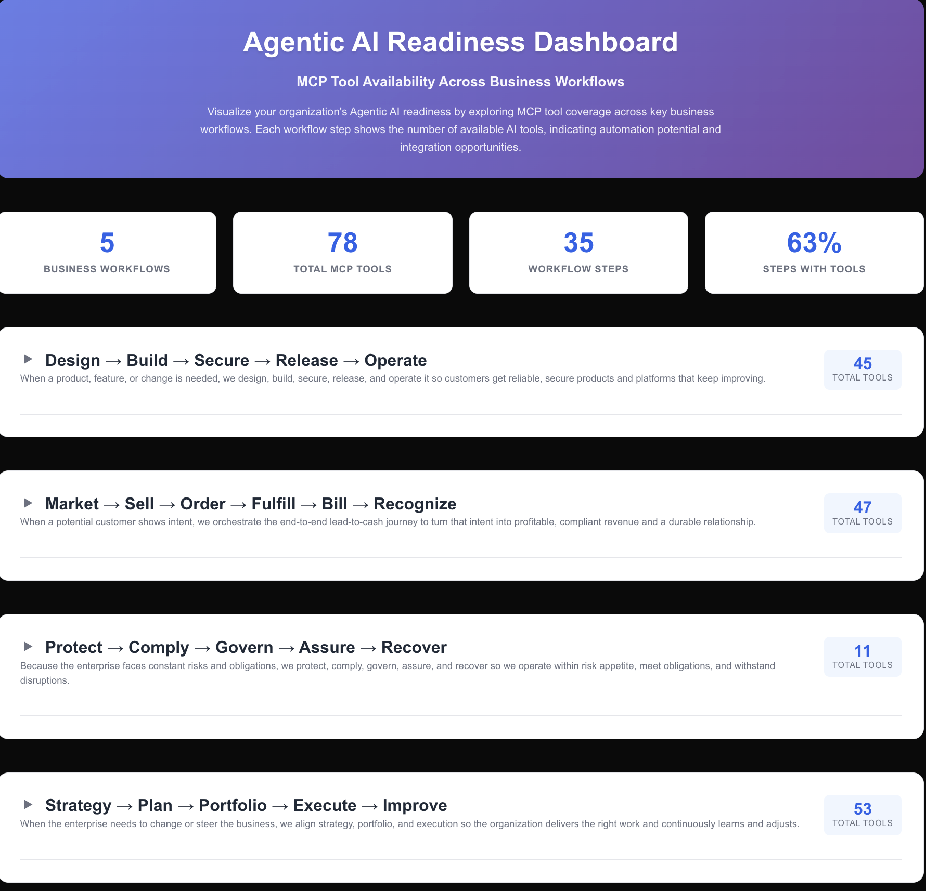

Slide 8
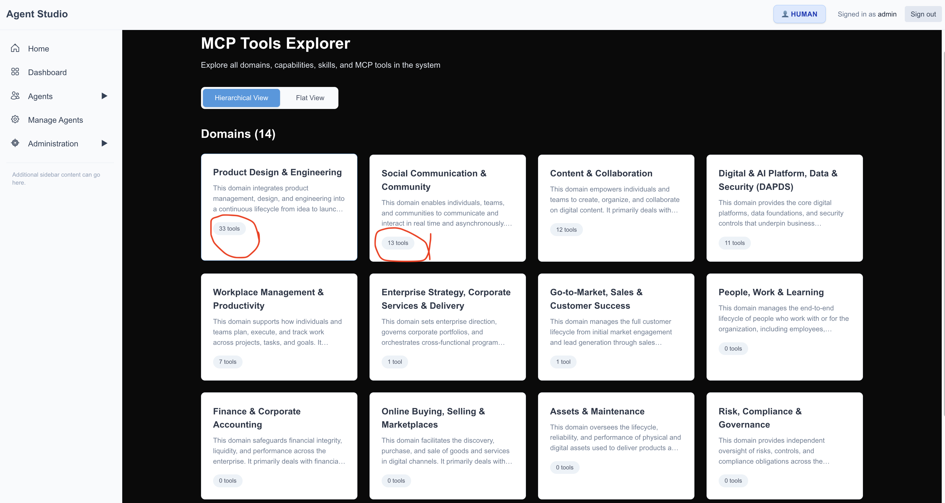

Slide 9
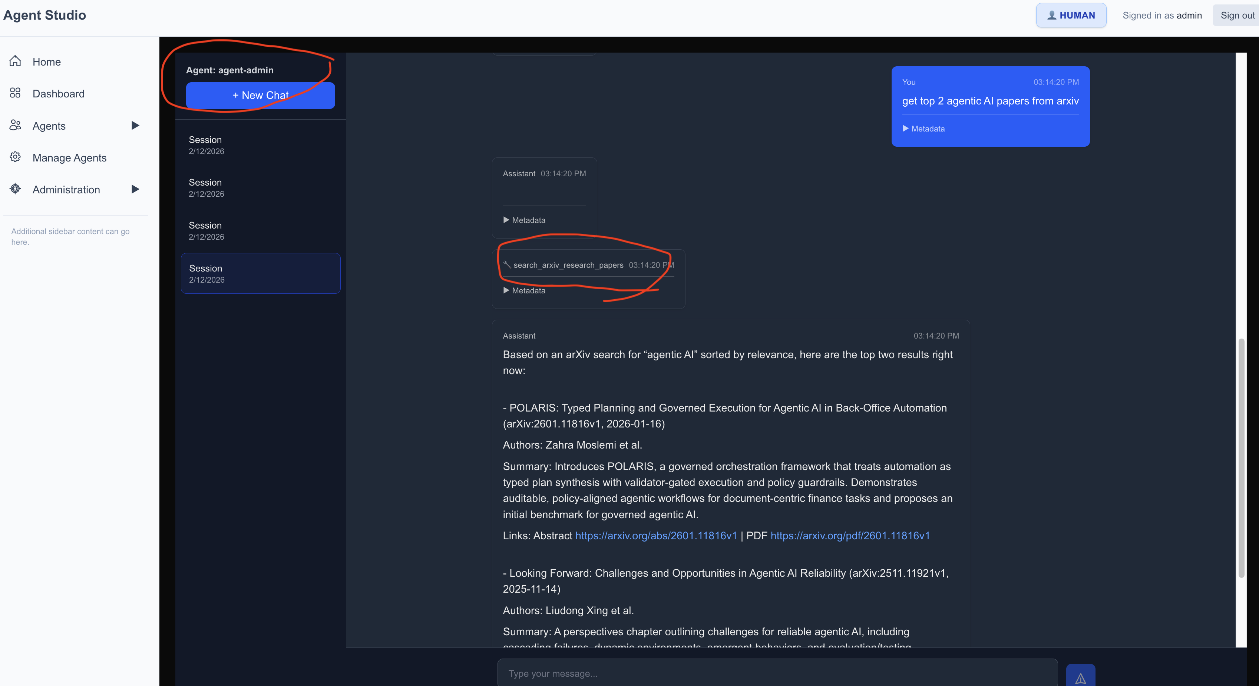
Agent Chat

