Slide 1
WAITERLESS

Slide 2
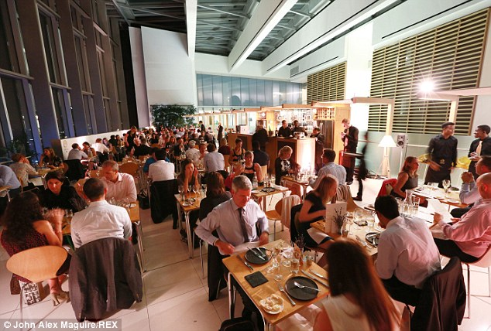
Notes:
-> said he’ll memorize but got it all wrong?
-> gave a ridiculous explanation on why the bill cannot be split?
-> couldn’t find him when the bill is needed?

Slide 3
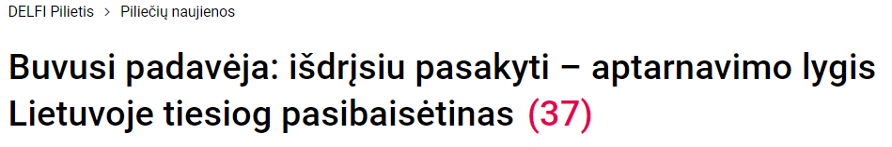
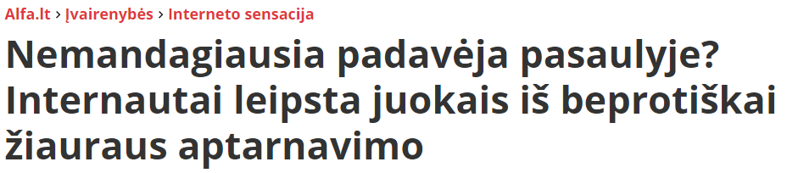

Slide 4
VALUE PROPOSITION

Slide 5
Value for restaurant
Reduce costs
Less staff needed
Remove printed menus
Increase revenue
More customers served in a shorter time
Automatic upselling in-app
Easier satellite location managemenet
Improve customer experience
Order instantly
Remove waiter error
Seamless card payments in-app

Slide 6
PROTOTYPE STATUS

Slide 7
DEMO

Slide 8
BUSINESS MODEL

Slide 9
Business model
Monthly subscription
Basic
Premium: promotions in-app
Percent of each transaction
Free trial - until substantial amount of restaurants use the platform, no monthly fee is charged

Slide 10
Research
Competitors
SECOND
LAST

Slide 11
Restaurant selling points
Reduce costs
Less staff ne
Automatic upselling
Is the colour of the clear sky and the deep sea. It is located between violet and green on the optical spectrum.
Red
Is the color of blood, and because of this it has historically been associated with sacrifice, danger and courage.
Yellow
Is the color of gold, butter and ripe lemons. In the spectrum of visible light, yellow is found between green and orange.
Blue
Is the colour of the clear sky and the deep sea. It is located between violet and green on the optical spectrum.
Red
Is the color of blood, and because of this it has historically been associated with sacrifice, danger and courage.

Slide 12
SCALABILITY

Slide 14
Instructions for use
EDIT IN GOOGLE SLIDES
Click on the button under the presentation preview that says "Use as Google Slides Theme".
You will get a copy of this document on your Google Drive and will be able to edit, add or delete slides.
You have to be signed in to your Google account.
EDIT IN POWERPOINT®
Click on the button under the presentation preview that says "Download as PowerPoint template". You will get a .pptx file that you can edit in PowerPoint.
Remember to download and install the fonts used in this presentation (you’ll find the links to the font files needed in the Presentation design slide)
More info on how to use this template at www.slidescarnival.com/help-use-presentation-template
This template is free to use under Creative Commons Attribution license. You can keep the Credits slide or mention SlidesCarnival and other resources used in a slide footer.

Slide 15
“Quotations are commonly printed as a means of inspiration and to invoke philosophical thoughts from the reader”

Slide 16
You can also split your content
White
Is the color of milk and fresh snow, the color produced by the combination of all the colors of the visible spectrum.
Black
Is the color of coal, ebony, and of outer space. It is the darkest color, the result of the absence of or complete absorption of light.

Slide 17
In two or three columns
Yellow
Is the color of gold, butter and ripe lemons. In the spectrum of visible light, yellow is found between green and orange.
Blue
Is the colour of the clear sky and the deep sea. It is located between violet and green on the optical spectrum.
Red
Is the color of blood, and because of this it has historically been associated with sacrifice, danger and courage.

Slide 18
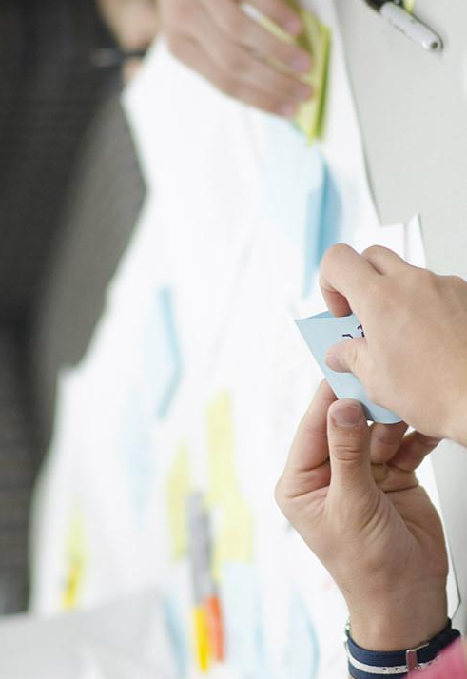
A picture is worth a thousand words
A complex idea can be conveyed with just a single still image, namely making it possible to absorb large amounts of data quickly.

Slide 19
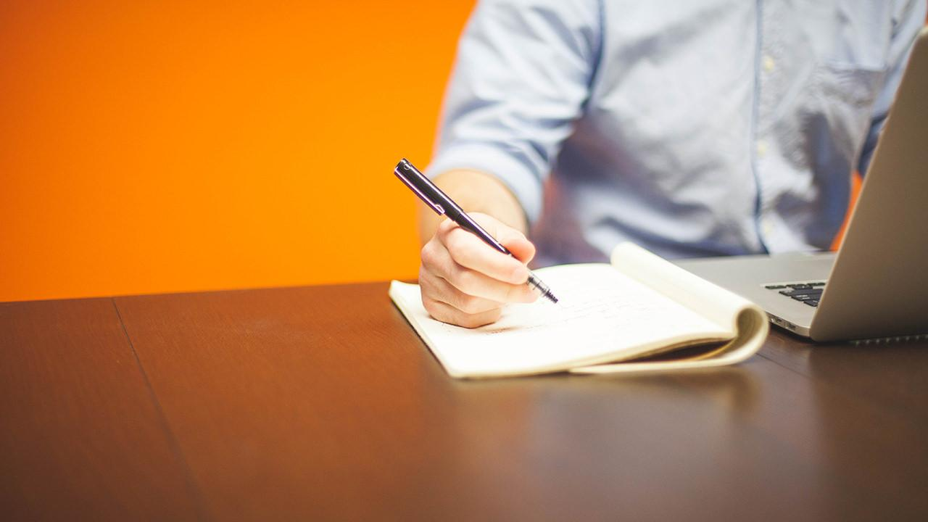
Want big impact?
USE BIG IMAGE

Slide 20
Use charts to explain your ideas
White
Gray
Black

Slide 21
And tables to compare data
 | A | B | C
Yellow | 10 | 20 | 7
Blue | 30 | 15 | 10
Orange | 5 | 24 | 16

Slide 22
Maps
our office

Slide 23
89,526,124
Whoa! That’s a big number, aren’t you proud?

Slide 24
89,526,124$
185,244 users
100%
That’s a lot of money
And a lot of users
Total success!

Slide 25
Our process is easy
FIRST
SECOND
LAST

Slide 26
Let’s review some concepts
Yellow
Is the color of gold, butter and ripe lemons. In the spectrum of visible light, yellow is found between green and orange.
Blue
Is the colour of the clear sky and the deep sea. It is located between violet and green on the optical spectrum.
Red
Is the color of blood, and because of this it has historically been associated with sacrifice, danger and courage.
Yellow
Is the color of gold, butter and ripe lemons. In the spectrum of visible light, yellow is found between green and orange.
Blue
Is the colour of the clear sky and the deep sea. It is located between violet and green on the optical spectrum.
Red
Is the color of blood, and because of this it has historically been associated with sacrifice, danger and courage.

Slide 27
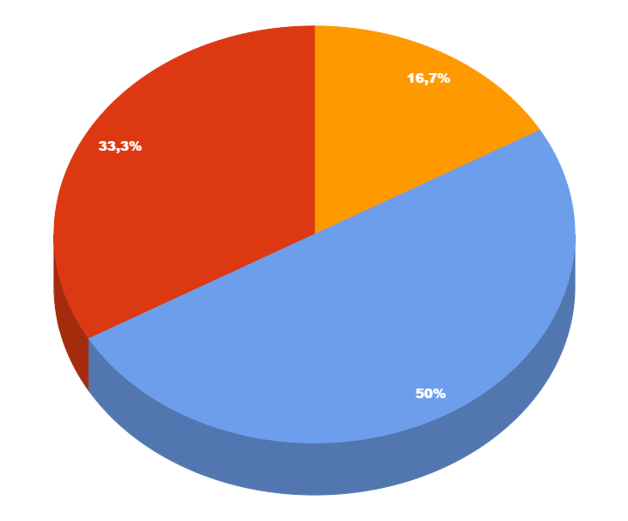
You can copy&paste graphs from Google Sheets

Slide 28
ANDROID PROJECT
Show and explain your web, app or software projects using these gadget templates.
Place your screenshot here

Slide 29
iPHONE PROJECT
Show and explain your web, app or software projects using these gadget templates.
Place your screenshot here

Slide 30
TABLET PROJECT
Show and explain your web, app or software projects using these gadget templates.
Place your screenshot here

Slide 31
DESKTOP PROJECT
Show and explain your web, app or software projects using these gadget templates.
Place your screenshot here

Slide 32
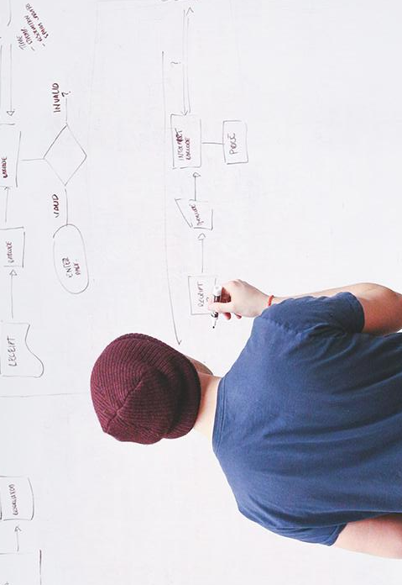
THANKS!
Any questions?
You can find me at:
@username · user@mail.me

Slide 33
Credits
Special thanks to all the people who made and released these awesome resources for free:
Presentation template by SlidesCarnival
Photographs by Startupstockphotos

Slide 34
Presentation design
This presentation uses the following typographies:
Titles: Hind
Body copy: Hind
You can download the fonts on this page:
https://www.fontsquirrel.com/fonts/hind
You don’t need to keep this slide in your presentation. It’s only here to serve you as a design guide if you need to create new slides or download the fonts to edit the presentation in PowerPoint®

Slide 35
SlidesCarnival icons are editable shapes.
This means that you can:
Resize them without losing quality.
Change fill color and opacity.
Change line color, width and style.
Isn’t that nice? :)
Examples:

Slide 36
😉
Now you can use any emoji as an icon!
And of course it resizes without losing quality and you can change the color.
How? Follow Google instructions https://twitter.com/googledocs/status/730087240156643328
✋👆👉👍👤👦👧👨👩👪💃🏃💑❤😂😉😋😒😭👶😸🐟🍒🍔💣📌📖🔨🎃🎈🎨🏈🏰🌏🔌🔑 and many more...

