Slide 1


Slide 2
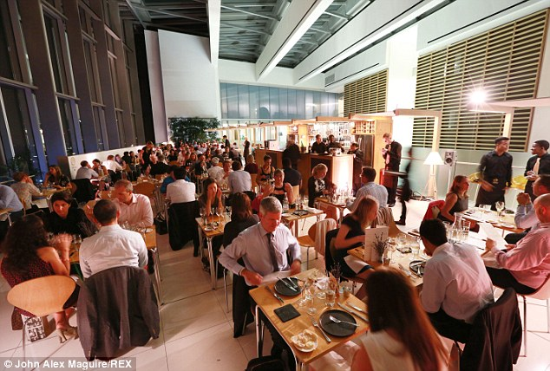
Notes:
-> said he’ll memorize but got it all wrong?
-> gave a ridiculous explanation on why the bill cannot be split?
-> couldn’t find him when the bill is needed?

Slide 3
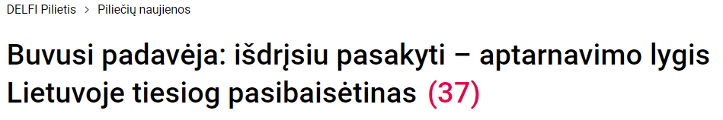
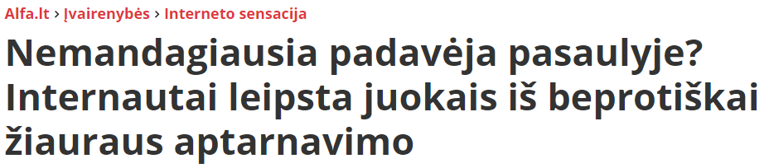

Slide 4
DEMO

Slide 5
VALUE PROPOSITION

Slide 6
Value for restaurant
Reduced costs
Less staff needed
Removed printed menus
Increased revenue
More customers served in a shorter time
Automatic upselling in-app
Improved customer experience
Order instantly
Removed waiter error
Seamless card payments in-app

Slide 7
PROTOTYPE STATUS

Slide 8
BUSINESS MODEL

Slide 9
Business model
Monthly subscription
Basic
Premium: promotion, upselling in-app
Percentage of transaction
Free trial – no monthly fee until enough customers

Slide 10
Research
Competitors
Based in USA (LeDiner, NorthStar)
Exlusive app production, not SaaS
Target audience
Casual dining, chain restaurants
Restaurants with satellite locations
Integration
Integrate with existing PoS systems
Separate web app for restaurant may be unnecessary
Notes:
Direct competitor: Lediner.online
QA:
Q – what percent does the card payment take?

Slide 11
6,94 billion $
14,6% average growth rate
Scalability
Global estimated restaurant management software market worth by 2025¹
of PoS systems usage per period ¹
Easy entry
1 platform for restaurants, 1 app for customers
¹ https://www.grandviewresearch.com/press-release/global-restaurant-management-software-market, May 2018

Slide 12
SCALABILITY

Slide 13
What‘s next?
Integrate
Meeting with R-keeper rep Paulius Kudulis
Finalize
Finish up mobile app
Improve UX
Sell
Show the MVP
Discuss with restaurants

Slide 14
“This may work. For some restaurants, I guess”
Tom Nicholson,
founder of Jurgis and Drakonas

Slide 15


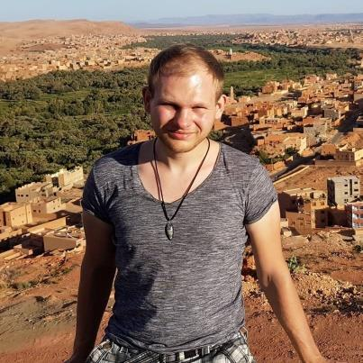



Team
Artūras Bončkus Mobile app dev
Jurgis Kargaudas Full-stack dev
Aurimas Šimkus Solution architect
Laurynas Šimkūnas Back-end dev
Arvydas Jocius Business developer

Slide 16
Use charts to explain your ideas
White
Gray
Black

Slide 17
And tables to compare data
 | A | B | C
Yellow | 10 | 20 | 7
Blue | 30 | 15 | 10
Orange | 5 | 24 | 16

Slide 18
89,526,124$
185,244 users
100%
That’s a lot of money
And a lot of users
Total success!

Slide 19
ANDROID PROJECT
Show and explain your web, app or software projects using these gadget templates.
Place your screenshot here

Slide 20
TABLET PROJECT
Show and explain your web, app or software projects using these gadget templates.
Place your screenshot here

Slide 21
DESKTOP PROJECT
Show and explain your web, app or software projects using these gadget templates.
Place your screenshot here

Slide 22
SlidesCarnival icons are editable shapes.
This means that you can:
Resize them without losing quality.
Change fill color and opacity.
Change line color, width and style.
Isn’t that nice? :)
Examples:

Slide 23
😉
Now you can use any emoji as an icon!
And of course it resizes without losing quality and you can change the color.
How? Follow Google instructions https://twitter.com/googledocs/status/730087240156643328
✋👆👉👍👤👦👧👨👩👪💃🏃💑❤😂😉😋😒😭👶😸🐟🍒🍔💣📌📖🔨🎃🎈🎨🏈🏰🌏🔌🔑 and many more...

