Slide 1
WAITERLESS

Slide 2
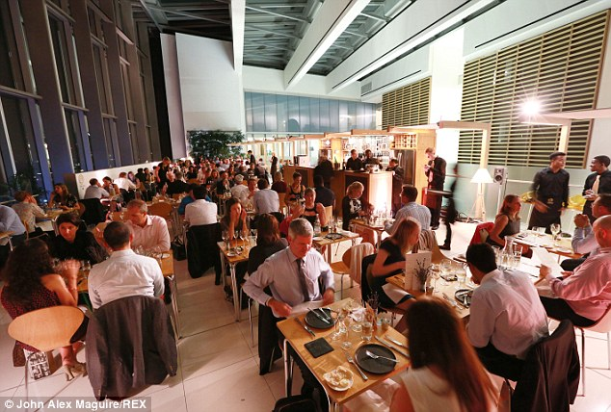
Notes:
-> said he’ll memorize but got it all wrong?
-> gave a ridiculous explanation on why the bill cannot be split?
-> couldn’t find him when the bill is needed?

Slide 3
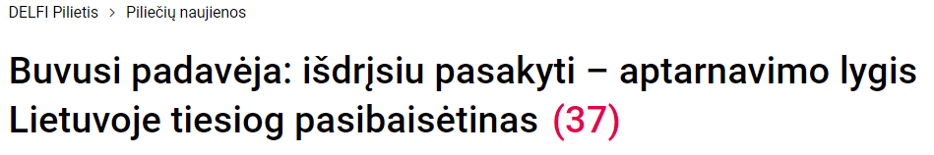
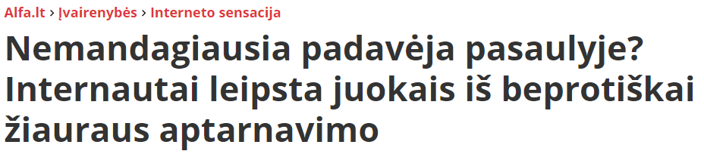

Slide 4
VALUE PROPOSITION

Slide 5
Value for restaurant
Reduced costs
Less staff needed
Removed printed menus
Increased revenue
More customers served in a shorter time
Automatic upselling in-app
Easier satellite location managemenet
Improved customer experience
Order instantly
Removed waiter error
Seamless card payments in-app

Slide 6
PROTOTYPE STATUS

Slide 7
DEMO

Slide 8
BUSINESS MODEL

Slide 9
Business model
Monthly subscription
Basic
Premium: promotions in-app
Percent of each transaction
Free trial – each restaurant can try out the platform without monthly fee for a limited period

Slide 10
Research
Competitors
Based in USA
Missing card in-app payments
Indirect (e.g. Wolt) may start doing it themselves
Target audience
Casual dining, chain restaurants
Restaurants with satellite locations
Integration
Integrate with existing PoS systems
Separate web app for restaurant may be unnecessary
Notes:
Direct competitor: Lediner.online
QA:
Q – what percent does the card payment take?

Slide 11
SCALABILITY

Slide 12
What‘s next?
Improve UX
Meeting with R-keeper rep Paulius Kudulis
Upgrade mobile-app UX
Finalize solution
Finish up mobile app
Add integrations
Contact restaurants
Show the MVP
Discuss possible usage

Slide 13
“This may work. For some restaurants, I guess”
Tom Nicholson,
founder of Jurgis and Drakonas

Slide 14
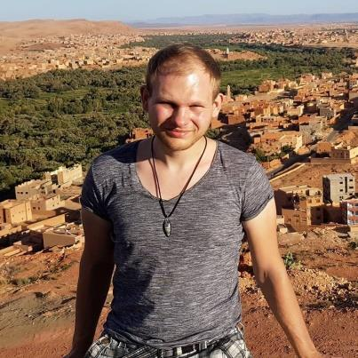





Team
Aurimas Šimkus Solution architect
Jurgis Kargaudas Full-stack dev
Artūras Bončkus Mobile app dev
Laurynas Šimkūnas Back-end dev
Arvydas Jocius Product owner

Slide 15
Use charts to explain your ideas
White
Gray
Black

Slide 16
And tables to compare data
 | A | B | C
Yellow | 10 | 20 | 7
Blue | 30 | 15 | 10
Orange | 5 | 24 | 16

Slide 17
89,526,124$
185,244 users
100%
That’s a lot of money
And a lot of users
Total success!

Slide 18
ANDROID PROJECT
Show and explain your web, app or software projects using these gadget templates.
Place your screenshot here

Slide 19
TABLET PROJECT
Show and explain your web, app or software projects using these gadget templates.
Place your screenshot here

Slide 20
DESKTOP PROJECT
Show and explain your web, app or software projects using these gadget templates.
Place your screenshot here

Slide 21
SlidesCarnival icons are editable shapes.
This means that you can:
Resize them without losing quality.
Change fill color and opacity.
Change line color, width and style.
Isn’t that nice? :)
Examples:

Slide 22
😉
Now you can use any emoji as an icon!
And of course it resizes without losing quality and you can change the color.
How? Follow Google instructions https://twitter.com/googledocs/status/730087240156643328
✋👆👉👍👤👦👧👨👩👪💃🏃💑❤😂😉😋😒😭👶😸🐟🍒🍔💣📌📖🔨🎃🎈🎨🏈🏰🌏🔌🔑 and many more...

