Slide 1
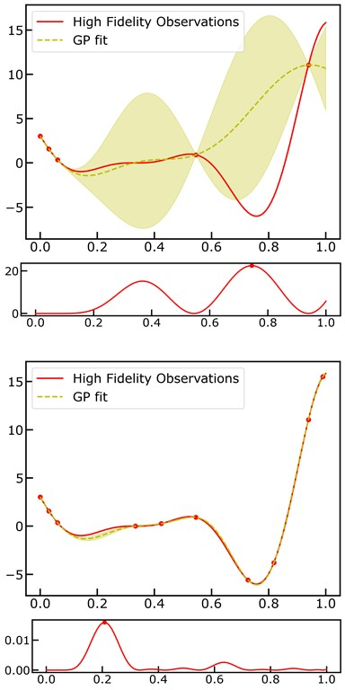


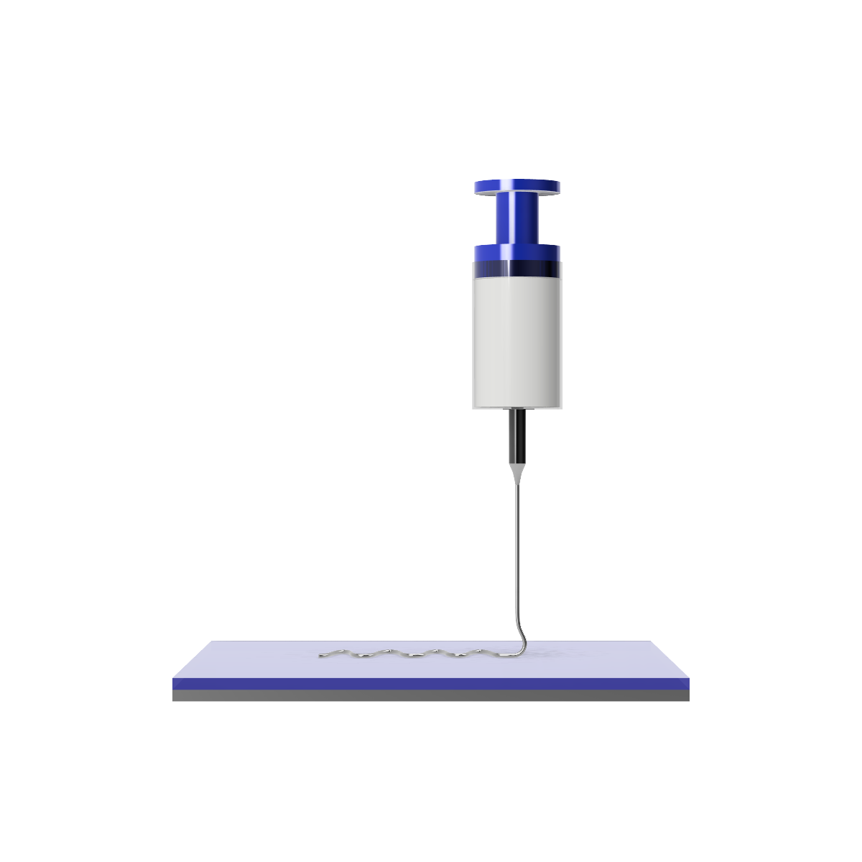
Machine Vision Module
Machine Learning Module
High Fidelity
Data
Gaussian Process Regression
Active Learning
Bayesian
Optimization
Physics-based Modeling Module
Multi-fidelity Modeling
Gaussian Process Regression
Active Learning
Bayesian
Optimization
Low Fidelity
Data
Geometrical Pattern Model
Quasi-static fluid mechanical sewing machine model
Jet Model
Steady state fluid flow + heat transfer + viscoelasticity

